Slide 1

Welcome to Hawkley Hall High School
This power point will provide you with extra information about life at Hawkley.
Where you see the icon, there will be some spoken information for you to listen to.
Look out for more information being uploaded to the website.

Slide 2
How are form groups arranged?
Close liaison with primary schools
Friendship groups
Gender split
Distribution of children of different abilities

Slide 3

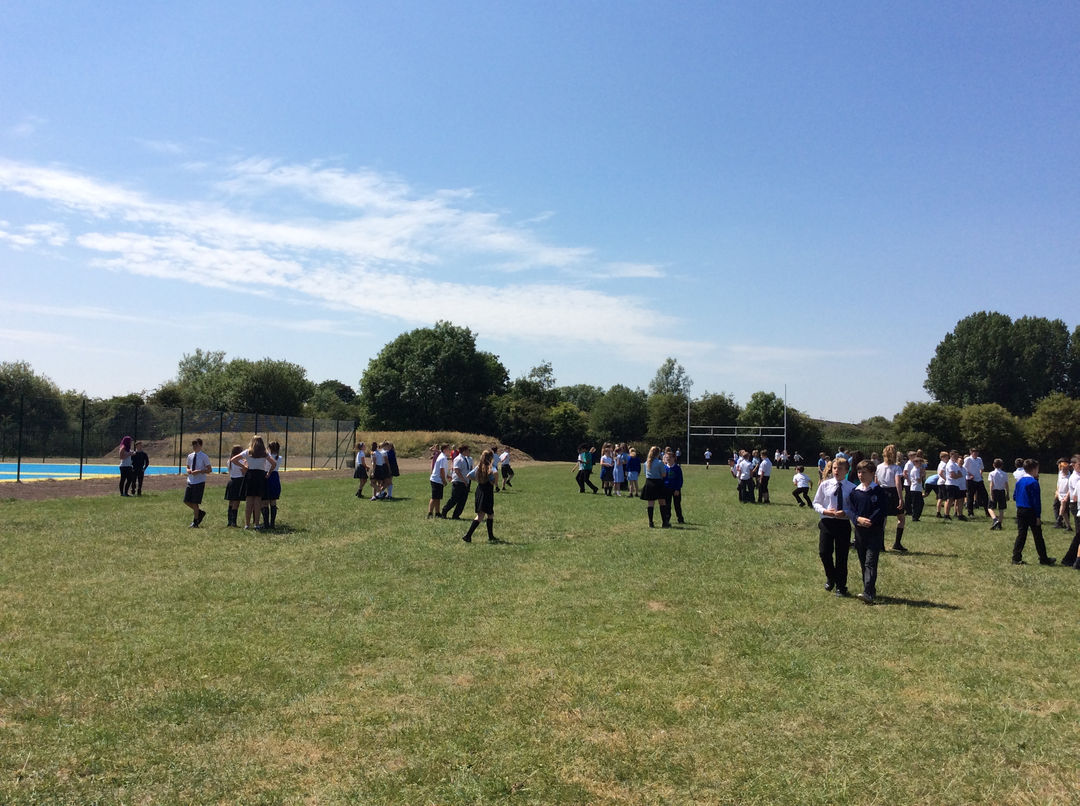
The Hawkley Way
We believe that good behaviour based on mutual respect is crucial to the success of every member of our school community.
We do things “The Hawkley Way”.
“Right to Teach, Right to Learn”

Slide 4
At all times
Do not discriminate and respect individuality
Treat others as you would like to be treated
Always try your best – have pride in yourself and in your achievements
Take pride in your appearance and wear uniform correctly at ALL times
Respect the environment, recycle whenever possible and put all litter in the bins
Have all your equipment for the day including your planner in your school bag
Move around school in a calm, quiet, orderly manner
Expectations in the Classroom
Be punctual
Enter the classroom in a calm, orderly way
Don’t shout out during the lesson – Voice opinion respectfully
Do not jeopardise the learning of others
Be supportive of others
Listen carefully and follow instructions – Don’t answer back!
Respect equipment, each others and schools
Complete tasks set to the best of your ability – have pride in your work
Maintain high standards at all times
Expectations in the Dining Room
Arrive at the correct sitting time for your year
Queue in an orderly manner and don’t keep places for friends
Sit down to eat
Eat properly using correct table manners and do not talk with food in your mouth
Don’t push in the queue if you to return to buy more food
Expectations for movement around school
Go straight to the lesson, do not stop to chat with friends
Keep to the left on stairs and corridors
Do not drop litter
Treat others as you would like to be treated
Expectations when travelling to/from school
Wear the correct uniform and wear it properly
Respect and do not disturb your local community – Be polite – Be sensible
Walk on the pavement and don’t interfere with other people’s property
Do not obstruct traffic by walking or cycling in the middle of the road

Slide 5

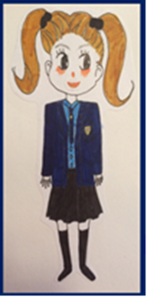
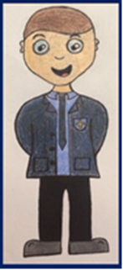

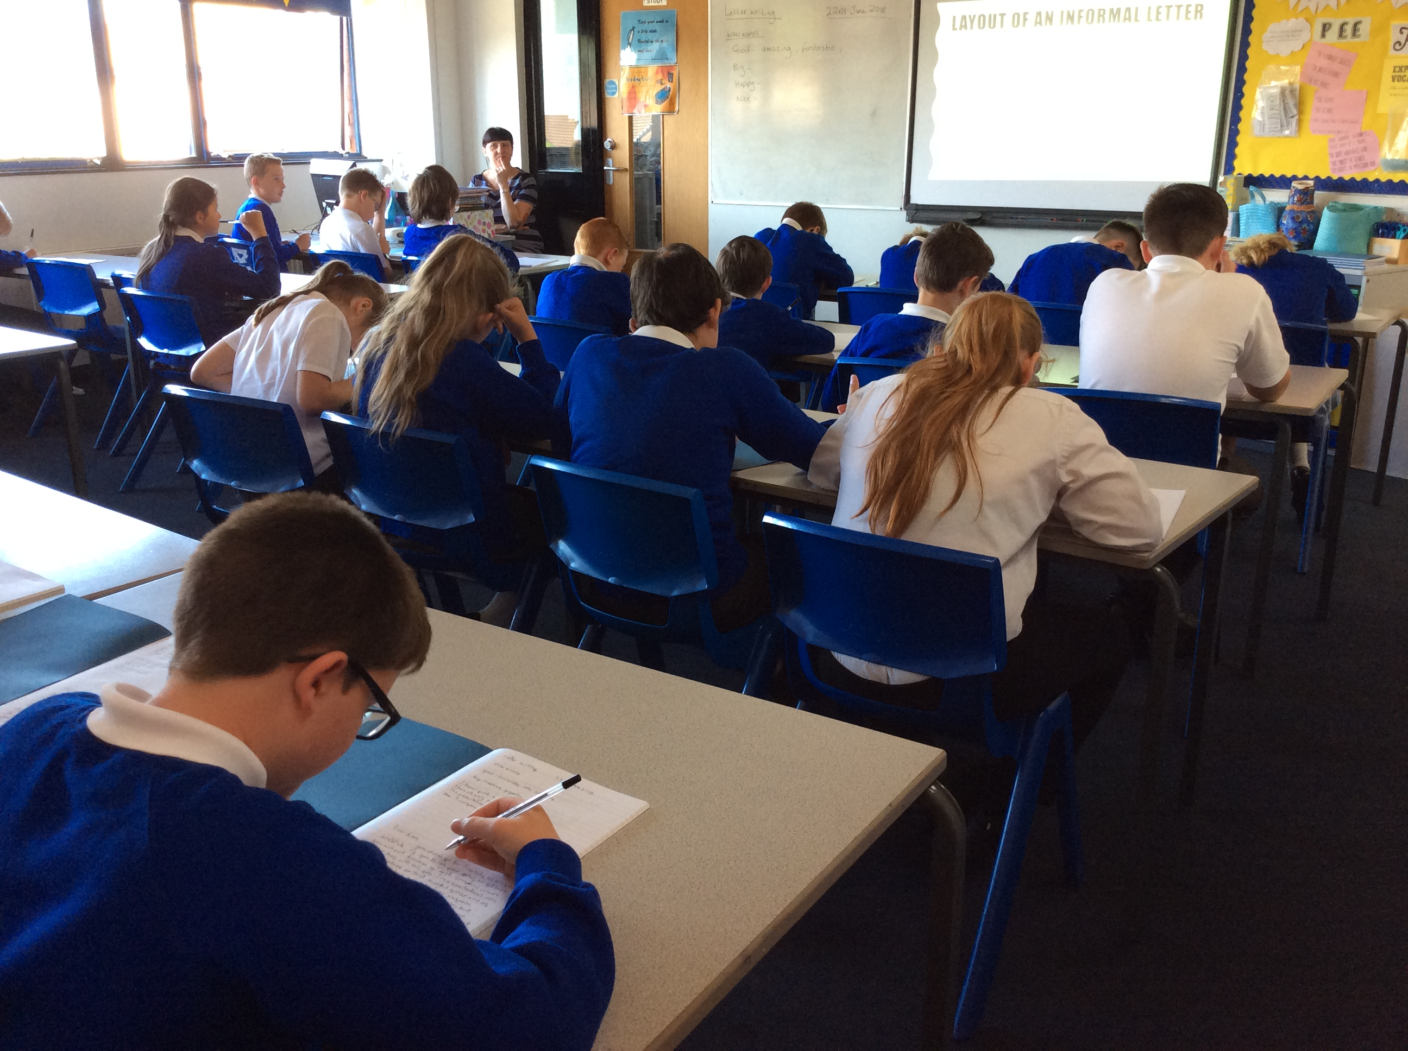
Effective Leaders
Team players
Honest
Punctual
Pro-active
Reliable
Mature
Adaptable
Competitive
Motivated
Responsible
Seek new challenges
Courteous
Creative
Literate
Confident
Articulate
Dedicated
Enthusiastic
Show empathy
Numerate
Time efficient
Well organised
Ambitious
Passionate
Good citizens
Determined
Excellent attenders
Problem solvers
Patient
Our aim is to ensure that Hawkley students have all of these attributes in their ‘toolkit’ by the time they leave in Year 11 so that they are in a position to compete with their peers.

Slide 6

Uniform
High standards and expectations regarding uniform leads to better behaviour
Use of ‘uniform card’ promotes smart uniform through reward
Full uniform list on website
Please ensure names are in all items
Uniform
Card

Slide 7
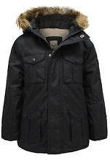
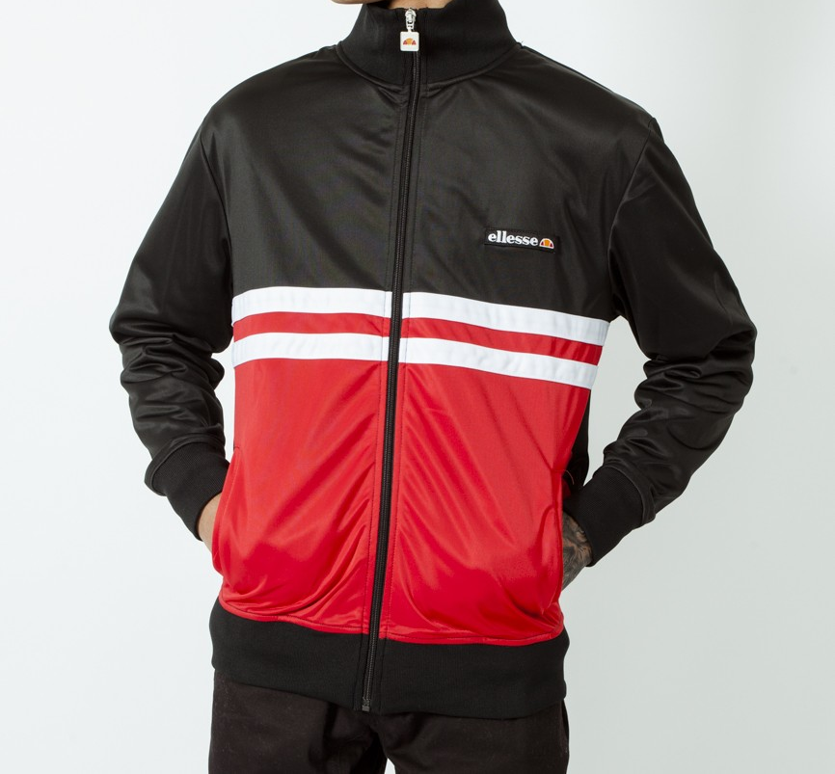



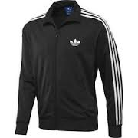
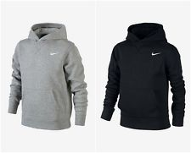


Uniform
Plain black coat
No grey
No logos
No hoodies or tracksuit tops

Slide 8
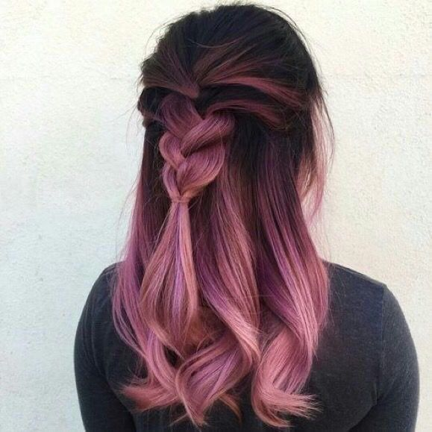

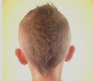
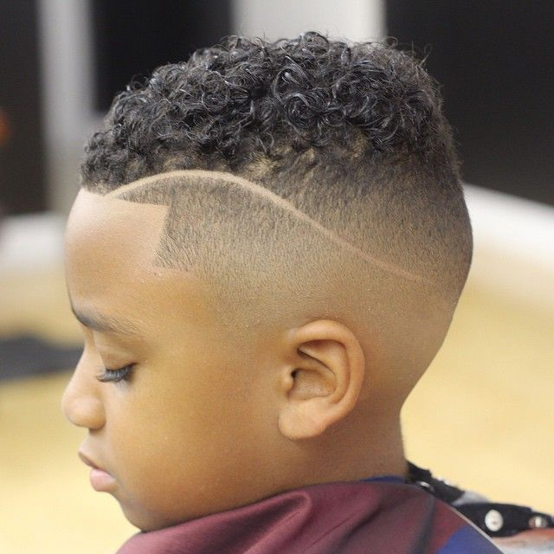
Uniform
Not shorter than than ‘No.2’
No extreme styles or ‘Mohican’ styles
No lines shaved
No un-natural colours/ obvious streaks

Slide 9
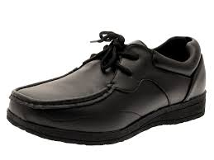
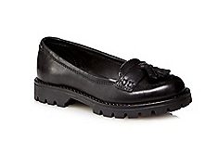
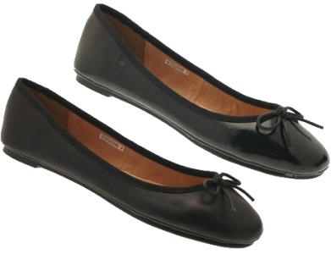

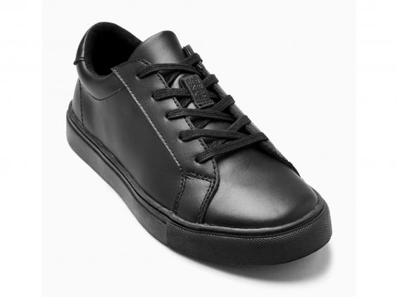
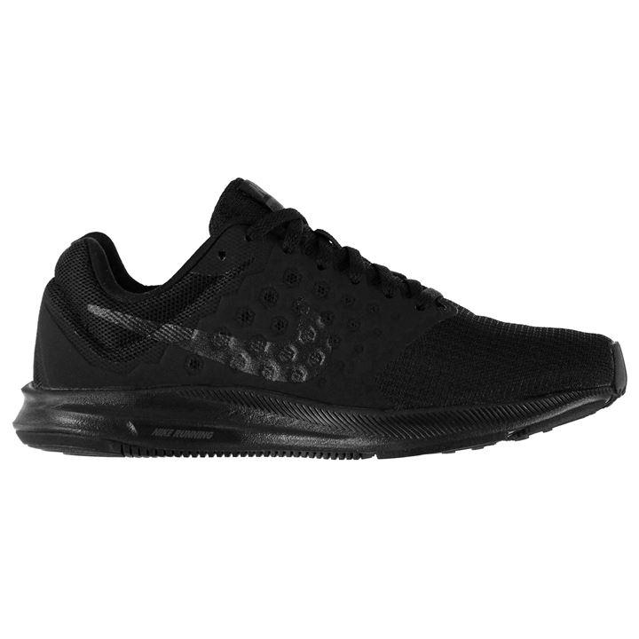
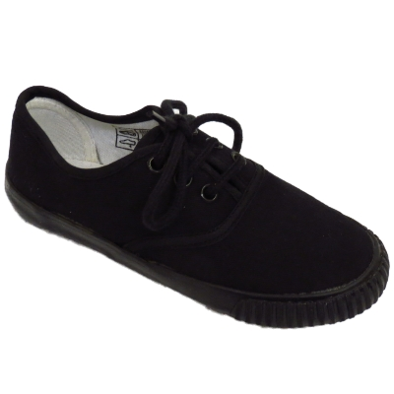
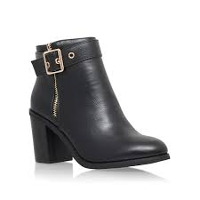
Uniform
Students lose break times and lunchtimes until they come to school in the correct footwear or with the correct hair style.

Slide 10

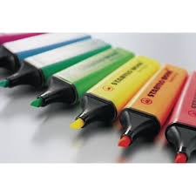
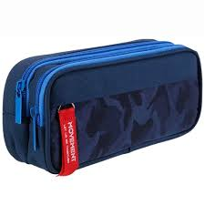
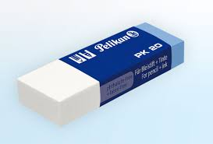
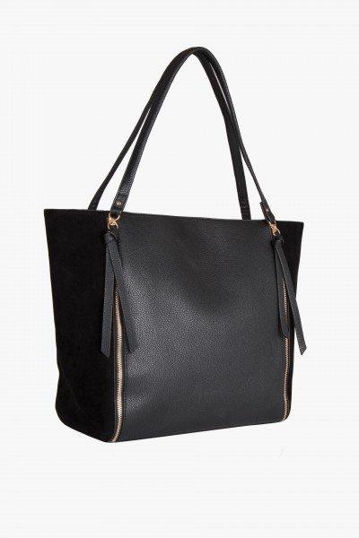
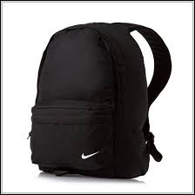

Bags and equipment

Slide 11
Jewellery
Any sort of jewellery not permitted
(if getting ears pierced, students must be able to remove their earrings)
Wrist watch is fine

Slide 12

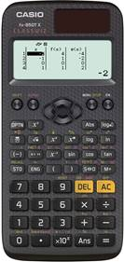
Casio FX83 ES
The cost in stores vary
Post office - £9
Calculator
Old Version
New Version

Slide 13
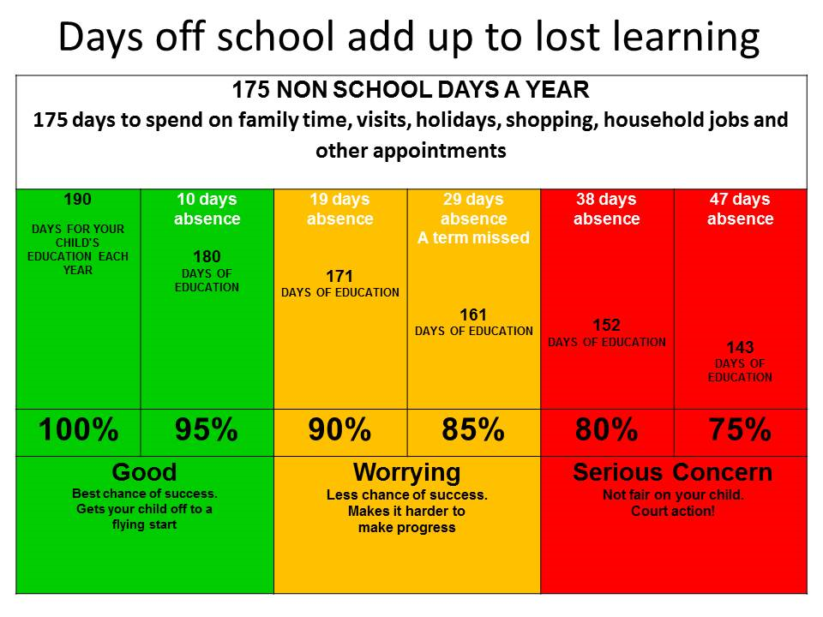
90% in a test is considered as excellent, but 90% attendance isn’t

Slide 14
Year 7 worries leading to absence
Forgotten to do homework and worried about getting a detention/ getting ‘shouted at’.
Friendship issues/ worried about being bullied
Issues caused through social media

Slide 15
Mobile Phones
Not to be brought to school
Must be kept out of sight and kept switched off
Will be confiscated if seen or heard (includes breaks, lunches and between lessons/before school)
Parents will be required to collect them if they are confiscated

Slide 16

‘Show My Homework’
You will be given a unique ‘log in’.
Teachers will set homework tasks on-line
Check deadlines
Resources uploaded
Teachers may still ask for you to complete homework in exercise books

Slide 17
Rewards
‘Classcharts’ – points given by all staff
Effort / work in lessons, homework, correct equipment, uniform, resilience, citizenship, attendance and punctuality
Xmas trip
Summer trip
Individual rewards – vouchers, certificates, praise postcards, phone calls home
Form rewards – pizza party

Slide 18
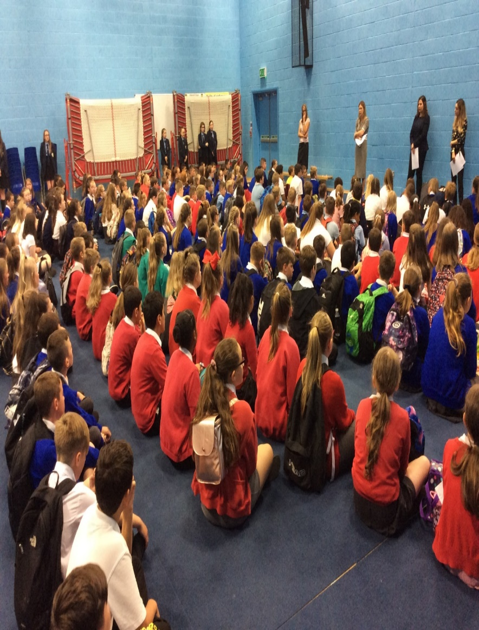
What will my first day be like?

Slide 19
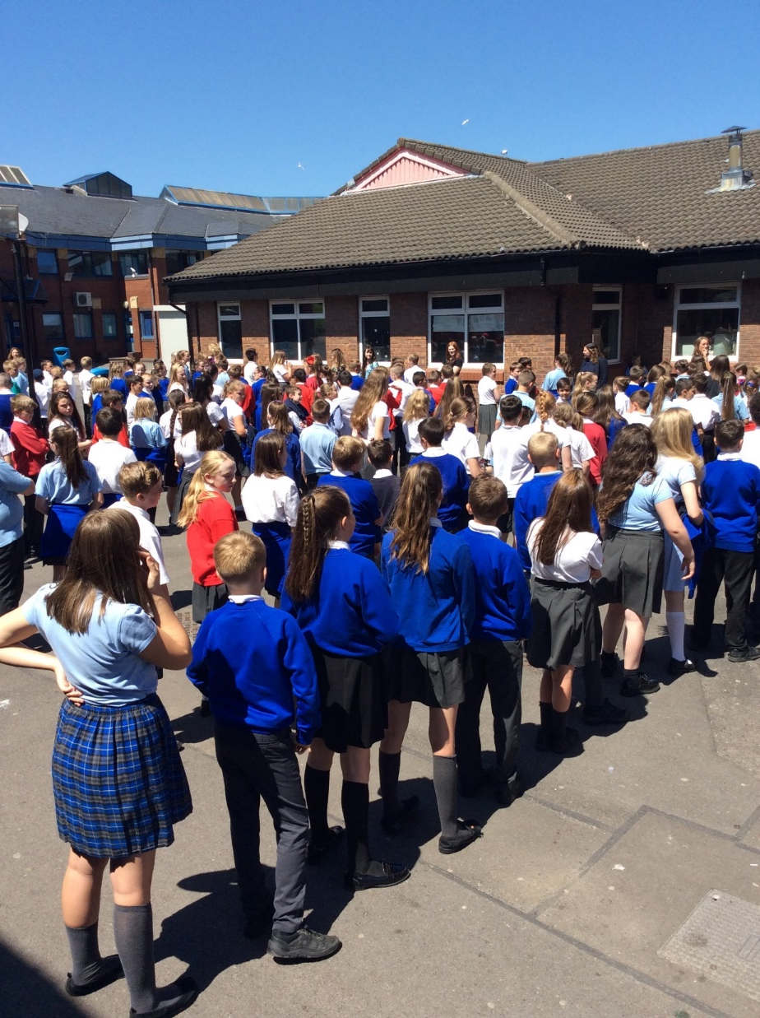
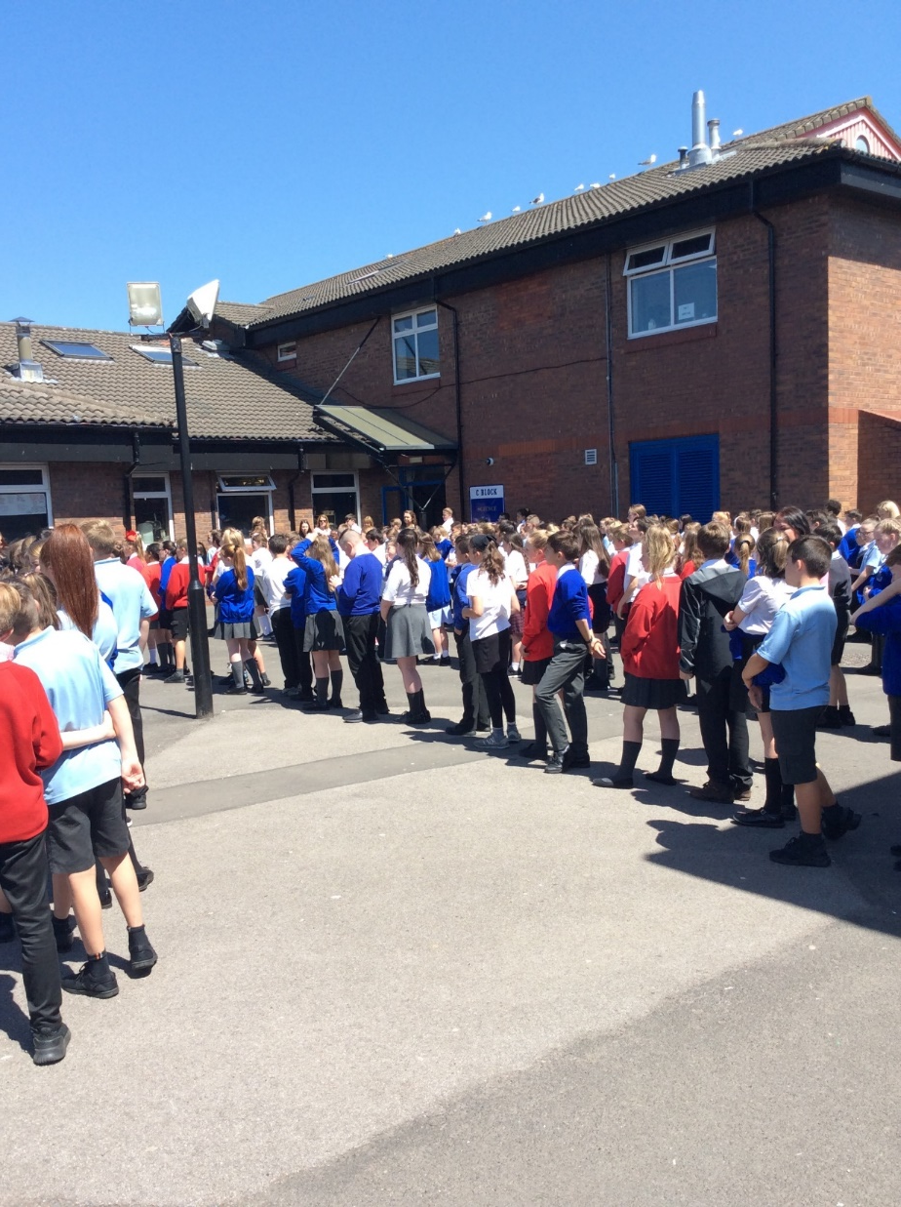
C Block – The Year 7 building is where you will line up each day

Slide 20

“You won’t get away with much in this school.”
“It’s been an amazing day!”
“I’m really looking forward to September.”
“It wasn’t that scary.”
“I love my form teacher.”
“I’m just really happy!”
“I’ve made new friends already.”
“It’s been the best day ever!”
“A lot of my nerves have gone.”
transition2020@hhhs.net
Mrs Holland

