Slide 1
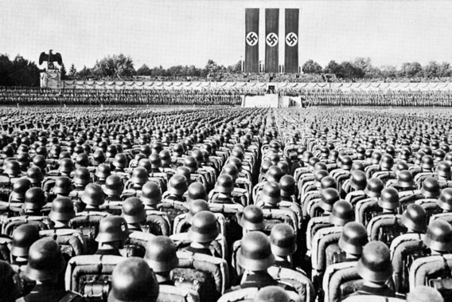
Weimar and Nazi Germany,
1918 – 39
GCSE History Revision Guide
Name: ___________
Form: ____________

Slide 2
How do I answer paper 3?
This page introduces you to the main features and requirements of the Paper 3 exam.
About Paper 3
Paper 3 is for your modern depth study.
Weimar and Nazi Germany, 1918-39 is option 31.
It is divided up into two sections: Section A and Section B. You must answer all questions in both sections.
You will receive two documents: a question paper, which you write on, and a Sources/ Interpretations booklet which you will need for section B.
The Paper 3 exam lasts for 1 hour and 20 minutes (80 minutes). There are 52 marks in total. You should spend approximately 25 minutes on Section A and 55 minutes on Section B.
The questions
Section A: Question 1
Give two things you can infer from Source A about…. (4 marks)
Complete the table.
Question 1 targets analysing, evaluating and using sources to make judgements. Spend about six minutes on this question, which focuses on inference and analysing sources. Look out for the key term ‘infer’.
Section A: Question 2
Explain why …. (12 marks)
Two prompts and your own information.
Question 2 targets both showing knowledge and understanding of the topic and explaining and analysing events using historical concepts such as causation, consequence, change, continuity, similarity and difference. Spend about 18 minutes on this question.
Section B: Question 3(a)
How useful are sources B and C for an enquiry into….? (8 marks)
Use the sources and your knowledge of the historical context.
Question 3 targets the same skills as question 1. Spend about 12 minutes on this question , which is about evaluating the usefulness of contemporary sources.
Section B: Question 3(b)
Study interpretations 1 and 2….
What is the main difference between these views? (4 marks)
Use details from both interpretations.
Questions 3b and 3c target analysing, evaluating and making judgements about interpretations. Spend about six minutes on each of these questions, which are about suggesting and explaining why the interpretations differ.
Section B: Question 3(c)
Suggest one reason why Interpretations 1 and 2 give different views about …. (4 marks)
You can use the sources provided to help explain your answer.
Section B: Question 3(d)
How far do you agree with Interpretation 1 / 2 about …. ? (16 marks + 4 marks for SPaG and use of specialist terminology)
Use both interpretations and your knowledge of the historical context.
Question 3(d) also targets these same skills. Spend about 32 minutes on this question, which is about evaluating an interpretation. Up to four marks are available for spelling, punctuation, grammar and use of specialist terminology.

Slide 3
What are Sources and Interpretations and how are they used in the exam?
This exam asks you to analyse and evaluate both sources and interpretations, and you need different skills for each.
Questions 1 and 3(a)
Here you will be asked to look at sources. These sources could be propaganda posters, accounts from people at that time, photographs or any written or visual source that is from the period. As the sources are generated from that time it is helpful to think about the nature of the source, the origin, who produced it and the purpose for which it was produced.
Questions 3(b), (c) and (d)
Here you will be asked to read interpretations of a particular enquiry or event from two different historians. Unlike analysing sources, interpretations are written after the time period or the event. They are often written by historians or commentators who express their views and opinions about historical people, events and changes. As they are people’s views and judgements based on evidence there can be differences and sometimes clear disagreements, about what people think.
Content: What information can you get directly from the source and its caption? It is important to spend time reading and studying source before you read the exam questions.
Bias: A source is still useful even if you think it is biased – it can be good for assessing people’s opinions of an event, for example.
Language: In written sources, the author’s language should give you clues about whether they are biased or even unreliable. Using appropriate examples by quoting directly from the source will help you gain better marks. Language can also tell you about the purpose of a source.
Selection: What has the author / artist chosen to include? What have they chosen to leave out? It’s important to consider both of these when you are thinking about reliability, usefulness and purpose in a source.
Hints and tips for examining sources.
Purpose: the reason the source was created could be one of the questions itself, but this will also help you to assess its reliability and usefulness.
Origins: The caption should tell you who produced the source and when. The origin will help you assess its reliability, usefulness and purpose.
Hints and tips for analysing and evaluating interpretations
How complete? | How objective? | What is the chosen emphasis?
The interpretations can be different because they are concerned with finding out about different aspects of the enquiry and may cover different ground. Sometimes, historians set out to look at one aspect specifically, whereas others may want to look at related issues in a broader sense. | Historians can hold different views because they come from a particular school of thought. Therefore, their questions and answers are shaped by their wider views of society and how it works and has worked in the past. This can have an important impact on the judgements and opinions they hold about historical matters. | Sometimes, historians use the same sources but reach different views because they place a different level of importance on the same evidence. They may have access to the same material sources as each other, but will draw different conclusions about the significance of that evidence.

Slide 4
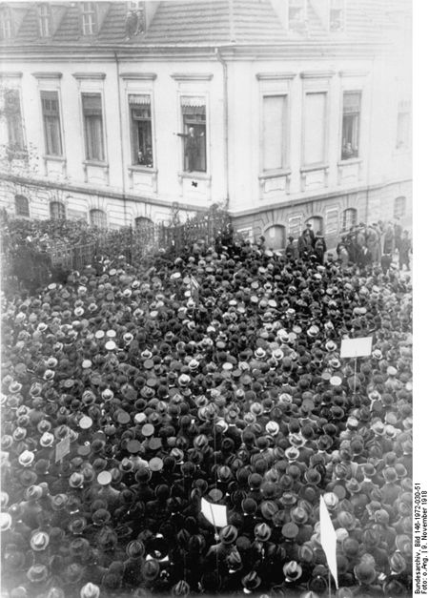
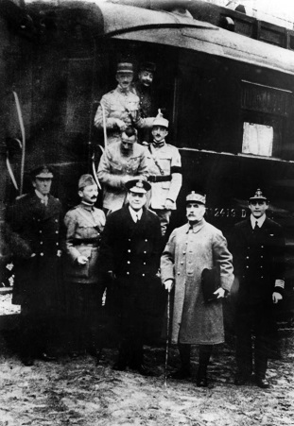

What was the impact of the First World War on Germany?
The First World War ended in 1918 and left Germany scared and crumbling, having been defeated by the combined force of Britain, France, Russia, Italy and the USA. Friedrich Ebert, leader of the Social Democratic Party, became the first German president and declared Germany a republic.
What was the impact of the First World War on Germany?
Two million German troops died and over four million were wounded (11 million in total fought in the war).
Government debts increased from 50 billion marks to 150 billion marks.
More than 750,000 Germans died because of food shortages.
The devastating effects of the war left many people with no option other than to revolt by striking and rioting.
The Abdication of Kaiser Wilhelm II (Emperor)
Timeline
9 November 1918
The Kaiser visited army headquarters in Spa.
Ministers tried to persuade the Kaiser to abdicate.
The Kaiser refused
Army officers refused to support the Kaiser
The Kaiser had no option but to abdicate.
10 November 1918
The Kaiser fled to Holland..
Revolution and the Declaration of the Republic
Once the Kaiser had abdicated, the German Republic was declared on 9 November 1918.
On 10th November, Friedrich Ebert suspended the old Reichstag and formed the Council of People’s Representatives as a temporary measure.
Philipp Scheidemann, of the Social Democratic Party (SDP) the largest party in the German government (Reichstag), declared the new Republic to the crowds. He was fearful that armed rioters were preparing to declare a communist government in Berlin, and, keen to prevent this, he promoted a peaceful transition.
The Berlin street were crowded. Some people were armed, hoping to take over parts of the city.
Scheidemann talking to the crowds from a window of a house in Berlin, 9 November 1918.
The Revolutionary period continued until August 1919, when the Weimar Republic was eventually established.
The armistice – the peace agreement between Germany and the Allies.
It was signed on 11th November 1918
It was the first major decision of Ebert’s new government.
The terms of the peace, the Treaty of Versailles, became a very big burden for the country,
War leaders outside the railway carriage where the armistice was signed on 11 November 1918.
Why did the end of the First World War lead to economic and political problems for Germany?
_________________________________________________________________________________________________________________________________________________________________________________________________________________________________________________________________________________________________________________________________________________________________________________________________________________________________________________________________________________________________________________________________________________________________________________________________________________________________

Slide 5
What were the strengths and weaknesses of the Weimar constitution?
Democratic government was established in the drawing up of a new constitution. This was done on 31st July 1919, in the town of Weimar, rather than in Berlin where there was still unrest..
The Weimar Constitution
The | Government
Chancellor Head of the government in the Weimar Republic. Chose all government ministers | Cabinet The main decision – making body of the government.
Head of State
President Head of Weimar Republic, Elected by the people every seven years. Had some important political powers. For example, the president chose the chancellor.
The Parliament Made up of two houses: the Reichstag and the Reichsrat. Normally, all laws had to pass through both houses Proportional Representation
Electorate Consisted of all men and women of 21 years old and over
Reichstag The more powerful of the two houses Controlled taxation Directly elected by the people at least once every four years | Reichsrat Also elected every four years. However, it represented the regions of Germany
Strengths and weaknesses of the constitution
Strengths | Weaknesses
Proportional representation made sure small parties had a fair share of seats. Women able to vote as well as men Voting age reduced from 25 to 21. No one group or person could have too much power There was an election for president every seven years Central government was more powerful than before, but local government still retained power in the regions The Reichsrat could regulate the power of the Reichstag by delaying new laws. | Proportional representation led to coalition governments that were unstable, or found it difficult to have strong policies and often fell apart. Lack of strong government led to weakness in a crisis that ended up with the president passing laws without the prior consent of the Reichstag, Article 48 constitution enabled the president to do this. It was not the choice of the people so was not that popular
Describe the key strengths and the key weaknesses of the new constitution.
________________________________________________________________________________________________________________________________________________________________________________________________________________________________________________________________________________________________________________________________________________________________________________________________________________________________________________________________________________________________________________________________________________________________________________________________________________________________________________________________________________________________________________________

Slide 6
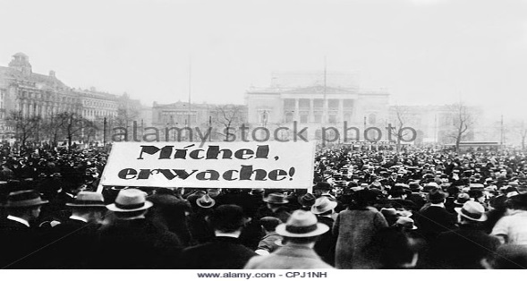
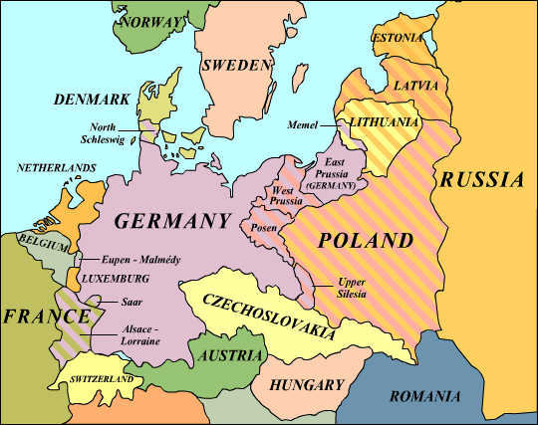
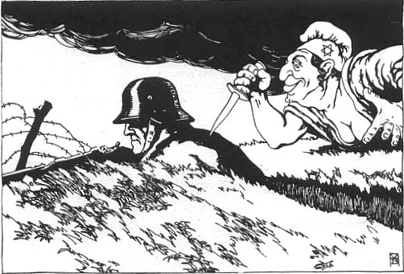
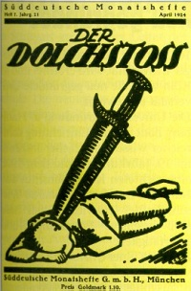
Why was the Weimar Republic so unpopular?
The Treaty of Versailles damaged Germany’s economy making the Weimar Republic weak from the start. People blamed the leaders of the new German republic for signing it. They were labelled the ‘November Criminals’ because they surrendered in November 1918 and were seen as traitors to their country.
The treaty and reparations
As the war guilt clause made Germany accept the blame for the war, the Allies said they were entitled to reparations (compensation). £6.6 billion was to be paid in yearly instalments to the Allied to repair damage in their countries
The Treaty and Military forces
Army limited to 100,000
Navy limited to six battleships, six cruisers, 12 destroyers and 12 torpedo boats (and no submarines)
All planes were destroyed and no air force was allowed
No military was allowed in the land bordering France (the Rhineland)
Article 231 of the Treaty of Versailles said that Germany was guilty of starting the war. Ordinary German people hated this blame and felt very resentful because of it. They believed they fought the war in self – defence and that other countries were to blame.
The treaty and land losses
Northern Schleswig voted to become part of Denmark
Memel was taken by Lithuania in 1923.
Polish corridor (Posen and West Prussia) was lost to Poland
Eupen and Malmedy were lost to Belgium
Alsace and Lorraine were lost to France
Upper Silesia voted to become part of Poland
Germany also lost 11 of its colonies.
The ‘stab in the back’ theory
German people never believed their army had been defeated in the war. Those who criticised the treaty said that the army had been betrayed by politicians – that they were ‘stabbed in the back’ and forced to surrender.
Remember
Land
Arms
Money
Blame

Slide 7
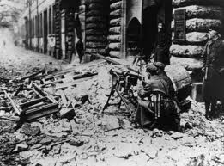

What were the threats to the Weimar Republic from the left and the right?
The new Weimar Republic government faced opposition from groups inside and outside the Reichstag, and from both the left and right wings.
The Spartacists
Left – wing
Came from the independent Socialist Party
Had soviet backing
Led by Roas Luxemburg and Karl Liebknecht
Based in Berlin
The Freikorps
Right wing
Made up of ex – soldiers who had kept their weapons
Had 250000 men in March 1919
Organised by regular army
Challenge from the left – the Spartacist revolt
In January 1919, the Spartacists took over the government’s newspaper and telegraph bureau, and tried to organise a general strike in Berlin, The Weimar government sent Freikorps units to put down the revolt.
Challenge from the right – the Kapp Putsch
In March 1920, Freikorps troops, fearing unemployment, decided to march on Berlin. Ebert asked the head of the army to resist the Freikorps but he refused. A nationalist politician, Dr Wolfgang Kapp, was put in charge by the rebels and the Weimar government fled Berlin seeking safety. In order to put down the rebels, or Kapp Putsch as it became known, the government organised the trade unions to go on strike. This they did and the national strike caused such chaos that Kapp could not rule Germany and was forced to flee. The Weimar ministers returned.
There was street fighting in Berlin for several days before the revolt ended and Spartacist leaders were shot.
Political attacks on the Weimar Republic
Political Assassinations
From 1919 – 1923 politicians in the Weimar Republic were worried about assassinations
In the early years of the republic, 376 political assassinations took place
Some right – wing extremists used the murders to weaken the new republic
Conservative judges were sympathetic to the conservative cause and gave them light punishment.
Left – wing parties in the Reichstag
Right – wing parties in the Reichstag
The Spartacist revolt
The Weimar Republic
The Kapp Putsch
Right – wing bias in the courts
Left – wing and right – wing political armies
Political assassinations
Describe the role of the FreiKorps in the Kapp Putsch and Spartacits revolt.
________________________________________________________________________________________________________________________________________________________________________________________________________________________________________________________________________________________________________________________________________________________________________________________________________________________________________________________________________________________________________________________________________________________________________________________________________________________________________________________________________________________________________________________
Why did the government deal so harshly with the Spartacists?
____________________________________________________________________________________________________________________________________________________________________________________________________________________________________________________________________________________________________________________________________________________________

Slide 8

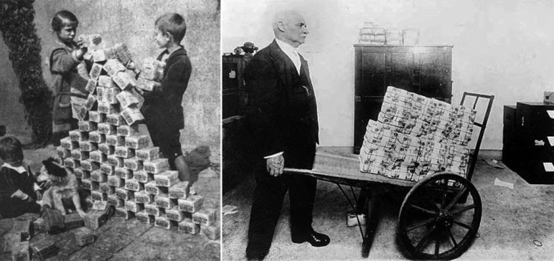
Why did hyperinflation become a problem in 1923?
In 1923 the German people faced a terrible economic crisis. There was hyperinflation that made the German currency worthless.
Hyperinflation
When the price of goods increases it is called inflation; when it increases spectacularly, it is called hyperinflation
Why there was hyperinflation:
1914 – 18
The government printed more money to pay for the First World War, but it didn’t have more gold – it was bankrupt.
1, mark
100, marks
1922
1918 - 22
The Weimar government printed more money for post – war shortages and asked for longer to pay the first reparations instalment
1919
200 000 billion, marks
1923
January 1923
French troops invaded the Ruhr to take reparations payments in goods and raw materials. German workers went on strike. 80% of German coal, iron and steel reserves were in the Ruhr and many of its factories. The occupation was a disaster for Germany’s economy.
The Weimar government printed more money to pay strikers and make up for loss of coal, steel and iron production.
The effects of hyperinflation
Negative effects
Some people could not afford essentials like bread
Wages rose, but not as quickly as prices
Some businesses went bankrupt (those that made money took over the struggling ones)
People with fixed or monthly incomes, such as pensioners, suffered most
Savings became worthless. This affected the middle classes most.
People blamed the Weimar government, which made it even more unpopular.
November 1923
The German mark was worthless
Positive effects
Farmers benefitted, as they were paid more for food.
Some people and businesses could pay off loans and mortgages
Fixed rents for rooms or shops became very cheap
Foreign visitors could buy more for their money
Complete a list of the ‘winners and losers’ of hyperinflation
Try to explain why each group did/did not benefit
Winners | Losers
The effects of hyperinflation on Germany are important for understanding various topics, so make sure you revise them.
Remember that middle class people were worst affected
Include positive and negative effects of hyperinflation in your list

Slide 9
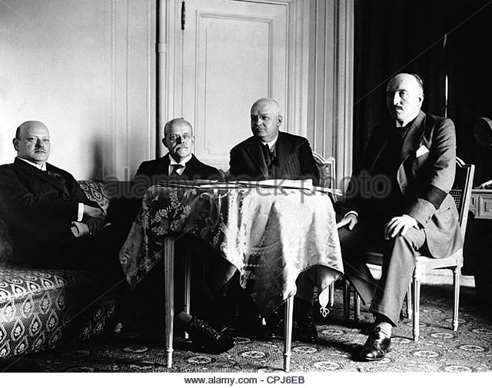
Why did Germany recover in 1923 – 29?
From 1923 – 29 Germany managed to recover from the immediate crisis of 1923, but there were still significant weaknesses in its economy. Gustav Stresemann, the new chancellor, played an important role.
Rentenmark
In November 1923, Stresemann set up the Rentenbank and issued the new currency called the Rentenmark.
Supply of these notes was tightly controlled. Their value was tied to the price of gold so it had real value. This encouraged more public confidence.
In August 1924, the Reichsbank was given control of the new currency. It was renamed Reichsmark. Hyperinflation was over.
International loans after the First World War
Loans made under Dawes and Young Plan
USA
Germany
Reparations payments made
The Reichsmark provided a much stronger basis for the recovery of jobs and businesses, but it could not bring back the losses experienced in the hyperinflation crisis.
Britain and France
The Dawes Plan 1924
In 1924, Charles Dawes, an American banker, designed a plan so Germany could pay its reparations.
Instalments were temporarily reduced to £50 million a year:
US banks agreed to make loans to German industry. The Allies felt more confident that they would get their reparations payments.
Gustav Stresemann (far left) at the London conference, where the Dawes plan was agreed
Young Plan, 1929
In August 1929, a committee set up by the Allies and led by an American banker called Owen Young proposed a plan.
The Young Plan reduced the total reparations debt from £6.6 billion to £2 billion
The payments could be made over a longer time, up until 1988.
Lower reparations meant lower taxes for German people
There was a lot of opposition, especially from the extreme political parties, like the Nazis, who felt it was extending the burden for future generations.
Improvements in the economy
The Weimar Republic’s economy improved because:
Industrial output doubled by 1928 and finally passed pre – First World War levels.
Employment and trade increased
However, there were still problems.
The extreme political parties were completely against Germany paying the reparations at all
The economic recovery depended on American loans, so remained fragile.
Why was the German economy still vulnerable, despite some improvements?
_____________________________________________________________________________________________________________________________________________________________________________________________________________________________________________________________________________________________________________________________________________________________________________

Slide 10
What were Stresemann’s successes at home and abroad?
Stresemann’s most important achievements were in economic and foreign policy. However, his main aim was to stabilise the political situation in Germany.
Stresemann’s success
Gustav Stresemann resigned the chancellorship in November 1923, but stayed as foreign secretary until 1929. His work in foreign affairs:
-Strengthened the confidence of the German people in the Weimar Republic
-Reduced the support for extremist political parties like the Nazis and the communists
-Increased support for moderate parties
-Reduced the economic hardships of the German people
Locarno Pact, 1925
This was an agreement between Germany, Britain, France, Italy and Belgium. In it:
-Germany agreed to its new border with France improving relations with the French
-The Allies and Germany agreed to the permanent demilitarisation of the Rhineland
-German membership of the League of Nations was up for discussion
Why was it a success for Germany?
-It improved relations with France with the border agreement
-The Locarno Pact was not imposed on Germany, unlike the Treaty of Versailles
-It increased the status and popularity of the Weimar Republic
-It helped boost confidence in more moderate political parties.
Stresemann was instrumental in making sure Germany was member of three important international pacts or agreements: The Locarno Pact, the League of Nations and the Kellogg – Briand Pact.
League of Nations
This was a new international body that hoped to discuss world problems in order to avoid resorting to war. It was set up in 1920 but Germany was initially excluded. In 1926, they were invited to join and become a member of the council.
Kellogg – Briand Pact, 1928
This was an agreement between 62 nations. It committed countries to avoiding the use of war to achieve foreign policy objectives.
Why was it a success for Germany?
-It showed that Germany was once again a major power.
-It showed that moderate political parties could build Germany’s strength internationally
-In increased public confidence in how Germany was being led.
Why was it a success for Germany?
-It showed Germany’s views counted
-It boosted the confidence held by most Germans in the Weimar government
It wasn’t all a success
-There were still some areas of discontent in spite of Stresemann’s work
-The hated terms of the Treaty of Versailles were still in place.
-The League of Nations was, for some, a symbol of the unpopular Treaty of Versailles.
-Some didn’t like the confirmation of the new border with France
Think about Stresemann’s position, his achievements and their results
Explain how Stresemann’s foreign policy helped to stabilise Germany
______________________________________________________________________________________________________________________________________________________________________________________________________________________________________________________________________________________________________________________________________________________________________________________________________________________________________________________________________________________________________________________________________________________________________________________________________________________________________________________________________________________________________________________________________________________________________________________________________

Slide 11
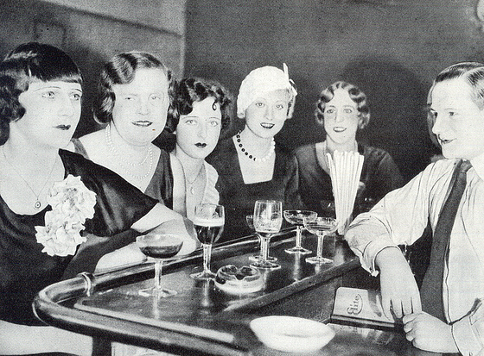
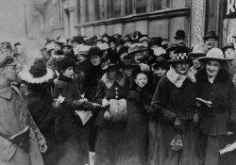
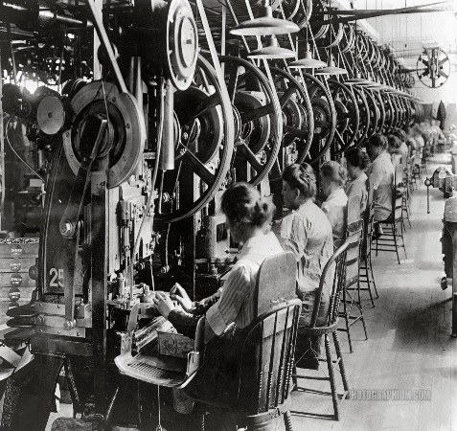
What were the changes for workers and women?
The period 1924 – 29 saw some important improvements for workers and women in Germany, but there were still underlying problems in German society.
Changes in living standards
Living standards improved after 1924, brought about by government funding and policies
Unemployment Insurance
3% of workers’ earnings were deducted to be put towards insurance that would give them a basic amount of benefits if they became unemployed or sick
Wages and work
-Working hours reduced
-Wages rose
-Working conditions improved
-Hyperinflation made unemployment insecure
-Well – off Germans resented seeing workers benefit
Standard of living
Housing
-15% rent tax was introduced to fund building associations
-Between 1925 and 1929, 101000 homes were built
-There was still a housing shortage but things had improved
Women at work | Women at leisure | Women in politics
Some of the gains in equality brought about the war were lost Most women gave up work after they married there was a drop in women working from 75% in 1918 to 36% in 1925. Few women secured high status jobs There was an increase in part – time work Some professions, like teaching and medicine, offered new opportunities to women Women were encouraged to go to university | Greater earning power led to more independence for younger, single women Women were less interested in marriage and family and more interested in having a ‘good time’ The behaviour of ‘new women’ was not liked by some men and women who felt traditional values were being eroded. | Women earned the vote in 1918 and could stand for elections. 90% turned out at elections. Article 109 of the constitution stated that women had equal rights with men and could enter professions on an equal basis. Marriage was an equal partnership

Slide 12

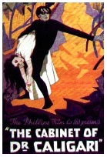

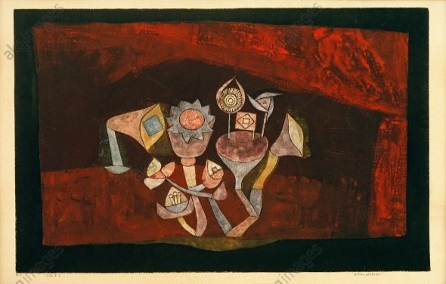
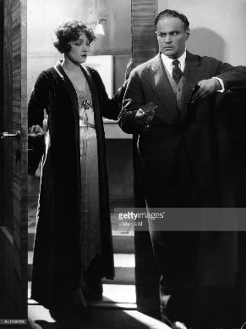
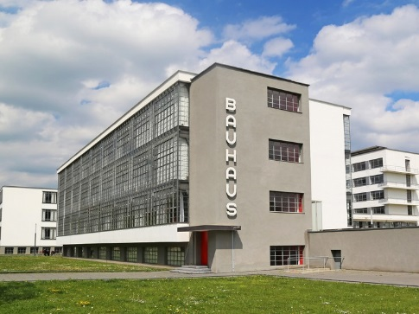
What were the cultural changes in 1924 – 29?
A variety of factors led to a rise in cultural changes and experimentation in Germany between 1924 and 1929. The main driving force in art and cinema was the movement called Expressionism.
Art
Weimar artists painted everyday life so that everyone could have access to their art. They wanted to make art that commented on problems in German society, or to make people think. Their style of work was called Expressionism, which was concerned with raw emotion, the seedier side of everyday life and confronting the disaster of the First World War. Artists like Otto Dix and George Grosz were influential to the movement, as was Paul Klee.
Cinema
Films became popular all over the world in the 1920s. Expressionism flourished in film making, particularly in Weimar Germany due to fewer restrictions. Some German films were very new and exciting in how they challenged traditional cinema.
All these films were marked by dark shadows, dramatic lighting and grotesque characters
A famous and very popular German actress of the time was Marlene Dietrich. Here she is in the film The Woman One Longs For, directed by Curtis Bernhardt in 1929.
Cave Flowers by Paul Klee, 1926. Klee taught at the Bauhaus school.
Architecture
New designers and architects challenged traditional ideas and practices in building and interiors.
The Bauhaus school was set up in Weimar, in 1919, by the architect Walter Gropius.
The school attracted many talented artists and designers
Their ideas challenged traditional styles that had been popular before the war.
Gropius wanted to bring together all the disciplines (art, architecture, design, typography, sculpture, etc.)
Their approaches looked radical compared to what had come before.
How did the new Weimar culture challenge traditional attitudes and values in Germany?
____________________________________________________________________________________________________________________________________________________________________________________________________________________________________________________________________________________________________________________________________________________________________________________________________________________________________________________________________________________________________________________________________________________________________________________________________________

Slide 13
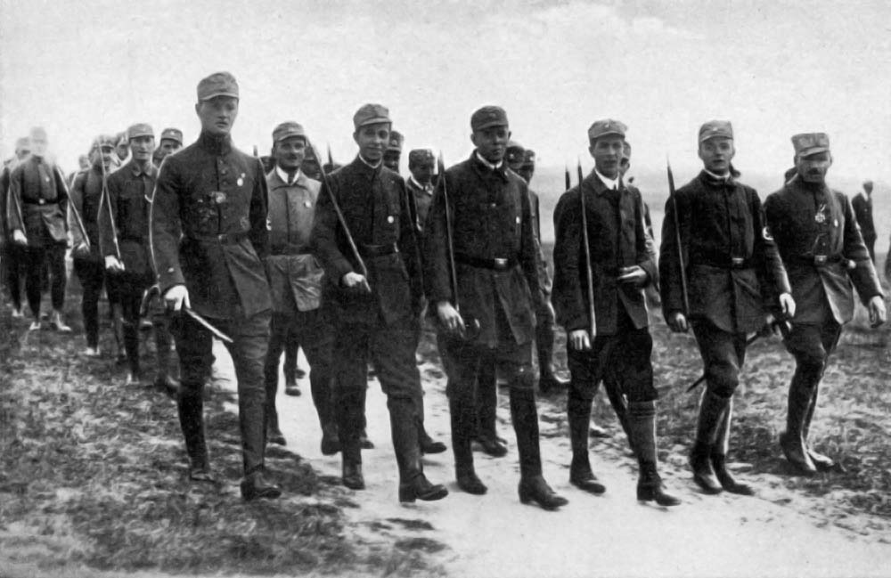
What was Hitler’s role in the early rise of the Nazi Party?
Adolf Hitler was born in Austria in 1889. He moved to Munich in 1913 and became obsessed with all things German. He fought in the First World War and his experience confirmed his views that Germany had a special destiny. He was shocked by Germany’s defeat and the outcome of the Treaty of Versailles.
Hitler and the early DAP/ NSDAP
Hitler’s early political career
The German Worker’s party (DAP) was set up by Anton Drexler in February 1919, in Munich; Hitler joined September 1919.
The DAP set up permanent headquarters, Hitler became second in command.
Hitler suggested a new name for the party – the National Socialist German Workers’ Party (NSDAP) or NAZI Party for short.
In July 1921, Hitler became leader of the Nazi Party.
Hess, Goering, Streicher and Rohm were selected as some of his party supporters.
1919 – Hitler joined the DAP
1920 – Hitler was second in command of the DAP
1920 – In August the DAP changed its name to the National Socialist German Worker’s Party
1921 – Hitler took control of the Nazi Party from Drexler.
Timeline
The 25 – point programme
The Nazi programme, written by Hitler and Drexler in 1920, included the following points.
Increase pensions for the elderly
Nationalise industry
Get rid of the Treaty of Versailles
Everybody should have a job
Build up Germany‘s armed forces
Only German races may be members of the nation. No Jew may be a citizen.
Expand Germany across new territory to feed the people and to settle surplus population (known as Lebensraun)
All citizens should have equal rights and duties
Every hard – working German to have the chance of higher education
State must protect mothers and infants, stop children working; make laws for compulsory sports.
The Sturmabteilung (SA)
The stormtroopers were a paramilitary force, made up of unemployed ex-soldiers. They were formed in August 1921 by Hitler and put under the command of Ernst Rohm. They wore brown uniforms and were nicknamed ‘brownshirts’. They were used to disrupt opposition meetings and to control crowds and any opposition to Hitler – often violently
The programme opposed: the Weimar politicians who agreed to the Treaty of Versailles; democracy, which they thought was weak; and Jews, who they felt undermined the German economy.
The Sturmabteilung (SA)
Explain who the 25 Point Programme would appeal to and why?
__________________________________________________________________________________________________________________________________________________________________________________________________________________________________________________________________________________________________________________________________________________________________________________________________________________________________________________________________________________________________________________________________________________________________________________________________________________________________________________________________________________________________________________________________________________________________________________________________________________________________________________________________________________________________

Slide 14
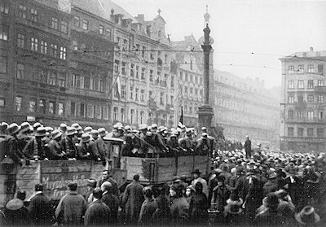
What was the Munich Putsch and its aftermath?
Hitler attempted to overthrow the Weimar government in November 1923. This was known as the Munich Putsch. After this date, and up to 1928, the Nazi Party struggled to get support.
Reasons for the Munich Putsch
Long Term | Medium Term | Short Term
‘Stab in the back’ Reparations The loss of Germany’s colonies | Hitler was influenced by Mussolini’s right-wing party in Italy – the Fascists. Mussolini marched on Rome in 1922, forcing the democratic government to accept him as leader. | Hyperinflation French troops entered Ruhr in 1923 and took over German businesses Hitler thought that he had support.
The events of the Putsch
Consequences of the Putsch
In the short term, the Putsch was not good for Hitler. He was in prison and the NSDAP was banned, and the Putsch had failed miserably because of lack of support. In the long term, however, the consequences were more positive for Hitler and the NSDAP.
Hitler used his trial to publicise his views.
He used his time in prison to write Mein Kampf (My Struggle). The book became a bestseller when published – it outlined his political ideas in particular his views on Jews.
The events of the Putsch made Hitler realise that the Party needed to rethink its tactics and be more organised in order to win support nationally, using violence and force wasn’t enough.
8th November 1923
Hitler with 600 SA entered a beer hall in Munich where the Bavarian government were meeting. At gunpoint, Hitler forced government leaders to support him. Rohm took over local police and army headquarters. Ludendorff, behind Hitler’s back, let the government leaders go.
9th November 1923
Hitler gathered with 1000 SA and 2000 volunteer supporters and marched on Munich town centre to declare himself President of Germany. The group was met by state police. Someone opened fire and there was chaos. Ludendorff, Rohm and Streicher were arrested.
11th November 1923
Hitler was found hiding at a friend’s house and was arrested.
Hitler was released from prison after only nine months. The ban on the NSDAP was lifted by 1925.
Bamberg Conference 1926
Hitler organised this conference to address splits between the socialist and nationalist wings of the Nazi movement. Hitler’s power as leader was secured and his vision of Nazism taken forward.
Was the Munich Putsch a success or a failure for the Nazi Party?
_________________________________________________________________________________________________________________________________________________________________________________________________________________________________________________________________________________________________________________________________________________________________________________________________________________________________________________________________________________________________________________________________________________________________________________________________________________________________

Slide 15
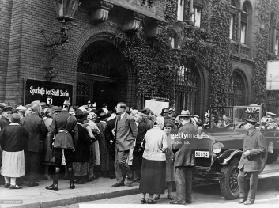
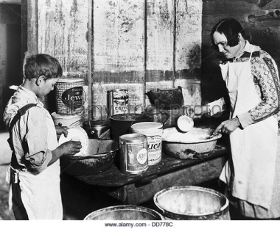
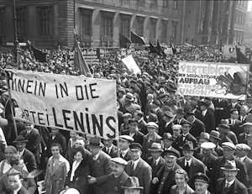
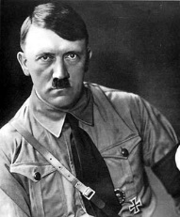
Why was there increase in support for the Nazi Party 1929 – 32?
In this period, the Nazis reorganised to benefit from the Weimar Republic’s weaknesses and economic problems. Hitler’s appeal as a leader also benefited them.
Wall Street Crash, USA, October 1929
US companies lost billions of dollars in value overnight. Many banks and businesses were ruined, and worldwide depression resulted.
US stopped lending money to Germany and demanded all loans to be repaid.
German businesses
Had to pay back loans
Received no more investment from the US
Had to pay increased taxes to government
German government
Couldn’t borrow money from the US
Refused to print more money
Increased taxes
Made cuts in unemployment benefit
Government workers had wages cut and some lost their jobs.
German people
Businesses reduced staff or closed
Millions of workers and farm labourers lost their jobs
Young people were badly affected by job losses
With no work, and benefits slashed, families suffered terrible poverty.
The Hitler Appeal
He travelled around the country giving speeches and talking on the radio
Hitler’s propaganda
Using propaganda techniques, Hitler persuaded:
Business people that he could solve the economic crisis.
Working class people that he could give them work and food
Middle class people that he could protect them from the communists, solve the economic crisis and return Germany to traditional values.
Rural communities that he could protect them from the communists, who might seize their land.
Young people to join him by providing something exciting for them to be part of
Women that the Nazis were the best party to save the nation and their families
He was a strong leader
His image appeared on most publicity material
The party adopted modern technology, e.g. aeroplanes
The effect the Enabling Act had on trade unions and political parties
Economic problems
Unemployment
Dissatisfaction with weak Weimar government
Increased membership of extreme left and right wing parties.
Support for the Communist party grew during this period but the Nazi Party grew faster. Support for the Communist Party was mainly from the working classes living in cities who wanted a party that could protect their jobs and wages.
Remember that, until the economic problems after 1929, the Nazis had very little successes in elections
Explain why the Nazis gained support 1929 – 32?
____________________________________________________________________________________________________________________________________________________________________________________________________________________________________________________________________________________________________________________________________________________________________________________________________________________________________

Slide 16
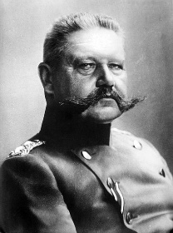
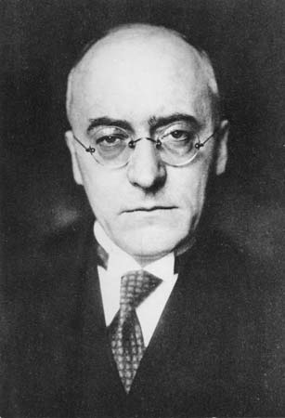
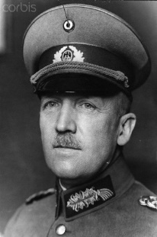
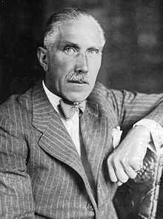
What were the key political developments in 1932?
The actions of four key people resulted in Hitler being Chancellor. You will need to know who these people were and the sequence of political events.
The four key players
Paul von Hindenburg – hero of the First World War and President of the Weimar Republic
Heinrich Bruning – the Chancellor.
General Franz von Papen – the politician and friend of Hindenburg
Kurt von Schleicher – the army general
Paul Von Hindenburg
Heinrich Bruning
Kurt von Schleicher
General Franz von Papen
Hitler’s road to power
Timeline
April 1932 – Hindenburg stands for re-election as President. No one party has 50% of the vote.
May 1932 – Election with Hindenburg being re-elected as President. Hitler increases his share of the vote. Chancellor Bruning bans the SA and announces a plan to buy up land from landowners and use this to house the unemployed. Both plans are very unpopular and Bruning resigns. Bruning is replaced by von Papen – he is put forward by von Schleicher. Von Schleicher had been planning a coalition between right – wing supporters and the Nazis. Hitler agrees to the coalition if the ban on the SA is removed. The coalition takes power.
July 1932 – Further elections take place – there is widespread fighting between the Communists and the Nazis. The Nazi share of the vote increases from 18% in 1930 to 38%. Hitler demands that he be made Chancellor – Hindenburg refuses.
November 1932 – Further election. Von Schleicher warns Hindenburg that if von Papen stays as chancellor there will be civil war. Von Papen goes.
December 1932 – Von Schleicher becomes Chancellor
January 1933 – Von Schleicher does not have the support of the public or the Nazis. He persuades Hindenburg that he could be the head of a military dictatorship. Hindenburg refuses. Von Papen persuades Hindenburg to appoint Hitler as Chancellor to avoid von Schleicher’s military dictatorship. He also suggests that he should become Vice – Chancellor so that he can keep a check on Hitler. Hitler becomes Chancellor.
Causes that are more important often have an effect on other causes.
List below the reasons why Hitler was able to become Chancellor.
____________________________________________________________________________________________________________________________________________________________________________________________________________________________________________________________________________________________________________________________________________________________________________________________________________________________________________________________________________________________________________________________________________________________________________________________________________
Challenge! Number them in order of importance from least to most important.

Slide 17
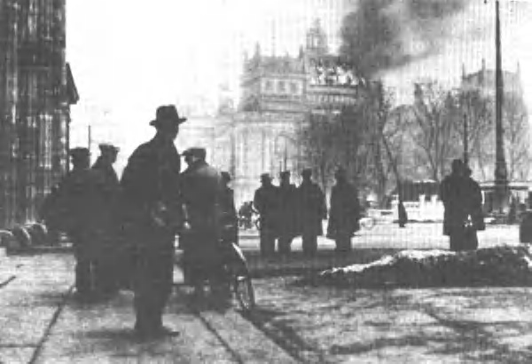
How did the Reichstag Fire and Enabling Act in 1933 help Hitler?
Now the Nazis and Hitler were in power, they used every opportunity, legal and illegal to remove any opposition and secure a dictatorship.
The Reichstag Fire
1. A lone Dutch communist was executed for starting the fire but Hitler seized the Communist Party of a conspiracy against the government. Four thousand communists were arrested.
2. It gave Hitler an excuse to issue a decree for the Protection of the People and the State, giving him powers to imprison political opponents and ban opposition newspapers.
3. He persuaded Hindenburg to call an election in March 1933 to secure more Nazi seats.
4. The Nazi Party managed to secure two – thirds of the seats by using the emergency powers to prevents the communists from taking up their 81 seats.
5. Hitler was now able to change the constitution.
The Reichstag Fire of 27th February 1933. Marinus van der Lubbe was arrested and killed for starting the fire – some people believed the Nazis had started the fire deliberately.
The Enabling Act, 1933
Hitler proposed the Enabling Act in order to destroy the power of the Reichstag and gave himself total power to make laws. It stated that:
The Reich Cabinet could pass new laws
The laws could overrule the constitution
Hitler would propose the laws
Result: Germany would no longer be a democracy
Hitler expected resistance to the act and so used the SA to intimidate the opposition. The vote was won by the Nazis 444 to 94.
The effect the Enabling Act had on trade unions and political parties
The Enabling Act allowed Hitler to get rid of opposition to the Nazis
Local Government: this was closed down on 31st March 1933 and reorganised with Nazi majorities. It was completely abolished in January 1934.
Trade Unions: these were replaced with the German Labour Front. Many Union officials were arrested on 2nd May 1933.
Oher Political Parties: in May 1933, the SDP and Communist Party offices and funds were taken by the Nazis. In July 1933, other political parties were banned.
Summarise the events of the Reichstag fire and what followed.
____________________________________________________________________________________________________________________________________________________________________________________________________________________________________________________________________________________________________________________________________________________________________________________________________________________________________________________________________________________________________________________________________

Slide 18
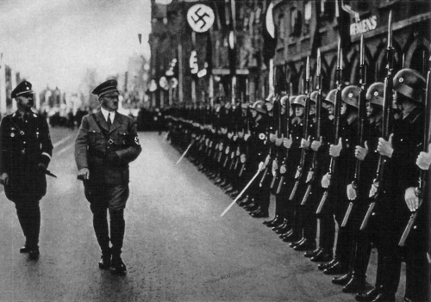
How did Hitler become Fuhrer?
Hitler continued to assert his authority and power. Key events occurred in 1934 which led to Hitler declaring himself Fuhrer.
Rohm, Hitler and the SA
Rohm did not like Hitler’s policies
Many of the SA were bitter because they felt undervalued and angry because many were still unemployed, but they were loyal to Rohm.
The leaders of the Schutzstaffel (SS) wanted to reduce the size of the SA in order to increase their own power.
Why Rohm and the SA were a threat to Hitler
The SA was much bigger than the army and the army feared Rohm wanted to replace them.
The SS
The SS was set up by Hitler in 1925 to act as his bodyguards. They were a select group run firstly by Schreck and then by Himmler. They appeared menacing in their black uniforms.
The Night of the Long Knives
Hitler decided he wanted to rid himself of the threat of Rohm and the SA. He did this by inviting Rohm and the SA. He did this by inviting Rohm and 100 SA leaders to a meeting in the town of Bad Wiessee on 30th June 1934. It was a ruse – when the leaders arrived they were arrested by the SS, taken to Munich and shot.
After the arrests, von Papen’s staff were arrested and his home surrounded. Von Papen was no longer able to watch what Hitler was up to. Further killings occurred, including that of von Schleicher.
Death of Hindenburg
President Hindenburg was the only person senior to Hitler. In August 1934, he died. Within hours, a Law Concerning the Head of the State merged the offices of Chancellor and President to create a new office of Fuhrer.
Fuhrer means ‘leader’ and Hitler used propaganda to ensure that he looked all powerful. The ‘Heil Hitler!’ Nazi salute made people swear loyalty to him personally, and he was portrayed as having superhuman, heroic qualities.
It was thought that not many people fully realised how many people were being killed – many were relieved that the power of the SA had been curtailed.
Army oath of allegiance
The day Hindenburg died, Hitler announced the army should swear an oath of allegiance to him, not to Germany.

Slide 19
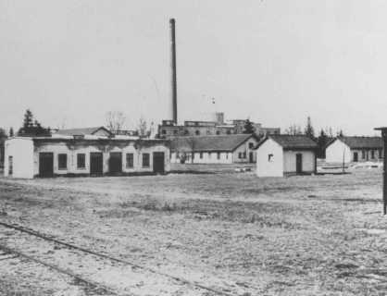
How did Hitler and the Nazi Party create a ‘Police state’?
A police state is when a government uses the police to control everyone’s lives. The Nazis used the SS, SD and the Gestapo to do this. Anyone the Nazis were suspicious of could disappear, at any time. They could be killed or taken to concentration camps.
Policing
Hitler set up his own security forces as he realised not all the existing German police supported him. These forces were run by the Nazi Party, not by the government. Their main weapon was fear:
SS (Protection Squad)
Set up by Heinrich Himmler in 1925
They were led to Himmler
They wore black uniforms
They controlled all Germany’s police and security forces.
They acted outside the law
Members had to marry ‘racially pure’ wives
They ran the concentration camp
SD (Security Service)
Set up by Heinrich Himmler in 1931
They were led by Reynhard Heydrich
They wore uniforms
Spied on all opponents of the Nazi Party, both at home and abroad.
Gestapo (Secret State Police)
Set up by Hermann Goering in 1933
They were led by Reynard Heydrich
They wore plain clothes
The spied on people
Prosecuted people for speaking out against the Nazis
Sent people to concentration camps and used torture.
The Legal System
Hitler controlled the legal system so that meant it was very difficult for anyone to oppose him. He did this by controlling the judges.
-All judges had to belong to the National Socialist League for the Maintenance of the Law.
-All judges had to favour the Nazi party in any decision
He also did this by controlling the law courts
-He abolished trial by jury – only judges were able to decide whether someone was innocent or guilty
-He set up a People’s Court to hear all treason cases. Trials were held in secret and judges were hand-picked
Concentration camps up to 1939
The first camp was built at Dachau in 1933 to house the growing number of people being arrested.
Camps were built in isolated areas so no one could see what was going on. Many were built.
Inmates were made up of: political prisoners, undesirables, such as prostitutes and homosexuals, and minority groups like Jews.
Inmates were treated very badly and forced to do hard labour
Jot down at least three ways in which the SS was used to control the German people.
Any answer about how the Nazis controlled Germany should feature the SS

Slide 20
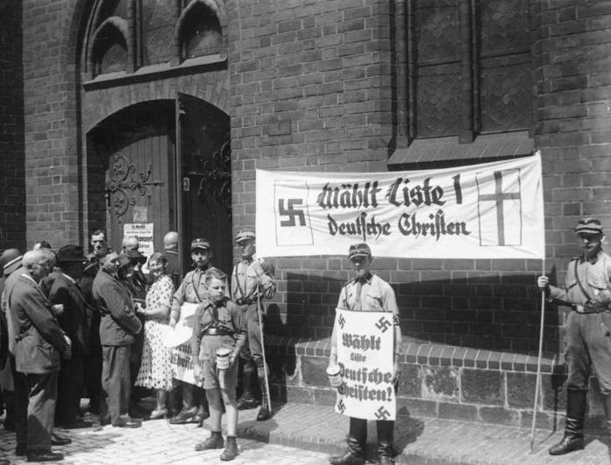
What were the policies towards the Church?
The Nazis wanted total loyalty to Hitler and his beliefs. The churches were potentially a threat to his power and therefore Hitler needed to control the churches’ influence.
Nazi vs Christian beliefs
Nazi Beliefs | Christian beliefs
Hitler as all – powerful leader | God as the ultimate authority
Aryan racial superiority | Everyone equal in the eyes of God
War, military discipline and violence important | Peace is what everyone should strive for
Dominance of the strong over the weak | The strong should look after the weak
The Catholic Church
Hitler worried that the Catholic Church would oppose him because Catholics:
Were loyal the Pope
Usually supported the Catholic Centre Party
Sent their children to Catholic schools and the Catholic youth organisation.
The Protestant Churches
Two Protestant churches were formed during the 1830s.
1) The Reich Church:
Was founded in 1933
Was made up of about 2000 Protestant churches
Supported the Nazis
Was led by Ludwig Muller
Has some members that wore Nazi uniform and called themselves German Christians.
The Concordat
In July 1933, Hitler agreed with the pope in a Concordat that Catholics were free to worship and run their own schools in return for staying out of politics. However, Hitler broke his promise and:
Priests opposing the Nazis were harassed and/or sent to concentration camps
Catholic schools had to remove Christian symbols and were later closed
Catholic youth organisations were banned
By 1937, the pope spoke out against Hitler in his statement known as ‘With Burning Anxiety’, which criticised Nazi policies.
Hitler’s strategy was to try and consolidate his power before openly attacking the influence and power of the churches in Germany. His ultimate goal was to replace the churches with a Nazi based religion.
SA troops outside a pro – Nazi church service, July 1933
2) The Confessional Church:
Was founded in 1934
Was made up of about 6000 Protestant churches
Opposed the Nazis
Was led by Martin Niemoller
Was repressed by the Nazis

Slide 21
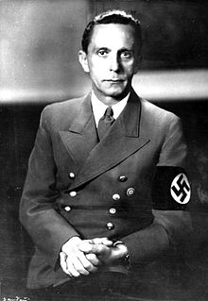
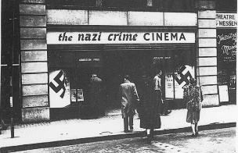
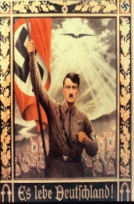
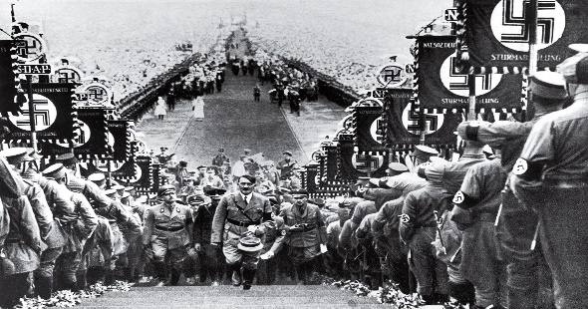

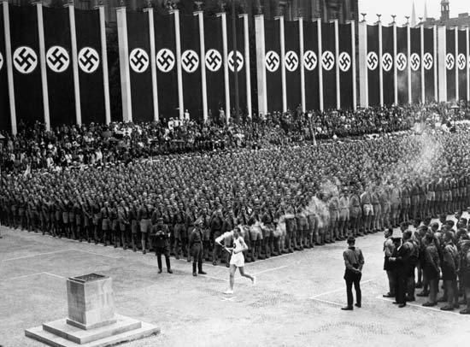
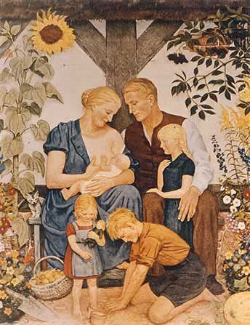
How did the Nazi Party use propaganda and censorship?
Hitler wanted to use propaganda (information to spread ideas) and censorship (government control over what people see, hear and read) to create a generation of people loyal to the Nazi regime and its values.
Joseph Goebbels – Reich Minister of Propaganga 1933 – 1945.
Goebbels played a central role as Nazi Minister of Enlightenment and Propaganda. He was a master at spreading Nazi ideas in a subtle as well as an unsubtle way. He essentially controlled newspapers, the radio, book publishing, film and the arts.
Methods of censorship
Public burning of books by Jewish writers or others who disagreed with Nazi views.
Radio producers, playwrights, filmmakers and newspapers were told what to say.
Newspapers opposing the Nazis were closed.
Only radios that couldn’t receive foreign stations were made.
Methods of propaganda
Hitler featured in much propaganda, either with a photograph or his name or title.
Posters showing Nazi beliefs were displayed everywhere
The cinema showed propaganda films, but mainly entertainment films that had subtle Nazi messages.
Huge rallies and military parades were held, projecting a power and strength that would either make Germans proud of their country or fill them with terror depending on their viewpoint.
The Nazis encouraged artists and playwrights to produce work highlighting Nazi ideas. ‘Degenerate’ art, such as modern art and jazz music, was banned.
Hitler made radio speeches which were played through loudspeakers in factories, cafes and on the streets. Entertainment programmes contained Nazi ideas and beliefs. This was called the People’s Receiver.
The Olympic games held in Berlin in 1936 was the idea event to promote Nazi ideologies such as Aryan superiority. It was also an opportunity to present Nazi Germany in a good light. It was well organised and a grand spectacle.
The Reich Chamber of Culture
Set up in 1933 and overseen by Goebbels, this monitored all aspects of culture and made sure they were consistent with Nazi ideas. The Nazis wanted grand and classical architecture, particularly the work of Albert Speer; artists to be members of a Reich Chamber of Visual Arts; to listen to traditional German composers like Beethoven and Bach.

Slide 22
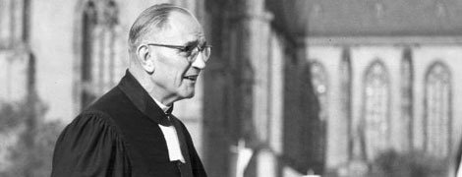
What was the opposition to the Nazi party within the church?
The extent of support for the Nazi regime differed between groups and individuals. Although Hitler tried to suppress opposition from the churches, there were still Catholic Priests and Protestant ministers and pastors who preached against Nazi policies.
Pastor Martin Niemoller
One of the main church opponents of Hitler was Martin Niemoller, but he didn’t always oppose the Nazis.
Niemoller’s changing attitude to Hitler
Pro – Nazi
-Niemoller voted for them in the 1924 and 1933 elections as he felt the Weimar Republic needed a strong leader.
-He didn’t oppose the Nazi restrictions on Jews.
-He wanted to be let out of prison to fight on the side of the Nazis in the Second World War.
Against Nazis
-He didn’t like Nazi interference in the Protestant Church.
-He opposed Nazi restrictions on Jews becoming Christians.
-He set up the Confessional Church in 1934.
Very against Nazis
-Niemoller was arrested many times for speaking out against the Nazis and Hitler between 1934 and 1937.
-He was sent to a concentration camp in 1938 where he stayed until 1945.
How pastors and priests opposed the Nazis.
6000 Protestant pastors joined Niemoller’s Confessional Church as a protest against Nazi policy, only 2000 remained in the German Christian Church.
About 800 pastors were arrested and sent to concentration camps.
400 Catholic priests spoke out and were arrested and imprisoned in the Priests’ Block at Dachau concentration camp.
Niemoller sermon
Niemoller preached this sermon to remind church leaders of the importance of speaking out against Nazi policies.
First they came for the Socialists
and I did not speak out
because I was not a Socialist.
Then they came for the Trade Unionists,
and I did not speak out
because I was not a Trade Unionist.
Then they came for the Jews,
and I did not speak out
because I was not a Jew.
Then they came for me
and there was no one left to speak for me.
How much opposition was there?
Opposition to the Nazis by church leaders was difficult because it was so dangerous to speak out openly. However, attendance at Christian churches remained high throughout the period, in spite of the Nazis’ attempt to curtail the churches.
Why couldn’t Hitler gain complete control of the churches?
_______________________________________________________________________________________________________________________________________________________________________________________________________________________________________________________________________________________________________________________________________________________________________________________________________________________________
How did Hitler and the Nazi Party use propaganda to gain support?
_______________________________________________________________________________________________________________________________________________________________________________________________________________________________________________________________________________________________________________________________________________________________________________________________________________________________

Slide 23
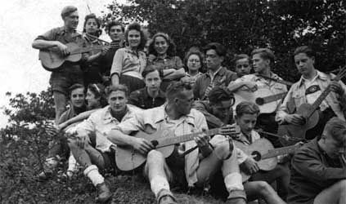
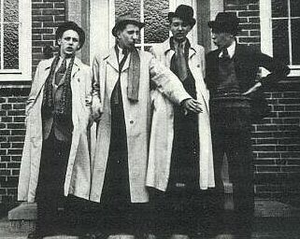
How did the Youth oppose the Nazis?
Another group that opposed the Nazis was the young. Some young people set up secret groups or refused to conform to what the Nazis wanted from them.
The Edelweiss Pirates
They were made up of mainly boys who copied an American style of clothing (checked shirts and white socks).
They sang ‘Smash the Hitler Youth in twain, our song is freedom, love and life’.
The Alpine flower, the edelweiss, was used as their symbol.
The Nazis were not threatened by their activities.
They were formed in the late 1930s, possibly as a consequence of Nazi Policies enforcing Hitler Youth membership.
By 1939 they had 2000 members.
They read and listened to banned music and literature and wrote anti – Nazi graffiti.
They were mainly based in working – class districts of large cities.
They went on hikes and camping expeditions in the countryside to get away from Nazi restrictions.
They taunted the Hitler Youth.
The Swing Youth
Another group of young people similar to the Edelweiss Pirates was the Swing Youth. Like the Pirates, they chose not to conform to Nazi ideas. They liked wearing American clothes. They listened to American music and watched American films. They gathered to drink alcohol, smoke and dance. They organised illegal dances attended by thousands. Unlike the Pirates they were largely made up of children from wealthy families with the money to buy records and own record players.
How effective was youth opposition up to 1939?
It was limited to:
Writing anti – Nazi graffiti
Telling anti – Nazi jokes
Attacking the Hitler Youth
Listening to banned music
Wearing American style clothing.
The motives of the youth opposition groups were cultural rather than political and their numbers were limited.

Slide 24
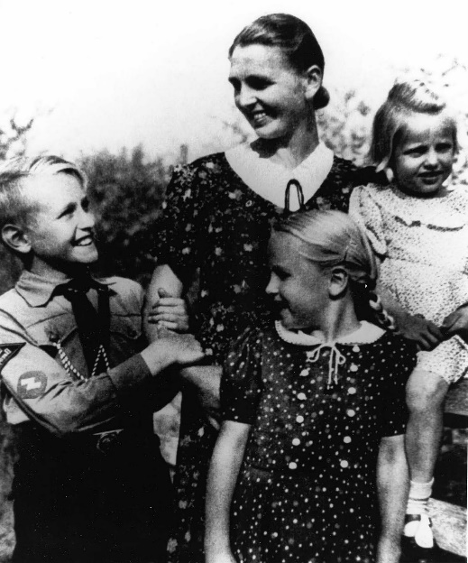
How did Nazi policy affect women and the family?
The Nazis had strong views about the role and position of women in society. Once they had control in Germany, they introduced policies that affected women’s lives in lots of ways.
The Nazis’ ideal woman
To have a natural appearance with long tied back hair and no make – up.
To marry and have children.
To stay at home and not go to work or university.
To wear traditional clothes.
To be sturdily built (for child bearing).
To be fair haired and blue eyed (Aryan).
To believe in the Nazi ideas of Kinder, Kuche, Kirche (children, kitchen, church).
To be a non – drinker/ non – smoker.
This image of the ideal Nazi mother is in strong contrast to how many women lived their lives during the days of the Weimar Republic.
Nazi Policy towards women How successful was it?
Women should not work, especially those who were married. Many professional women lost their jobs and were replaced by men. | During 1933 – 36 the number of employed women fell.
Women should get married. The Marriage Law of 1933 initiated the use of vouchers (Marriage Loans) to newly married couples if the woman agreed to stop working. | The number of marriages did increase, but it’s not clear if this was due to Nazi policy, or other reasons such as a stronger economy.
Women should have at least four children (Couples were let off one – quarter of their Marriage Loan repayments for each child they had). | The birth rate did increase, but this may have been because the economy was improving rather than because of Nazi policies. Few women had more than two children.
The German Women’s Enterprise gave women medals for having children, and ran classes and radio programmes on home – based matters. | The German Women’s Enterprise had six million members, which suggests that many women welcomed Nazi policies.
How did life differ for women in Weimar Germany and Nazi Germany?
________________________________________________________________________________________________________________________________________________________________________________________________________________________________________________________________________________________________________________________________________________________________________________________________________________________________________________________________________________________________________________________________________________________________________________________________________________________________________________________________________________________

Slide 25
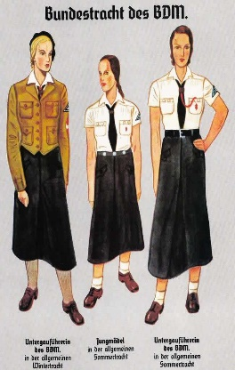
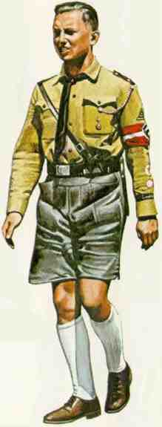
What were the Nazi youth organisations?
There were four Nazi Youth Groups: Young German Folk (boys aged 10 – 14), Young Girls (girls aged 10 – 14), Hitler Youth (boys aged 14 – 18), and League of German Maidens (girls aged 14 – 18). Meetings and activities took place after school, at weekends and in the holidays.
Nazi aims for young people
To be proud Germans who supported a strong, independent Germany.
To be loyal supporters of the Nazi Party and to believe in Nazi policies – preparing children for their future roles as adults.
Boys to be strong and healthy in order to work for the German economy and fight in the German forces.
How the Nazis wanted children to be brought up for the good of Germany
The Nazi policies for the young differed between girls and boys. They encouraged the young to regard Hitler as a father figure and they made sure that the Nazis had control of children outside of school.
Girls to be strong and healthy in order to be strong wives and fertile mothers.
Examples of youth group activities
Boys
Shooting
Military drills
Signalling
Military – style camps
Helping the fire brigade during the war
Formed military brigades to defend Berlin in 1945.
Both
Hiking and Camping
Learning about Hitler
Learning about racial superiority
Singing patriotic songs
Sport and competitions
Taking part in Nazi marches and rallies
Reporting people who made anti – Nazi comments
Collecting for Winterhilfe (a charity)
Girls
Cookery
Housework
Needlework and craft
Learning what to look for in a good husband
Learning about babies and childcare
How Hitler control young peoples lives?
____________________________________________________________________________________________________________________________________________________________________________________________________________________________________________________________________________________________________________________________________________
Why did Hitler force young people to join the Nazi Youth Groups?
____________________________________________________________________________________________________________________________________________________________________________________________________________________________________________________________________________________________________________________________________________

Slide 26
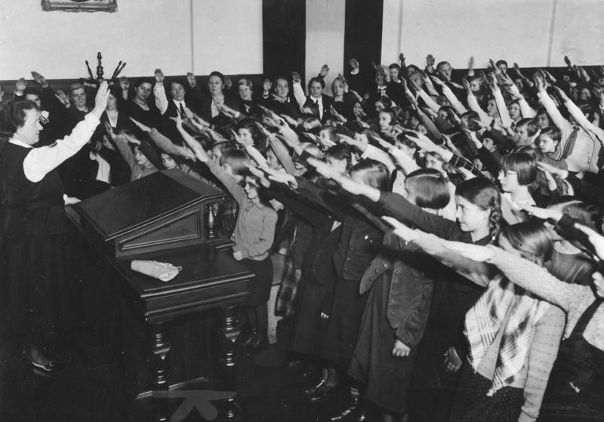
How did the Nazis control education?
Another way the Nazis controlled children was through education. This was another method of making German children loyal Nazis in preparation for their future roles in the Nazi state.
Nazi control of education
Schools | Teachers | Subjects | Propaganda
Children had to attend state school until they were 14. There were separate schools and girls and boys. Optional schools after age 14: National Political Educational Institutes and Adolf Hitler Schools. All schools followed a set curriculum – this was different for girls and boys. | It was compulsory for teachers to be Nazi Party members. Those who didn’t teach Nazi ideas were dismissed. Teachers’ camps taught them how to use Nazi ideas in their teaching. Nearly all teachers joined the Nazi Teacher’s League. Teachers were forced to attend courses to learn about Nazi ideas. | 15% of time was spent on PE to ensure a healthy and strong population. Girls were taught domestic skills, while boys were taught science and military skills. Both sexes were taught the traditional subjects: German, History, Geography and Maths. New subjects: Race Studies and Nazi Eugenics were taught to both sexes. | All lessons began and ended with the Hitler salute. Nazi flags and posters decked classrooms. From 1935 all textbooks had to be approved by the Nazi Party. Traditional subjects were rewritten to glorify Germany, e.g an emphasis on German writers and historical figures. Racial ideas and anti – Semitism were embedded within subjects.
Race Studies involved learning how to classify racial groups and about the superiority of the Aryan race. Eugenics is the science of using controlled breeding to attempt to produce the perfect human being.
The ultimate aim of the Nazi education policy
To turn boys intro strong soldiers who would fight for Germany.
To glorify Germany and the Nazi Party.
To prepare girls to be good wives and mothers.
To create loyal Nazis
To teach Nazi beliefs about race.
To put across key Nazi ideals.
Explain why the Nazis made the education of boys and girls different
_______________________________________________________________________________________________________________________________________________________________________________________________________________________________________________________________________________________________________________________________________________________________________________________________________________________________
Think about the aims of Nazi education as well as the content of the lessons.

Slide 27
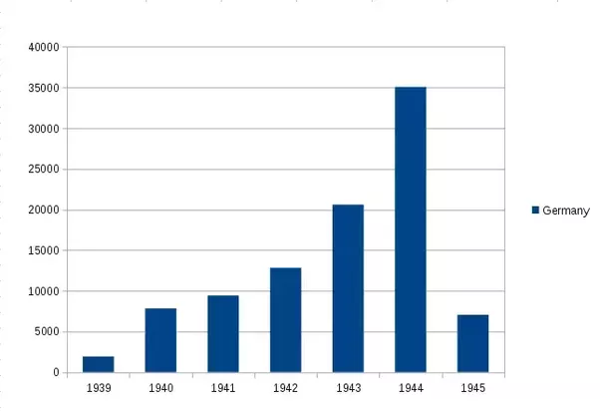
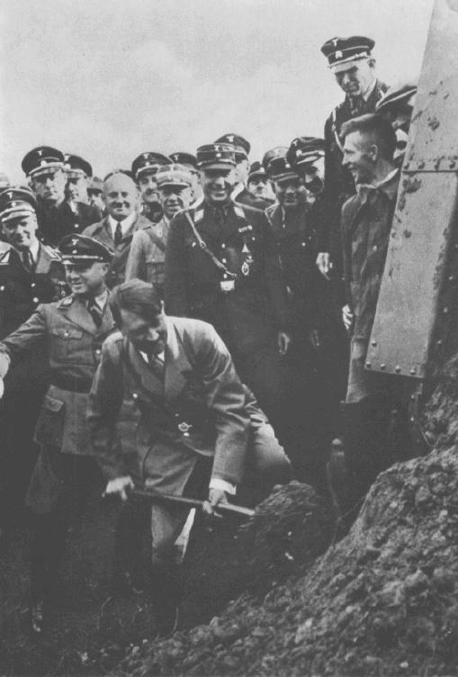
Did the Nazis reduce unemployment?
Reducing high levels of unemployment was important for Hitler. From 1933 he set out schemes to achieve this.
Why Hitler wanted to get people working
The unemployed:
1: were dangerous politically – if they were poor and hungry they might turn to other political parties for help.
2: were believed by the Nazis to be a burden on society and a waste of valuable resources.
National Labour Service (RAD)
This was started by the Weimar government and continued by the Nazis.
From July 1935, it was compulsory for all men aged 18 – 25 to serve for six months on this scheme.
They worked on jobs creation schemes and other public works such as draining marshes.
Many hated RAD: the pay was low, the hours long and the work boring.
Job creation scheme
Rearmament
Another way that the Nazis provided jobs was through building up their stockpile of arms, even though the Treaty of Versailles had stipulated limits on this. This provided many jobs.
The Nazis reduced unemployment by putting money into large projects. These benefitted the economy and also reduced unemployment.
Public buildings
7000km of autobahns (motorways) connecting up the country,
Construction projects
Sports facilities e.g stadia for the Berlin Olympics, 1936.
Hitler making a start on the first autobahn in 1933.
Invisible unemployment
Official government figures showed unemployment was falling but they did not include:
Jews being forced out of jobs
Women being dismissed or leaving their jobs
Unmarried men under 25 doing National Labour Service
Opponents of the regime who were sent to concentration camps
Official figures showed that unemployment had dropped from 4.8 million in 1933 to 0.3 million in 1939 – an amazing achievement. But this did not take into account ‘invisible unemployment’.

Slide 28
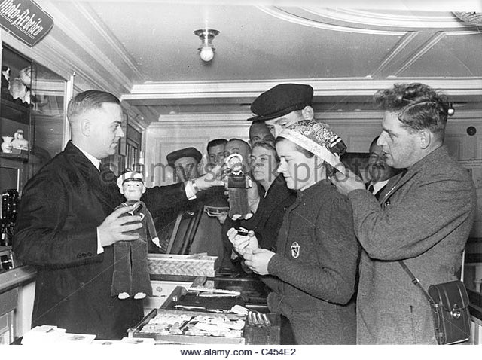
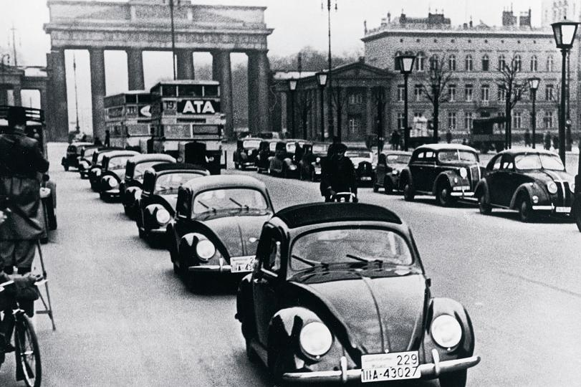
Did the standard of living improve under the Nazi regime?
Nazi economic policies in general, improved the standard of living of the German people, although some sections of society lost out.
Nazi workers’ organisations
Hitler realised that he must make sure that the German workers were satisfied and avoid losing their support. He set up different workers’ organisations that were meant to improve the lives and conditions of German people.
German Labour Front
The Deutsche Arbeitsfront (DAF) replaced trade unions. Workers had to be members. It ran several schemes.
German workers on the first KdF trip to Italy in 1937, buying souvenirs on the ships
Strength Through Joy (KdF)
This aimed to increase productivity by making workers happy. It provided low – cost or free activities (e.g concerts, holidays) for hard workers.
Beauty of Labour (SdA)
This aimed to improve conditions by reducing noise in workplaces, providing canteens and even building swimming pools. However, workers had to construct these in their spare time, so it wasn’t very popular.
The Volkswagen (People’s car)
One of the KdF’s schemes was to promote car ownership. Hitler asked Porsche to design a family car and the VW Beetle was the result. Workers paid 5 marks a week towards buying a car but, by 1939, no-one had paid in enough so the money went towards rearmament.
Parade of KdF Volkswagen Beetles in 1939, a propaganda stunt
Had the standard of living improved by 1939?
Better off | Worse off
More jobs with most men in work | ‘Invisible unemployment’ meant many were still unemployed.
Average wages rose by 20% compared to 1933 | The cost of food rose by an equivalent amount so this cancelled out wage rise.
KdF provided leisure activities and holidays and SdA improved working conditions | With the banning of trade unions, workers had few rights and worked longer hours: 43 hours a week in 1933 up to 49 hours in 1939.
Car ownership increased three - fold | Only high earners could afford cars. Low earners had to spend money on essentials.
Decide whether you think the standard of living of the German people had improved by 1939, write a paragraph backing up your decision.
_________________________________________________________________________________________________________________________________________________________________________________________________________________________________________________________

Slide 29
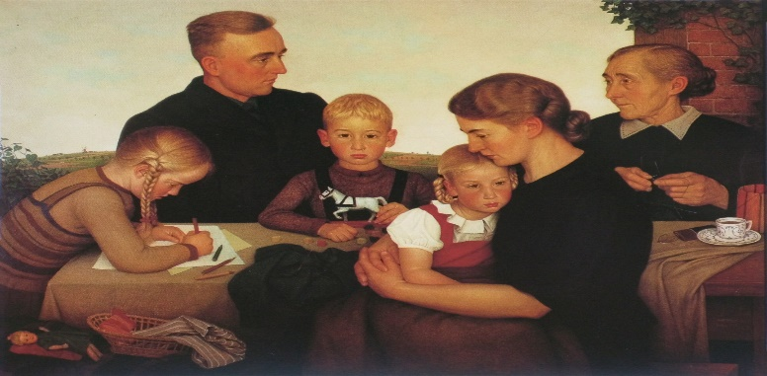
What were Nazi racial beliefs and policies?
Hitler was keen to increase the number of ‘pure’ Germans (Aryans) who were blond haired, blue eyed, tall and athletic, and who would work hard, join the army or have children.
Nazi racial hierarchy
How the race grew
‘Race farms’ were set up when Aryan men and women met to have Aryan children. The SS were central to the Nazi master race, as they only recruited Aryans and were only allowed to marry Aryan women.
Aryans
The ‘master race’
Other white western Europeans
Seen as fellow humans but lower than Aryans
Eastern Europeans
Slavs – seen as ‘sub-human’
Black people and gypsies
Both seen as ‘sub-human’ and ‘work shy’ (lazy).
Jews
Seen as lowest of ‘sub human’ races and blamed for Germany’s problems.
An idealised Aryan family
Untermenschen
Untermenschen meant ‘inferior people’ or ‘sub humans’, and was the terms used by Nazis to describe Slavs, gypsies, black people and Jews.
In 1935, the Nuremberg Laws banned Aryans from marrying gypsies, black people or Jews.
Mixed race children were sterilised
After 1933, many gypsies were arrested and sent to concentration camps. From 1938, all gypsies had to be registered and were banned from travelling. In 1939, they were told they would be deported.
Slavs were reminded continually that they didn’t fit the Aryan ideal, but were persecuted less than other groups.
Other undesirables
The Nazis also believed other group of society were undesirable and should be treated differently.
Homosexuals were sent to prison or concentration camps and subjected to medical experiments to correct their ‘disorder’ after laws against homosexuality were strengthened.
Mentally handicapped people were sterilised after a new law, The Prevention of Hereditarily Diseased Offspring was introduced in 1933.
Mentally and physically handicapped babies were killed.
Vagrants were seen as ‘work shy’ and put in concentration camps.
Describe how the Nazi policies on race became harsher as the 1930s wore on
_____________________________________________________________________________________________________________________________________________________________________________________________________________________________________________________________________________________________________________________________________________________________________________________________________________________________________________________________________________________________________________________________________________________________________________________________________
The treatment of gypsies is a good example to use

Slide 30
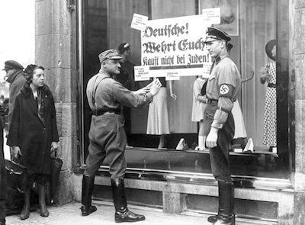
How were the Jewish persecuted against?
The persecution of the Jewish community in Germany escalated throughout this period. It began with an attack on Jewish businesses and the removal of Jewish people from their jobs.
Used as scapegoats for Germany’s problems.
Associated with communism (Karl Marx was Jewish).
Long – standing distrust of Jewish people – a common belief across Europe.
Reasons why most non-Jewish German people let the persecution happen
Reasons why Jews were persecuted
Blamed for Germany’s defeat in First World War and the Treaty of Versailles (especially as some politicians involved were Jewish).
Suspicious of a different religion.
Jealous of their success – many Jews were professionals or owned businesses.
The influence of Nazi anti-Semitic propaganda
The fear of the Gestapo and the SS if they did speak out
Jewish businesses
Professions and other aspects of life
1933 The SA organised a one – day boycott of Jewish shops. They painted a yellow star on doors an discouraged people from going inside.
1933 Jewish actors and musicians were banned from performing. Jewish civil servants and teachers were sacked. Jews were no longer allowed to join the army. Jews were banned from inheriting land. There was an SA one – day boycott of Jewish lawyers and doctors.
1937 Jewish businesses were taken over by Aryans.
1934 Some Jews were banned from public places like park and swimming pools – other councils painted park benches yellow specifically for Jewish people.
1938 Jews had to register their property. Jewish shops were set on fire or vandalised (Kritallnacht).
1939 Jews were barred from owning businesses.
1935 The Nuremberg laws, that placed restrictions on Jewish life were declared.
1936 Jews were banned or restricted from working as vets, accountants, teachers, dentists and nurses.
1937 Jewish passports had to be stamped with a ‘J’. ‘Israel’ or ‘Sarah’ had to be added to Jewish names.
1939 The Reich Office for Jewish Emigration was set up with the purpose of expelling all Jews from Germany.

Slide 31


How did Jewish Persecution continue?
Two events occurred during the time that had a major impact on the lives of Jewish communities in Germany. These were the passing of the Nuremberg Laws and the terrifying events of Kristallnacht.
The Nuremberg Laws, 1935
A new set of laws was passed to make it easier to persecute Jews.
The Reich Law on Citizenship
Only those of German blood can be citizens.
Jews must become subjects, not citizens
Jews cannot vote, have a German passport or work for the government
Jews must wear a yellow star shaped patch sewn on clothes for ease of identification.
The Reich Law for the Protection of German Blood and Honour
No Jew must marry a German citizen.
No Jew is allowed to have sexual relations with a German citizen.
Hitler at the Nuremberg Rally where the Laws were declared
Kristallnacht (the Night of the Broken Glass), 1938
7th November
A 17 year old Polish Jew entered the German embassy in Paris and shot a German
8th November
Goebbels used the event to stir up resentment against Jews by attacking homes and synagogues in Hanover.
9th November
Goebbels and Hitler decided to increase the violence to a nationwide attack
9th – 10th November
Groups of uniformed and non – uniformed gangs ran amok amongst Jewish communities, destroying and burning homes, shops, businesses and synagogues.
Consequences of Kristallnacht
Goebbels blamed the Jews for staring the trouble and ordered them to pay damaged. Jews were fined 1 billion marks.
100 Jews were killed
814 shops were destroyed
171 homes were destroyed
191 synagogues were destroyed

Slide 32

How do I answer question 1?
Question 1 on your exam paper will ask you to ‘infer from source A….’. There are four marks available for this question.
Source A: A poster used during the Berlin Olympics in 1936.
Making inferences from a source
Making inferences is working something out that isn’t directly shown. First of all, think about what is suggested or implied by the source and then try to show how the source helped you make that inference. Include supporting details from the source to back up what you say.
Give two things you can infer from Source A about propaganda in Nazi Germany.
Complete the table below to explain your answer. (4 marks)
Worked example
Sample answer
What I can infer: That Hitler wanted to use the Olympic games to show the world how strong the Nazi regime was.
Details in the source that tell me this: The predominance of the Swastika flag; the strength and fitness of the athlete and the signs of industry in the background.
What I can infer: That the games have been organised by the Nazi regime.
Details in the source that tell me this: The Swastika flags behind the athlete and on the athlete’s vest show that the athlete supports the Nazi regime and is happy to represent it.
You must consider the intended audience and the purpose for which the source was produced. Also, think about when it was produced as this context is vital for analysing the source, not just describing it.
Sometimes, it is helpful to think about when you can see and then move on to think about what it suggests. You need to make sure that you don’t just describe the source but go further and show you can make inferences.

Slide 33

Sources/ Interpretations Booklet for the Sample Paper on the next pages
Source B: From an interview with a member of the Nazi Party, 1936
…for five years I remained unemployed and I was broken both in body and spirit and I learned how stupid were all my dreams in those hard days at university. I was not wanted by Germany … then I was introduced to Hitler. You won’t understand and I cannot explain either because I don’t know what happened, but life for me took on a tremendous new significance .. I committed myself, body, soul and spirit to the movement.
Source C: A poster produced by the Nazi Party in 1932, in which they appeal to women to support Hitler in the best interests of their family.
Interpretation 1: From The History of the Gestapo, by Jacques Delarue, published in 1964.
Never before, in no other land and at no time had an organisation attained such a comprehensive penetration of society, possessed such power and reached such a degree of… terror and horror, as well as … effectiveness. The Gestapo spotted or overheard every German’s slightest movement.
Interpretation 2: From The Nazis: A Warning From History, by Laurence Rees, published in 2001
Like all modern policing systems, the Gestapo was only as good or bad as the cooperation it received – and the files reveal that it received a high level of cooperation. Only around 10% of political crimes committed … were actually discovered by the Gestapo; another 10% were passed on to the Gestapo by the regular police or the Nazi Party. Around 80% was discovered by ordinary citizens who turned the information over… Most of this unpaid cooperation came from people who were not members of the Nazi Party – they were ‘ordinary’ citizens.

Slide 34
How do I answer question 2?
Question 2 on your exam paper will ask you to ‘Explain why…’. There are 12 marks available for this question.
Worked example
Explaining key features and causes
Explaining why involves looking at the key features of something and thinking about its causes. Key features are accurate and relevant knowledge. Causes are what led to a situation or change happening. To explain causes, you must show how a number of causes led to that event or change.
Explain why the Nazis wanted women to focus on home and family life. (12 marks)
You may use the following in your answer.
Marriage loans
Birth rates
You must also use information of your own.
Sample answer
You must use your own knowledge and not limit yourself to the bullet points.
The Nazis wanted women to stay at home and look after a large family so the population would grow.
The Nazis believed that women and men had different roles in society. This meant that women were expected to follow traditional ideas about the importance of caring for children.
Here the student has given the correct cause but only a vague answer, and hasn’t developed an explanation.
This is also a correct cause and the beginning of an explanation: the student needs to add more detail to the explanation to improve this answer.
Improved answer
Make sure you identify what reasons led to the Nazis making women focus on home and family.
The Nazis wanted the population to grow so they tried to limit women to roles within the home and family. After the First World War, Germany’s population had been falling and Hitler was keen to expand Germany so it was vital to make sure women had more children. They were given special medals to reward them for having large families, which included bronze, silver and gold if you had over eight children. There were also financial incentives for women, such as Marriage Loans. The 1933 Law for the Encouragement of Marriage lent couples money when they married, if the wife left work. For each child they had, they were let off a quarter of this loan. These policies show how the Nazi government encouraged women to focus on their family and raising children.
Another important cause was Hitler’s ideas about ‘racial purity’. He was determined to increase the number of Aryan children and reduce the number of non – Aryans and minority groups in Germany. The Nazi policies on women gave encouragement to Aryan mothers, but other minority groups were stopped from having children by being sterilised.
This states the cause and explains why Nazis wanted to restrict women to the home and family.
This student has used their knowledge of the period to support their answer with specific examples.
Using ‘Another important cause was…’ to introduce a new point is a good way of writing a clear answer.
You could also include some information about how the League of German Maidens prepared young women for their future roles.

Slide 35
How do I answer Question 3(a) – Evaluating usefulness?
Question 3(a) on your exam paper will ask you to judge ‘How useful are sources B and C…’ There are 8 marks available for this question.
Worked example
Judging usefulness of sources
To judge the usefulness of a source, you need to think about the enquiry question and the criteria you will use to reach your decision. You will need to consider the provenance of each source – its nature, origin and purpose – and whether these make the source useful or not in addressing the enquiry question.
Study Sources B and C (in the sources at the start of these example answers)
How useful are sources B and C for an enquiry into why people supported the Nazis?
Explain your answer, using Sources B and C and your own knowledge of the historical context. (8 Marks)
Sample answer
He was a member of the Nazi Party and was very keen, ‘I committed myself, body, soul and spirit.’ He knew what it felt like to be part of the organisation and he shows how people could have got swept away in the excitement.
The poster is useful because it shows the Nazis wanted to get support from different groups, like women. They used posters to try to get support for the Nazis in the election in the early 1930s.
This answer lacks analysis and describes rather than judges the usefulness of the sources.
This student has used criteria about origins and audience in judging the usefulness of this source for the enquiry.
Improved answer
The Nazi Party member is recollecting his feelings about joining and supporting the Nazi Party. He describes his circumstances as unemployed, possibly in the early 1930s when unemployment reached a new high in Germany. He is quite defensive about his support for the party and says an outsider would ‘not understand’. His personal experience of the emotions tied up in his membership are useful to understand the emotional appeal that the Nazis drew on to build support, but could also be a limitation as he is clearly concerned about how people in hindsight might view him and his support for the Nazis when he was a young man.
The poster is useful for finding out about why different groups supported the Nazis. It gives us an insight into how the Nazis targeted different groups with specific messages. In this case, women are urged to consider their roles as wives and mothers in order to rally their support. However, the poster in isolation does not help us judge the impact of the poster on the audience, just the messages that the Nazi Party wanted to convey in order to gain support. The women who did vote Nazi were probably swayed by these ideas as the Nazis wanted to make women believe that their role in the home and family was valuable and they wanted them to accept a different gender role to men.
Key Terms
Provenance – the origin of a source
Nature – what type of source it is, such as a propaganda poster or a speech extract.
Purpose – the reason a source was created.
Specific language is used in this answer, such as: insight, judge, impact, convey, promote.
This answer is a good answer because it evaluates the poster for this enquiry by considering its nature and purpose and it highlights issues about the impact on the audience.

Slide 36
How do I answer question 3(b) – identifying and explaining differences?
Question 3(b) on your exam paper will ask you to identify ‘the main difference between the views’ in two interpretations. There are 4 marks available for this question.
Worked example
Spotting and explaining differences in interpretations
An interpretation is a historian’s account or explanation based on evidence. When analysing the differences between interpretations, think about the points of view the historians present. Look for the important or key differences, not just the surface details. For this question you need to look for a fundamental difference that you can spot.
Study Interpretations 1 and 2 in the source booklet before these questions. They give different views about the German public’s support for the Nazis.
What is the main difference between the views?
Explain your answer, using details from both interpretations. (4 marks)
Remember to include points from both sources. It’s important to refer directly to the interpretation and include short quotations to support what you say.
Sample answer
This answer focuses on a surface point of difference rather than the underlying difference. A stronger answer would pick out a more fundamental difference.
These interpretations are difference because the first one says that the Gestapo heard everything, whereas the second historian says that some crimes were reported to the regular police, not the actual Gestapo.
Improved answer
Delarue argues that the Gestapo achieved ‘comprehensive penetration’ of German society. Therefore, the attitudes of the German public were fully controlled by the Gestapo. He claims the use of ‘terror and horror’ was successful in making sure that the public believed the Gestapo was all knowing and ‘overheard’ activities or even the smallest action. On the other hand, Rees states that the Gestapo’s work in controlling people’s attitudes was based more on a public willingness to cooperate with them, rather than due to terror. He backs this up by saying that 80% of political crimes investigated by the Gestapo were as a result of ‘ordinary citizens’, rather than Nazi Party members denouncing people and reporting their ‘suspicions’ to the Gestapo.
This student uses short quotations to support the analysis.
The focus of this answer is on the key point of difference, rather than more minor differences.
Here, a key difference is explained and supported with detailed points from both interpretations.
You must think about the specific language you can use in your answer, like: ‘argues’, ‘claims’, ‘states’, ‘on the other hand’ and ‘back this up’. These phrases help you produce a better answer because they help show you are analysing another person’s judgement or opinion about something.

Slide 37
How do I answer question 3 (c) – Suggesting reasons for different views?
Question 3(c) on your exam paper will ask you to explain why two interpretations give different views. There are 4 marks available for this question.
Worked example
‘Suggest’ questions
In a question that asks you to suggest a reason, you need to offer and explain an idea about why there are differences. You need to show you understand that historical interpretations are judgements and opinions based on evidence and that, as a result, different views can exist.
Suggest one reason why Interpretations 1 and 2 in the source booklet before the questions give different views about German public support for the Nazis. (4 marks)
You may use sources B and C to help explain your answer.
You must give one reason why historians reach different conclusions about historical questions.
Sample answer
In this answer, the student explains the different views in the interpretations by looking at the different focuses the historians have chosen.
One reason why Interpretations 1 and 2 give different views about German public support for the Nazis is that the historians have different focuses.
Delarue wrote his argument in the early 1960s. At that time the idea that the Nazis secured support through the use of terror and totalitarian control was popular among historians. The war had only finished 15 years earlier and historians often explained the behaviour of the German public in terms of the level of control and fear that was spread in Germany by the regime. Delarue’s specific focus for his research was on the ‘history of the Gestapo’. Therefore, his concern was to explain the role of the Gestapo and terror organisations in Germany, rather than ask wider questions about the support and cooperation from the German people that the Nazis were able to secure for a range of other reasons. In contrast, Rees chose to examine how the German public gave their support to the Nazi regime. His focus was different as, by 2001, he was able to ask different questions about support that may not have been possible by the 1960s, when Delarue was writing. The idea that the German people may have been attracted to Nazi ideas and values for reasons other than fear and terror is supported by Source B. This source shows how long-term unemployment and the disillusionment this created were also possible reasons for Nazi support.
In explaining the differences between the interpretations, the student takes into account the context of when each one was written.
The student has used Source B to back up their argument about why the Interpretations differ. Source B supports the idea that Germans were attracted to the regime for different reasons and that it wasn’t all due to fear and the use of terror.
The explanation in this answer is clear and refers to both interpretations.

Slide 38
How do I answer question 3(d) – evaluating interpretations?
Question 3(d) on your exam paper will ask you to evaluate an interpretation by explaining how far you agree with it. There are 16 marks available for this question. An additional 4 marks are available for good spelling, punctuation, grammar and use of historical terminology. This question in total offers 20 marks, nearly half of your whole paper, you must make sure that you allow enough time for this question!!!
Worked example
How far do you agree?
You must:
Explore different views on the debate
Reach a clear judgement yourself
Give detailed knowledge of the context and wider issues
Use both interpretations, not just the one stated in the question
Explain your answer, develop and give reasons.
How far do you agree with interpretation 2 about German public support for the Nazis.
Explain your answer using both interpretations and your knowledge of the historical context. (16+4 SPaG marks)
Sample extract
I don’t agree with the interpretation that there was a lot of support for the Nazis from ordinary Germans. They had to rely on concentration camps to get rid of opposition. They used terror and propaganda to control people. The public didn’t really support the Nazis fully because there was opposition like the Edelweiss Pirates, so not everyone thought they should help them.
A clear view is given in this answer with a supporting reason
A point is made by the student but there is no supporting evidence.
Improved extract
The student attempts to develop a line of argument but it is not well chosen because the Edelweiss Pirates were a small group and not typical in Germany as a whole.
I agree with Rees that the Gestapo was only partially effective. However, on his second claim, that there was a high level of cooperation from the German public, I agree only to some extent.
While I accept that the perception of the Gestapo as all-knowing and all-seeing was part of the carefully constructed image of the Nazi state, cooperation with the Gestapo could itself be evidence that the public were fearful of not appearing to support the regime and felt coerced to ‘name names’.
Active participation in the regime was demanded from the Nazi state and Nazi organisations were compulsory in all aspects of life, from the DAF, for workers, to the Hitler Youth, for young men. The process of Nazi coordination of society left little room for individual thought or freedoms. In this context, the fact that any non conformity, like listening to American Jazz or befriending a Jewish neighbour, is evidence that Nazi support was not total and complete in the way Hitler wanted.
Highlighting key points in the interpretation can help you focus on the precise arguments that you need to evaluate to make your judgement.
This answer engages directly with Rees’ claims in Interpretation 2, and evaluates different points he makes while putting his arguments in the wider context.
Remember that for this question an additional 4 marks are available for good spelling, grammar and use of historical terminology. Use specific historical vocabulary, such as perception, coerced, Gestapo, compulsory, DAF.

Slide 39
Practice
Put your skills and knowledge into practice with the following questions.
Section A
Answer Questions 1 and 2
You have 1 hour 20 minutes for the whole of Paper 3, so you should use the time carefully to answer all the questions fully. Remember to leave 5 minutes or so to check your work when you’ve finished writing.
Source A: From a 1932 Nazi party election flyer written to directly appeal to those supporting the Communist Party at the election.
We Nazis help each other.
He who has something to eat shares it with him and who has nothing.
He who has a spare bed gives it to someone who has none. That is why we have become so strong. The election shows what we can do. Everyone helps! Everyone sacrifices! The unemployed give up their wedding rings. Everyone gives, even if it is but a penny. Many small gifts become a large one.
Give two things you can infer from Source A about Hitler’s election tactics in Germany in the early 1930s.
Complete the table below to explain your answer (4 marks)
To ‘infer’ is to make a claim based on evidence, in this case, the source you are given in the exam.
i) What I can infer: The Nazis used flyers to build support in the 1932 election ________________________________________________________________________________________________________________________________________________
Details in the source that tell me this: ________________________________________________________________________________________________________________________________________________________________________________________________
ii) What I can infer: ________________________________________________________________________________________________________________________________________________________________________________________________
Details in the source that tell me this: ________________________________________________________________________________________________________________________________________________________________________________________________
Spend 5 minutes on this answer. You need to identify two valid inferences from the sources.
An example of a suitable inference might be that ‘The Nazis were specifically targeting certain groups like the Communists who they saw as a group of voters they needed to win over to their ideas. I know this from the source because….’
You need to give supporting details selected from the source to back up both your inferences.

Slide 40

Sources and Interpretation Booklet for your questions
Source B: from the Twenty – Five Programme, originally produced by the DAP in February 1920.
We demand the union of all Germans in a Greater Germany.
We demand equality of rights for the German people in its dealings with other nations.
We demand land and colonies to feed our people and settle our surplus population.
Only those of German blood …. Are members of the nation. No Jew may be a member of the nation.
We demand that the State’s primary duty must be to promote work and the livelihood of its citizens.
All citizens shall have equal rights and equal duties.
We demand… a law to take from the owners land any needed for the common good of the people.
We demand… the creation of a people’s army.
We demand the creation of a strong and central state power for the Reich.
Source C: A NSDAP campaign poster from 1924. It emphasises Nazi principles of family, work and nationalism.

Slide 41
Interpretation 1: From The Hitler Myth, by Ian Kershaw, published in History Today Volume 35, Issue 11, November 1985.
Before 1930, the … Fuhrer cult around Hitler found an echo among at most a few hundred thousand followers. But with the Nazi Party’s breakthrough in the 1930 election (which brought it 18.3 percent of the vote), the Fuhrer cult ceased to be merely the property of a fanatical fringe party. The potential was there for its massive extension, as more and more Germans saw in Nazism – symbolised by its leader – the only hope for a way out of the gathering crisis. Those now surging to join the Nazi Party were often already willing victims of the ‘Hitler Myth’. Not untypical was the new party member who wrote that after hearing Hitler speak for the first time, ‘there was only one thing for me, either to win with Adolf Hitler or to die for him. The personality of the Fuhrer had me totally in its spell.’ Even for the vast majority of the German people who did not share such sentiments, there was the growing feeling – encouraged by Hitler’s profile even in the non – Nazi press – that Hitler was not just another politician, that he was a party leader extraordinary, a man towards whom one could not remain neutral.
Interpretation 2: From The Coming of the Third Reich, by Richard J Evans, published in 2004.
Nazi propaganda …. Skilfully targeted specific groups in the German electorate … providing topics for particular venues and picking the speaker to fit the occasion. The … Party recognised the growing divisions of German society into competing interest groups in the course of the depression and tailored their message to their particular constituency. The Nazis adapted… a whole range of posters and leaflets designed to win over different parts of the electorate.

Slide 42
You have 1 hour 20 minutes for the whole of Paper 3, so spend about 15 minutes on this answer.
2: Explain why the Nazis attempted the Munich Putsch in 1923.
You may use the following in your answer:
Invasion of the Ruhr (1923)
Hitler’s leadership of the Nazi Party
You must also use information of your own. (12 marks)
There are a number of causes behind the Nazis attempt to seize power in 1923. _______________________________________________________________________________________________________________________________________________________________________________________________________________________________________________________________________________________________________________________________________________________________________________________________________________________________________________________________________________________________________________________________________________________________________________________________________________________________________________________________________________________________________________________________________________________________________________________________________________________________________________________________________________________________________________________________________________________________________________________________________________________________________________________________________________________________________________________________________________________________________________________________________________________________________________________________________________________________________________________________________________________________________________________________________________________________________________________________________________________________________________________________________________________________________________________________________________________________________________________________________________________________________________________________________________________________________________________________________________________________________________________________________________________
‘Explain’ means you have to give causes of the Munich Putsch, not just describe what happened.
You need to include information of your own that is not in the bullet point hints.
Marks are awarded for your analysis and understanding of causation and for your knowledge and understanding of the topic.
Useful phrases when answering causation questions include: because, led to, resulted in, propagated, factors that caused.
Keep your explanations focused on the question. Although you might remember lots of detail about the Munich Putsch, you need to focus on providing reasons why the Nazis attempted the Putsch, not on giving a description of it.

Slide 43
___________________________________________________________________________________________________________________________________________________________________________________________________________________________________________________________________________________________________________________________________________________________________________________________________________________________________________________________________________________________________________________________________________________________________________________________________________________________________________________________________________________________________________________________________________________________________________________________________________________________________________________________________________________________________________________________________________________________________________________________________________________________________________________________________________________________________________________________________________________________________________________________________________________________________________________________________________________________________________________________________________________________________________________________________________________________________________________________________________________________________________________________________________________________________________________________________________________________________________________________________________________________________________________________________________________________________________________________________________________________________________________________________________________________________________________________________________________________________________________________________________________________________________________________________________________________________________________________________________________________________________________________________________________________________________________________________________________________________________________________________________________________________________________________________________________________________________________________________________________________________________________________________________________________________________
You need to show good knowledge of the key features and characteristics of the event and analyse causation. You also need to show how factors combined to bring about an outcome – in this case, how different factors came to together, resulting in the Putsch.

Slide 44
___________________________________________________________________________________________________________________________________________________________________________________________________________________________________________________________________________________________________________________________________________________________________________________________________________________________________________________________________________________________________________________________________________________________________________________________________________________________________________________________________________________________________________________________________________________________________________________________________________________________________________________________________________________________________________________________________________________________________________________________________________________________________________________________________________________________________________________________________________________________________________________________________________________________________________________________________________________________________________________________________________________________________________________________________________________________________________________________________________________________________________________________________________________________________________________________________________________________________________________________________________________________________________________________________________________________________________________________________________________________________________________________________________________________________________________________________________________________________________________________________________________________________________________________________________________________________________________________________________________________________________________________________________________________________________________________________________________________________________________________________________________________________________________________________________________________________________________________________________________________________________________________________________________________________________
You must include a conclusion to sum up how the different causes led to this event. If you think that one reason was more important than the others, this is where you state and explain this.
The best L8/9 answers will consider how some causes link together and lead into each other, rather than each being separate acts and events.

Slide 45
Section B
3(a) Study Source B and C in the sources booklet.
How useful are Sources B and C for an enquiry into the ideas and tactics of the Nazi Party up to 1930?
Explain your answer, using Sources B and C and your knowledge of the historical context. (8 marks)
Both sources B and C are useful for finding out about Nazi ideas and tactics in the 1920s.
_____________________________________________________________________________________________________________________________________________________________________________________________________________________________________________________________________________________________________________________________________________________________________________________________________________________________________________________________________________________________________________________________________________________________________________________________________________________________________________________________________________________________________________________________________________________________________________________________________________________________________________________________________________________________________________________________________________________________________________________________________________________________________________________________________________________________________________________________________________________________________________________________________________________________________________________________________________________________________________________________________________________________________________________________________________________________________________________________________________________________________________________________________________________________________________________________________________________________________________________________________________________________________________________________________________________________________________________________________________________________________________________________________________________________________________________________________________________________________________________________________
You should spend about 10 minutes on this answer.
How useful means you have to judge what the sources suggest about the enquiry question and what the limits or problems could be.
You need to identify and comment on the pros and cons of each source and make a judgement.
Make sure you include some knowledge of the context and don’t just rely on information given in the sources.

Slide 46
However, there are some drawbacks with both sources for this enquiry. These include
_____________________________________________________________________________________________________________________________________________________________________________________________________________________________________________________________________________________________________________________________________________________________________________________________________________________________________________________________________________________________________________________________________________________________________________________________________________________________________________________________________________________________________________________________________________________________________________________________________________________________________________________________________________________________________________________________________________________________________________________________________________________________________________________________________________________________________________________________________________________________________________________________________________________________________________________________________________________________________________________________________________________________________________________________________________________________________________________________________________________________________________________________________________________________________________________________________________________________________________________________________________________________________________________________________________________________________________________________________________________________________________________________________________________________________________________________________________________________________________________________________________________________________________________________________________________________________________________________________________________________________________________________________________________________________________________________________________________________________________________________________________________________________________________________________________________________________________________________
Remember you need to evaluate the usefulness of both sources.

Slide 47
3(b) Study Interpretations 1 and 2 in the sources booklet. They give different views about Nazi tactics and support up to 1930. What is the main difference between these views?
Explain your answer, using details from both interpretations. (4 marks)
Interpretations 1 and 2 both discuss Hitler’s tactics and support in the 1920s but offer different views.
_____________________________________________________________________________________________________________________________________________________________________________________________________________________________________________________________________________________________________________________________________________________________________________________________________________________________________________________________________________________________________________________________________________________________________________________________________________________________________________________________________________________________________________________________________________________________________________________________________________________________________________________________________________________________________________________________________________________________________________________________________________________________________________________________________________________________________________________________________________________________________________________________________________________________________________________________________________________________________________________________________________________________________________________________________________________________________________________________________________________________________________________________________________________________________________________________________________________________________________________________________________________________________________________________________________________________________________________________________________________________________________________________________________________________________________________________________________________________________________________________________
You should spend about 7 minutes on this answer.
You need to identify the key difference, rather than just surface differences.
Make sure you refer to both interpretations.
Remember, historians’ interpretations are their views and opinions about causes, events and significance.
Remember to focus on the underlying difference.

Slide 48
3(c) Suggest one reason why Interpretations 1 and 2 give different views about the Nazi tactics and support up to 1930.
You may use sources B and C to help explain your answer. (4 marks)
Interpretations 1 and 2 offer different views about Nazi tactics and support because
_____________________________________________________________________________________________________________________________________________________________________________________________________________________________________________________________________________________________________________________________________________________________________________________________________________________________________________________________________________________________________________________________________________________________________________________________________________________________________________________________________________________________________________________________________________________________________________________________________________________________________________________________________________________________________________________________________________________________________________________________________________________________________________________________________________________________________________________________________________________________________________________________________________________________________________________________________________________________________________________________________________________________________________________________________________________________________________________________________________________________________________________________________________________________________________________________________________________________________________________________________________________________________________________________________________________________________________________________________________________________________________________________________________________________________________________________________________________________________________________________________
You should spend about 7 minutes on this answer.
You need to explain one reason why the interpretations differ
Make sure you refer to both interpretations to back up your answer.
Remember, historians’ interpretations are their views and opinions about causes, events and significance.
Remember to explain either the historians’ focus, emphasis or the different weight they give to the sources.

Slide 49
3(d) How far do you agree with Interpretation 1 about Hitler’s tactics and support up to 1930?
Explain your answer, using both interpretations and your knowledge of the historical context. (20 marks)
I ___________________ with the views in interpretation 1 ______
__________________________________________________________________________________________________________________________________________________________________________________________________________________________________________________________________________________________________________________________________________________________________________________________________________________________________________________________________________________________________________________________________________________________________________________________________________________________________________________________________________________________________________________________________________________________________________________________________________________________________________________________________________________________________________________________________________________________________________________________________________________________________________________________________________________________________________________________________________________________________________________________________________________________________________________________________________________________________________________________________________________________________________________________________________________________________________________________________________________________________________________________________________________________________________________________________________________________________________________________________________________________________________________________________________________________________________________________________________________________________________________________________________________________________________________________________________________________________________________________________________________________________________________________________________________________________________________________________________________________________________
You should spend about 30 minutes on this answer.
You need to provide a clear line of argument. Say whether you agree or disagree in the first sentence.
Say why you think the interpretation is valid or questionable.
Remember that 4 marks are for SPaG in this question. Make sure you leave time to check your spelling, punctuation and grammar.

Slide 50
___________________________________________________________________________________________________________________________________________________________________________________________________________________________________________________________________________________________________________________________________________________________________________________________________________________________________________________________________________________________________________________________________________________________________________________________________________________________________________________________________________________________________________________________________________________________________________________________________________________________________________________________________________________________________________________________________________________________________________________________________________________________________________________________________________________________________________________________________________________________________________________________________________________________________________________________________________________________________________________________________________________________________________________________________________________________________________________________________________________________________________________________________________________________________________________________________________________________________________________________________________________________________________________________________________________________________________________________________________________________________________________________________________________________________________________________________________________________________________________________________________________________________________________________________________________________________________________________________________________________________________________________________________________________________________________________________________________________________________________________________________________________________________________________________________________________________________________________________________________________________________________________________________________________________________
Remember, historians’ interpretations offer their views for you to challenge.
Make sure you refer to both the interpretations to back up your answer.
Include a number of reasons for your opinion to build an argument throughout

Slide 51
________________________________________________________________________________________________________________________________________________________________________________________________________________________________________________________________________________________________________________________________________________________________________________________________________________________________________________________________________________________________________________________________________________________________________________________________________________________________________________________________________________________________________________________________________________________________________________________________________________________________________________________________________________________________________________________________________________________________________________________________________________________________________________________________________________________________________________________________________________________________________________________________________________________________________________________________________________________________________________________________________________________________________________________________________________________________________________________________________________________________________________________________________________________________________________________________________________________________________________________________________________________________________________________________________________________________________________________________________________________________________________________________________________________________________________________________________________________________________________________________________________________________________________________________________________________________________________________________________________________________________________________________________________________________________________________________________________________________________________________________________________________________________________________________________________________________________________________________________________________________________________________________________________________________________________________________________________________________________________________________________________________________________________________________________________________________________________________________________________________________________________________________________________________________________________________________________________________________________________________________________________________________________________________________________________________________________________________________________________________________________________________________________________________________________________________________________________________________________________________________________________________________________________________________________________________________________________________________________________________________________________________________________________________________________________________________________________________________________________________________

Slide 52
___________________________________________________________________________________________________________________________________________________________________________________________________________________________________________________________________________________________________________________________________________________________________________________________________________________________________________________________________________________________________________________________________________________________________________________________________________________________________________________________________________________________________________________________________________________________________________________________________________________________________________________________________________________________________________________________________________________________________________________________________________________________________________________________________________________________________________________________________________________________________________________________________________________________________________________________________________________________________________________________________________________________________________________________________________________________________________________________________________________________________________________________________________________________________________________________________________________________________________________________________________________________________________________________________________________________________________________________________________________________________________________________________________________________________________________________________________________________________________________________________________________________________________________________________________________________________________________________________________________________________________________________________________________________________________________________________________________________________________________________________________________________________________________________________________________________________________________________________________________________________________________________________________________________________________
Include a brief conclusion to sum up your argument

