Slide 1

Welcome to GCSEPod

Slide 2



The Power of Pod
We have invested in an award-winning digital content and learning provider, called GCSEPod.
Pod Credentials:
Supporting students at KS4 for over 10 years
Used in over 1,300 schools worldwide
Recommended by the Association of School and College Leaders
Winner of multiple educational technology awards:
Geoff Barton, General Secretary
Association of School & College Leaders

Slide 3



GCSEPod helps your child to:
Accelerate progress
and raise results.
Consolidate subject knowledge
and improve recall.
Improve engagement and encourage independent learning.

Slide 4
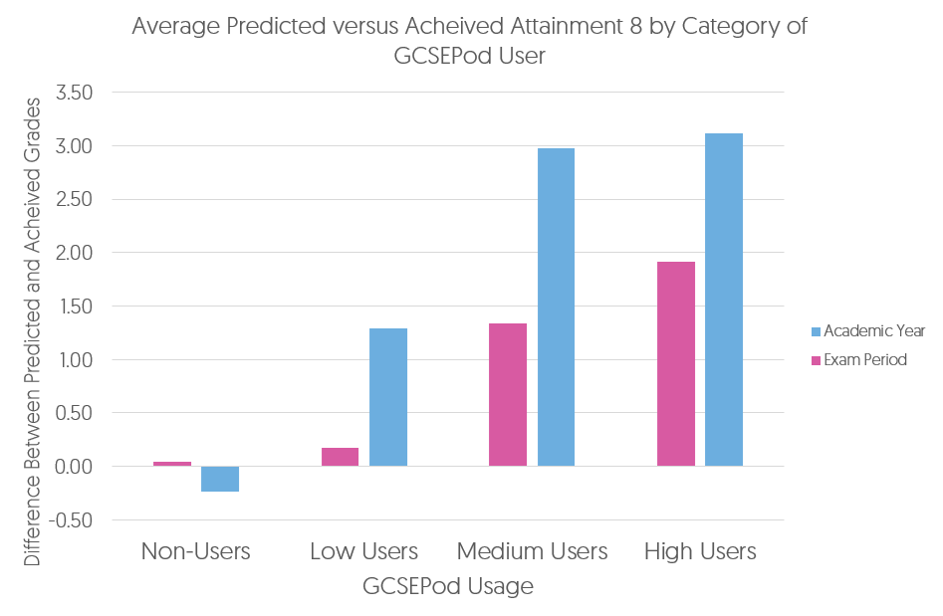
When used effectively, GCSEPod can have a BIG impact on final grades
Data from over 2,200 students shows that higher GCSEPod users are more likely to exceed their predicted grades by a larger margin than those who don’t use GCSEPod.
High academic year usage yielded a greater impact than high usage in just the exam period.
On average, highest users received 3 grades higher across their subjects than predicted.
High Users = average 122 Pods watched in academic year
Medium = average 34 Pods watched in academic year
Low = average 6 Pods watched in academic year
Non Users = 0 Pods watched in academic year

Slide 5
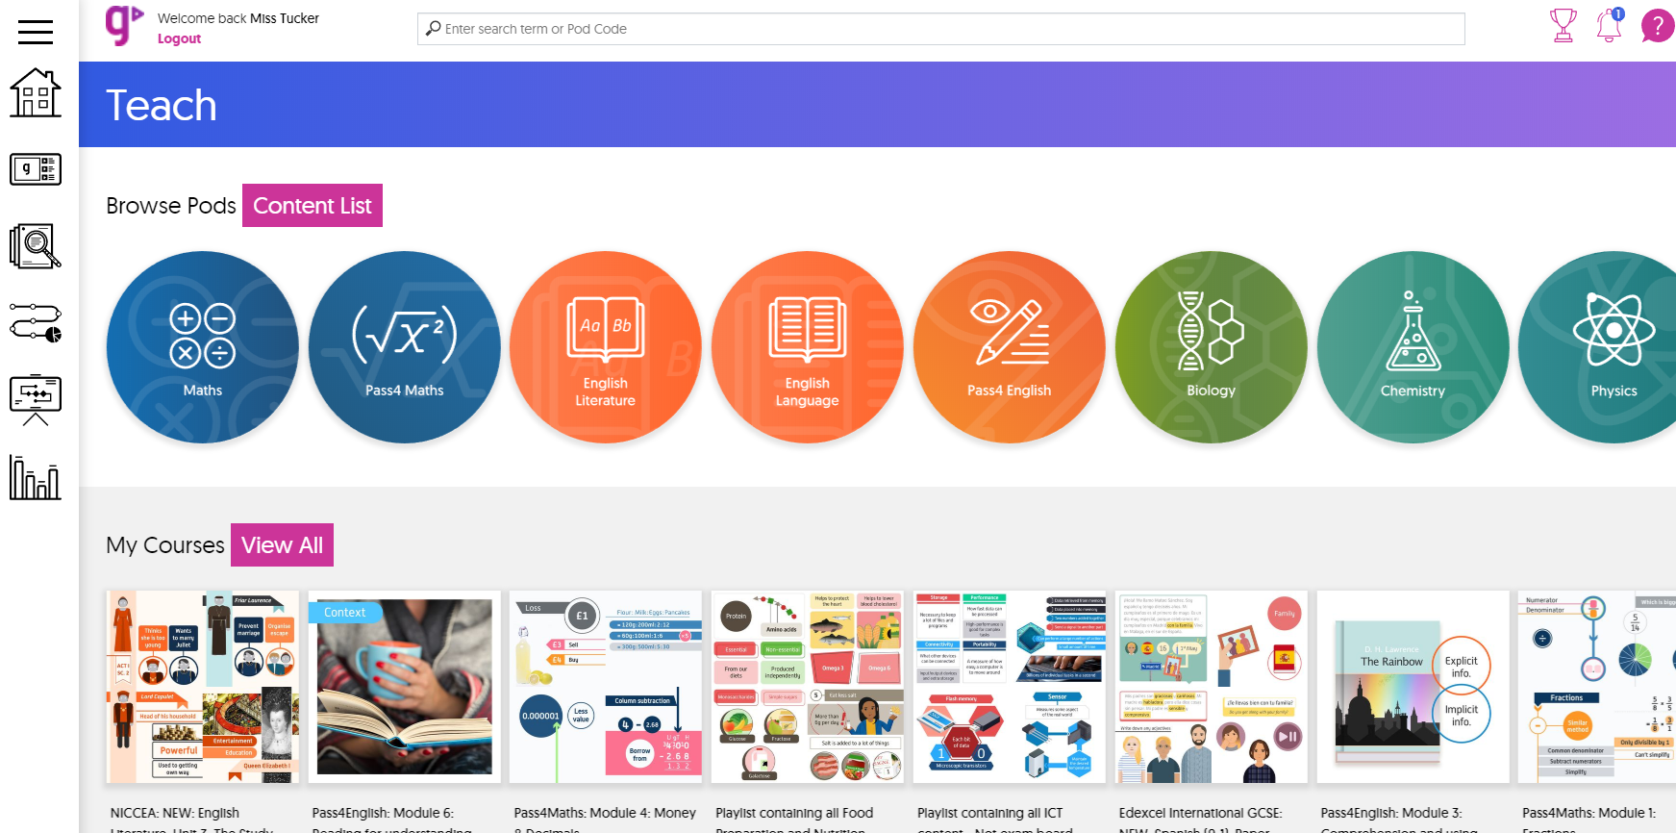
What’s included?
Independent learning and revision materials:
  27 GCSE subjects.
  Exam board specific playlists.
  Available on computer, phone or tablet.
  Apps available for Android and Apple.

Slide 6

What’s included?
Independent learning and revision materials:
  Each topic contains a playlist of 3-5 minute videos called “Pods.”
  Pods contain all key words, facts, quotes and labelled diagrams for full understanding.
  Can be watched online or downloaded for offline viewing (like BBC iPlayer).
  Students can organise Pods into playlists and favourite Pods to return to (like YouTube or Spotify).

Slide 7

Let’s watch an example Pod
https://www.gcsepod.com/our-pods/

Slide 8

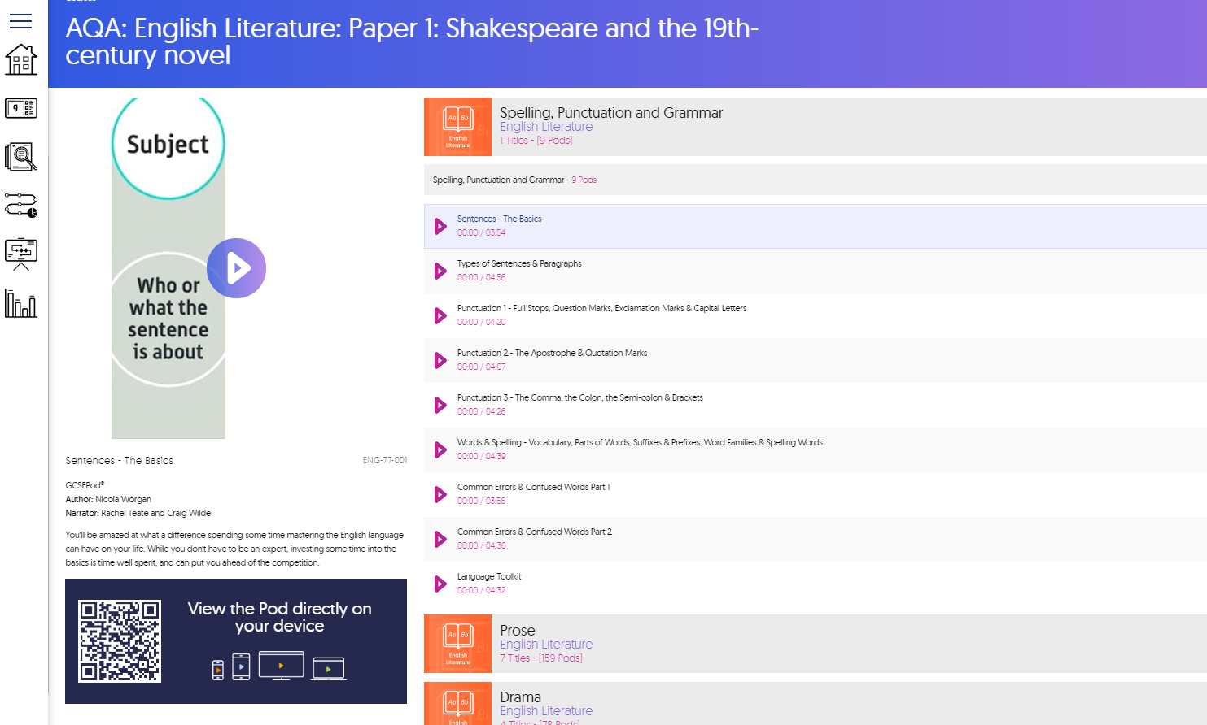
What’s included?
Exam specific revision:
  Each upcoming exam has a corresponding playlist.
  Exam playlists contain all the Pods relevant to that specific paper.
  An exam timetable includes the exam dates.

Slide 9
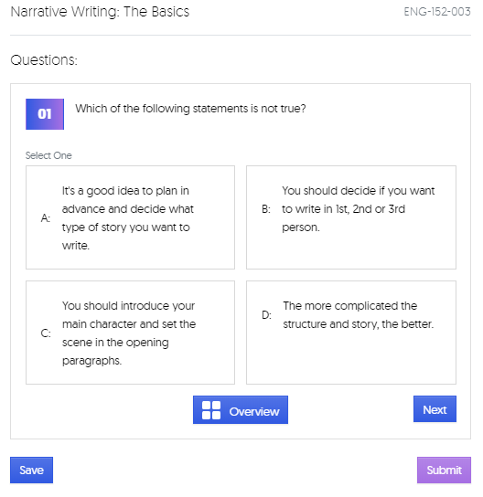
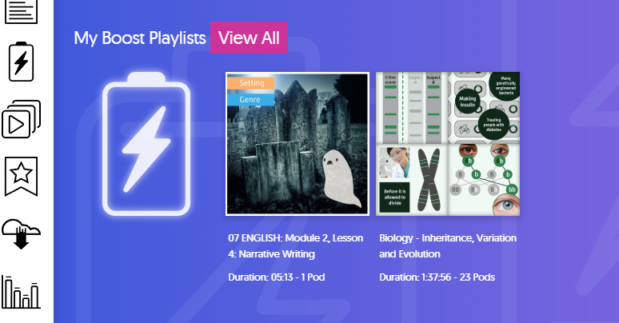
What’s included?
Assessment and homework:
  Assessment and homework can be set on GCSEPod.
  Assignments can be completed on any device and students receive instant results (unless free text questions are included).
  If students do not achieve 100% in an assignment, a BOOST PLAYLIST will be automatically generated containing videos to help fill the identified knowledge gaps.

Slide 10
How to ensure your child benefits from GCSEPod…

Slide 11

Anywhere, Anytime
To the shops
My son found the GCSEPods very handy as he could listen to the videos on the school bus in the morning.
He did really well in his GCSEs so we both appreciate your resources very much.
Parent
At school
On holiday
In the car
At home
On the paper round
Travelling to and from school
At the gym

Slide 12
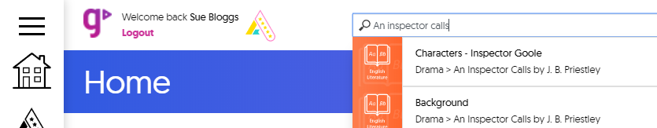
Maximise learning time at home
  If your child is stuck on homework, search for the relevant GCSEPod video using the search and watch the Pod together:
  Encourage your child to watch a Pod video rather than Googling the answer to a question.
  Listen to Pods together and test each other on what you have learned.
  Use the Pods to brush up on your own knowledge before helping with homework.
Over 31 million Pods have been watched on GCSEPod.
68% have been watched out of school hours.

Slide 13

Tips for using GCSEPod with your child
Watch online or offline! Download Pods to a mobile device before travelling. This way you can make normally wasted time into productive learning time.
Create Playlists! Use the My Playlist area to create bespoke playlists on topics that they may find challenging. This gives fast access to Pods that will help to fill in knowledge gaps.
Use memory cards! Watch the Pods and then together write key facts, dates, diagrams and quotes. Then test their knowledge to see how much they remember.
Top Tip* Turn it into a competition and reward your child for correctly answered questions.

Slide 14

If you were to purchase GCSEPod privately, it would cost £200 per year.
Ensure your child makes the most of their free access through the school.

Slide 15
The advantages of using GCSEPod…

Slide 16

How GCSEPod can help your child
Make learning and revision much more manageable.
Enhance subject knowledge recall.
It allows you to get involved with your child’s progress.
Improve your child’s confidence and motivation.
Pre-made exam playlists help to organise revision.
Takes the stress out of learning.

Slide 17
GCSEPod helped my daughter enormously with her GCSE revision. The Pods were clear and easy to understand and she could write notes while they were on.
I remember helping her revise and any concept she didn’t understand she’d say ‘don’t worry, I’ll watch that on GCSEPod’.
Next time I tested her on the topic she would have a full understanding. It was a great help in her achieving her excellent GCSE results.
Parent

Slide 18

Evie had an amazing set of results, mainly 8s and 7s! I think GCSEPod is really helpful - especially for her science subjects (she did combined science) and got 8, 7 - brilliant!
Parent
Wow! Emma actually asked if GCSEPod counted as revision as she can't believe it! I can't believe it either! How fantastic to have a resource that meet students on their level, I am blown away! She actually does not feel as though she is doing revision!
Parent

Slide 19


Retrieval Practice
Practice bringing information from memory for better results.
“Retrieval Practice” is a learning strategy where we focus on getting information OUT. Through the act of retrieval, or calling information to mind, our memory for that information is strengthened and forgetting is less likely to occur.

Slide 20
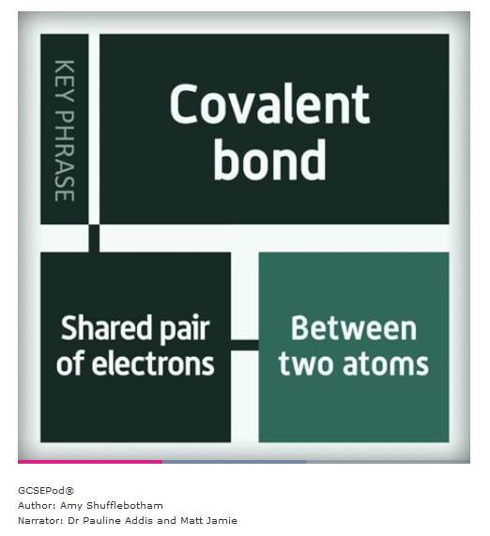

Retrieval Practice
Practice bringing information from memory for better results.
At-home activities using Retrieval Practice
Watch a Pod with your child.
Ask your child to write key words on a flash card.
Watch the Pod again – your child should summarise their knowledge of each key word on the back of each flash card.
Allow your child time to flesh out their cards with as much information as they can remember.
Test your child by asking them to define the flash card words without looking.
Covalent bond

Slide 21
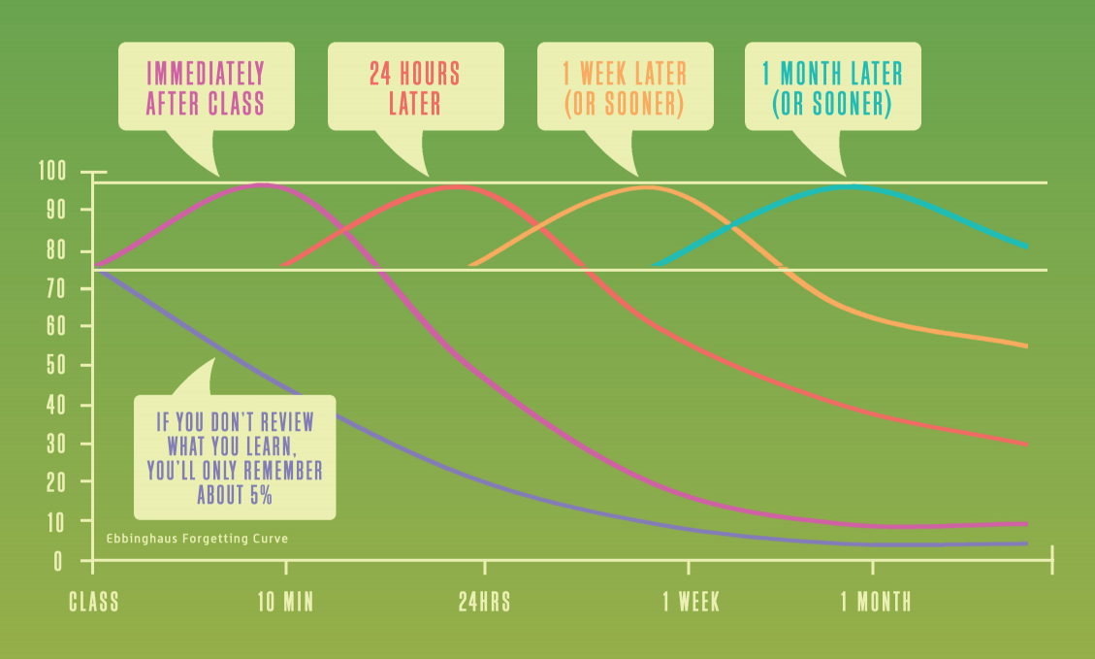
Spaced Practice
Practice bringing information from memory for better results.
It has been proven that by reviewing at regular intervals, you can reduce how much you forget to just 10%.

Slide 22
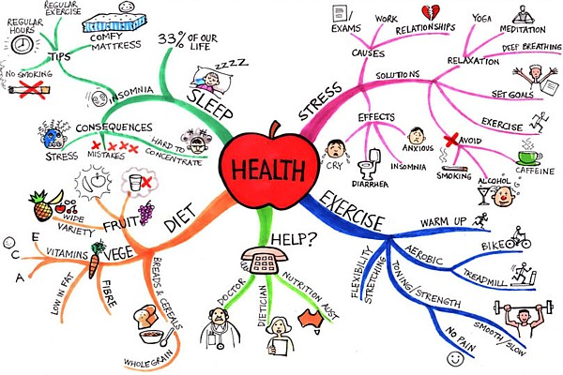
Spaced Practice
Revise, rest, repeat…….space out revision for better results
Reviewing 4 times within a month can help you remember nearly 100%
Immediately After Class
4 Hours Later
Mind Mapping
Encourage your child to watch a Pod and write down all the key words. Then, from memory, ask them to fill in as much information as they remember on a mind map.
Review Maps
Cover your child’s mind map and see how much they remember. Highlight the information they couldn’t remember and recommend revising the topic again.

Slide 23
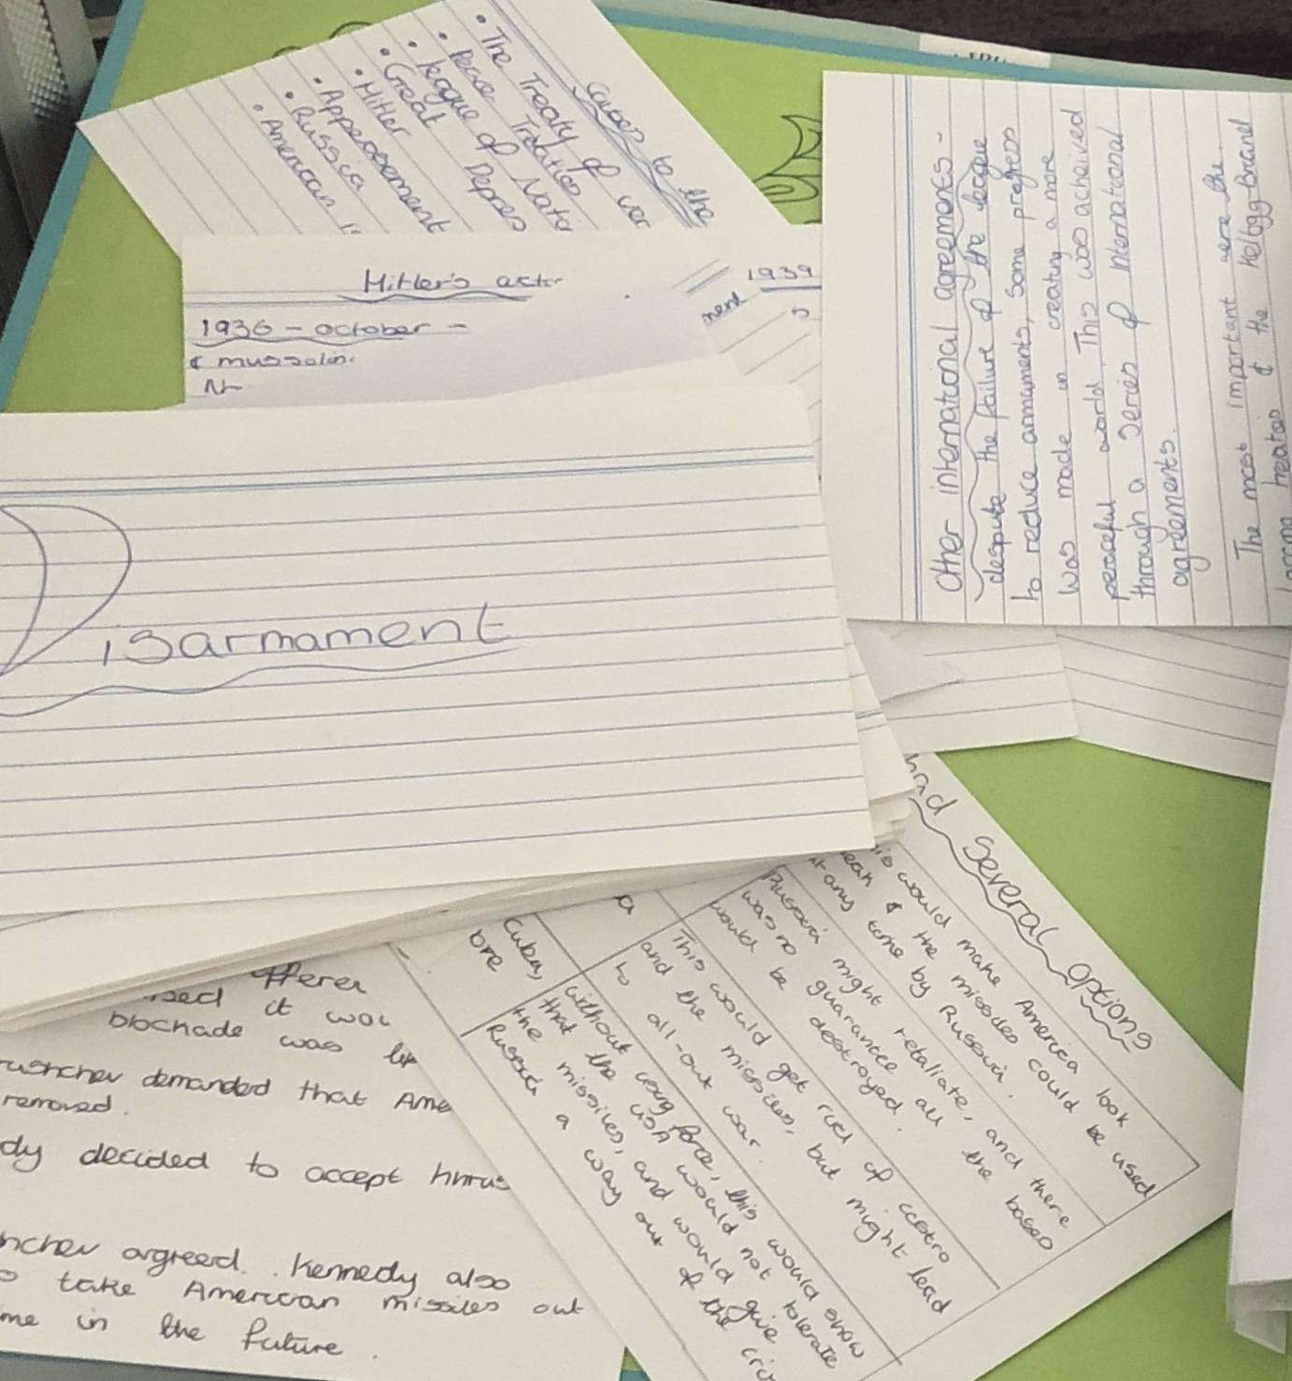

Spaced Practice
Revise, rest, repeat…….space out revision for better results
Reviewing 4 times within a month can help you remember nearly 100%
1 Week Later
1 Month Later
Memory Cards
Encourage your child to create their own questions with the answers on the reverse. Then, test their knowledge.
Past Papers
Encourage your child to watch GCSEPod’s Pods again and then practice past papers.

Slide 24

Dual Coding
The Science behind why students get better results with the help of GCSEPod.
Combine both words and visuals for quicker and stronger recall

Slide 25

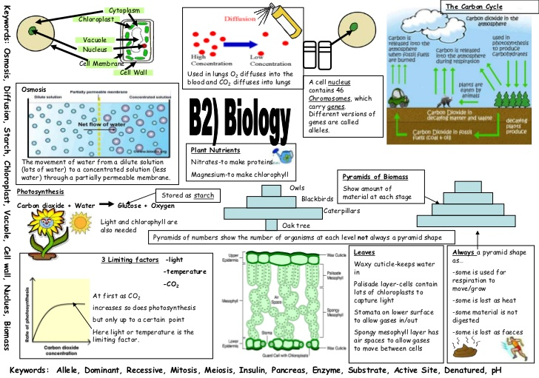
Dual Coding
The Science behind why students get better results with the help of GCSEPod.
Just reading text alone improves our memory by 10% in 3 days but looking at the picture we are likely to remember 65%.
Watch a Pod together, then using the images from the Pod, suggest your child draws a poster combining the images with keywords and definitions. Copying the labelled diagrams in the Pods helps the knowledge to stick!

Slide 26

Interleaving
Interleave revision to remember more
Interleaved practice is a learning technique that involves switching between topics and ideas and has been shown to improve long-term learning relative to blocked study of the same idea or topic.

Slide 27
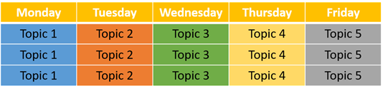
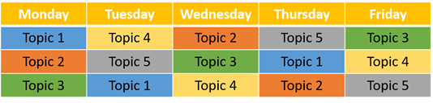
Interleaving
Interleave revision to remember more
Ask your child to create a learning/revision timetable using the interleaved practice example below. They should choose topics that are similar and related either from the same subject or a different one.
The Pods on GCSEPod are set out in a very clear and organised way. This makes it easier for your child to plan out their revision so that similar and related ideas and concepts, such as in Maths and Science, are studied together and in different orders, rather than separately and/or always in the same order.
Less Effective Blocked Practice
Highly Effective Interleaved Practice
Your child can watch the Pods on each topic and then complete active tasks from the previous slides.

Slide 28


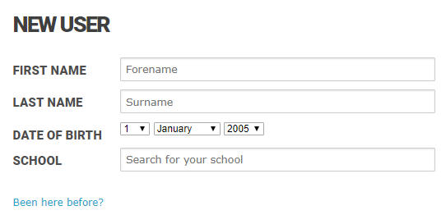
How Your Child Will Access GCSEPod
1
Go to: https://members.gcsepod.com
2
Click New Here? Get Started!
3
Enter your details
If they’ve already activated their account, they can simply enter their username and password.
4
Create your username and password

Slide 29

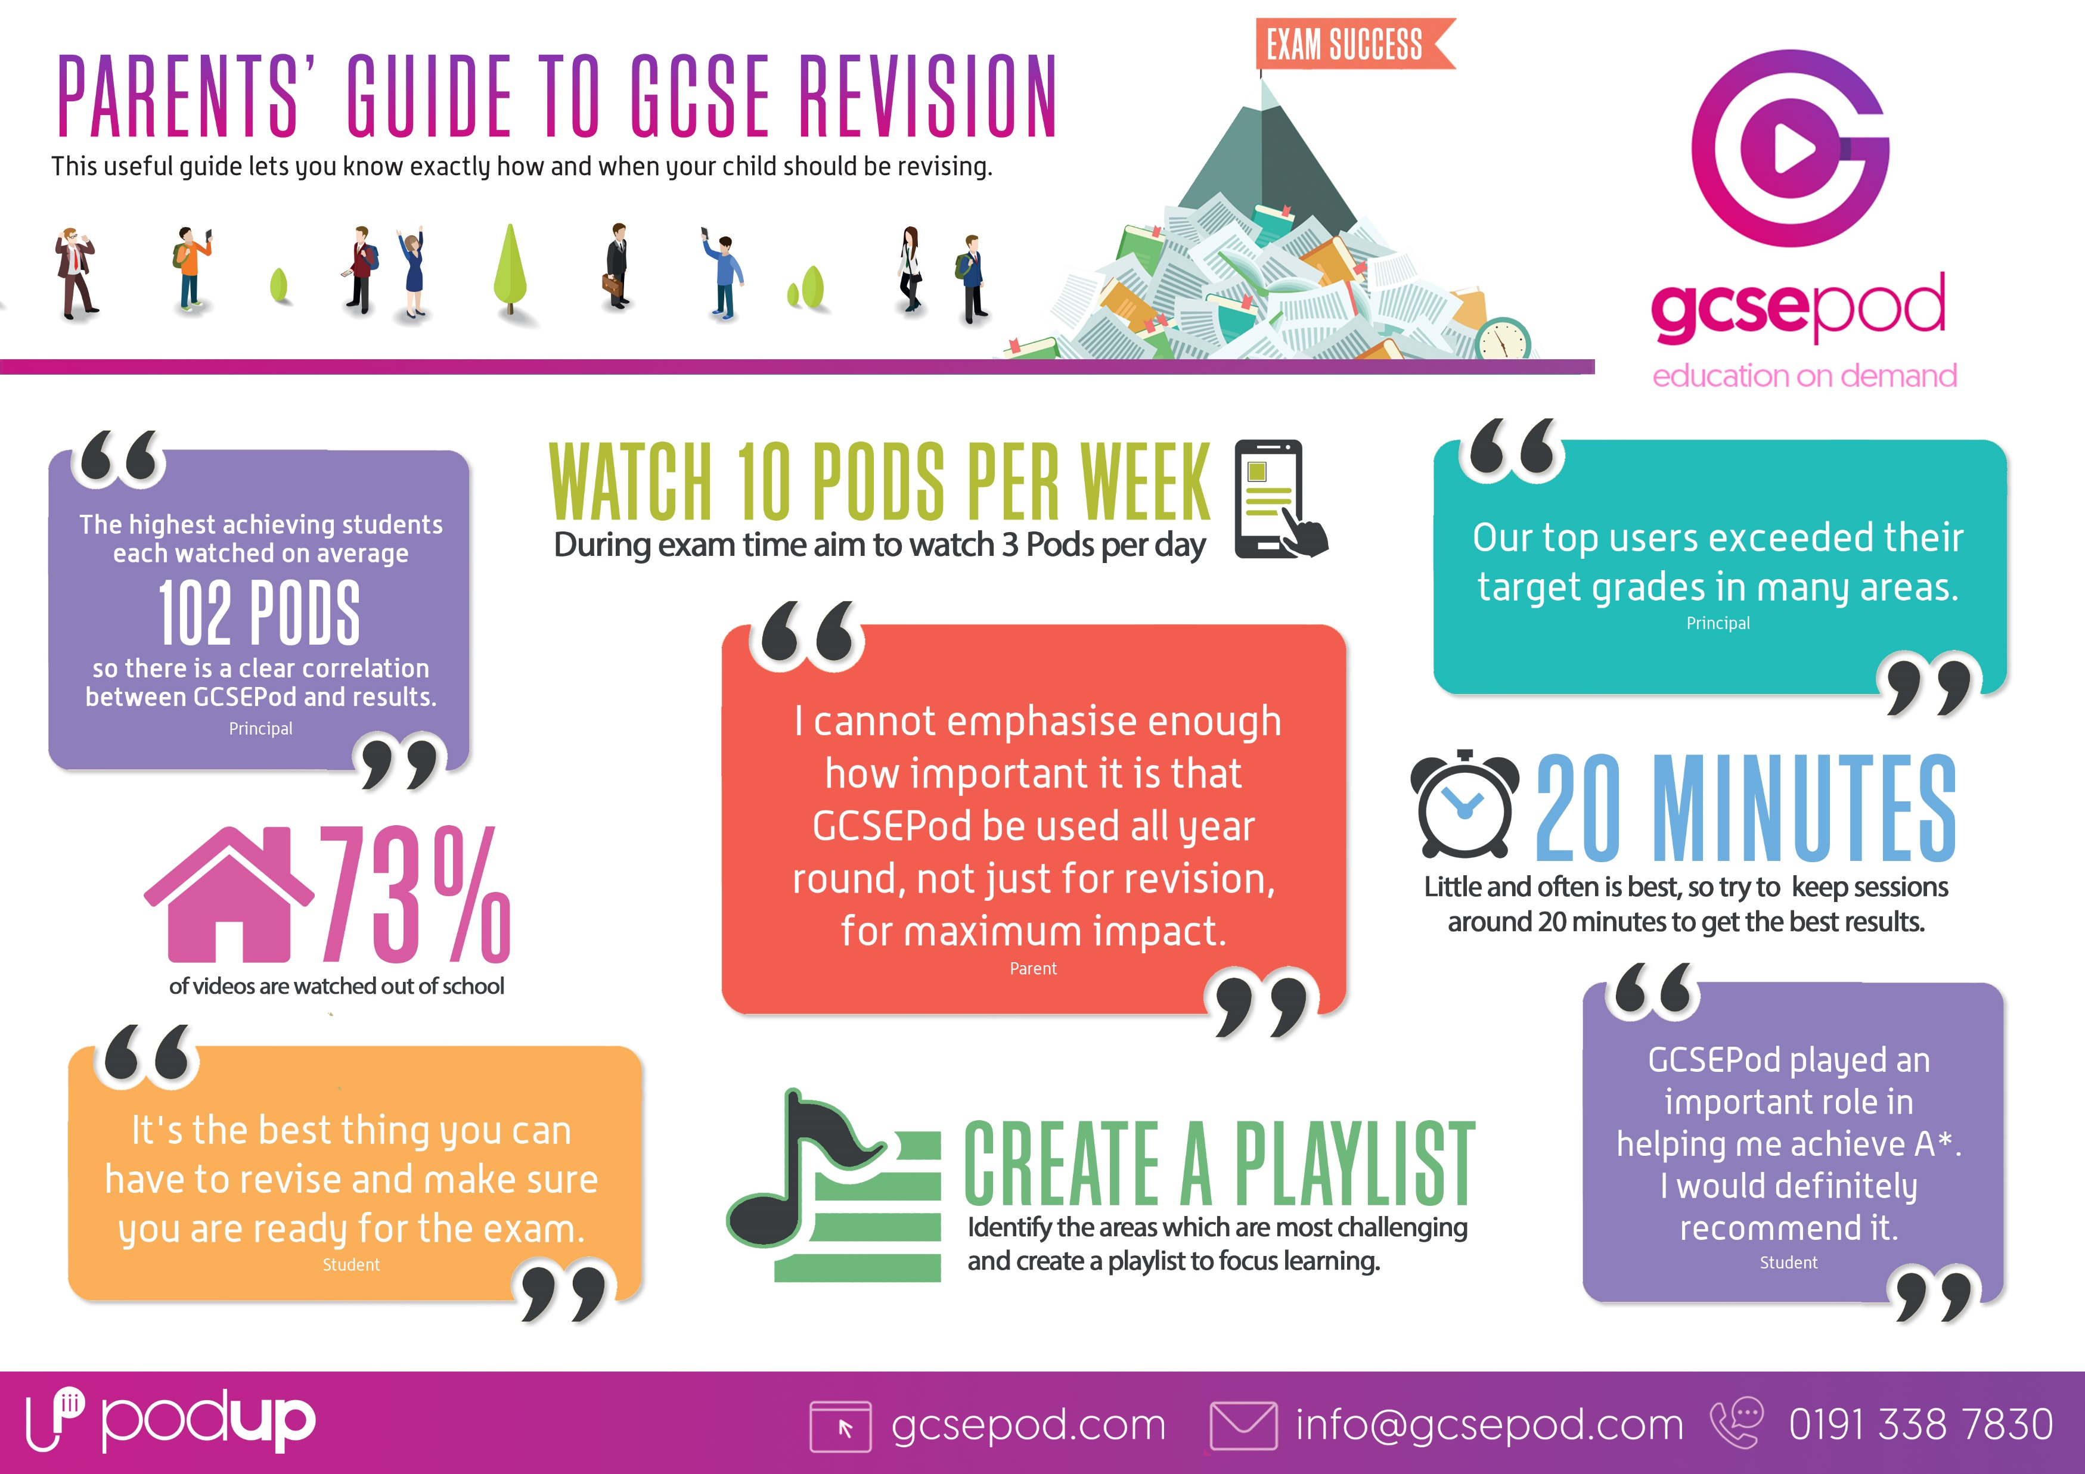
To find out more about GCSEPod and to access more information and supporting guides on your child’s GCSEs, please visit: www.gcsepod.com/parents

Slide 30

.

