Slide 1

The Study of Religion: Paper 2
Theme F: Human Rights and Social Justice
Revision Cards

Slide 2
Human Rights & Social Justice
Human Rights
In 1948 the United Nations adopted the universal declaration of Human rights.
It gives basic human rights that everyone is entitled to, regardless of gender, nationality, religion or race.
It sets out what should be the minimum rights for human beings to enjoy freedom, justice and peace.
The UK passed the Human Rights act in 1998.
These human rights stopped slavery and allowed the right to life, election, education and a fair trial.
Having rights also means we have to respects other’s rights.
It is a moral responsibility to listen and respect all, even if they have different views.
Social Justice..-Ensuring that society treats people fairly whether they are poor or wealthy and protects people’s human rights.
Christian Responses
God is the God of justice- we have a duty to be just and care for all. “Let justice role like a river, righteousness like a never falling stream.” – Prophet Amos said that God was not pleased with the way the people of Israel were treating each other. “Let everyone be subject to the governing authorities, for there is no authority except that which God has established.”- God has set the laws for us to follow. ‘Love thy neighbour”- Jesus taught Christians to care for one another. The Parable of the good Samaritan and the Parable of the Sheep and Goats teach to help those who need it. “Faith without action is dead.”- Christians have a duty to promote social justice.
Cairo Declaration of Human Rights (CDHR)
Some Muslims countries disagree with the UDHR and have adapted their own.
Saudi Arabia argued that Shari’ah law already have humans rights to those living in their society so the UDHR are not needed.
The Qur’an says, ‘help one another to do what is right and good.” Shows that everyone should be supported and treated fairly.
Some believe that they did not reflect the teaching of the Qur’an.
CDHR summarised the teachings of the Qur’an, the Sunnah and the Islamic legal tradition.
All rights are subject to Shari’ah law.
Some people think they are not up to date enough- such as homosexuals not having equal rights.
Muslim beliefs
Muslims regard it as their religious and social responsibility to work for justice and just causes. Justice is a virtue. Giving money to the poor is a central part of Islam. (Zakah or alms-giving/ One of the 5 pillars) Muslims believe that it is important to be involved in social and community projects such as helping the homeless or working with young people with learning disabilities. Prophet Muhammad tried to make a difference and change social reforms. Golden rule of Islam ‘Love for humanity is what you love for yourself.” “Adhere to justice, for that is closer to awareness of God. God has promised reward for good works.” “God command justice, doing good and generosity.”

Slide 3
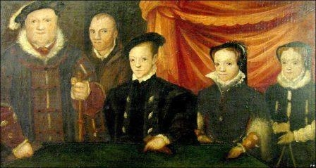
Religious Freedom
Religious Freedom is the right to believe or practice whatever religions one chooses.
In Britain toda, the official state religion is Christianity (The Church of England)
The government protects freedom of religious expression.- this is right to worship in whatever way they choose or not.
Nobody can be forced into a faith or to join the church.
Muslim views
It is a choice to choose to be a Muslim. “Let those who wish to believe in it do so, and let those who wish to reject it do so.” Some Muslim countries allow Christians and Jews to worship as they are ‘People of the Book’- they are accepted because they follow the revelations of God. In some countered, like Pakistan, blasphemy laws exist to make it illegal for Muslim to critise the Qur’an or the Prophets. Islam does not teach intolerance towards one another and people should be free to practise their faith. In Saudi Arabia, there is little religious freedom of other faith. Muslims promote tolerance Changing religion or giving up the belied in Islam is seen as a sin and considered a crime. The punishment ranges from nothing to execution. Muslims believe there life is a act of religious expression and obedience to God. In the UK, Muslims are allowed to worship, build mosques, have Islamic schools and evangelise. Muslims women are taught to dress modestly and in the UK are allowed to wear a variety of clothes that show their faith- however in some places (Netherlands) the burqa is banned.
Christian views
Christianity teachings encourage tolerance and harmony. The gospel od Mark records Jesus telling the disciples to not stop a man (who was not a Christian) driving out demons in the name of Jesus- “If they are not against us then they are for us.” When Christians fight they are not following Bible teachings “Be completely humble and gentle, be patient, bearing with one another in love.” “Live at peace with everyone.” Religious freedom is encouraged as it is a part of God’s design. Jesus taught religious freedom. Christians believe it is a fundamental human right.
Historically, Britain has not always been as tolerant as it is now.
Henry VIII- wanted to break with the Catholic Church (for a divorce) and created the Church of England. Henry looted the Churches and killed Catholics who opposed him,
Mary I- (Bloody Mary) Changed the religion back to Catholicism and killed anyone who objected. Here burned 280 heretics.
Elizabeth I- Broke with the Catholic Church again and people who did not go to Church were fined and risked having their property being taken away of being put into prison. Those who supported the Pope risked persecution.
In the Middles ages- The crusades organised by Christian kings wanted to recapture the city of Jerusalem from Muslims.
Christians still face persecution in countries where they are the minority, for example, the middle east and Pakistan.

Slide 4

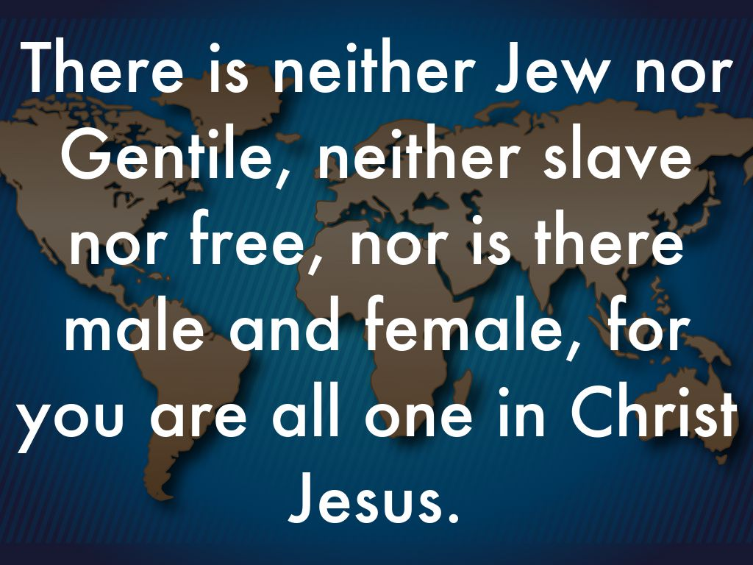
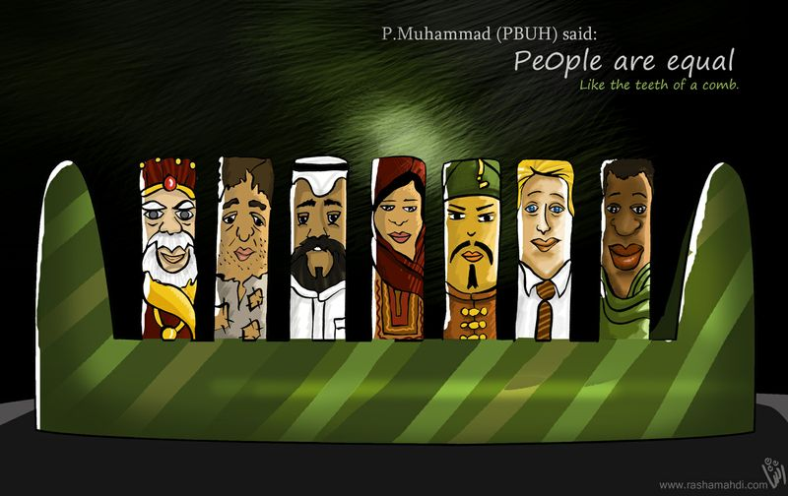
Equality
Equality...means to be equal, especially in status, rights and opportunities.
Islam
Islam teaches that God created everyone and therefore are of equal value, People are different but are equal in value. Muhammad said that ‘People are as equal as teeth of a comb.” Everyone is born equal and can’t bring possessions with them, similarly to death, People are only judged on how well they live their life in obedience to God.
Christianity
Christians believe humans are important and special because we have been created in God’s image. People are different but are equal in value and can have a relationship with God. “God does not show favouritism.” “There is neither Jew nor Gentile, slave nor free, nor is there male or female, for you are all one in Christ Jesus.” James warns against prejudice and discrimination. “Love thy neighbour as yourself.” Christians are encouraged to treat everyone as equals.

Slide 5

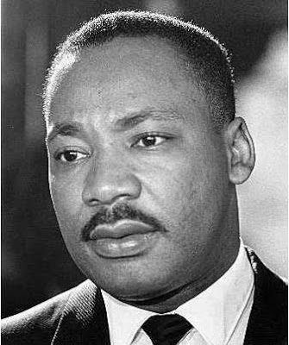
Prejudice and Discrimination: Racism
Prejudice and Discrimination in the UK
Prejudice means thinking less of someone because of their race, colour, religion, gender or sexual orientation.
It is an opinion which is formed without good reason.
Prejudice can lead to discrimination.
Usually, this is unfair and can lead to people feeling worthless, hated and very vulnerable.
In the worse cases prejudice can lead to genocide and mass killings.
Sometimes discrimination can be positive- for example- creating wheelchair ramps and lifts so those who are disabled can access things.
Prejudice | Unfairly judging someone before the facts are known; holding biased opinions about an individual or group.
Discrimination | Actions or behaviour that result from prejudice
Racism | Showing prejudice against someone because of their ethnic group or nationality.
In Britain, Acts of Parliament have ben passed to make racism illegal.
However it still happens today- For example, football where many nationalities and races play together, yet many face racist comments. “Show racism the red card” is a campaign that uses top footballers to educate against racism,
Martin Luther King Baptism minister who fought against racism in the USA in a non-violent way. He received many death threats and attacks for his role in the Civil Rights movement, He wanted equal rights and opportunities for Black people as well as whites. He was awarded the Nobel peace prize in 1964 and assassinated in 1968.
Christian views
Most Christians oppose racism in all forms. However the Dutch reformed Church did support the apartheid (black slavery, segregation and white supremacy) in south Africa. (For money and power) Archbishop Desmond Tutu was one of the leaders who lead a peaceful campaign for equal civil rights and the abolition of the apartheid which ended in 1994. “There is neither Jew nor Gentile, neither slave nor free, nor is there male and female, for your are all one in Christ Jesus.”
Muslim views
The Qur’an does not support racism. The Qur’an teaches equality and that differences in people show the wonderful creativity of God’s creation, “We created you all from a single man and a single women and made you into races and tribes.” Muhammad said ‘An Arch is not better than a non-Arab and a white person is not better than a black” Islam is a brotherhood (ummah)- no distinction between people of different races. People are judged on their actions not their race. While on Hajj all Muslims wear white to show equality in the eyes of God. Some Muslim extremists have been against westerners but usually for their disagreement for the way they live their lives or their atheism.

Slide 6
Prejudice and Discrimination: Sexuality
Christian views to Human sexuality
Part of God’s plan for humans to have sex. Man and women should ‘increase in number’ Some Christians believe that they should do the most loving thing therefore their teachings should adapt into a changing world. (Homosexuality/ sex before marriage)
Christian views against homosexuality | Christian views accepting homosexuality
Against God’s command to increase in number- can’t reproduce. Sexual relationships between men are forbidden in the Bible. Not allowed to get married within a Church. | No detail on homosexual relationships between women as there is no penetrative sex. Homosexual relationship aren’t sinful (as long as sex is not involved) Church of England allows homosexuality as long as they are faithful and committed to one another. Some believe Bible teachings need to be updates to this modern society- therefore making it acceptable.
“ Do not have sexual relations with a man as one does with a women; that is detestable.”
Muslim views on Homosexuality
Homosexuality is forbidden. In most Muslim countries it is against the law. Human sexuality is a choice but choosing to be drawn to the same sex is not right. It is against the natural law of God. It is against God’s will. Homosexuals should control their actions and not break God’s laws. Some believe homosexuals will have to answer to God on judgement day,
“ Must you, unlike other people, lust after males and abandon the wives that God has created for you? You are exceeding all bounds.”
Muslim views to Human sexuality
It is a way for humans to express themselves. It is natural. Forming heterosexual relationships should lead to having children. It is part of being human. Sex is for pleasure not just reproduction. Humans have natural sexual instincts. Human body is created by God and all parts have a purpose. Being celibate is wrong. Sex between husband and wife is a blessing from God.
Key Terms | Definitions
Human Sexuality | How people express themselves as sexual beings
Heterosexual | To be sexually attracted to members of the opposite sex.
Homosexual | To be sexually attracted to members of the same sex

Slide 7

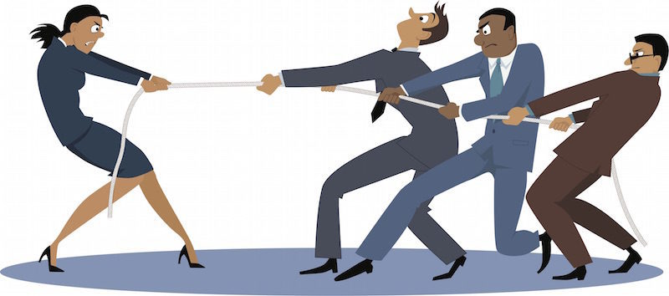
Prejudice and Discrimination: Sexism
 | For- Equality | Against- Sexist
Christians | In 1993, the Church of England allowed women to be ordinated as priests and in 2014 the first women became a bishop. Most have no problem with women being a part of the clergy. Non-conformists have been ordaining women for nearly 100 years. Not the culture in those days of the Bible- need to be updated. Women funded Jesus’ mission. | ‘Christ is the head of man, so a man is the head of a woman. Women should not lead worship.” “Women should remain silent in churches. They are not allowed to speak… for is disgraceful for a woman to speak in the Church.” Catholic and Orthodox Churches do not support women becoming priests. Jesus chose men to be his disciples.
Muslims | Equal in value but different in their roles. “Anyone, male or female who does good works and is a believer will enter paradise.” Women are allowed to work if they want and many Muslim women in the UK are doctors, teachers etc. Women should also worship God. Some mosques allow women to lead worship. | Husbands should take good care of their wives. Men are allowed more than one wife. Women should stay at home and look after the children. Women do not have to go to Mosque 5 times a day or on a Friday for Jummah prayer. Women cannot be Imams In Saudi Arabia, women have to cover up if they leave their home and must be with a chaperone.

Slide 8

Prejudice and Discrimination: Disability
Key Terms | Definitions
Disability | A physical or mental impairment which has an adverse effect on a person's ability to carry out normal day-to-day activities.
Positive discrimination | Treating people favourably because they have been discriminated against in the past or have disabilities.
There are around 500 million disabled people in the world.
It can be those who have visual, hearing, speech, mental impairments or who have lost a limb or have restricted mobility.
Some people do not understand these problems and ignore them or show prejudice/ discriminate them,
The Equality act protects those who are disabled.
Christian views
Christians oppose discrimination against the disabled. It does not show Christian love (agape) Jesus healed the sick and disabled and taught his followers to ‘Love thy neighbour’. Christians support positive discrimination as it helps those who need it. Parable of the sheep and goats- Help others
Muslim views
Muslims are taught to help those who need it. They are taught to look after the elderly and children including those with disabilities. Muslims agree with the use of positive discrimination. In the eyes of God we are all equal and therefore we should help all. Some Muslims believe that those who have a disability is because they have sinned against Allah and Allah has given them their punishment,
Disabled toilets
Access ramps
Lifts
Positive Discrimination to the disabled
Front row seats to concerts and football matches
Wheelchair parking

Slide 9
Wealth
Christian views on wealth- What does the Bible say?
The Old Testament | The New Testament
God blesses people with wealth when they are faithful to him. | Money can make people forget how to ‘Love thy neighbour.’
King Solomon became a rich king: ‘Moreover I will give you what you have no asked for- both wealth and honour- so that in your lifetime you will have no equal among kings.” | Parable of the Camel and the eye of the needle. “It is easier for a camel to go through the eye of a needle than for someone who is rich to enter the Kingdom of God.”
King David acknowledged that wealth comes from God. ‘Wealth and honour come from you; you are the ruler of all things,” | “No one can serve two masters… You cannot serve both God and money.”
“But remember the Lord your God, for it is he who gives you the ability to produce wealth.” | The Parable of the sheep and goats
“A tithe of everything from the land; whether grain from the soil or fruit from the trees, belongs to the Lord; it is holy to the Lord.” | The parable of the good Samaritan
Tithe | One tenth of annual produce or earnings (Christian)
Zakah | Purification of wealth by giving 2.5% of savings each year to the poor
Sadaqah | Good actions or voluntary payments that are undertaken for charitable reasons.
How should Christians use their wealth?
Everyone needs money to pay bills otherwise people would go into debt. The Bible does not condemn people using their money on holidays and luxuries. The wealthy have a responsibility to give money to the church and pay for the mission. Jesus taught that the parable of the Rich man and Lazarus and the Parable of the sheep and goats shows that we should help those who are needy and we will go to heaven. Christians believe that by sharing they are helping Jesus and showing agape love. “Truly I tell you, whatever you did for one of these brothers and sisters of mine, you did for me.”
Wealth in Islam
Wealth and riches are a blessing from God and should be used to benefit everyone. The value of money is the good that it is able to do. Muslims who have money have a responsibility to look after the poor. Hoarding money is not acceptable. “Tell those who hoard gold and silver instead of giving to God’s cause that they will be punished,” Money should only be obtained lawfully. (Working, property and inheritance) Not gambling, selling alcohol or drugs and fraud. Muslims have to serve God and wealth can distract from that. “Beware of greed for it is ready poverty.” Islam teaches that it is the duty of the husband to take care of his family and give to charity if there is anything left over. Zakah is one of the five pillars. Sadaqah can also be given which is to donate to food banks, clothes and money. For Shi’a Muslims, Khums is a 20% tax- half goes to charity and the other half goes to religious leaders.

Slide 10

Exploitation
Usury | The act of loaning money with interest. (Islam)
Exploitation | Misuse of power or money to get other to do things for little or unfair reward.
Human trafficking | The illegal movement of people, typically for the purposes of forced labour or commercial sexual exploitation.
Example- Primark
Some of Primark’s clothes were being made by children (ages 11 and under) and many were refugees. They were employed in poor conditions to sew sequins and beads onto T-shirts by candlelight.
They worked long hours for around 60p a day.
 | What is it? | Christian views | Muslim views
Fair pay | Many companies in LEDC pay tiny wages to make big profits. Many are forced into labour- £1 a day for 16 hours Working conditions are poor. In the UK we have a national minimum wage to stop exploitation. | Christians support fair pay for fair work. Christians agree with the national minimum wage in the UK. | Employers and Employees are a brotherhood, they have responsibilities to one another. If they work hard they should get fair pay. Shari’ah law protects workers of different faiths The organisation of Islamic conference- does not discriminate against males and females and all should get paid fairly.
Excessive interest on loans | Those who are poor and vulnerable get stuck with moneylenders. Unable to then pay them back with the high rates. | Wrong- Help to poor not exploit them. | Forbidden in Islam- given the term riba. Changing interest is an injustice and exploits those in poverty. It is a sin- “God blights usury.” “Do not charge your brother interest whether on money or food or anything else that.”
People trafficking | Criminals profit from the control and exploitation of others. This could be refugees/ migrants, sex trafficking and slave labour. Often ran by criminal gangs. | Against exportation of the vulnerable. All equal in the eyes of God. | “Liberate those from bondage.” Islam does not support people trafficking and considered it as something which need to be eradicated (stopped completely) It is wrong because it exploits the vulnerable, which is contractor to Islamic teachings.
Example- Rana Plaza Disaster
In 2013, in Bangladesh over 1100 workers lost their loved and over 2000 were injured when a factory collapsed.
It did not have planning permission and was unstable. It could not take the machinery. Severe punishments were given to the owner and new laws came into place giving better and safer working conditions for workers.

Slide 11
Poverty
Poverty- being without money, food or other basic needs of life (being poor).
Responsibilities of those living in poverty
Christians | Muslims
Encourage the poor to attempt to break out of poverty if they are able. Many will take part in training courses. Some do voluntary work to give them experiences and references. Important to help those who need assistance. “The one who is unwilling to work shall not eat.” Christians encourage those who are addicts to seek her to stop them being in poverty. “For drunken and gluttons become poor.” | Muslims are told to give generously to help the poor and needy through Zakah and Sadqah “Cure poverty with charity and giving generously.” Islam encourages people to work, if possible, so that they do not have to rely on others. “I guarantee that those who economise will never fall poor.” Islam also encourages careful budgeting to avoid poverty.
Problem of poverty
Everyone has the same basic needs; food, water, shelter, clothing, health care, education and employment.
800 million people in the world suffer from chronic hunger and undernourishment.
Around 100 million are homeless
750 million lack safe drinking water and over 2000 die a day because of the diseases caused from it.
Most of those who are in extreme poverty live in LEDC’s.
In the UK, welfare benefits try to help provide basic necessities.
Natural disasters
Lack of healthcare
Unfair trade
HIV/ Aids
Unemployment
Lack of education
War
Causes of large scale poverty
Debt
Corrupt leaders

Slide 12




Giving money to the poor
Long term aid These aim to provide a long term solution to poverty- such as education and training with tools and skills. This is to help people get out of poverty themselves.
Emergency Aid (Short term) Is usually needed after a disaster such as an earthquake or flood and charities give temporary shelter supplies of food and water and emergency healthcare
Christian
Guided by the concept of justice. Will buy Fairtrade to help promote fairness. Responsibility of looking after the world and those in it (stewardship) They have a duty to demonstrate compassion because Jesus taught ‘ Love thy neighbour as yourself.” Many Christians support soup kitchens, food banks and charities that provide help for those in poverty. Christianity encourages people to use their gifts and talents to get out of poverty- The parable of the talents. They support campaigns that promote equality.
Send a Cow-
Started by British Christian diary famers to help Uganda after a long civil war.
The cow would be sent to a family that needed help as it provides milk and income from selling milk.
The charity provides training, tools and seeds, along with other livestock.
Focus is long-term aid.
Muslim Aid
Works in over 70 countries.
It responds to emergency situations by providing immediate aid following a disaster.
Also provide education and assistance to those who are suffering from poverty.
It hopes that people will become self-reliant
Provides education, skills training, clean water, healthcare and income generation.
Islamic relief
Provide aid to those living in poverty.
Includes emergency aid when there had been a disaster.
Islamic relief also provides long-term aid.
Work with local communities to promote sustainable economic and social development so that communities support themselves.
Aim to enable people to break out of poverty and secure their own future without the need for charity.
Muslims
Muslims believe they have a duty to help the needy wherever they are. “Be good to your parents, to relatives, to orphans, to the needy”, There are many Muslim charities that work to help underprivileged people in the UK and abroad. “If anyone saves a life it is as if he saves the lives of all mankind.”
Muslim hands
Helps British Muslims who are facing difficulties.
Aim to enable under-achieving communities to love a life free from poverty, exploitation and exclusion.
It works to get people out of poverty, support prisoners, assist marginalised women and works with vulnerable young people, the elderly and drug abusers.

