Slide 1
The Study of Religion: Paper 2
Religion and Life
Revision Cards

Slide 2
Origins of the universe
Christian beliefs on Creation
God designed and created the universe. God created all things ‘out of nothing’ ex nihilo Genesis 1 gives a Christians a detailed story about how the Earth was created.
Muslim beliefs on creation
God created the world in 6 days (phases) This could be periods of time.
Before time existed, God existed and he created the universe on his divine word.
The Qur'an does not specify what happened on each day.
The Qur’an does not mention a day of rest but instead says that God put the whole universe under his command.
Muslims believe that God’s work and creation never ends as it continues with every new birth and every new seed that grows.
The Big Bang Theory
The scientific explanation for how the universe began.
13.8 billions years ago all matter was compressed into a small, hot and dense collection of mass.
A massive expansion of space took place and matter was flung in all different directions.
The universe expanded and cooled.
The starts grouped together and formed galaxies.
Days | What happened?
Day 1 | God said ‘Let their be light’. He created day and night.
Day 2 | God made the sky.
Day 3 | God formed the seas and the land, covering the land with vegetation and plants.
Day 4 | God created lights in the sky- sun, moon and stars,
Day 5 | God made fish and other animals of the seas, and the birds in the air.
Day 6 | God finished by creating all the animals on land, made humans. He made humans in his own image.
Day 7 | God rested on the 7th day and made it holy. He was very pleased with his creation because it was good.
Christian views | Muslim views
Fundamental Christians believe that every word in the Bible has been inspired by God and therefore 200% true. Liberal Christians believe that the Bible is more like a parable/ symbol and the main message is that God brought the universe into being but we should use to science to try and understand it. The Big Bang could have been God’s way of forming the universe. | Islam encourages the search for clear understanding and scientific explanations that may enable a greater understanding of God. The Qur’an encourages scientific exploration about the origins of the universe. Muslims believe that the Qur’an links well to the Big Bang Theory. The Qur’an explains why the universe came into being but science should explain how. As long as they understand that it is created by God. It was not an accident but was designed, and God’s creation was perfect and good.

Slide 3

Value of the world
Value of the world:
Humans are the most intelligent species on earth.
Humans should live in harmony.
Muslims and Christians believe they should respect nature and care for the environment,
Living on God’s earth is a privilege.
Islam stresses that we must live in harmony with all creature of God.
Dominion:
In order to manage the earth Christians were given power and authority to rule.
Some believe that this means they can do what they like with the earth.
Some say they cannot do what they like if it damages something God has made.
Awe and Wonder:
When people see beautiful landscapes, starts etc… many people are awestruck and filled with wonder.
The beauty and complexity of the world proves to come that God must exist.
God’s creation inspires awe and wonder.
Nature is amazing because it represents the glory of God
Stewardship
Christians: God has given humans the privilege of living in the world therefore they should take responsibility and look after it. One planet that cannot be replaced. Adam was the first steward when he was told to take care of the Garden of Eden. | Muslims: God has given humans responsibility to take care of the planet. Called khalifah We need to look after the world for future generations. Looking after the environment brings balance. Humans will be judged on the day of judgement about their treatment of the planet. “It is he who has made you successor on the earth.” God is the creator therefore we should not damage is creation. “God created everything and the earth belongs.”
Notes:
Stewardship – I and C
Dominion- C

Slide 4


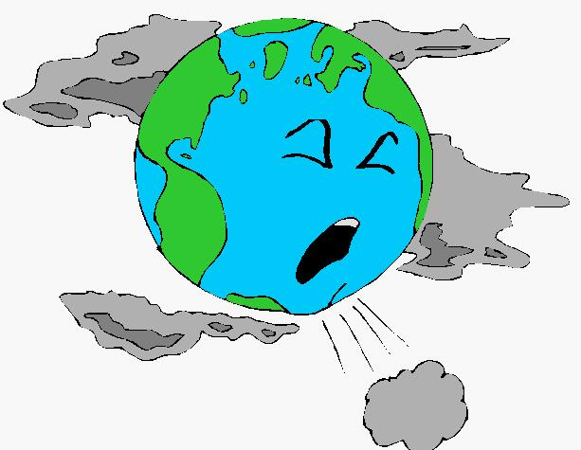
Use and abuse of the environment
Pressures on the environment
The world’s population is growing therefore it has implications on the environment.
Large populations create most waste and there is a real danger that the planet is getting seriously damaged.
Key Word | Definition
Natural resources | Material found in nature- such as oil and trees- that can be used by people.
Sustainable development | Building and progress that tried to reduce the impact on the natural world for future generations
Abuse | Misuse of the world and environment
Non-renewable energy | Things the earth provides that will eventually run out, for example, oil, coal
Deforestation | The cutting down of large amount of forest
Recycling | Reusing old products to make new ones.
Looking after the environment
Recycling Reusing items such as plastic bags or donating items not needed. Reducing the number of vehicle journeys by walking, cycling or public transport. Being careful to turn lights off and use water responsibly. Planting trees.
Muslim views to abuse of the environment The Hadith advices Muslims to take only what is needed from the world. “ Do not seek from it more than what you need.” “Eat and drink but do not be extravagant: God does not like extravagant people.” The IFEES Project | Christian views to abuse of the environment Being in charge does not give people the right to abuse, spoil, waste or destroy what God has made. Humans are only tenants of God’s world. Thoughtless exploitation should be opposed. The Assisi and Ohito meetings

Slide 5

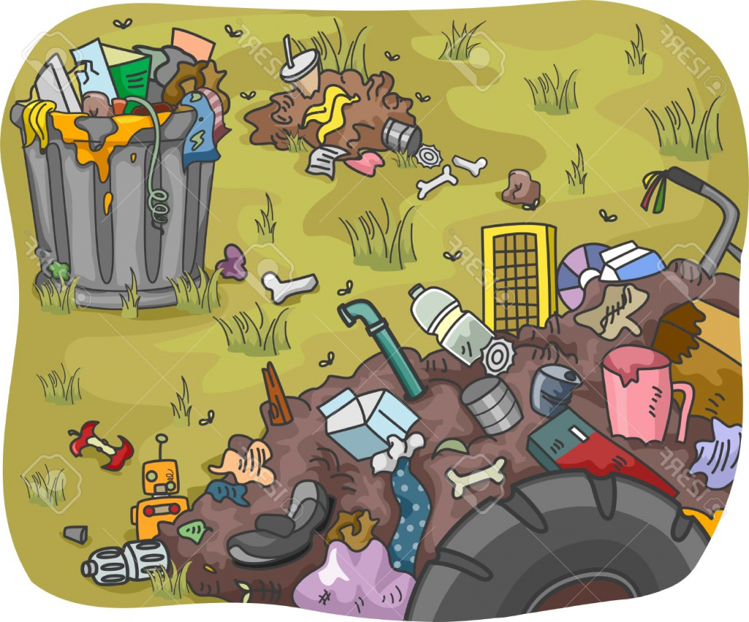
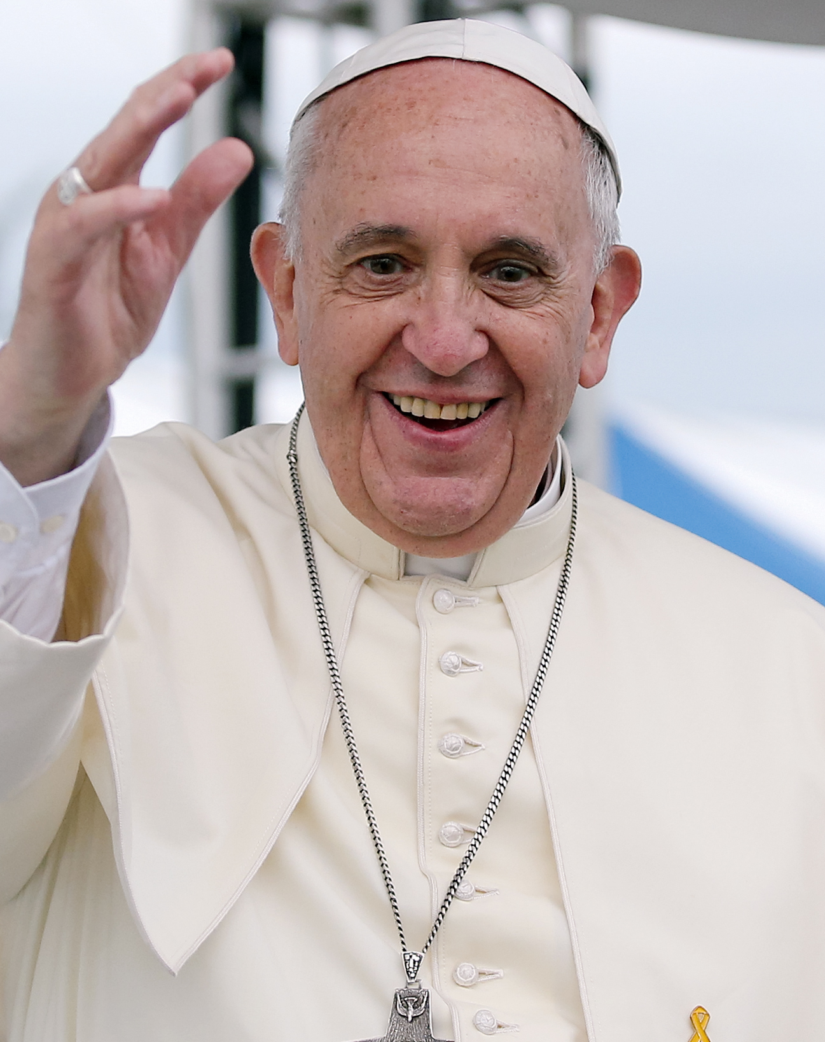
Pollution
Pollution:
Making something dirty and contaminated, especially the environment.
Pollution puts the health of humans, animals and plants at risk.
Pollution is a problem as technology advances and the world’s population grows.
“ The earth is the LORD’S and everything in it.”
Christian views on Pollution
Christian believe that the world is on loan to humans, who have been given responsibility by God to look after it. Parable of the talents. Polluting the planet is not good stewardship. Pollution harms other therefore goes against ‘love thy neighbour’.
“Every human act of irresponsibility towards creatures is an abomination,”
Types of Pollution:
Water | Air | Land
Caused by dumping waste into the sea. Have a bad effect on marine life. Example- The deep water horizon oil spills killing thousands of birds and marine animals. | Caused by fumes from factories and vehicles. Long-term exposure can lead to asthma, lung cancer and other diseases. It also causes global warming, climate change and acid rain. | Caused by the ineffective disposal of waste. When chemicals enter the earth this can poison wildlife, making farming less efficient and result in contaminated food.
Pope Francis challenge the world to help reduce pollution:
The Pope called for the world to act to protect the environment.
He called the letter ‘To care for our one common home.”
He states that we need to reduce waste, pollution and change poverty.
He says the world looks like an immense pile of filth.
He says we should recycle.

Slide 6
Animals
Animals for experiments
Scientists test new products, such as medicines, cosmetics and additives that are added to food.
To test to make sure it is safe for humans.
Testing cosmetics on animals was banned in the UK in 1998.
Most animal testing now is on rats or mice that are bread for that purpose.
Value of Animals
God created all living things and they all worship God in their own way. Each animal is valuable to God and should be treated with kindness and compassion. There are over 200 verses in the Qur’an about animals. Christians believe God created animals for humans to use and care for. Humans are more important because they were created in the image of God. The story of Noah’s ark teaches Christians to protect animals but that it is also acceptable to use them for our benefit.
Animals for food
Those who decide to be vegetarian or vegan usually do so because they are against killing animals.
Some object to the ways animals are treated rather than actually eating animals.
Some simply do not like the taste.
Christian views on animals testing | Muslim views on animals testing
Christians support limited animal testing, providing there is no other safe way to develop medicines. Acceptable as long as it is in a caring way. Christians believe that humans life is more important. | Harming an animals is not allowed. Causing them to do a job beyond their power is not acceptable. An acceptation can be made if it is to protect/ save human life. Suffering must be kept to a minimum. Humans will be judged on judgement day based on their actions towards animals.
Christian views on eating animals | Muslim views on eating animals
Christians have the choice to be meat eaters. But they should also be sensitive to others. Against killing animals. We are more dominant so can do what we like. | Muslims are allowed to eat meat that has been kidded according to Shari’ah law. Food must be halal and slaughtered correctly. Animals must be killed in the name of God. Forbidden to eat pig meat.
“Take with you seven of every kind of animal, a male and its mate.”
“All creature that crawl on the earth and those that fully with their wings are communities like yourselves.”
“Everything that lives and moved about will be food for you.”

Slide 7

Origins of human life
Christian beliefs about the origins of human life:
In Genesis, God created male and female humans on the final day of creation; Adam and Eve.
In Genesis 2, Adam was formed by God from the soil and God breathed life into him.
He was told to look after the garden of Eden and not to eat from the Tree of knowledge of good and evil.
While Adam was sleeping, God took one of his ribs and formed Eve, the first woman.
Some Christians believe the story is literally true and the whole human race are descendants.
Others say it is just a story to say that God created humans to be close to him.
Evolution
Suggests that all living things in the world have developed over time from simple forms. Charles Darwin, studied the variation in plants and animals and recognised the differences around the world. He wrote the book on the origin of species, in which he put forward the idea of natural selection. Darwin argues that the creatures with characteristics most suited to the environment are more likely to survive, reproduce and pass on their genes of their offspring. They will adapt to survive in their natural habitats and therefore will create new species, The fittest survive and some have to go extinct.
Christian attitudes to evolution | Muslim attitudes to evolution
Christians believe that they do not need to worry about what the theory implies about God’s role in creation. Some believe Darwin is wrong as life started the way the Bible states, Some except adaption but do not believe there is enough evidence to rely on that. Some say God is the creator but the Bible is saying why whereas science can explain how. | Some Muslims reject evolution and are creationists; they believe that all God formed all the different species. Some believe that it is not compatible with the Qur’an. Some support human evolution as a key principle of modern biology. Some argue that evolution is acceptable but does not apply to humans, as God created man for a certain reason.
Muslim beliefs about the origins of human life:
When God has finished creating the universe, he created the first human being.
Some believe he named him Adam, he taught him the names of all things and created from his soul a wife, Eve-who is referred to as the ‘Mother of humankind’.
God allowed the to dwell in the garden of paradise with free will but commanded then to not eat from a certain tree.
Iblis tricked/ tempted Adam and Eve into eating from the Tree,
Adam and Eve began naked and tried to cover themselves and felt shame and regret.
God sent them down to earth to start the human world.
The whole human race is descended from Adam and Eve.

Slide 8

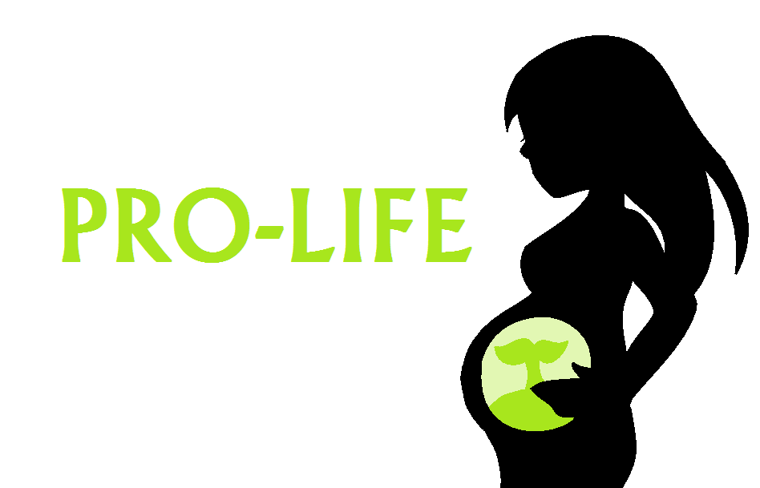
Abortion
What is abortion?
It is the removal of the foetus from the womb to end a pregnancy before the child is born.
It is usually deliberate.
The Legal position
Before 1967 abortion was illegal in the UK You can now have an abortion up to the 24th week of pregnancy. There is no limit if the mother’s life is in danger or if the foetus is severely deformed.
Christian views for abortion | Christian views against abortion | Muslim views for abortion | Muslim views against abortion | Non religious views for abortion | Non religious views against abortion
If it saves the mother’s life. Acceptable if the mother was raped or the child would be disabled. Can be the lesser of two evils. | Against the sanctity of life. Life is a gift from God and a blessing. Life begins at conception | Allowed in certain circumstances- mother’s life is in danger, result of rape. Lesser of two evils. Baby born with serve physical or mental disabilities. | Muslims should value life. Haram. Not acceptable if it due to finances. It must happen before ensoulment (40 or 120 days) Taking a life- murder. | Pro-choice groups, agree with abortion because a woman’s life comes first. Women have the right to choose as they carry the baby, If the mother will be harmed mentally or physically she should be allowed an abortion. It is also cruel to bring a severely physical or mentally disabled child into the world. | Pro-life argue that life begins at conception. Abortion is murder. Unborn children need to be protected. Disabled people can have a good life therefore why should they be terminated. Unwanted children should be adopted. A lot of people who have abortions will suffer from depression and guilt
 | “Before I formed you in the womb I knew you, before you were born I set you apart.” |  | “Do not kill your children for fear of poverty- we shall provide for them and for you- killing is a great sin.”

Slide 9
Euthanasia
Euthanasia in Greek means good death. It is the intention to end the life of someone who is in pain or has poor quality of life due to a serious illness.
Active Euthanasia: When active steps are taken to end someone’s life, for example by giving them a lethal injection | Passive Euthanasia: When doctors stop providing treatment or do something that is intended to quicken the natural process of dying, for example not resuscitating.
The Right to Die
Some argue that euthanasia gives a dignified and peaceful death.
Others argue that we should offer ‘care not killing’.
Some believe that we need to protect the depressed, disabled, elderly and sick.
In some countries were it is legal, doctors will not be persecuted and the patient must request it themselves and their suffering must be unbearable.
Christian views for euthanasia Some Christians do support euthanasia and believe that the drugs that are used to end a suffering person’s life are God-given. It is the most loving thing to do. God has given people free will so they should be able to choose when to end their lives. “Blessed are the merciful.” | Christian views against euthanasia Taking life interferes with God’s plan It is open to abuse life murder and people might feel pressured into having it. Against the Sanctity of Life Only God has the right to take life. “You shall not murder” Modern drugs and hospice care provide the dying with a chance to end their lives with dignity and without pain. Going through pain and suffering brings you closer to God as you understand the suffering of Jesus.
Muslims views against euthanasia Not included in the reasons allowed for killing. Against the sanctity of life. All life is a gift from God and should be looked after. Only God will decide when life ends. “Do not take life, which God has made sacred except by right.” Suffering is for a reason. God is testing the faith. Euthanasia is haram and a sin against God.

Slide 10
Death and the afterlife
Is death the end?
Christian | Muslim
Death is not the end and God judges whether a person will spend eternity heaven or hell. Catholics believe in purgatory, where souls undergo purification in order to achieve holiness to be with God and enter heaven. Some believe that the afterlife/ judgement begins the moment you die, where others believe you must wait until judgement day. Some Christians believe that heaven is bodily and others believe it is spiritual. | Muslims believe that death is not final, but a new beginning of a new stage. Muslims believe they will be waiting until the day of judgement called barzakh, which means barrier. The soul does not die but continues in the afterlife, heaven or hell. The afterlife is known as Akirah. Current life is a test or trial before the next realm of existence.
The value of human life
God has given humans free will to choose between right and wrong. Each person has one life and it is their choice how they life it. Christians and Muslims believe that what they do in life will effect the eternally. This encourages them to follow the instructions of God.
Christian views on heaven | Christian views on hell | Muslim views on heaven | Muslim views on hell | Muslim views on judgement
Heaven is wonderful and where God resides. It is place where everyone worships God. There is no death, mourning or pain in heaven. Heaven is more important than any other ambition. We go to heaven because of Jesus’ death on the cross. Christians should try to avoid sinning. | The Bible says that hell was originally designed for Satan and his demons. A place for punishment. Hell is a place of torment and there is no rest. Some believe that it is just punishment to be without God. Hell is something that should be avoided. | Called paradise or Jannah Muslims aim to reach paradise. After judgement everyone will have to cross the Sirat Bridge over hell. If given the book of life in the right hand you will enter heaven. Eternal beautiful garden of physical and spiritual pleasures and delights. No suffering. | Also called Jahannam. The Qur’an describes hell using the vivid imagery of blazing fire and terrible punishment. Both physical and spiritual torture. Muslims who do not do enough good deeds might find themselves in hell. It will eventually end and they will enter heaven. Non-believers will stay their forever. | Everyone is accountable for their actions. The angel Israfil will blow a trumpet announcing the last day and the dead will be resurrected. Good will look at their book of life and decide the fate of the individual.

