Slide 1

The Study of Religion: Paper 1
Islam Practices
Revision Cards

Slide 2
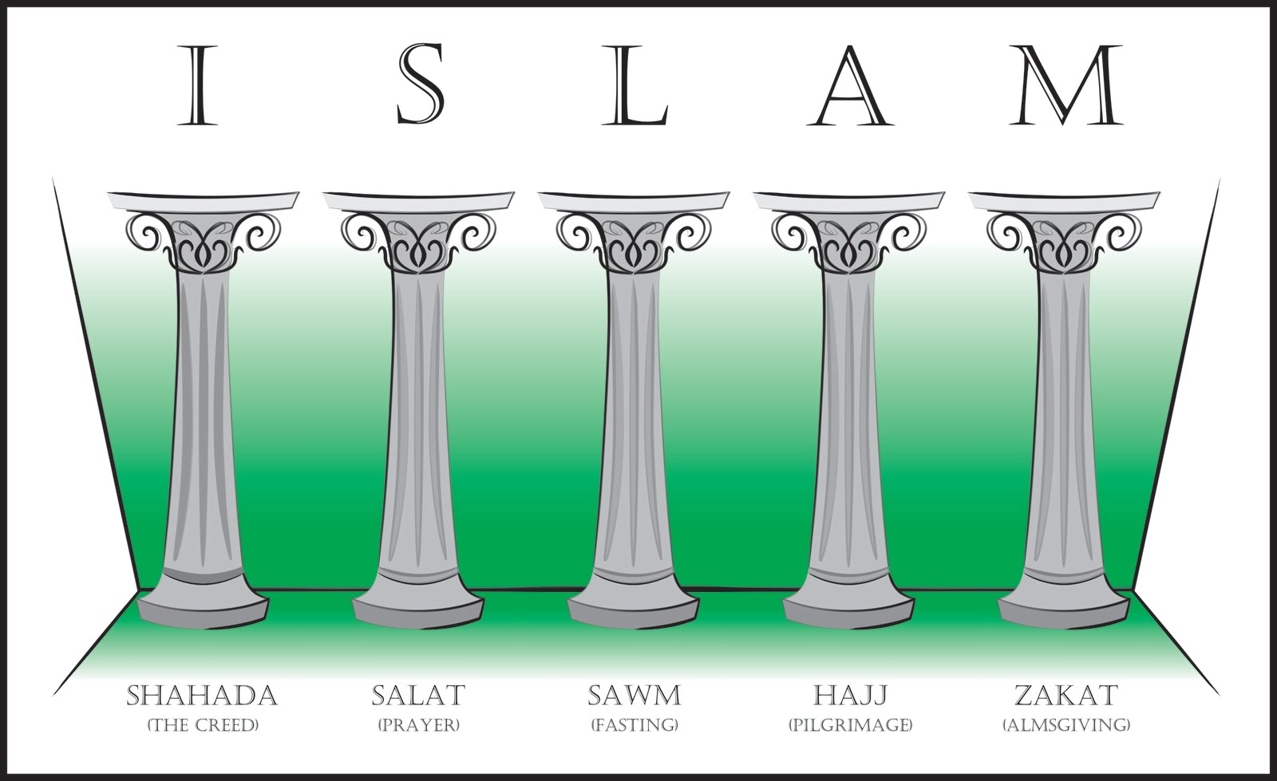
The 5 Pillars & 10 Obligatory Acts
The Five Pillars:
Central to Muslim practices. They are key to living a perfect Muslim life.
They show obedience and dedication to God.
10 Obligatory Acts in Shi’a Islam:
Salah | Sawm | Zakah | Khums | Hajj | Jihad | Amr-bil-Maruf | Nahi Anil Munkar | Tawallah | Tabarra
Prayer | Fasting | Charitable giving | 20% tax on income. Half goes to charity and the other half to Shi’a leaders | Pilgrimage | The struggle to maintain the faith. Greater and lesser Jihad. | Encouraging people to do what is good. | Discouraging people from doing what is wrong. | Being loving towards the friends of God, Muhammad and the Imams. | Disassociating from the enemies of God.

Slide 3
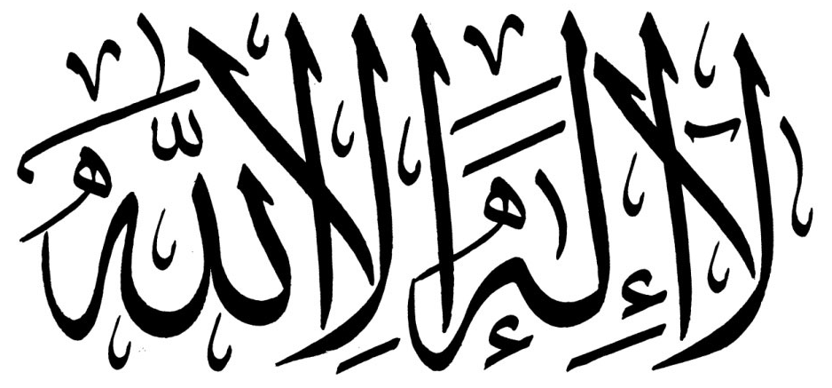
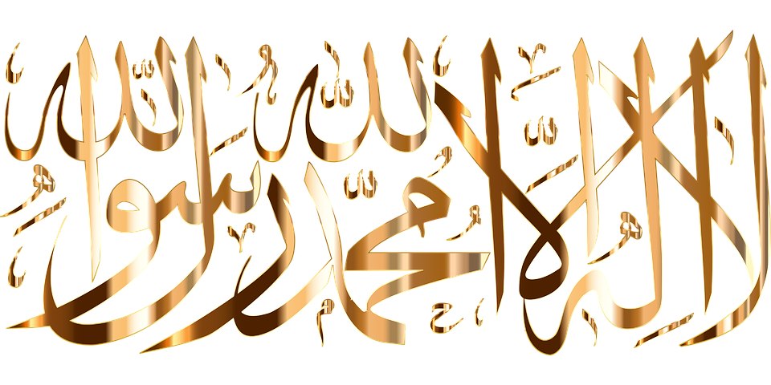
The Shahadah
The Shahadah
In Arabic it is ‘La ilaha illa Allah wa- Muhammad rasul Allah.” Muslims recite this in front of Muslim witnesses to join the Muslim community. It is said many times in a Muslim’s life. It is said when a baby is born, so the first thing they hear is the basic belief of the faith they are born into. It is included in the daily prayers. If possible, it becomes the last words of a Muslim before they die.
Why is it important?
It is the foundation for the other four pillars.
The other pillars are the Shahadah put into practice.
This also applies to the additional five Obligatory acts found in Shi’a Islam.
The Shahadah
Sunni:
“There is no God but Allah and Muhammad is the Prophet of Allah.”
Demonstrates Shi’a beliefs that Ali is the true successor of Muhammad
Shi’a:
“There is no God but Allah and Muhammad is the Prophet of Allah and Ali is the friend of God.”

Slide 4
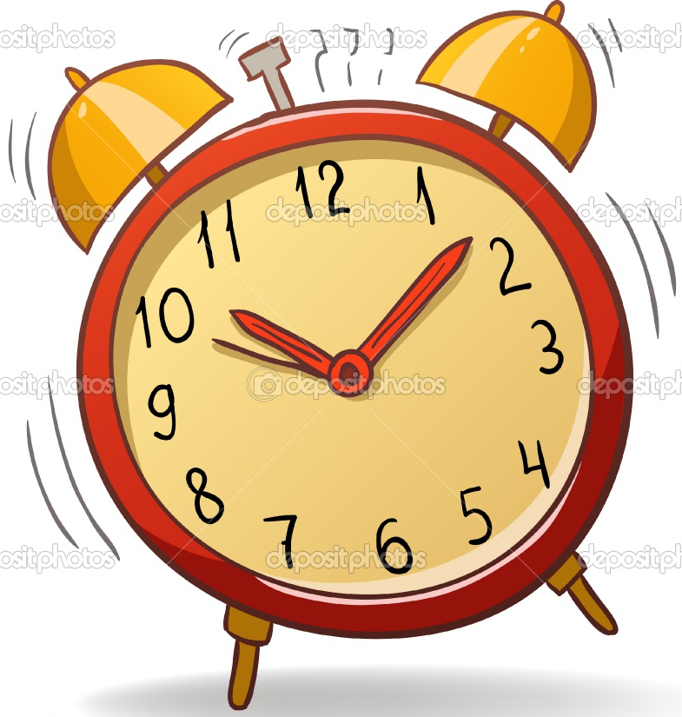
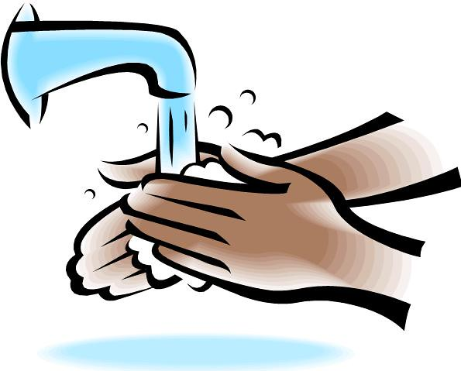
Salah: Prayer- Prayer in the Mosque, at home, times and preparation
Sunni Muslims are required to pray at five set times during the day.
Prayer times change because of the sun, therefore differs from summer to winter.
It’s a part of the self-discipline required in submitting themselves to God.
How do Muslim’s prepare for prayer?
Muslims must be spiritually clean before they pray. It is achieved by wudu. This is instructed in the Qur’an. Mosques have two special rooms, one for men and one for women. Washing is done under running water, so they are clean. It symbolises spiritual cleanliness rather than physical cleanliness. It allows Muslims to focus fully on God in their prayers.
Fajr | Just before sunrise
Zuhr | Just after midday
Asr | Afternoon
Mahhrib | Just after sunset
Isha | Night
Shi’a Muslims combine the midday and afternoon prayers and the sunset and night prayers, so they pray 3 times a day.
Direction of Prayer
Muslim’s must face the holy city of Mecca.
Meaning that they are physically and mentally focusing on a place associated with God.
All Mosques have a Mihrab on the Qiblah wall, which shows the direction they face when praying.
Sometimes Muslim’s have a special compass to show the way.
Prayer at Home | Prayer in the mosque
Acceptable to pray at home. They must perform Wudu before they pray. The room must be clean and suitable. Many Muslims will use prayer mats and position it facing Makkah (Mecca) Women find it helpful to pray at home especially if they have children to look after. | Mosques have special carpets that look like rows of prayer mats, facing mihrab- giving them a suitable space. Prayers a led by Imam who is at the front of the congregation but also facing the mihrab. Men and women are separated by a curtain or they pray in separate rooms. The imam’s voice is broadcasted in the women’s room.

Slide 5
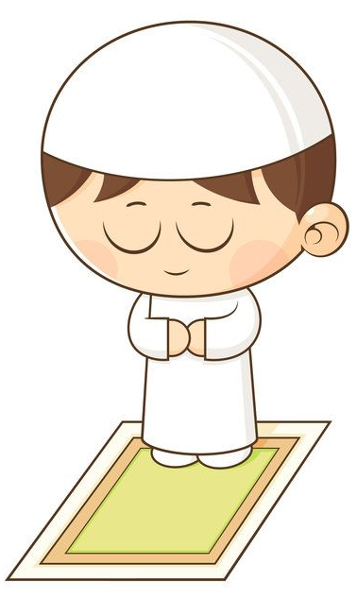
Salah: Prayer- Jummah, movements and importance
The Rak’ah:
Sequence of actions and recitations. The Rak’ah changes slightly depending on which prayer it is used in.
Most include:
Jummah Prayer
The midday Friday prayer is considered special. All male Muslims are expected to attend; and women can if they want. The Imam delivers a sermon to remind Muslim’s of their obligations and duties to God. Muslin’s must leave their work and close their businesses to attend.
“Believers! When the call to prayer is made on the day of congregation, hurry towards the reminder of God and leave off your trading.”
Standing | Muslims recite the first chapter from the Qur’an.
Bowing | Muslims say in Arabic “Glory be to my Lord who is the very greatest” three times. The bowing position shows they believe God to be great.
Upright position | They make a recitation praising God.
Kneel | They kneel with their forehead, nose, hands, knees and toes touching the floor. This is called prostration and shows complete obedience to God. They recite ‘How perfect is my Lord the most High”
Sitting | They sit while reciting ‘God is the greatest’ and after pause for a few seconds.
Prostrating | While prostrated they repeat ‘God is the greatest”
Kneeling | Once the number of Rak’ah’ are completed, while kneeling, Muslims turn their face to the right and the left. Reciting “Peace be upon you, and the mercy and blessings of God.”
Personal Prayers | Can be added at the end of the final rak’ah. They do not have to be in Arabic or follow any set form.
One of the five pillars
God commanded them to prayer
Prayer gives a greater awareness of God
Motivates them to do God's will
The importance of prayer
The actions of bowing reminds Muslims God is greater and more important
Unites Muslims worldwide as they all pray the same
Reciting from the Qur’an reminds Muslims of its importance

Slide 6
Sawm: Fasting during Ramadan
Ramadan
The most important month of the Islamic calendar. The Qur’an was revealed to Muhammad during Ramadan. Many will recite the whole Qur’an over the 30 days of Ramadan. Muslims focus on fasting, charity and pleasing God.
Charity
Being hungry reminds them that the poor feel that way all the time. (Empathy)
Reminds Muslims to help the poor.
Many Muslims pay Zakah during Ramadan.
The Night of Power
Marks the beginning of God’s revelation to Muhammad. Angel Jirbil instructed Muhammad to start reading. Observing the night of power gives Muslims the benefits of worshipping for a thousand months. Muslims will try to keep awake throughout the night on each of the possible dates (of the night of power) to read and pray.
Fasting
During the daylight hours, Muslims will fast (no food or drink) Some get up before sunrise in order to eat for the day. The fast is broken at sunset. The evening meal is shared with family and friends, followed by extra prayers and readings from the Qur’an. Smoking and having sex is also not allowed. Focus for the month is on God. Fasting purifies and cleanses the soul. Considerable amount of discipline needed.
Who does not need to fast?
If Muslims cannot fast they can make it up later if they can. Health problems Pregnant women Mother's nursing babies or children. Those who are ill Children can attempt to fast for a shorter time to help train themselves.
“What will explain to you what that Night of Glory is? The Night of Glory is better than a thousand months.”
Difficulties: Muslims in the UK might think that there is more temptation to break fast. For example, PE lessons- needing a drink

Slide 7

Zakah: Almsgiving
What is it? | Where did it come from? | How it is given? | Who gets it? | Why is it important?
Giving alms (giving money to the poor) It is compulsory to give 2.5% of savings to the poor (only if you are able) Many give it at the end of Ramadan. Muslims acknowledge that everything belongs to God. Wealth should remember God and therefore help those in need. Means to purify or cleanse. | It is an instruction in the Qur’an. The Qur’an does not specify how much should be given, the percentage was worked out at a later date by Muslim scholars. | Only Muslim’s with a greater saving than the nisab (a figure) are required to give. It can be donated directly to a charity such as Islamic Relief or Muslim Aid. It can also be put into a collection box in the mosque to be distributed among the poor. Muslims are encouraged to voluntarily give their money and time to charity at any point of the year called Sadaqah. | The poor The needy Those in debt Those fighting/ working for God’s cause. Travellers in need. The Imams/ religious leaders. Orphans Parents Close relatives | It frees people from desire and teaches self discipline and honesty. Giving helps purify the soul, removing selfishness and greed. Duty imposed by God. Sign of a true Muslim. Gives good attitude towards money. Teaches people to share Strengthens community by making the rich support the poor. Links to prayer- feel concern for others and puts concern into action.
Khums
Important to Shi’a Muslims. Addition to Zakah. Originally Muslims were required to donate 20% to the leader representing the state of Islam. Today, it is still 20% but half the money goes to Shi’a religious leaders, the rest goes to the poor.
“Alms are meant only for the poor, the needy.”
“God is aware of whatever good you do.”

Slide 8
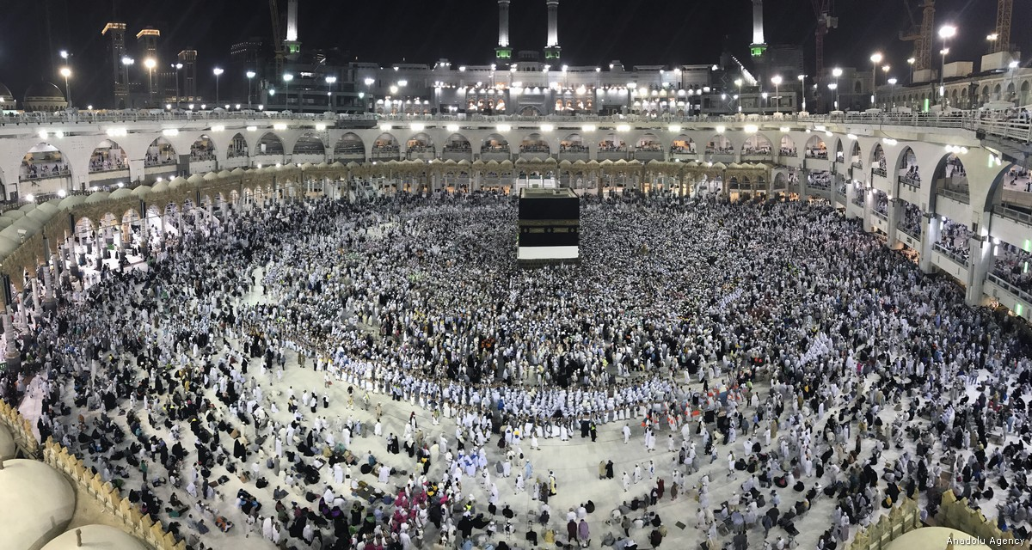
Hajj: Origins and importance
What is Hajj?
A pilgrimage (journey made for religious reasons), Muslims should make it once in a lifetime, provided they are healthy and wealthy enough. Some will help others with financial support. It is a religious obligation not a holiday. It occurs in the last month of the Islamic calendar.
“Pilgrimage to the House is a duty owed to God by people who are able to undertake it”
Origins of Hajj
Around 4000 years ago, Ibrahim was told by God to take his wife Hajira and son Ishmael to Arabia.
He was then told to leave them on their own with some food and water.
They ran out of supplies and they started to suffer. (hunger and dehydration)
Hajira ran up and down the hills of Marwah and Safa before collapsing.
She prayed to God for help which caused water to spring from the ground.
Ibrahim was told by God to build a shrine to him- this became the Ka’aba.
Centuries later, the city of Mekkah was established using the water of Zamzam (Ishmael’s well)
Over the years, Mecca was corrupted and was not restored until Muhammad returned from Madinah (the first pilgrimage)
One of the five pillars
Once completed become a Hajji
Deep spiritual transformation making them a better person
Reminds them of the faith of Ibrahim
Aware that God is watching them.
The importance of Hajj
Lead to forgiveness of sins
Teaches sincerity and humility in a relationship with God.
Shows self-discipline. Physically and mentally demanding
Emphasises unity and equality- clothing, tents at Mina
Produces inner peace

Slide 9
Hajj: Where and Why?
Preparing for Pilgrimage | Mecca | Hills of Safa and Marwah | Mecca | Mina
Before Hajj, pilgrims enter a sacred state called Ihram. It involves ritual washing, praying and putting on Ihram clothing. White is a sign of equality and purity. Women wear a single colour that cover their whole body apart from their face. | Begins at the Ka’aba. Pilgrims circle the Ka’aba 7 times. They touch the black stone or raise their hand to acknowledge it. Muslim’s circle the Ka’aba and recite ‘Here I am. Oh Lord, at your service. Praise and blessings to you.” | The crowd walked along a covered walkway linking the hills of Safa and Marwah. (Link to the story of Ibrahim) They do this walk 7 times. | Muslims return to Mecca to collect bottles of water from the well of Zamzam. | On the way to Arafat (13 miles) Muslims stop for the night at Mina, where they pray and read the Qur’an. The next morning they walk to Arafat.
Arafat | Muzdalifah | Mina | Mecca | Optional: Madinah
This is where Muhammad preached his last sermon. They spend the whole day praying in the hot summer sun. The heat form the sun is a reminded of what judgement day will be like. Some will spend all day to show the death of their faith. “Standing in Arafat” Teaches that God will forgive sins. | Muslims then walk to Muzdalifah, where they spend the night. On their way they collect 49 small pebbles to be used at Mina. | There are 3 stone walls called the Jamarat. These walls represent the devil and temptation, Pilgrims throw pebbles they have collected at the walls to show they reject evil. Many people will sacrifice and animal (links/ time of Id-ul-Adha) Pilgrims will then cut their hair. | The following day Muslims return to Mecca and circle the Ka’aba 7 more times. | Many take the opportunity to travel to Madinah to visit the prophet’s Mosque. The huge mosque is built on another small mosque (that the prophet built). It contains the tomb of Muhammad and some of the early Muslim leaders.
 |  |  | Mina
 |  |  | They then return to Mina to spend two nights there, remembering God and reflecting on his blessings before Hajj ends.

Slide 10
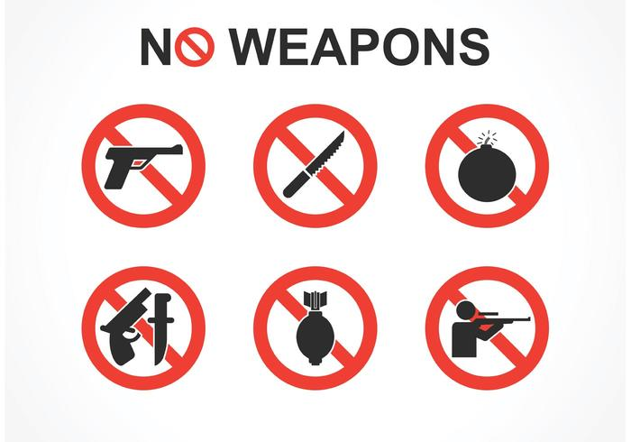
Jihad
Jihad:
Refers to the struggle against evil, either as an individual or as the collective faith of Islam.
Muslims should strive to improve themselves and the societies in which they live in a way that God would approve of.
Links back to the time of Muhammad.
“This is my path, leading straight so follow it.
Greater Jihad- The personal inward struggle to live in line with the teachings of their faith,
Observing the five pillars is a required part of greater Jihad. It is the constant struggle to purify one’s heart from all evil traits. Must devote their lives to God and avoid temptations and distractions. Some will learn the Qur’an by heart which requires a great discipline and practice. Some make great efforts to improve life for people in the community. Zakah and Sadaqah. They aim to deepen their relationship with God.
Lesser Jihad- the outward struggle to defend Islam from threat
Considered less important than greater Jihad. Muslims who are persecuted should protect their freedom to practice their faith. The Qur’an has sometimes allowed extreme violence in the name of lesser Jihad. Some believe behaving in such a violent way is justified in the context of war. However it does not justify terrorism that targets innocent civilians. Fighting for a religious course is sometimes referred to as a Holy war.
Holy War Criteria:
Declared by a fair religious leader.
Cannot be used to make people convert to Islam.
Must be in response to threat to the faith,
Must not be used to gain territory or wealth.
Must be the last resort after all other methods have been tried first.
Never allowed to justify terrorism- this is not greater jihad nor lesser. It does not bring you closer to God therefore this would not be accepted by ‘true Muslims’.

Slide 11
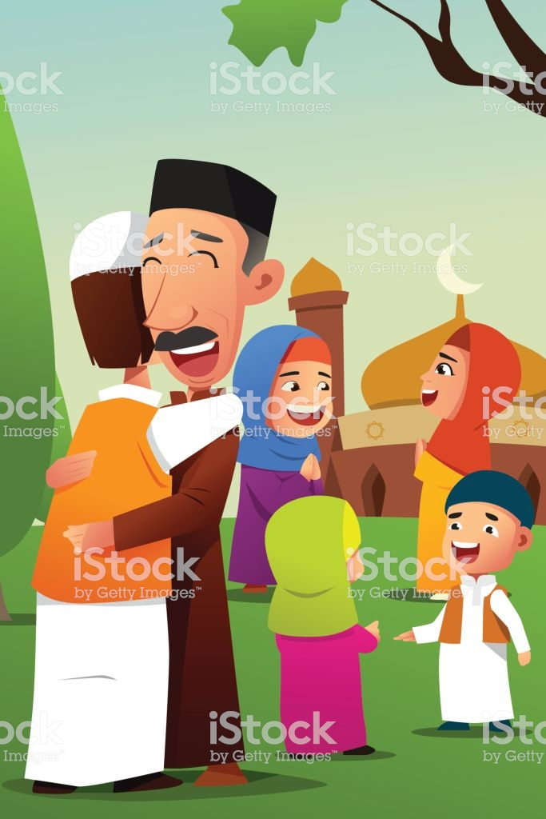
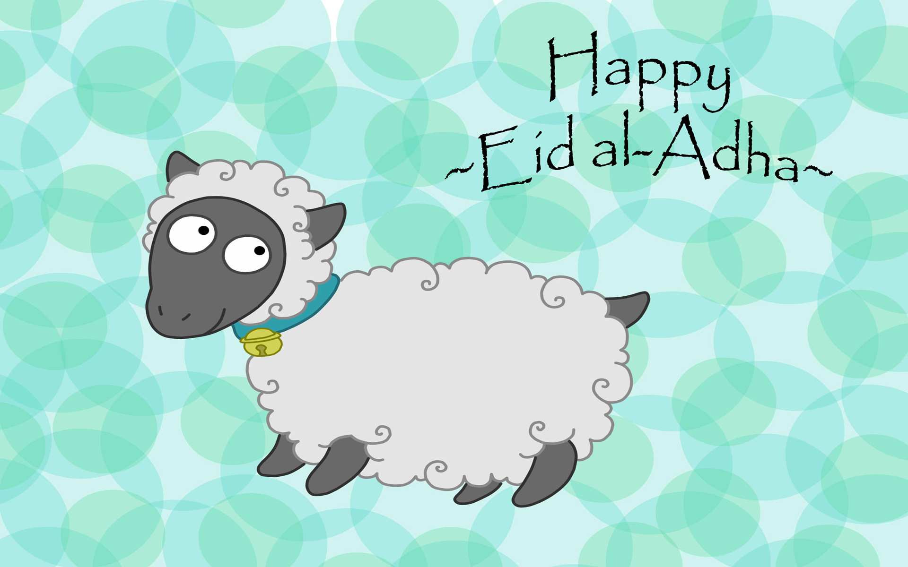
Id-ul-Fitr and Id-ul-Adha
 | The origins | Why is the festival important? | How is it celebrated?
Id-Ul-Fitr Festival celebrated at the end of Ramadan | Prophet Ibrahim noticed other festivals being celebrated in Madinah, Muhammad said God had appointed two other days that are better to celebrated. Festival of breaking the fast. Known as lesser Eid. | Celebrated the end of Ramadan. Muslims thank God for giving them the strength to help them fast for the month. Give thanks to God for guidance and wisdom from the Qur’an. Remembers that the Qur’an was revealed during the month of Ramadan. | Over 1,2 or 3 days. Muslims gather in Mosques or large outdoor areas to say special prayers. The imam’s sermon reminds Muslims that they should forgive and settle disputes. They help the poor. Women decorate their hands with henna. Special biscuits are made. Men go to mosques. Visit family members. Children are given gifts.
Id-Ul-Adha Festival that celebrates the Prophet Ibrahim’s willingness to sacrifice his son. | Prophet Ibrahim noticed other festivals being celebrated in Madinah, Muhammad said God had appointed two other days that are better to celebrated. Greater Eid or festival of sacrifice. Remembers and honours prophet Ibrahim who was willing to sacrifice his son. | It is a part of Hajj, but is celebrated all over the world. Reminds Muslim’s of the importance of sacrifice. | Lasts for 4 days. People visit family and friends. Enjoy festival meals. Go to the mosque where a sermon is given about sacrifice. On Hajj many Muslims will sacrifice an animal .Meat is given as charity People in Britain will give money instead of meat to support those in need. Cards and gifts are give.
Notes:
11

Slide 12
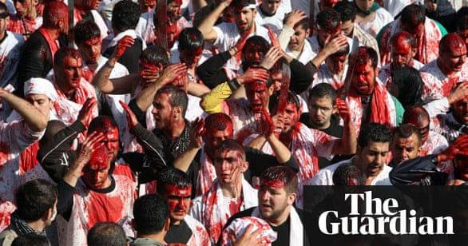
The festival of Ashura
Shi’a Muslims- Origins
Remember the death of Husayn (Grandson of Muhammad) in Karbala in Iraq. The battle was fought between Husayn and his supports and the army of Caliph. With 70 men, women and children, Their camp was set on fire and their bodies were trapled upon by the horses of their enemy, Husayn and the male followers were killed.
How is it celebrated?
A day of great sorrow because of the tragic events of Karbala. Day of mourning- reading out the poems that retell the story. Public holiday (day off) in Afghanistan, Iraq and Pakistan. Some beat and cut themselves to connect with Husayns sufferings and death. Some perform re-enactments and plays to retell the story In London, people gather in the street and some men beat themselves as a mourning ritual. Some believe they should shed blood Some will go on pilgrimage to the tomb of Husayn
Sunni Muslims- Origins
The Day of Atonement. It remembers the day when the Israelites were freed from slavery in Egypt. Some believe it remembers the day Noah left the ark after the flood.
How is it celebrated?
Some believe that Muhammad nominated it to be a day of fasting. Show kindness to family and the poor. Recite prayers and learn form Islamic scholars.
The Problems
Some religious leaders have condemned self harm and believe that it is wrong to harm the body God gave them.
UK leaders encourage people to donate blood instead.
Notes:
12

