Slide 1

The Study of Religion: Paper 1
Islam Beliefs
Revision Cards

Slide 2
The Oneness of God
Beliefs about God
Sunni and Shi’a Muslims believe that there is only one God; Tawhid. Islam is a monotheistic religion. The Arabic word for God is Allah. The Shahadah shows the belief in one God. “There is one God but Allah and Muhammad is his prophet.” God is an undivided entity. No one else and no other object has God’s attributes or qualities. The only sin that God will not forgive is the sin of shirk. Which is attributing God-like qualities to any other being or thing.
“He is God the One, God the eternal. He begot no one nor was He begotten. No one is comparable to hum.”
“You who believe, obey God and the Messenger.”
They show their belief in their daily lives.
They make God their number 1 priority
Live according to God’s will
The Supremacy of God’s will
God is the creator therefore nothing happens unless God allows it, whether it is good or bad. Everything happens under God’s will. The supremacy of God’s will is an article of faith. God’s will is supreme and above all things. Muslims often add the words ‘God willing’ (Inshallah) after they promise to do something. This lead to the belief that God controls everything and humans do not have Free Will.
They worship God
The impact of these beliefs on Muslims
“Misfortunes can only happen with God’s permission.”
They respect the prophets (not worship them)
Muslims accept that bad things happen and they are ‘meant to be’

Slide 3

Key beliefs of Sunni and Shi’a Islam
Sunni Islam | Shi’a Islam
When Muhammad died, Sunni Muslims believe that the Qur’an and the Sunnah had the authority to guide Muslims. They elected Abu Bakr to be their leader (Caliph) to make sure people follow God’s laws. The Caliph’s don’t make the laws, they enforce them. Sunni meaning followers of the Sunnah. | Shi’a Muslims believe that Muhammad had names his cousin Ali as his successor. Ali and his supporters thought that the true leaders (Imams) had to be descendants of Muhammad and chosen by God. Shi’a Muslims only accept the sayings of Muhammad that have been passed to Ali or his followers.
The Five Roots of Shi’a Islam
Angels- the Communication from God to humans.
The Prophets of God- Muhammad is the most important Prophet of God.
Tawhid- The belief in one God.
Imamate- Accepting the 12 Imams as leaders of Islam
Tawhid- The belief in one God.
The Six articles of Faith in Sunni Islam
Holy Books- The Qur’an is the highest authority
Justice of God- God is just and wise and holds humans accountable for their actions.
The Prophets of God- Muhammad is the most important Prophet of God.
The Day of Judgment- When humanity will be judged by God.
The Supremacy of God’s will- God knows all and allows all to happen.
Resurrection- After death they will be resurrected and judged by God.

Slide 4
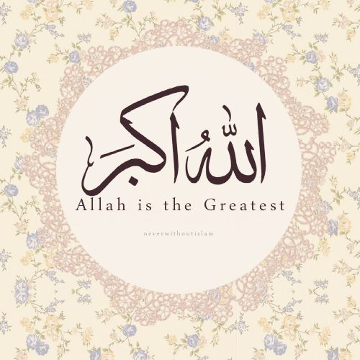
Nature of God
‘God is the greatest’:
Every day Muslims hear and say the words ‘Allahu Akbar’ meaning God is the greatest.
The names of God
God has revealed himself to the people through Muhammad and the Holy Books. There are 99 names of God in the Qur’an. These names help Muslims to understand God’s nature. Many Muslims memorise the names of God and recite them when praying. They help Muslims to feel God’s presence.
“The Most Excellent Names belong to God: use them to call on Him.”
Immanent: Within all things and close to his people
Justice and Fair: He treats people fairly and justly, and requires Muslims to do the same. Links to the Day of Judgement.
“He is with you wherever you are.”
Merciful: He understands suffering, cares for them and forgives if they are truly sorry.
Qualities of God
Beneficent: Source of all goodness. Life and the Earth is a gift.
Omnipotent: He is the creator, sustainer and owner or all things. He is all powerful
Transcendent: Beyond all things

Slide 5
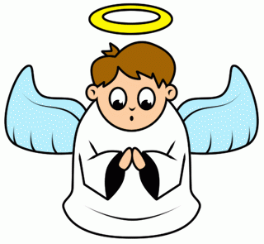
Angels
Beliefs about Angels
One of the six articles for Sunni Islam. Angels are part of the unseen world. Created from light. Receive God’s word and pass them to the prophets. They are pure and sinless. They do not have free will. They live to please and worship God. The power to take human form. Example- Ibrahim’s story and Mary (appeared as men)
The belief in angels in Islam is called Malaikah
Jibril | Mika’il | Israifil | Others
Also called Gabriel. He is an archangel and is a trusted messenger of God. Jirbril relayed the Qur’an to Muhammad. He appeared to Muhammad when he was a child and purified his heart. When Muhammad was 40 he appeared to him and told him what God wanted him to do and guided him throughout his entire life. | High ranking archangel. The angel of mercy. God assigned Mika’il to reward the righteous for the good during their lives. He also sends the rain, thunder and lightening to earth. Mika’il warns that amyone who is an enemy of God’s angels is also an enemy of God. | Will blow a trumpet to announce the day of judgement. | Record actions of humans in the book of deeds. Used on the day of judgement. Guardian angels and look after us from conception until our death. The angel od death and his helpers take people’s souls to God. Angels escort people to heaven and hell.

Slide 6
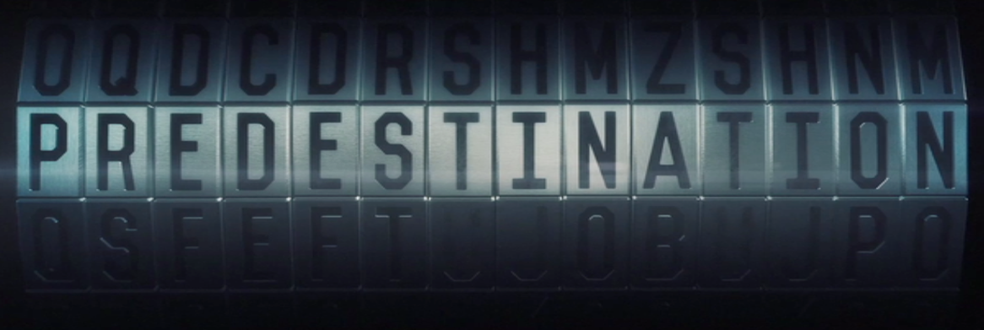
Predestination
Predestination-The idea that God knows everything and determines everything that will happen in the universe.
What is it?
God has everything written down that determines everything that is going to happen in the universe, It is written in the ‘book of decrees’. Links to the supremacy of God’s will
Link to Human Freedom
Shi’a Muslims believe that God knows all but does not decide all- meaning we have free will/ choice.
God is the creator of time and therefore is not bound by it. He is outside of time. This means he knows what has happened, is happening and what will happen.
Humans act freely and God just knows what they will do.
The Day of Judgement
God will judge humans for their actions on Earth.
This is why God has given humans free will, to make judgement fair.
He will punish those for their bad choices and reward those for the good.
God puts the responsibility back to people even though he knows what they are going to do.
“Only what God has decreed will happen to us. He is our Master: let the believers put their trust in God.”
“God does not change the condition of a people [for the worse] unless they change what is in themselves.”

Slide 7
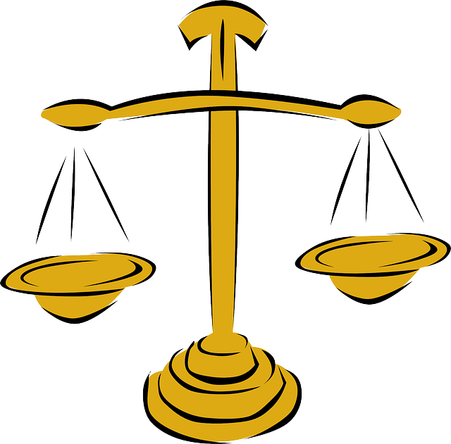
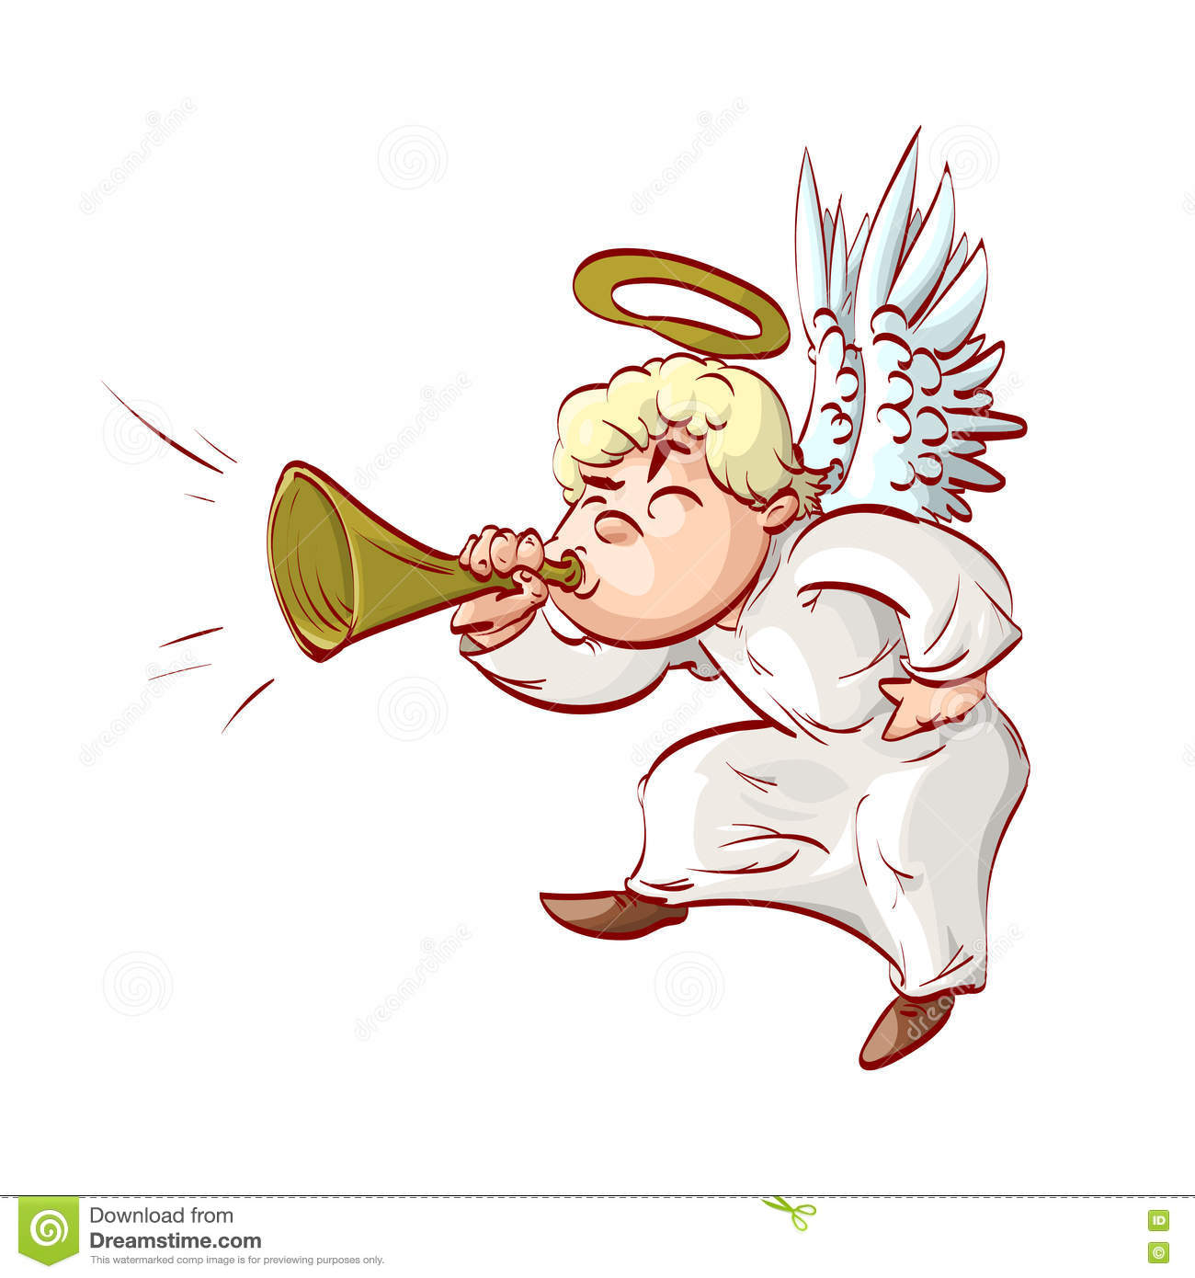
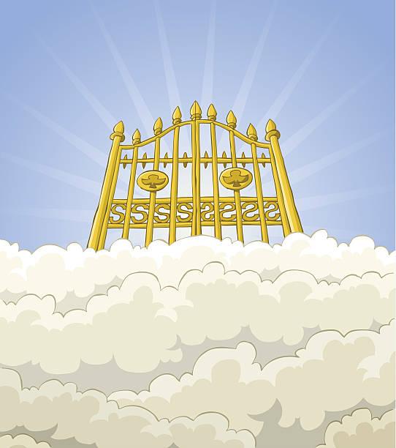

Life after death
Akhirah:
The belief in everlasting life after death.
Beliefs about life after death
Muslims believe that when they die a person still has a conscious existence in the grave. They enter a state of waiting called barzakh which means barrier. The are waiting for the day of judgement. While lying in the grave, God will send two angels to question them about their faith. This results in their rewards and punishments. Others believe that they will stay in their graves until the end of the world when the day of judgement will come.
Accept suffering and know what God will provide justice
Encourages responsibility for their actions
How does it influence Muslims?
Avoid sin and do the right thing
Aware they are accountable for their actions
The Day of Judgement | Resurrection | Heaven | Hell
Will come when God’s purpose for the universe has been fulfilled. Angel Israfil will blow the trumpet and announce that the world will be destroyed. God will forgive those who are truly spry for what they have done. God souls the souls by making them cross a narrow bridge that is over the fires of hell. | When Angel Israfil blows the horn again, everyone who had ever lived will be raised from the dead and judged by God. The book of their life will be handed to them and read out. | If the are given the book in their right hand they will go to heaven. Described as the gardens of happiness. It is a rewards for those of faith and good deeds. | If they are given the book in their left hand they will go to hell. Descried as a place of fire and torment. It is a punishment for those who reject God and do evil. It is absence from God.

Slide 8

Prophethood and Adam
What is a prophet?
Prophets are God’s chosen people to bring the message of Islam to people. Belief in prophets is known as Risalah. Method of communication between God and humans. God gives instructions to prophets to teach people about how he wants them to live. The are considered role models to believers. They are good people who live according to God’s will.
Prophet Adam
First man on earth and the first prophet of Islam.
Created by God from the dust of the ground.
Father of the human race.
God taught Adam the names of all things.
God then asked Adan to teach the angels. The angels then bowed to him
Iblis (the Devil) refused to bow and was thrown out of paradise and he vowed to tempt humans to sin.
God created Eve (Hawwa) for Adam and they lived in the garden of Eden.
Iblis deceived them into disobeying God and eating from the tree.
They were thrown from paradise and brought sin into the world.
“He taught Adam the name of all things.,,
First to learn to plant seeds
First to cook food
Bury the dead correctly
Had many Children
God told him what food to eat.
First to harvest crops
First to repent for wrongdoings
Importance of Adam

Slide 9
Prophet Ibrahim
Passed all of God’s tests
Muhammad was on of his descendants
The Story of Ibrahim
Ibrahim always wondered about who created the universe, He declared his belief in one God (Allah). He determined to stop idol worship. One day, when everyone left the town, he took and axe and destroyed all the idols in the temple. He left an axe around the neck of the biggest idol. He asked why people worship an idol that cannot speak, hear or defend themselves. Ibrahim was burned alive. A miracle occurred and burned the chains and he walked out completely unscathed. Many people began to follow God.
Why is Ibrahim important?
Role model- obedience, kindness and compassion
Father of all nations
Refused to worship idols
Ibrahim’s link to:
The Ka’aba | Ishmael | Hajj
Small building in the middle of the mosque in Mecca. House of God and holiest place in Islam. Original built by Adam but was destroyed by the flood at the time of Noah. Ibrahim and Ishmael rebuilt It on the same site. | Ibrahim had a dream to sacrifice his son to God. Ibrahim’s willingness to be obedient save Ismael’s life and God swapped him with a lamb. He was a man of faith. During the festival of Id-ul-Adha, Muslim’s slaughter an animal to remember Ibrahim’s willingness to sacrifice his son. | Pilgrimage returns Muslims to Ibrahim's perfect faith. At Mina, Muslims throw stones at the pillars in the same way Ibrahim threw stones at the devil that tried to tempt him. When pilgrims run between the two hills they drink the water from Zamzam. This remembers the story of Ibrahim’s wife Hagar, who searched for water for her and Ishmael and God rewarded her with the well. Mecca is sometimes known as the city of Ibrahim.

Slide 10
Prophet Muhammad and the Imamate
Muhammad
Muhammad’s Life
He is known as the last and greatest prophet. Born in Mecca, was an orphan and married a wealthy widow, Khadija at the age of 25. Angel Jibril appeared to him with a message from God. For more that 20 years, Muhammad received further revelations from God making the Qur’an.
Muhammad’s preaching
After his revelation, Muhammad proclaimed that God is one. He challenged the people of Mecca to give up cheating, gambling, drinking and idol worship. Muhammad fled persecution with his followers to Madinah in 622CE. This was the start of Hajj and Ummah. After the night journey, Muhammad gathered a tribe of 10,000 Muslims converts and conquered the city in the name of Allah.
The Night Journey
Muhammad recorded this in the Qur’an. The angel Jibril took Muhammad to Jerusalem on a horse-like creature with wings. He then ascended into heaven and spoke to God and the past prophets. Isa (Jesus) told Muhammad that people should pray 5 times a day.
The Imamate
When Muhammed died, Muslim’s split into two groups, Shi’a and Sunni.
Shi’a believe that Muhammad named Ali, his successor- he became the first Imam.
Shi’a believe that Ali appointed him by divine instruction and therefore leadership should follow in the family line.
The Twelver branch of Shi’a Islam believes that there have been 12 Imams in total.
Muhammad al-Mahdi was the last Imam and kept alive and hidden somewhere on earth and will return with Jesus to bring justice and equality.
The Imams rule justly and are also the only people who can interpret the Qur’an without fault.

Slide 11
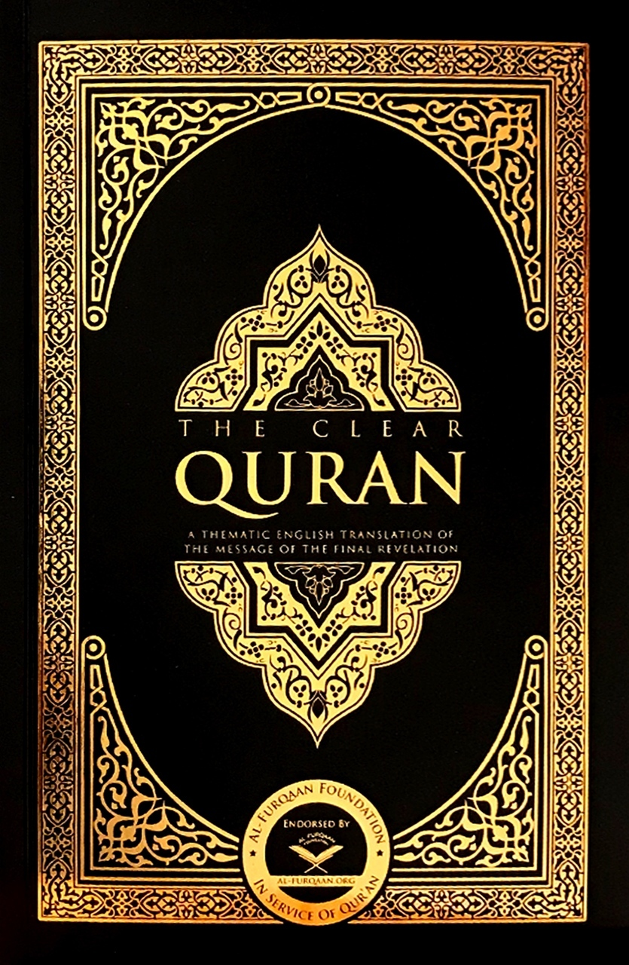
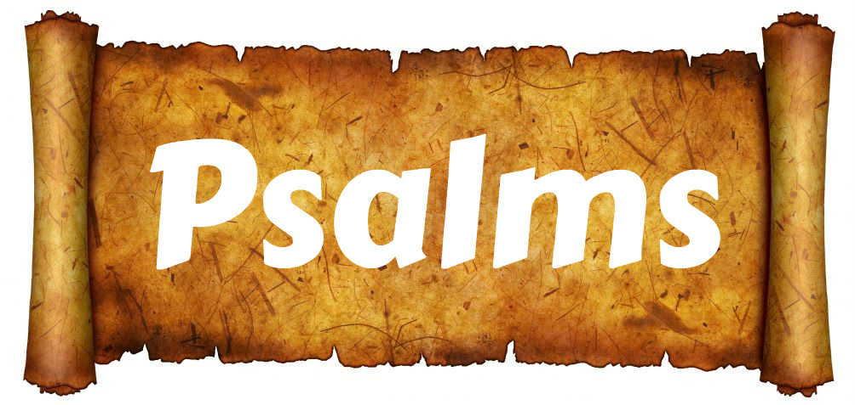
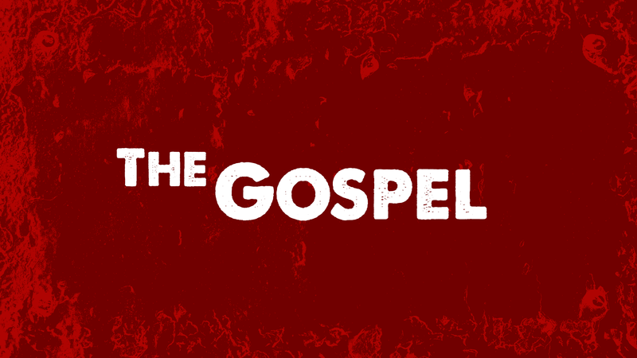
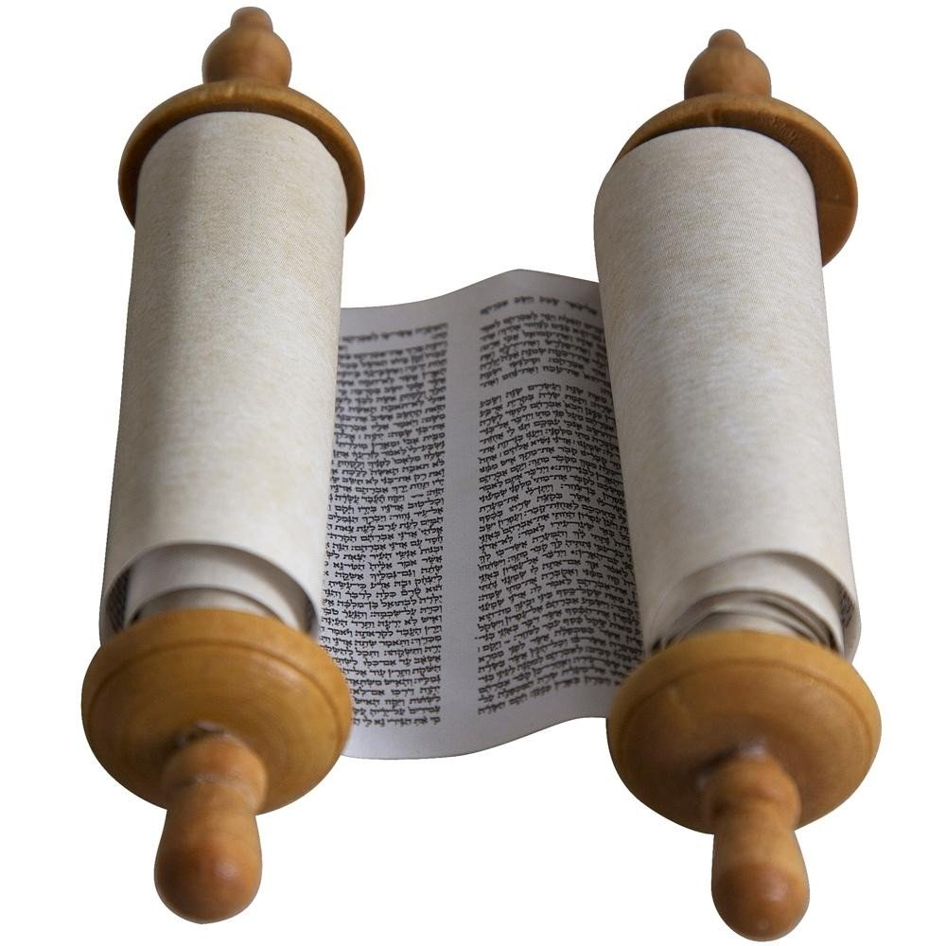
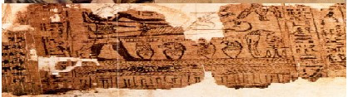
Holy Books
“This is the Scripture in which there is no doubt, containing guidance for those who are mindful of God.”
The Qur’an | The Contents | The importance
 | Mixture of historical accounts and advice on how to follow God. It begins with a short prayer to God and is used in the daily prayers. Arranged in length of chapters. Muslim children are encouraged to learn Arabic so they can read the Quran. | Word of God Foundation of every believer’s faith. Most sacred text of Islam. Infallible source of authority. Written in perfect Arabic. Original is in heaven, so when Muslims read it they believe God is directly speaking to them.
“This is truly a glorious Qur’an on a preserved Tablet.”
Other Holy Books
The Torah (Tawrat) Revealed to Moses (Musa). It is mentioned 18 times in the Qur’an. | The Psalms (Zabur) Revealed to David. It is mentioned 3 times in the Qur’an. Similar to Psalms in the Bible. | The Gospel (Injil) Revealed to Jesus (Isa) It is believed to been lost but some messages can be found in the Bible. Mentioned 12 times in the Qur’an | The Scrolls of Abraham (Ibrahim) Referred to in the Qur’an but have been lost and no longer exist. Revealed to Ibrahim.

