Slide 1

The Study of Religion: Paper 1
Christianity Practices
Revision Cards

Slide 2

Worship
Why do Christians Worship?
To praise and thank God. To ask for forgiveness. To seek God’s help for themselves or for others. To deepen their relationship with God and strengthen their faith.
Type | What are the features of this? | Why is this important? | Examples
Liturgical Worship | Church service that follows a set structure with set responses. E.g. Eucharist service in the Catholic Church or Church of England | Familiar Traditional Universal- some in all Churches | Catholic Orthodox Anglican Churches
Non-liturgical worship | No set order- can change from week to week. Hymns, Bible readings and sermon may be included. | Suits certain themes. Emphasis on word of God (i.e. the Bible) | Methodist Baptist United reformed
Informal worship: Charismatic | Free-flowing worship, may include dance, clapping, calling out. Singing and music is more modern with relaxed feelings. | Less formal and more modern More relevant to people today. | Pentecostal Church Evangelical movements
Informal worship: Waiting | No leader and no set structure. Sit in a circle in silent reflection. People may speak when they feel moved by God/ holy spirit. | Less formal More personal God speaks to individuals. | Quakers
Private worship | Personal worship- may include prayer and Bible readings. Worship aids (e.g rosary, icons) may be used. | Personal time with God. Time out from stress and everyday pressures. | All Christians

Slide 3

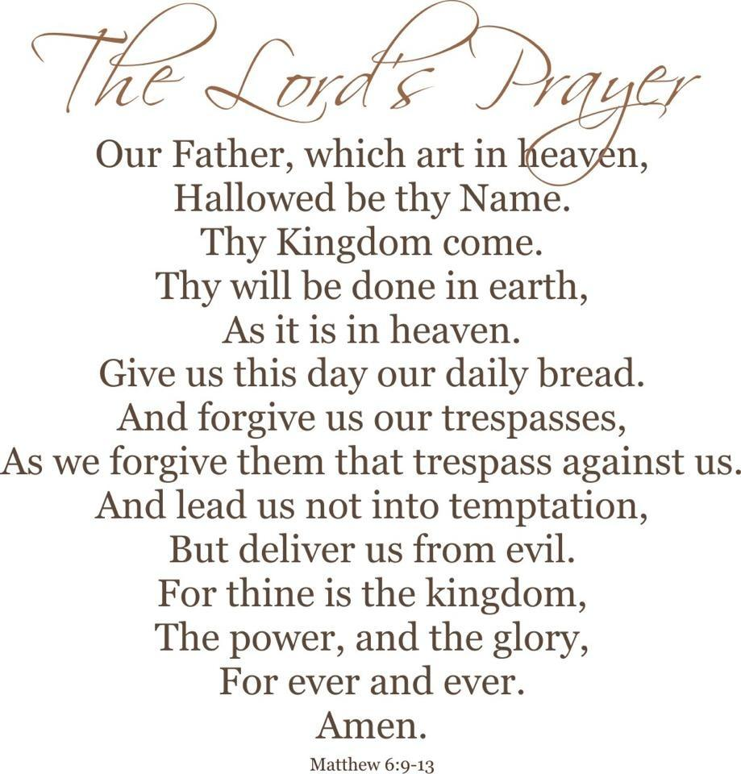
Prayer
Set Prayers | Prayers that have been written down and said more than once by more than one person (e.g. Lord’s prayer)
Informal Prayers | Prayer that is made up by an individual using his or her own words.
Importance of prayer
Enables Christians to talk and listen to God. Help Christians to keep a close relationship with God. Helps Christians to accept God’s will even if it means suffering. Gives a sense of peace. Gives strength in times of trouble. Encourages reflection in the middle of a busy life.
STOP- Reasons why Christians might pray:
To say Sorry for what they have done wrong.
To Thank God for something or someone in their life.
For Other people, family, friends or other people in need.
To say Please, to ask for something they need.
The Lord’s Prayer
This is how Jesus taught his disciples to prayer. It is a model of a good prayer- combining praise of God and asking for what you need. It shows the importance of forgiveness, you need to forgive others in order to be forgiven yourself. It is often said during worship and at Holy Communion, baptisms, marriages and funerals. It is said regularly in Church schools.

Slide 4
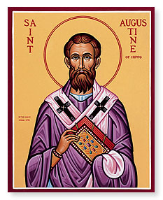
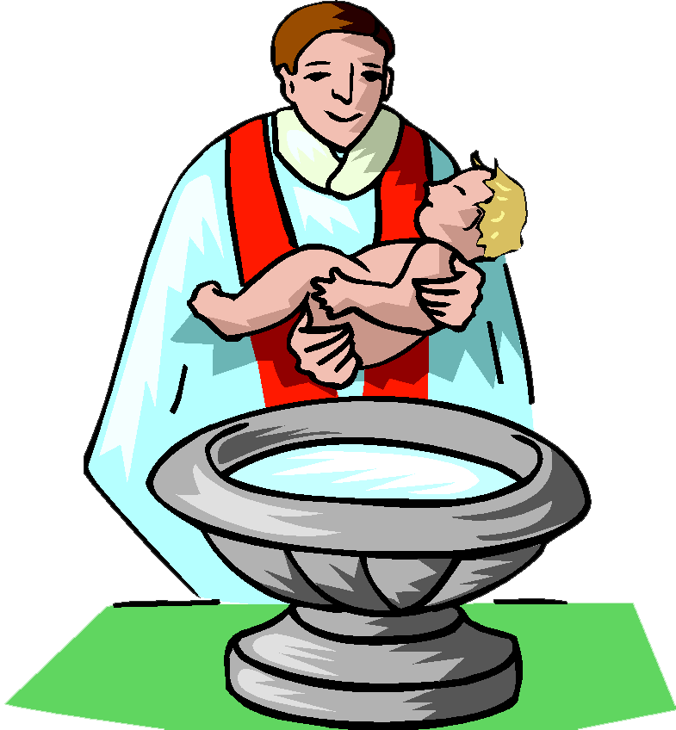
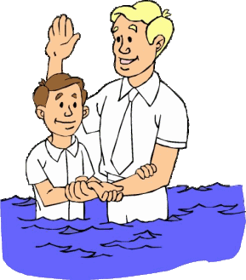
The Sacraments: Baptism
St Augustine of Hippo described Sacraments as:
Importance of Baptism
Becoming a member of the Christian Church. Becomes a child of God. Receives God’s saving grace and the Holy Spirit. A person is cleansed of sin. Enters new life with Christ in the Christian community. It imitates Jesus’ baptism by John the Baptist.
“An outward and visible sign of an inward and spiritual grace.”
Different Christian beliefs about sacraments
Catholic and Orthodox Christians recognise the 7 sacraments; Baptism, Confirmation, Holy Communion, Marriage, Holy orders, reconciliation (confession) and anointing the sick. Many Protestant Christians only accept 2 sacraments: Baptism and Holy Communion. Other Christians such as Salvation Army and Quakers accept no sacraments.
Type | Practiced by | Reasons why | What happens
Infant baptism | Catholic Orthodox Anglican Methodist | Removes original sin. Always the child to be welcomed into the Church as soon as possible. Parents can thank God for their new baby. | Priest or minister pours blessed water onto the baby’s head in the name of the Trinity. Godparents and parents make promises to God.
Believer’s baptism | Baptist Pentecostal | People should be old enough to make a decision about their faith. The decision to live a life dedicated to Jesus is what saves not being baptised. | The person is fully immersed in a pool which symbolises cleansing from sin. They are blessed in the name of the Trinity. They give a brief testimony

Slide 5


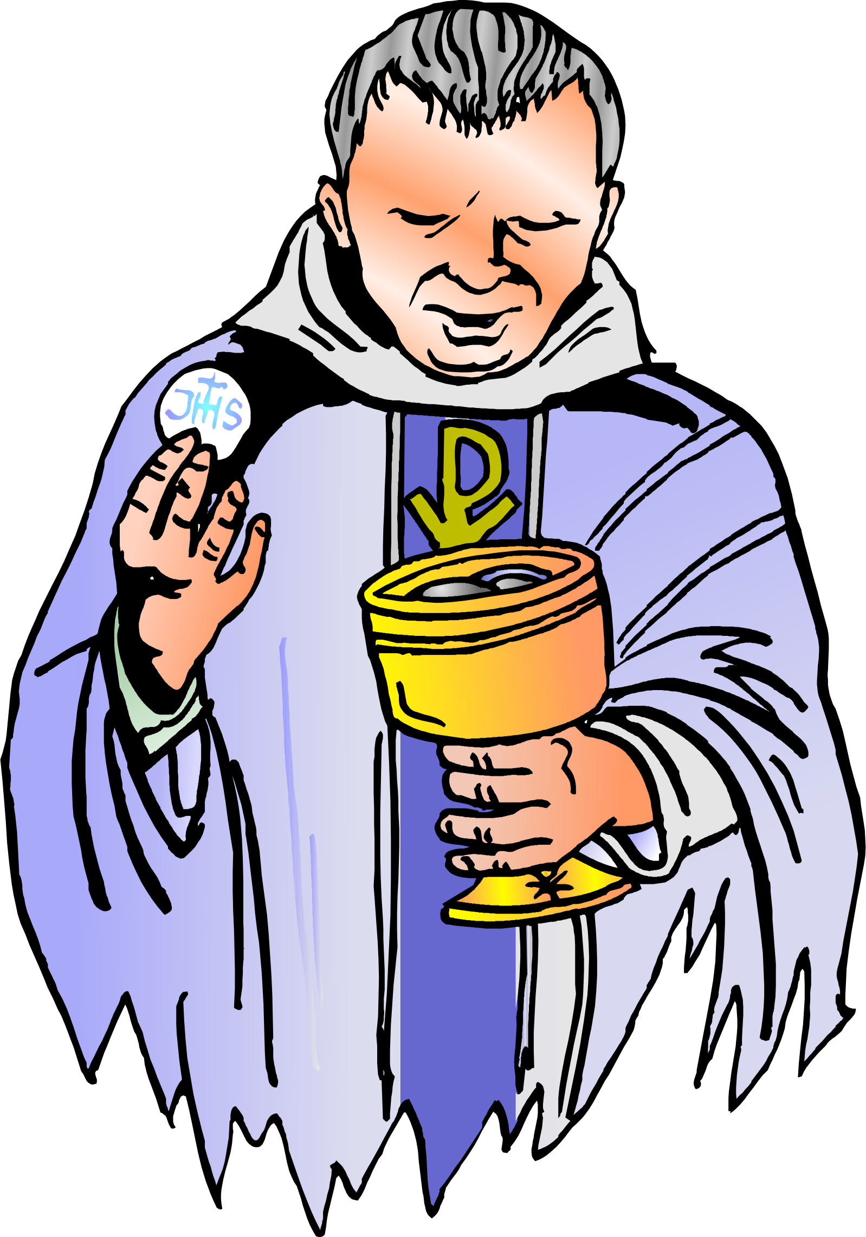
The Sacraments: Holy Communion
The Meaning of the Holy Communion
Catholics and Orthodox
They believe the bread and wine become the body and blood of Jesus.
This means Jesus is fully present in bread and wine.
This is a divine mystery and is know as transubstantiation.
Protestant Christians
They celebrate Holy Communion as a reminder of the Last Supper with Jesus.
They do not believe that the bread and wine become the body and blood of Jesus, they are symbolic.
“For whenever you eat this breaks and drink this cup you proclaim the Lord’s death until he comes.”
1 Corinthians 11:26
The importance of the Holy Communion
Individuals | Communities | Wider society
Christians receive God’s grace by joining in the sacrifice of Jesus. It helps to strengthen their faith. They believe they become closer to God. | Holy communion brings believers together by sharing the bread and wine. This can provide support and encouragement for those going through a difficult time. | It acts as a call to love other in a practical way. It encourages Christians to work for equality and justice. Many Churches collect money to support those in need.

Slide 6



The Sacraments: Celebrating Holy Communion
How Denominations Celebrate the Holy Communion differently:
Orthodox | Catholic | Methodist
Holy Communion is known as the Divine Liturgy Much of the service is held behind the iconostasis. Priest receives break baked by the members. Prayers are said for the local community and those in need. Behind the iconostasis, the priest says the words of Jesus at the Last Supper. Bread and wine is distributed on a spoon. Prayers or thanksgiving are said. Unconsecrated bread is given out to members of the Church | There are Bible reading and prayers. The Creed is said. Prayers are said for the Church and for those in need. The sign of the peace (shaking hands) is shared. Bread and wine are brought to the altar. The priests repeats the words of Jesus at the Last supper. Wine is distributed in a chalice (shared cup). Wafers might be used instead of bread. The priest blesses people and sends them out to live the gospel. | Service begins with a hymn and prayer of praise and thanks. Bible readings and sermon are given. Prayers for the world and those in need. The minister repeats the words and actions of Jesus at the Last Supper. There is an ‘open table’ anyone who wishes may receive Holy Communion. Wine is non-alcoholic and distributed in small cups. Service ends with a blessing and instruction to go and serve God.

Slide 7

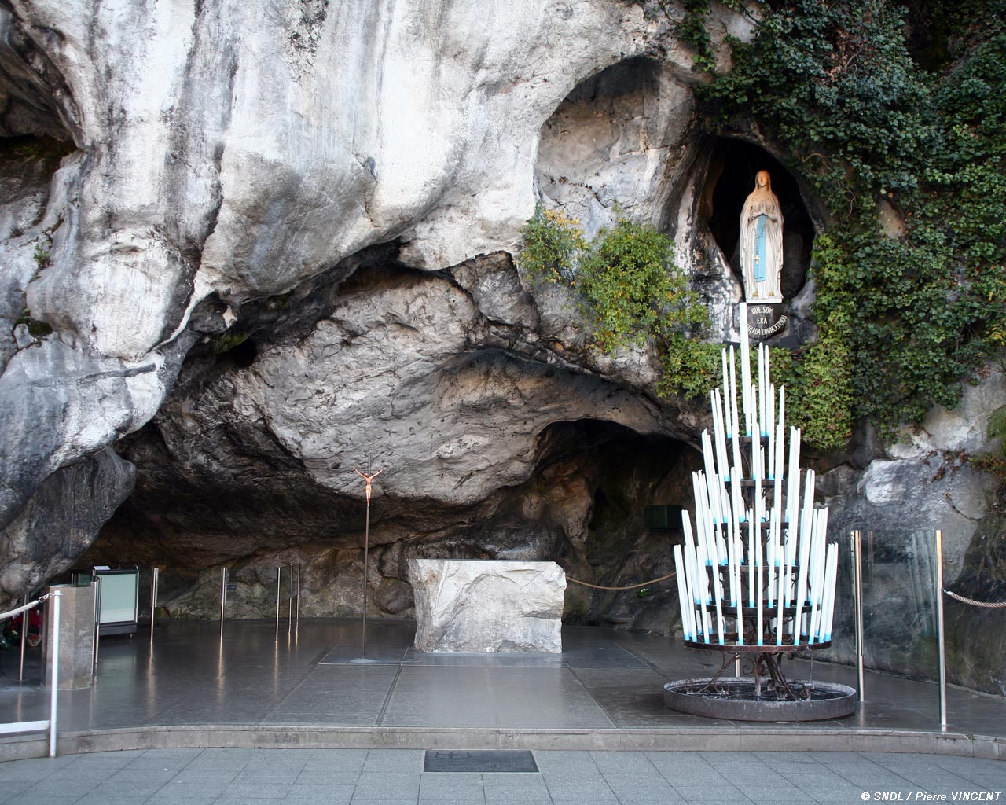
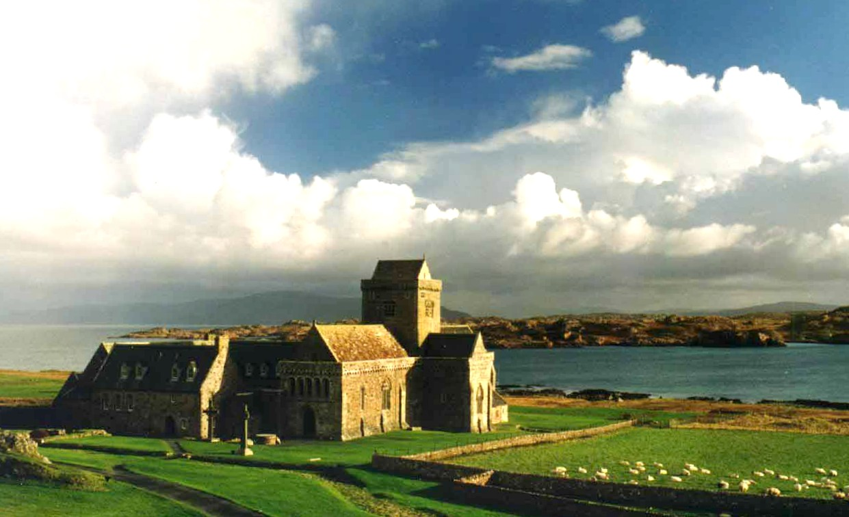
Pilgrimage
Pilgrimage:
A pilgrimage is a journey made by a believe to a holy site for religious reasons. It is a spiritual journey as well as a physical journey
Visit a holy place
Meet/ help other pilgrims
Pray for something
Be forgiven for sin
Seek for a cure for illness
Why might a person go on a pilgrimage?
Strengthen faith in God
Be thankful to God
Grow closer to God
Reflect on one’s life
Type | Significance | Activities
Lourdes (town in France) | The Virgin Mary is said to have appeared in a number of visions to a young girl called Bernadette. Many told Bernadette to dig in the ground and when she did a spring of water appeared. This water is believed to have healing powers. | Pilgrims go to Lourdes to bathe in the water of the spring, or help other pilgrims who are ill or disabled to bathe in the waters. Pilgrims also pray for healing or forgiveness. They may recite the rosary together.
Iona (Island of Scotland) | Where St Columba established a monastic (monks) community in the 6th century. The community now has a centre where pilgrims can stay | It is quiet and peaceful, a place of natural beauty. Pilgrims can spend time praying , reading the Bible, reflecting and meditating. Pilgrims also attend services in the abbey Church, take part in workshops and visit the island’s holy or historical sites.
Other pilgrimages:
Other popular paces of Christian pilgrimages include: Holy Land (Jerusalem), Rome and the Vatican City.

Slide 8

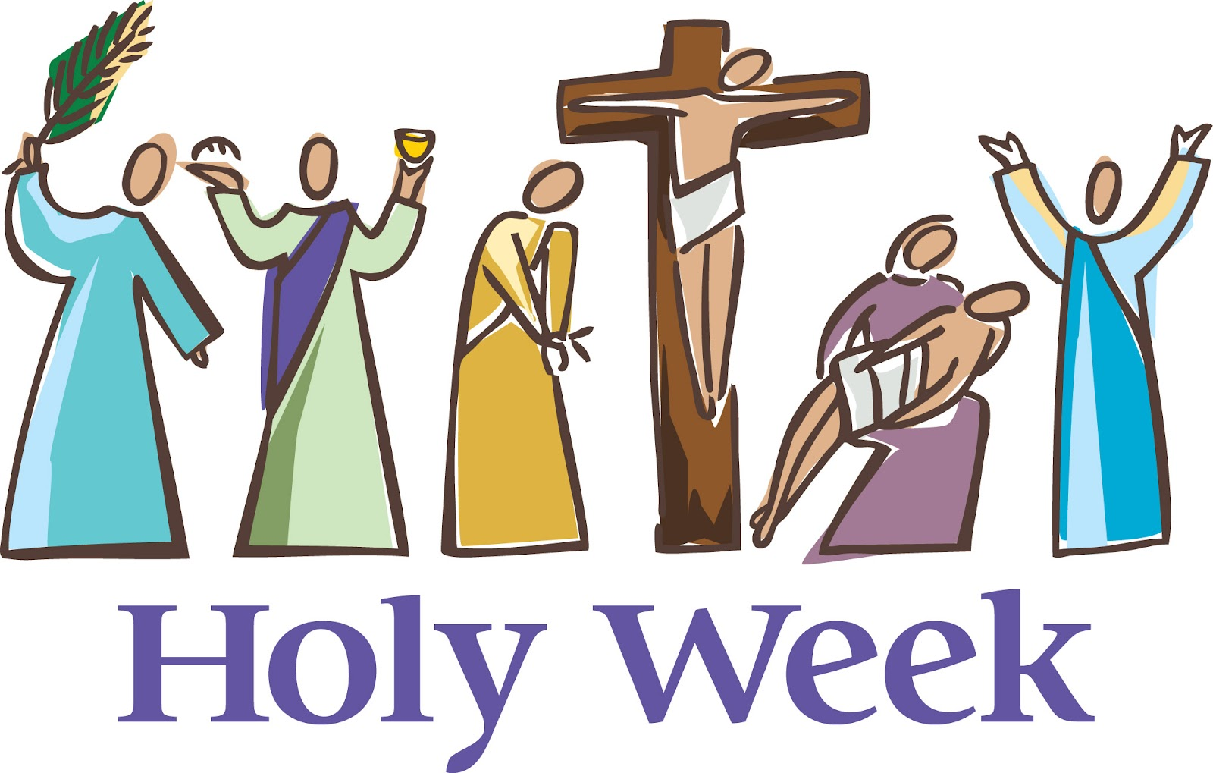
Celebrating Festivals
How is Christmas celebrated?
Lights represent Jesus coming into the world of darkness. Nativity scenes show bay Jesus being born. Carol services with Bile readings remind Christians about God’s promise of a saviour and the events of Jesus’ birth. Midnight Mass reflects the holiness of the night and joy Christians feel at Jesus’ birth. Cards and gifts recall the wisemen’s gifts to Jesus. Christians give to charity in this time of peace and goodwill.
Christmas commemorate the incarnation of Jesus, when God became human and dwelt on earth.
How Is Holy Week and Easter Celebrated?
Day | Events | How is it commemorated?
Palm Sunday | Jesus’ triumphant entry into Jerusalem | Christians are given palm crosses in church services. These are kept until the next year and burnt on Ash Wednesday.
Maundy Thursday | The Last Supper and the arrest of Jesus | The Queen gives out ‘Maundy Money’ to elderly people, symbolising Jesus’ instruction to ‘Love one another’. The ‘Mass and Last Supper’ is celebrate.
Good Friday | Jesus was out to death on the cross | Colourful items are removed from Churches and no candles are lit symbolising the death of Jesus. Processions are led through towns and cities, often remembering the stations of the cross.
Easter Sunday | Jesus rose from the dead. | Churched are filled with flowers and special hymns are sung to rejoice in the resurrection. The priest declares ‘Christ has risen.’
This Photo by Unknown Author is licensed under CC BY-NC-ND
This Photo by Unknown Author is licensed under CC BY-NC-ND

Slide 9
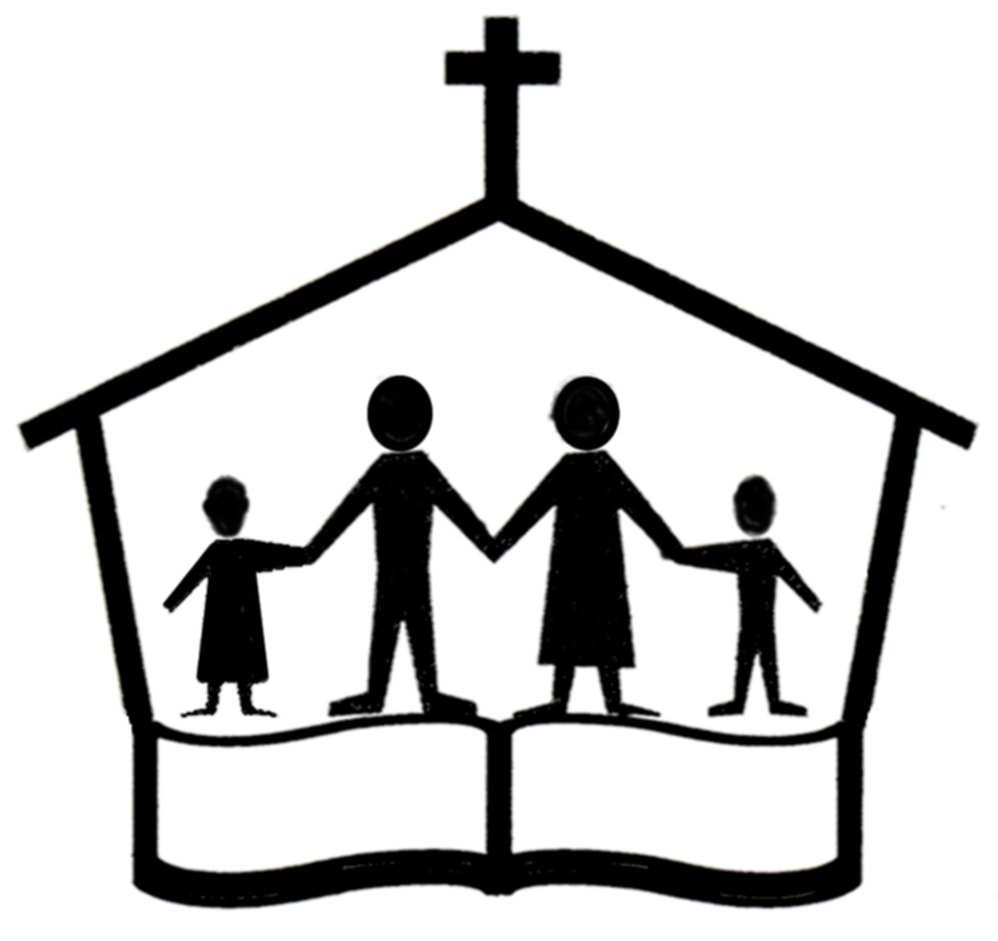
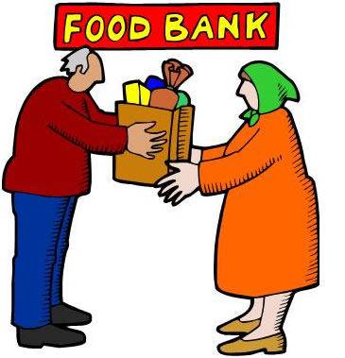


The role of the Church in the local community: Food banks
What does the Church and the church do?
Individual churches and the Church (worldwide Christian community) help to support local communities in many ways:
The Church (Capital C)
Support local projects such as food banks to support the needy. Provide social services such as schooling and medical care. Help those in need. Campaign for justice.
Individual churches (lowercase c)
Educate people about Christianity (e.g. Bible study groups) Meeting places for worship. Provide activities for young people. Places where Christians can socialise and be guided spiritually.
Examples of the Church Helping the Local Community:
The Trussell Trust
Charity running over 400 food banks un the UK.
Food donated by churches, and boxes in supermarkets.
Aim to bring religious and non-religious people together to end poverty
The Oasis Project
Project run by Plymouth Methodists.
Provides internet café, training courses, job club and food banks.
Spiritual and practical advice given to those in need

Slide 10


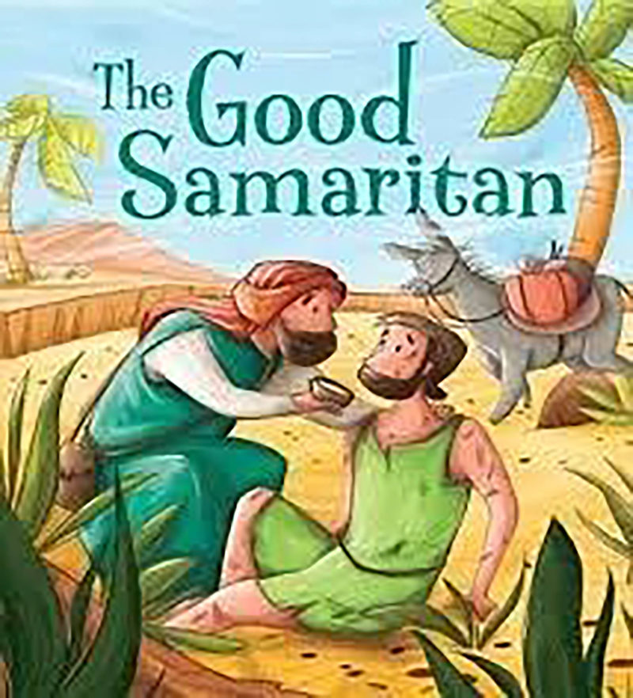


The role of the Church in the local community: Street Pastors
The importance of Helping in the Local Community
Jesus taught that Christians should help others by showing agape love towards them.
Jesus teaches Christians that they should give practical help to people in need.
The Golden Rule teaches that you should treat others in the way that you expect to be treated. | The book of James teaches “Faith without actions is dead”. It is important to put the teachings of Jesus into practical action. | The Parable of the Good Samaritan shows that you should help all people in need whether friend or enemy. | The Parable of the Sheep and Goats shows that it is important to treat all people as through they are Jesus.
Street Pastors
Started in London in 2003. Volunteers are trained to patrol streets in towns and cities. The main aim originally was to challenge gang culture and knife crime in London. The focus was widened to respond to drunkenness and anti-social behaviour. They work closely with the police and councils. They listen to people’s problems and advice ion where they might get help. They provide water, food and clothing (including flipflops). School Pastors were set up in 2011 to discourage illegal drug use, bullying and anti-social behaviour in schools.

Slide 11

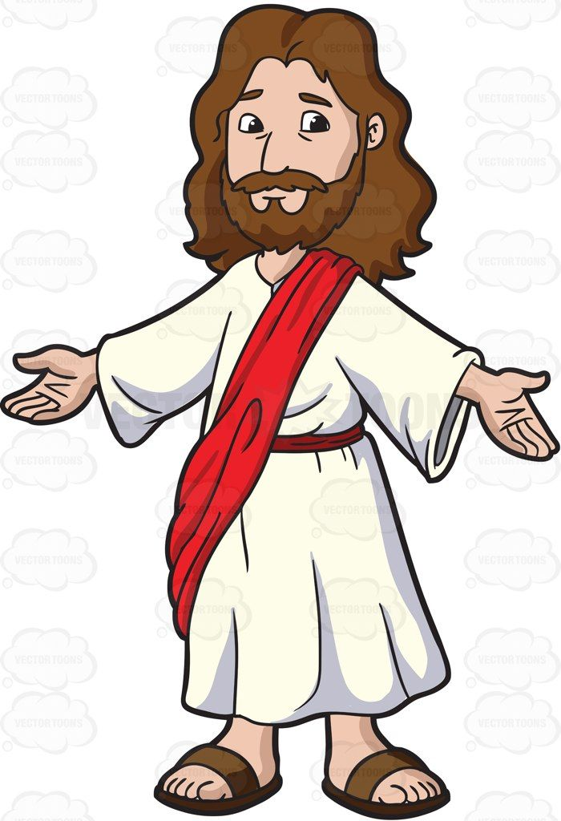

The Place of Mission and Evangelism
The Great Commission
The Great Commission is the instruction from Jesus to his disciples to spread the gospel (good news) and make disciples of all nations through baptism. The Holy Spirit at Pentecost gave the disciples the gifts and courage needed to carry out the Great Commission. All Christians have a duty to spread the gospel and tell others of their faith. Some Christians become missionaries or evangelists (people who promote Christianity, for example by going to foreign countries to preach or do charitable work.) They aim to persuade people to accept Jesus as their saviour.
“Therefore go and make disciples of all nations, baptising them in the name of the Father, and the Son and of the Holy Spirit.”
Evangelism:
Spreading the Christian gospel by public peaching or personal witness.
The Alpha Course
Alpha is an example of evangelism in Britain. It started with the aim of helping church members understand the basics of the Christian faith. The course is now used as an introduction for those interested in learning about Christianity. It is described as “an opportunity to explore the meaning of life” through discussions. Courses are held in homes, workplaces, universities and prisons as well as churches.

Slide 12
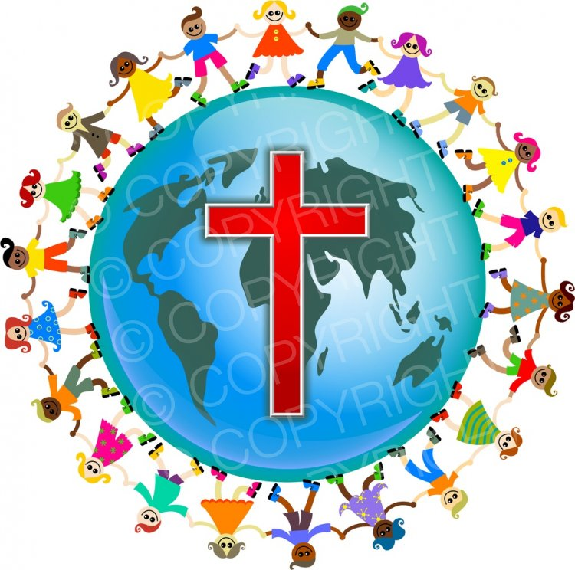
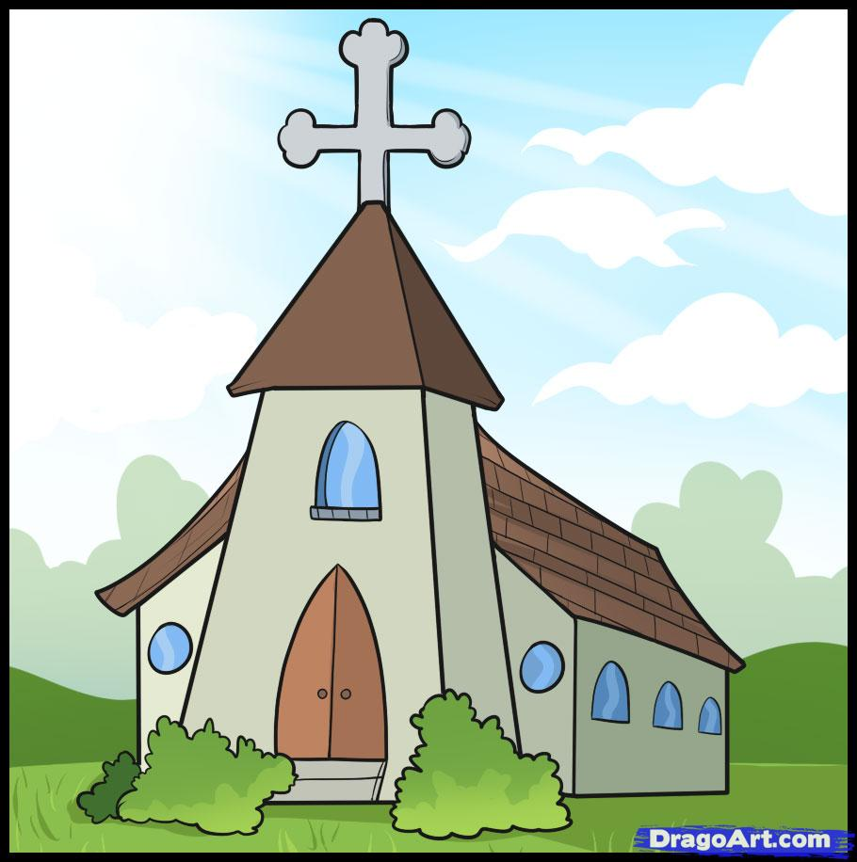
Church Growth
The Growth of the Church
The Church is growing rapidly in South America, Africa and Asia but not in the USA, Europe and the Middle East. Worldwide, 80,000 people become Christians each day and over 500 new churches begin. The Church’s mission is to make new disciples, not just new believers. Everyone should spread the faith of Christianity. Evangelism should be followed by training new coverts (people who have converted to become Christians) in the way of following Jesus and spreading the faith. Every Christian has a role in encouraging fellow believers.
Advertising using social media (twitter/ facebook)
Talking about what God has done in their life
Media such as God TV and Christian Radio
Ways Christians spread the faith:
Inviting people to other events of church
Praying for others to accept God in their lives.
Inviting friends to different ways of ‘doing’ church
Telling friends and family about their beliefs.

Slide 13
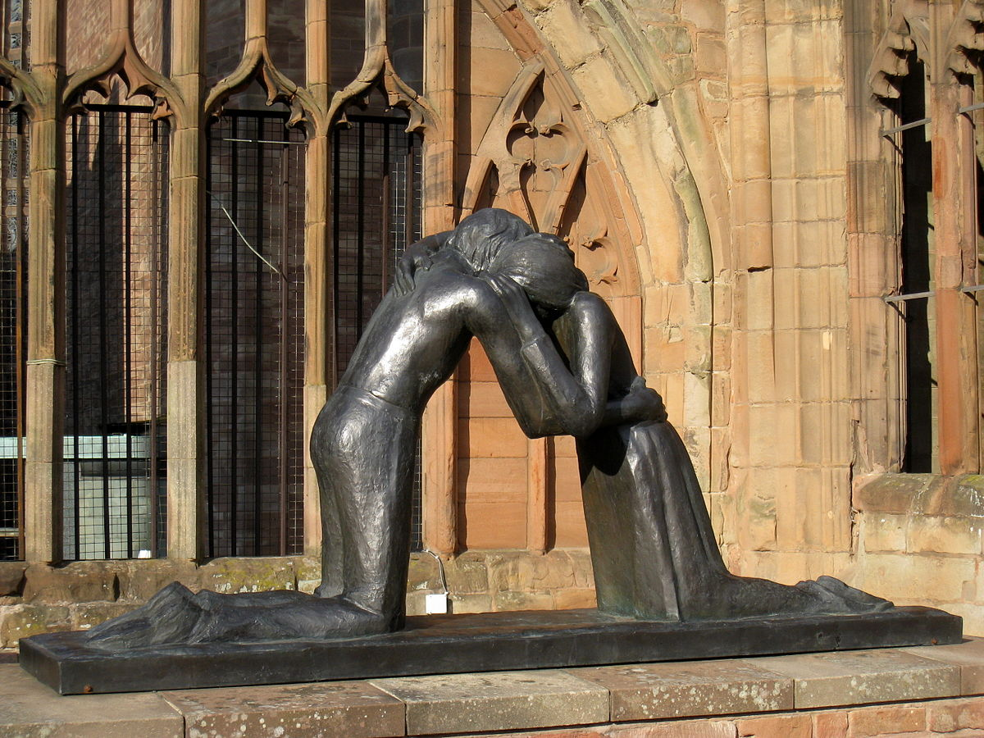


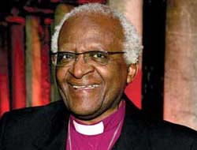
The Importance of the Worldwide Church
Reconciliation is the restoring of harmony after relationships have broken down
Working for Reconciliation
Christians believe humans were reconciled to God through Jesus’ death and resurrection. This helped restore the relationship between God and humanity which has been broken through sin. The Gospel of Matthew (New Testament) teaches that Christians should be reconciled to each other. Reconciliation is therefore an important port of the Church’s work. This might involve anything from trying to restore relationships between people, to work for peace between different groups or nations.
Corrymeela Community
Brings together people from different backgrounds, include people of different faiths and politics. Meet at a centre in Northern Ireland to build trust and explore ways of moving away from violence so they can work together.
Desmond Tutu
Former Archbishop of Cape Town in South Africa. Companied against the apartheid (segregation) in South Africa. He campaigned for justice but did not allow the use of violence. He led meetings of reconciliation between victims and preparations.
Irish Church Peace Project
Brings Catholics and Protestants together in Northern Ireland. Aims to develop peace and understanding between the two denominations.

Slide 14
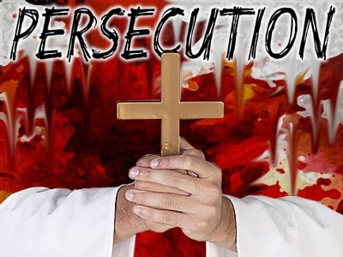

Christian Persecution
What is Persecution?
Religious persecution is hostility, ill-treatment or discrimination because of a person’s religion. It is estimated that 80% of all acts of religious discrimination today is aimed at Christians. This persecution happens around the world but particularly in North Korea, Somalia, Iraq and Syria
Examples of Persecution
Being forced to pay extra taxes to government. Job discrimination Being forbidden from building churches. Attacks on homes, churches and family, including murder and rape.
Some Christian responses to Persecution
Persecution might have a positive effect- it strengthens faith and allows them to share in the suffering of Jesus. | The Church believe it is important to act against persecution by supporting persecuted Christians. | Christians are encouraged to show love and forgiveness towards their persecutors.
“I want to know Christ- yes to know the power of his resurrection and participation in his suffering.”
Philippians 3:10
“Do not be overcome by evil, but overcome evil with good.”
Romans 12:21
Ways the Church helps persecuted Christians
Christians have smuggled Bibles into countries for persecuted Christians. Open Doors is a Christian charity which supports persecuted Christians. The Barnabus Fund send money to support persecuted Christians. Christian Solidarity Worldwide campaigns for religious freedom for all.

Slide 15

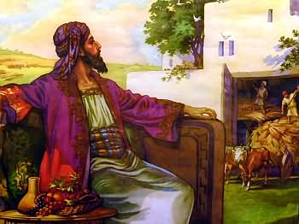
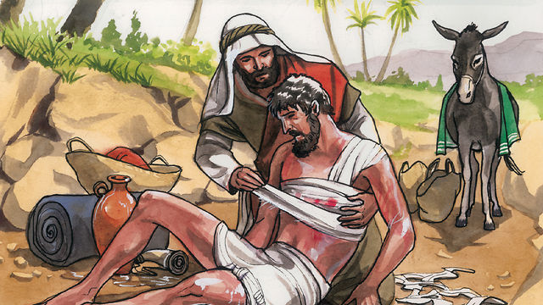
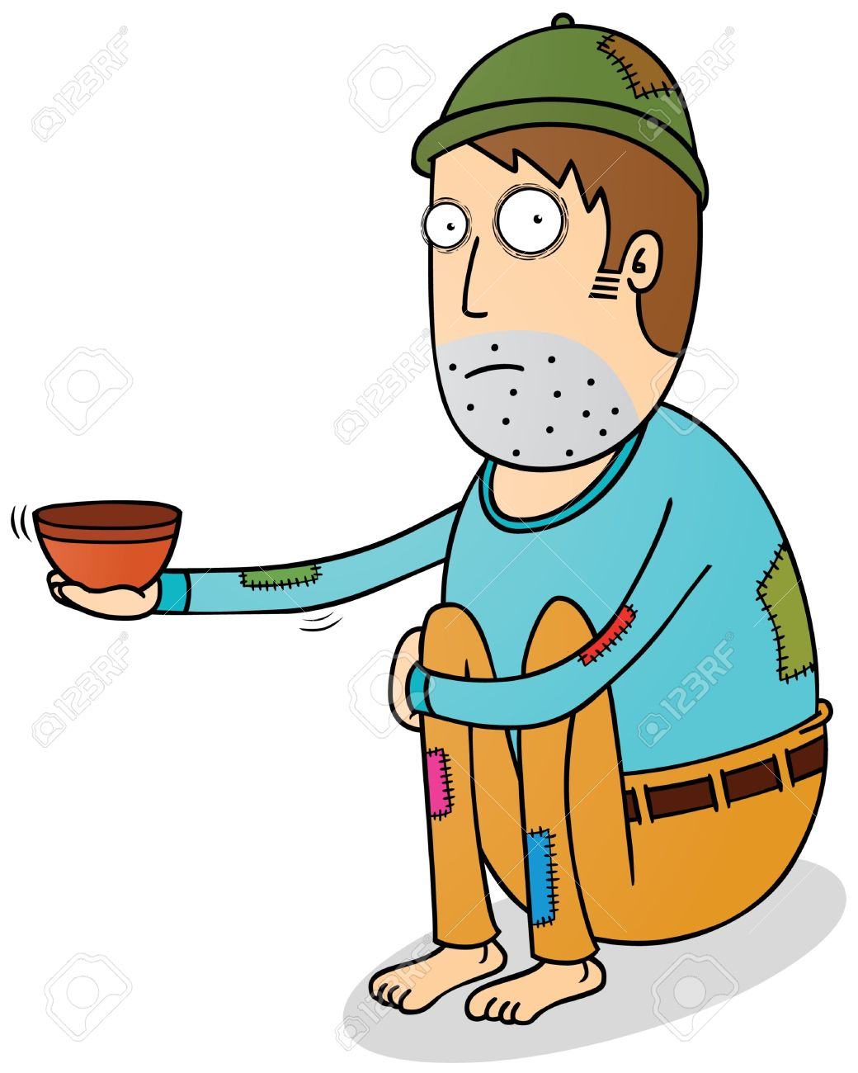
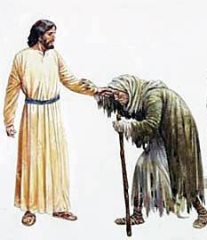
The Church’s response to World Poverty
Helping those in Poverty
Christians try to help those living in poverty because Jesus taught that this was important. Three Christian charities that support those in poverty are Christian Aid, Tearfund and CAFOD.
Teachings of Jesus about poverty | Jesus once told a rich man to sell everything and give to the poor- “It is easier for a camel to go through the eye of a needle than for someone who is rich to enter the Kingdom of God.”
 | The Parable of the Rich Man and Lazarus tells of a rich man who ends up in hell for ignoring a beggar.
 | The Parable of the Good Samaritan teaches the importance of helping all people whoever they are.
 | Jesus helped outcasts such as lepers, tax collectors and sinners.
Causes of poverty
Debt
Natural disasters
Disease
Unfair trade
No education
No health care
Conflict
Corrupt leaders
Lack of education
Christian Aid | Tearfund | CAFOD
Supports projects to encourage sustainable development. Provides emergency relief such as food, water, shelter and sanitation. Supports campaigns to end poverty and global warming and works to encourage fair trade. | Works with churches worldwide to lift people out of poverty. Supplies emergency aid after natural disasters. Provides long-term aid to help communities become more self-reliant. Supported by fundraising and prayer from churches | Works to train and support communities to work their way out of poverty. Gives short-term aid such as food, water and shelter during disasters. Campaigns with the government. Encourages Catholic churches and schools to donate money and pray.

