Slide 1




Slide 2


Revision might not be your most favourite thing in the world…
But if you put the effort in now, you will reap the rewards for the rest of your life.
Notes:
Read through the quote with your class – emphasise the greatness of Muhammad Ali and the sacrifices needed in order to gain reward.

Slide 3

First thoughts……
Write down one concern/worry/negative belief you have about your revision to date.
Don’t write your name on it.
Crunch it up and throw it across the room (NOT AT SOMEBODY!)
Notes:
Distribute A5 paper to students – ask students to be anonymous, honest and sensible when writing their initial thoughts about revision.

Slide 4

Second thoughts……
Pick up a paper ball
Read the words or statement.
Write a positive response or advice to overcome the issue.
Be ready to share in 1 minute.
Notes:
Reinforce to students that it doesn’t matter whose paper they pick up – they are to write a positive response/piece of advice for whichever way their person is struggling.
Take responses from students – encourage oracy.

Slide 5

Focus – How good is your focus?
Focus is a choice.
Focus is about active listening, making notes, asking questions, tuning in.
Focus is about making eye contact with the person speaking.
Focus is staying on task and ignoring distractions
What distracts you?
How could you improve your FOCUS?
Write each idea on a post-it note, and bring to the front of the room (don’t put your name on)
Notes:
One post-it each for distractions/obstacles to revision
One post-it each for solutions
Provide space for these to be placed.

Slide 6
https://www.youtube.com/watch?v=Qvcx7Y4caQE
Discuss:
Procrastination: ‘to delay or postpone action; put off doing something’
Honestly, how much do you procrastinate?
In what ways do you procrastinate?
What can we do to stop it?
Notes:
Wat

Slide 7


IT MAKES SENSE TO CATER FOR THE 5 SENSES!
Hearing: Explanations, listening, podcasts, music, making up rhymes, songs or raps to help you remember
Sight: pictures, doodles, video, images, diagrams, lines, colours, drawings
Smell: scented candles, scented pens, coffee brewing in the next room when ready for a break
Touch: Stress balls, moving or sorting Q and A cards, thinking walks
Taste: rewarding yourself with snacks or sweets when you complete work. Eating fruit for brain food
Notes:
Read through this with students.

Slide 8
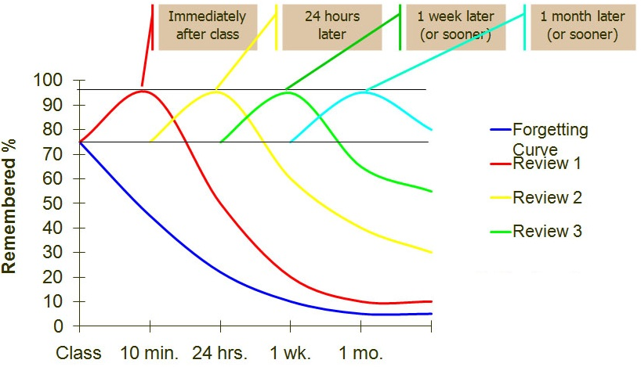
How Does Spaced Repetition Work?
While repetition is essential for remembering what you have learned, the amount of information that the human brain can absorb falls quickly over time. This is known in psychology as the Ebbinghaus Forgetting Curve
Notes:
Reinforce to students the importance of repetition over time, revisiting learning at different points – checking that understanding is still there is vital.

Slide 9
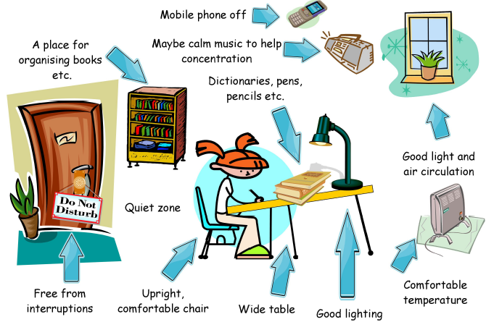
Resources needed to revise
Getting yourself in the right frame of mind and the right environment to revise is so important in minimising procrastination, keeping focus and spending MEANINGFUL time on revision.
Notes:
Read through this with students.

Slide 10
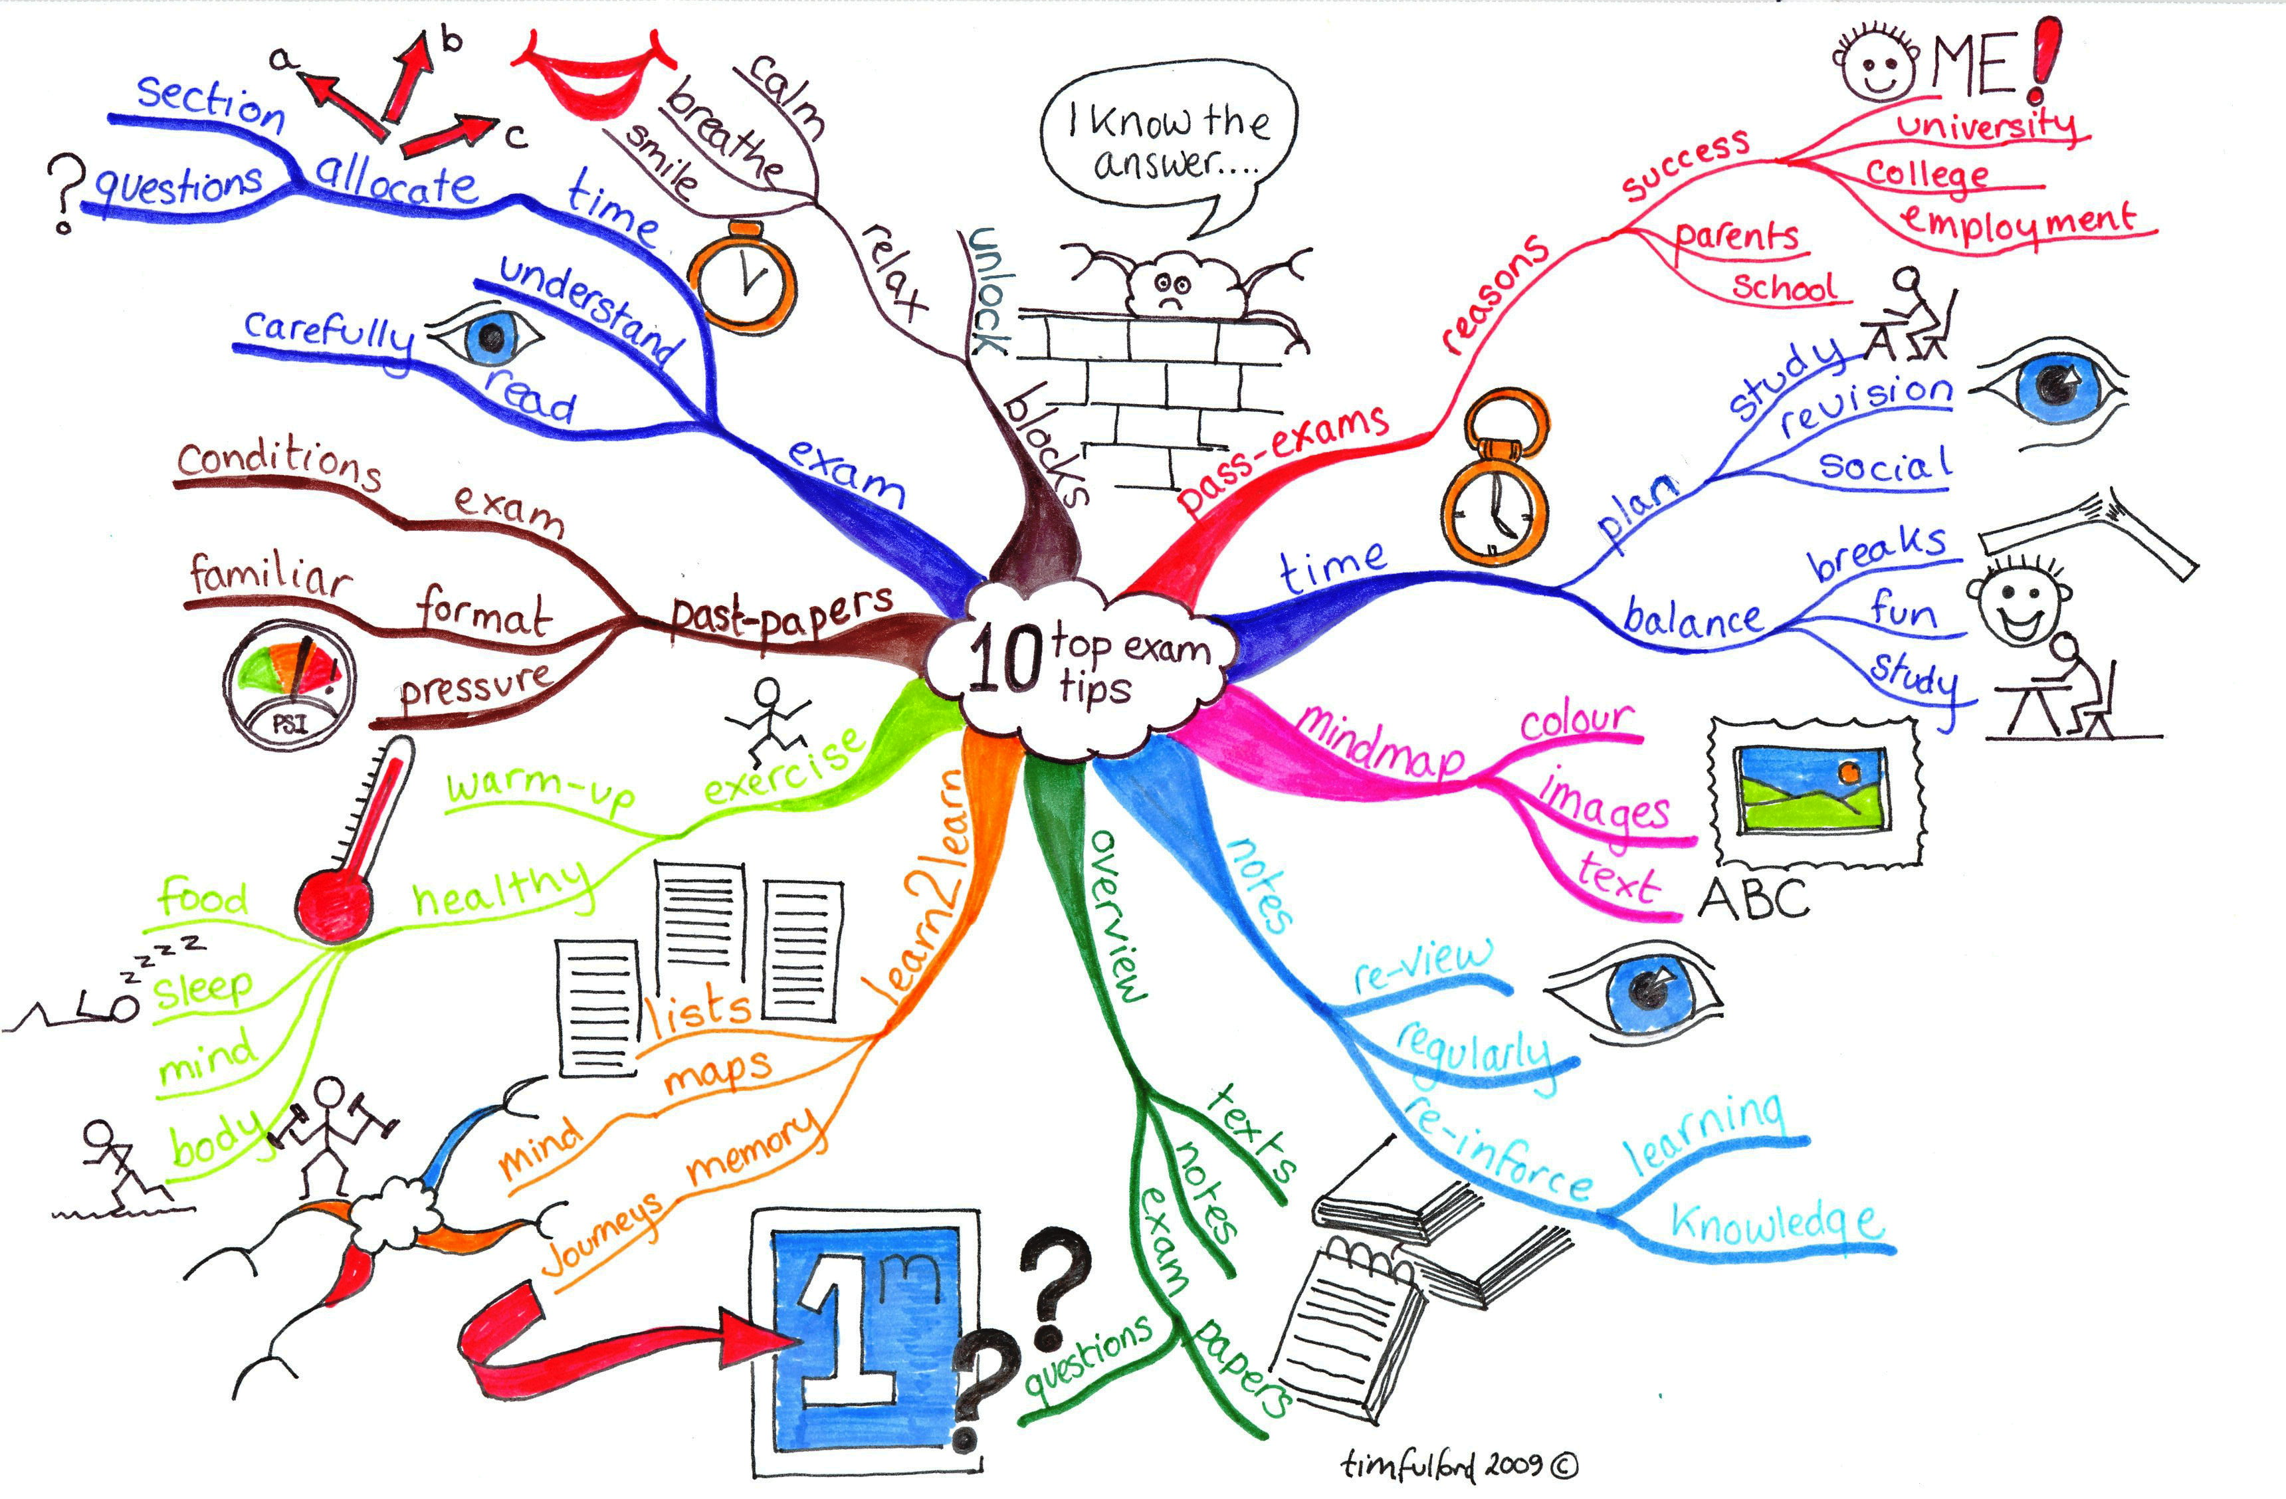
Notes:
Advise students if they would like a copy of this – they will be available from MRS BARTON on Monday.

Slide 11
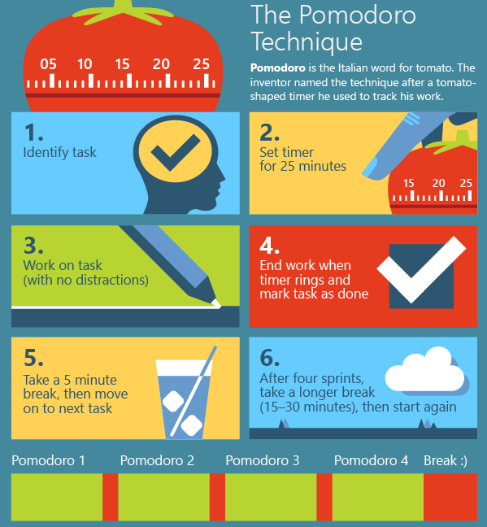
Are you working effectively?
Notes:
** NON-ESSENTIAL SLIDE** - If you feel your group are not in need of something like this, please just reinforce the importance of chunking and prioritising tasks. Reinforce the importance of timing themselves so that revision is purposeful and meaningful rather than dragged out.

Slide 12
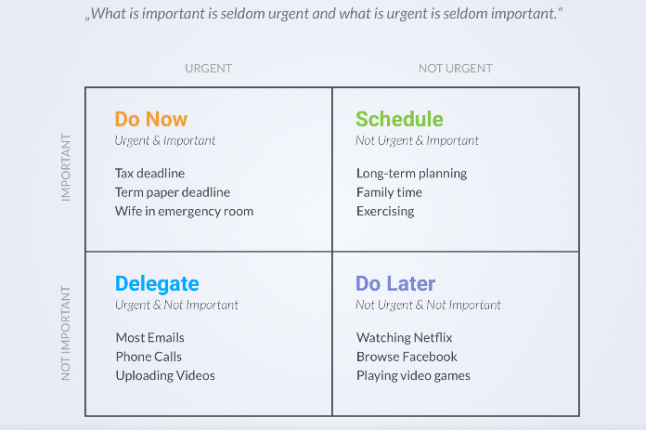
Eisenhower Matrix – Help!
Notes:
** NON-ESSENTIAL SLIDE** - If you feel your group are not in need of something like this, please just reinforce the importance of chunking and prioritising tasks. Reinforce the importance of timing themselves so that revision is purposeful and meaningful rather than dragged out.

Slide 13
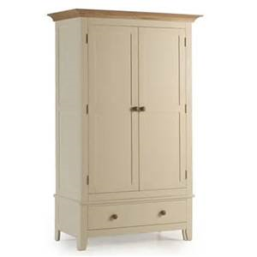
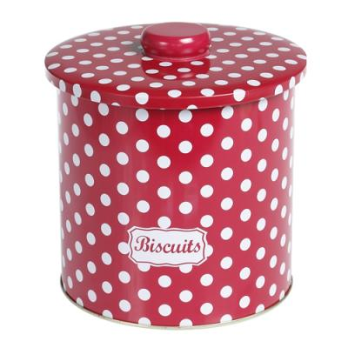
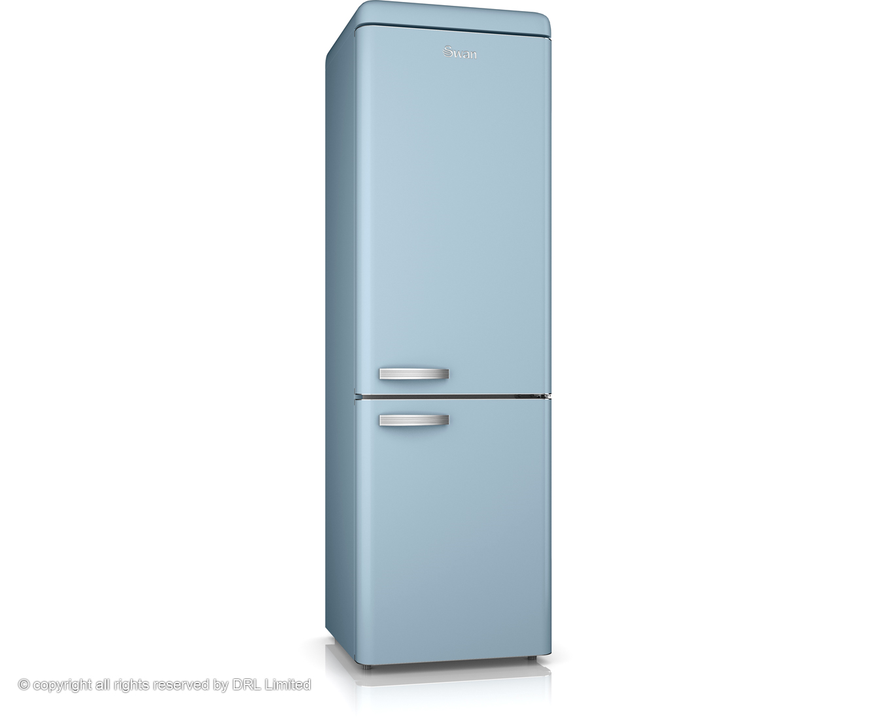

WHAT DO THE FOLLOWING HAVE IN COMMON?
Notes:
Pose this question to students – take responses.

Slide 14
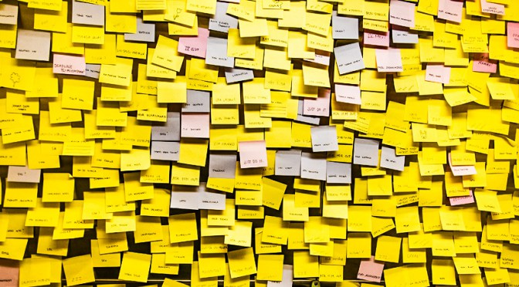
They are all an ideal place to put sticky notes
Write or draw things on sticky notes and then put them where you’ll see them. Seeing them day in day out will help you REMEMBER.
Notes:
Advise students that recall and repetition is key in revision – constantly seeing prompts (even just key words etc) will make a massive difference.

Slide 15
Ever decreasing circles (or squares)
Notes:
**IF SUITABLE FOR YOUR GROUP** - Circles decrease in size in order to show learning being condensed; the first circle/box will contain lots of information – this will then reduce to the second – and will eventually boil down to a couple of key words (prompts)

Slide 16
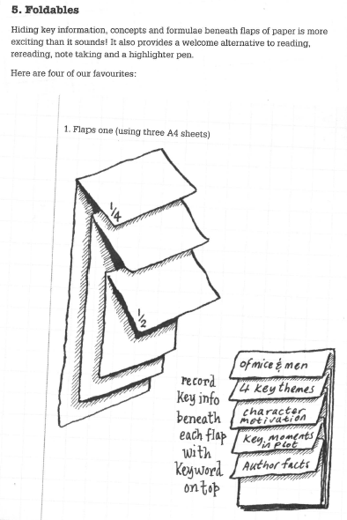
Foldables
Hiding key information, concepts and formulae beneath flaps of paper is more interesting than it sounds. It also provides a welcome alternative to reading, rereading, note taking and a highlighter pen
Notes:
**IF SUITABLE FOR YOUR GROUP**

Slide 17
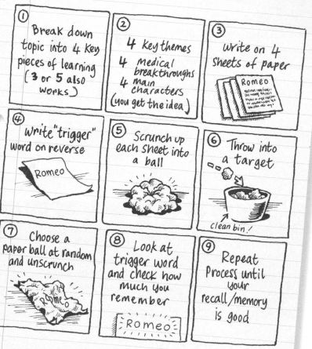
Four Revealed
Another technique to help you condense information and create ‘triggers’ for a topic. This could also be collaborative and involve testing each other
Notes:
**IF SUITABLE FOR YOUR GROUP**

Slide 18
Over to you…
You have been asked to bring along a piece of information, topic work, text which you are finding difficult to revise (or maybe you haven’t tried to revise it YET).
You are going to try some of the revision methods we have looked at today, either from this PP or from the handout[s] given to you.
You must have evidence at the end of the session of PROGRESS (e.g. at least 2 pieces of completed revision on a particular topic/area)
Your session leader has some prizes to give out to those who produce the most INNOVATIVE revision resources during the remainder of the session.
Notes:
Session leaders need to distribute both handouts provided to students – one is more simplified than the other.
Session leaders will have some high street vouchers to give out to those who have produced great revision resources for themselves, and given max effort.

