Slide 1










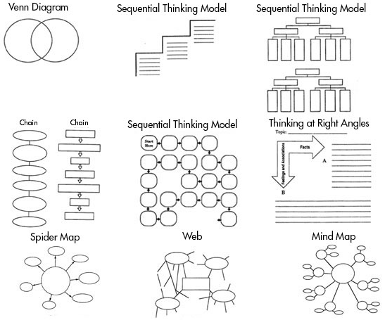
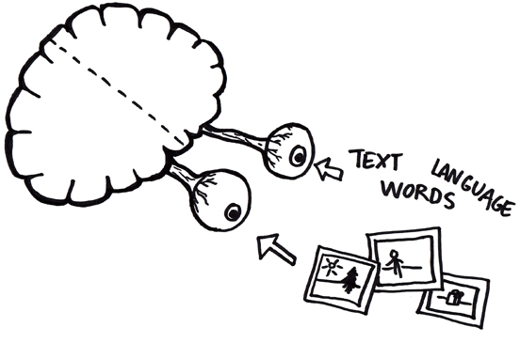
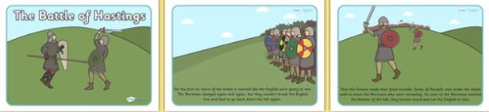
@mrthorntonteach
How do we revise?
Three common revision techniques that are LEAST effective in helping you revise are:
Highlighting texts
Re-reading
Summarising text
Whilst these methods may feel like you are revising, there are many better methods to help you revise.
Flashcards
Using Flashcards
Using the Leitner Method, using the video below
https://youtu.be/C20EvKtdJwQ
You can also create excellent flashcards online or on your phone using Quizlet
which also had an app.
Simply create with questions on side and
answers on the other side. You can colour code
for specific topics and quiz yourself or others.
Post its can be also useful for key words and timelines
How to use across subjects:
There are a variety of ways to use flashcards in revision for the skills you need
Key Terms
Create for key words and terms
Formula
Create for formula/equations you need to know
Judgments
Create an agree or disagree argument against a quote
Narrative
Create to show a narrative of events in order
Retrieval Practice
Testing what you know is a powerful tool in revision, the effort
to remember something really strengthens your memory
Apps such as Memrise and Quizlet allow you to use or create your own quizzes based on topics.
Create them, test yourself or get someone to test you, it’s works!
Types
There are a number of types you can create:
Multiple Choice Questions
True or False
Short Explanation Questions
Odd One Out
If this is the answer then what is the question
How to use across subjects:
Spaced
Test on old and new topics mixed up
Knowledge Organisers
Use to create ‘must know’ quizzes for a topic
Formula
To use a formula or equation to find a solution
Examples
‘Give two examples of……’
Transform It
Graphic organisers are a great way of ‘transforming’ your notes/information into visual revision topics.
They can be used to create links, show a narrative, identify the causes/consequences and importance of something.
How to use across subjects:
Humanities – Create a visual flow diagram of the chronological events in a time period e.g. Key events in Jesus’ life
Science – Create a Venn diagram to show what changed and did not over time within an experiment
English – At the end of a week, mind map all you can remember about a topic and link area together. Then add to your mind map using a different colour using notes/resources
How to:
Dual Coding
Dual coding’ is the method of putting your knowledge into visual form alongside words. It increases the chances of you remembering it.
Use simple drawings with
matching simple descriptions
The drawing should represent your understanding of the topic
Try to draw links between images
An example activity you can do its creating a comic strip to represent the events of the Battle of Hastings.

Slide 2
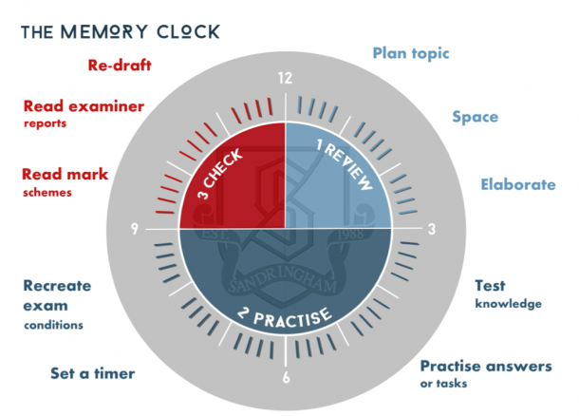
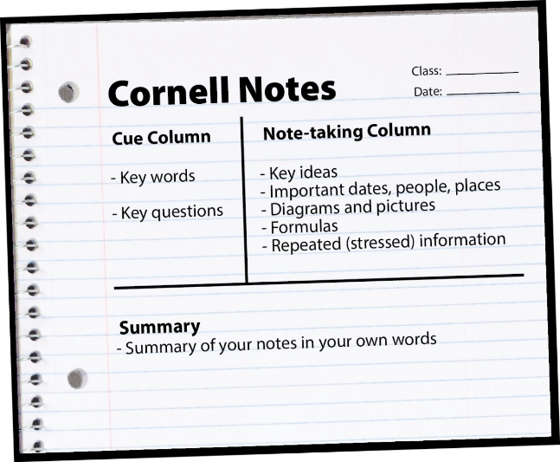
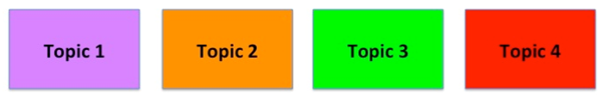
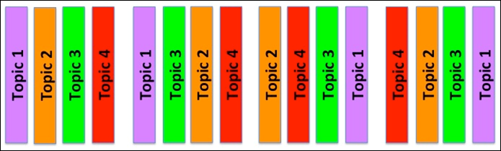
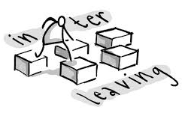

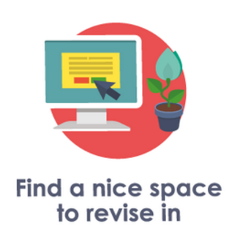

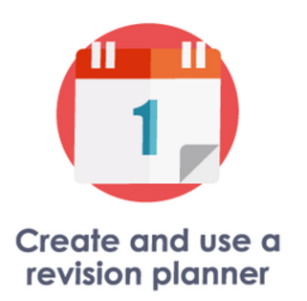

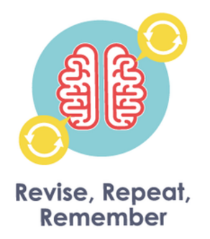
@mrthorntonteach
How do we revise?
Deliberate Practice
Set aside time to practice improving your knowledge or historical skills. Choose what you need to do, it must be tough enough to challenge you, and practice, practice, practice!
You should focus on something that you are almost able to do but not just yet!
How to use across subjects:
Use a model answer from the teacher/that you have written in class, pull it apart and identify the key parts. Then answer a similar question and try to replicate the techniques/skills.
Study material, complete practice questions in timed conditions. Then use your notes to correct / improve your answer.
A week later, redo a similar question. Repeat as necessary.
The Cornell Method
This method can be used in your revision books as a great method to get you to ‘think’ about your revision. Simply split your page into 3 sections as shown on the diagram on the left:
  Note Taking
  Cues
  Summary
How to use across subjects:
Use it to summarise a whole topic or theme, for example
How did medical treatment change or continue over time?
The story of Macbeth
Interleaving and Spacing
Don’t revise your all topics in one go (cramming), you should revise ‘chunks’ of a topic for small amounts of time (15 minutes) and then move onto another ‘chunk’ from a different topic.
This will improve your memory!
How to use across subjects:
Create a revision plan to cover topics you need to cover (least confident first!) and then go back over them again later. Spread our your learning in small sections, 5 hours to 5 x 1 hour
Use your flashcards to self test yourself on old and new topics, self testing across these
The Big Picture
The basics
The best way to aid your understanding of a topic is to make sure you are confident with the big ‘overview’ story before you begin revising individual topics.
Simply, make sure you eat, sleep and take time out!
How to use across subjects:
Create a timeline to identify the key events in a topic and colour code the themes.
Mapping out what you can remember about a topic before you start

