Slide 1

Y11 Parents Information Evening:
Using Technology to Support Your Child’s Progress
6 November 2018

Slide 2
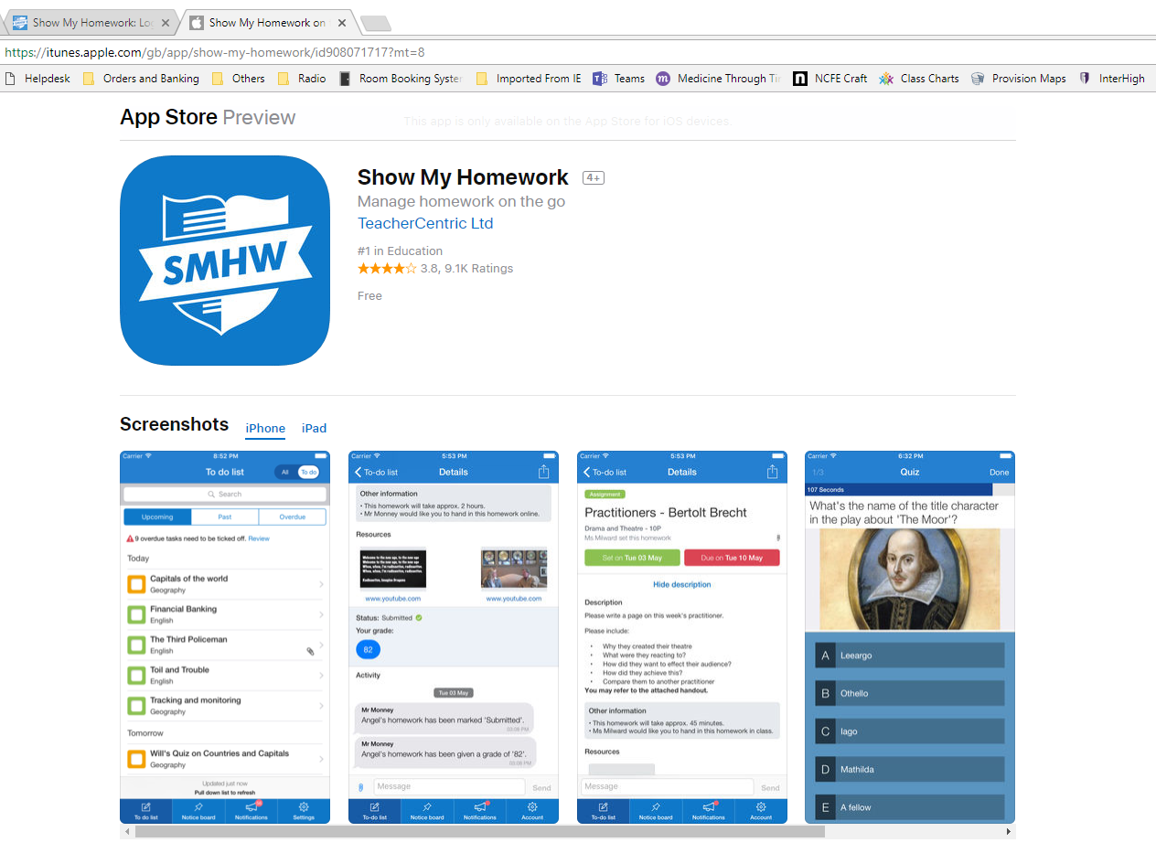
Progress and Homework: Show My Homework – www.showmyhomework.co.uk
This is the platform we use to set all homework across school.
All students and parents should have an account so they are aware of what homework has been set.
In Y11 students should always have homework regardless of what is set – this should be revision.
You can set up notifications so you never miss a homework that has been set.
You can check whether or not your child has completed their homework.
Get the app for Android or iOS

Slide 3
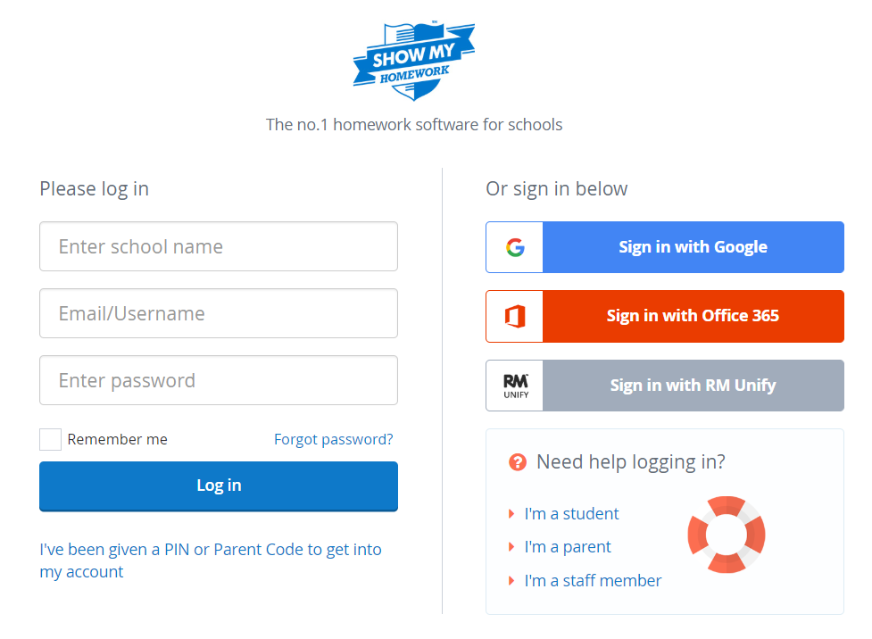
First time logging on…….

Slide 4
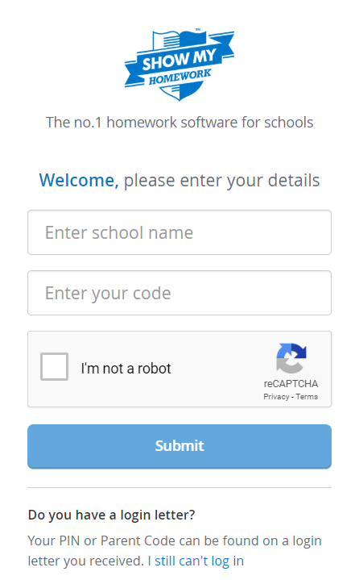
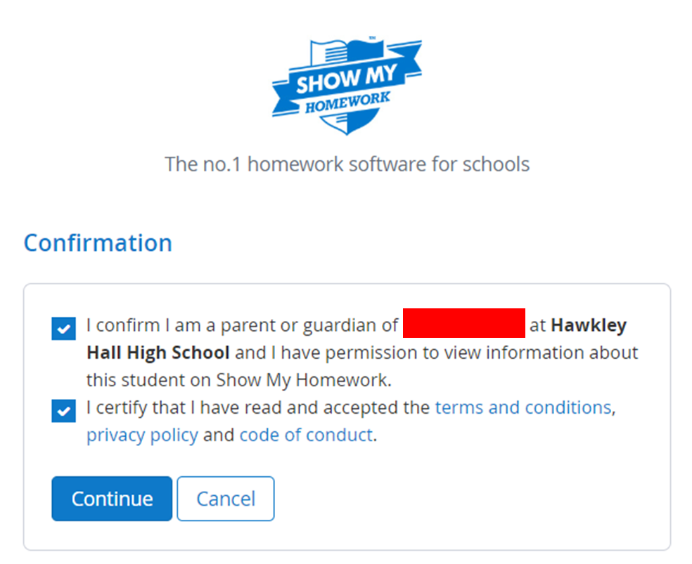
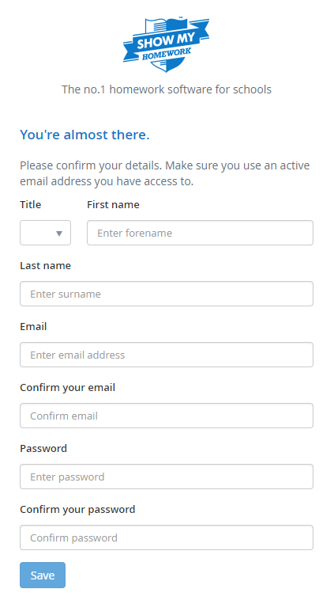

Slide 5
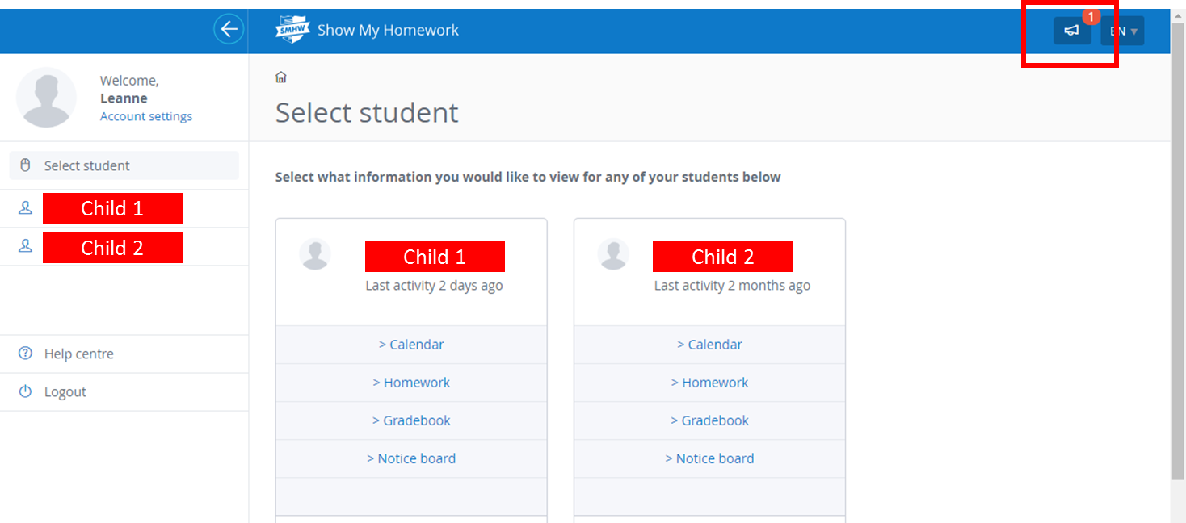

Slide 6
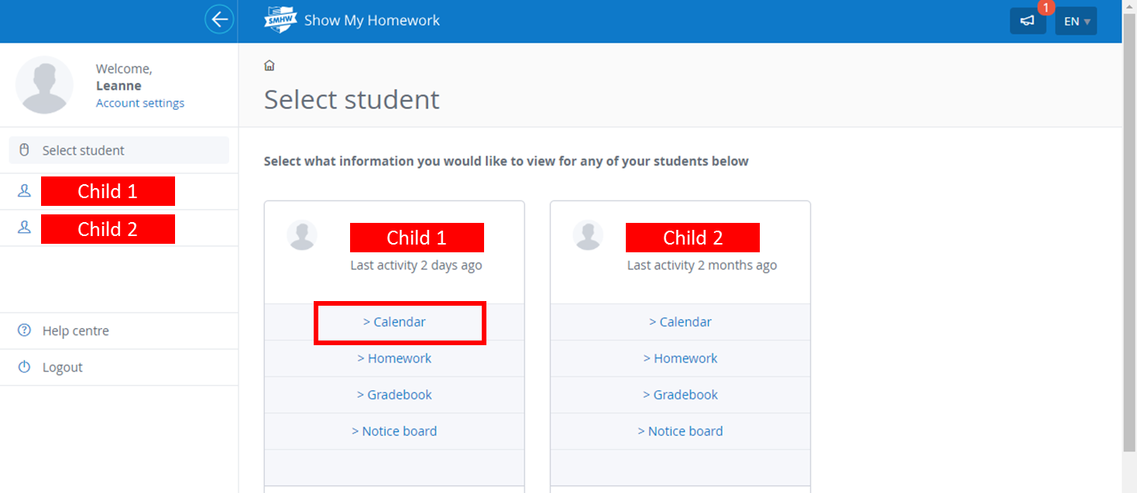

Slide 7
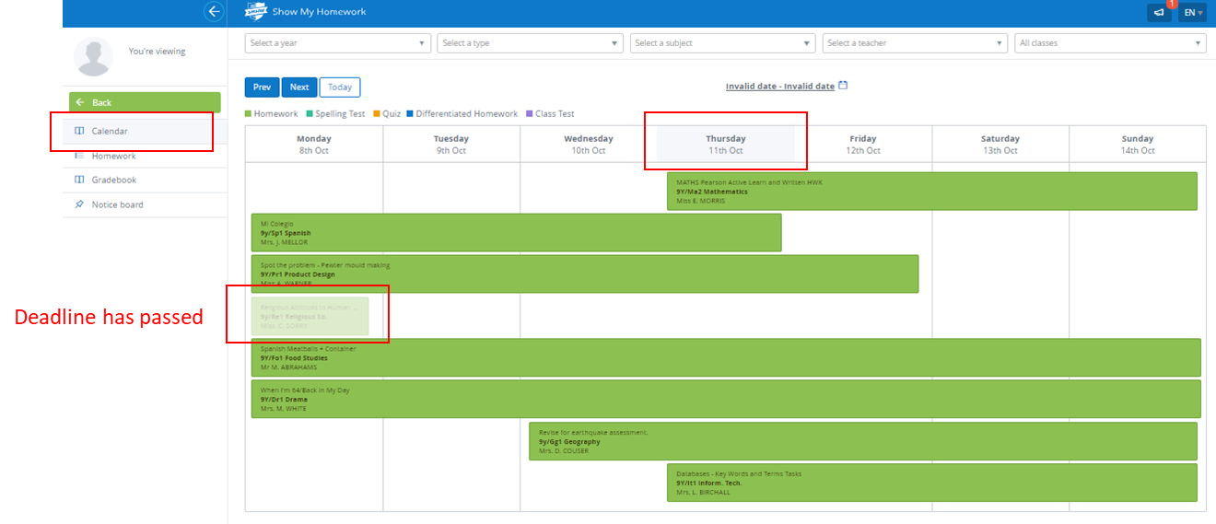

Slide 8
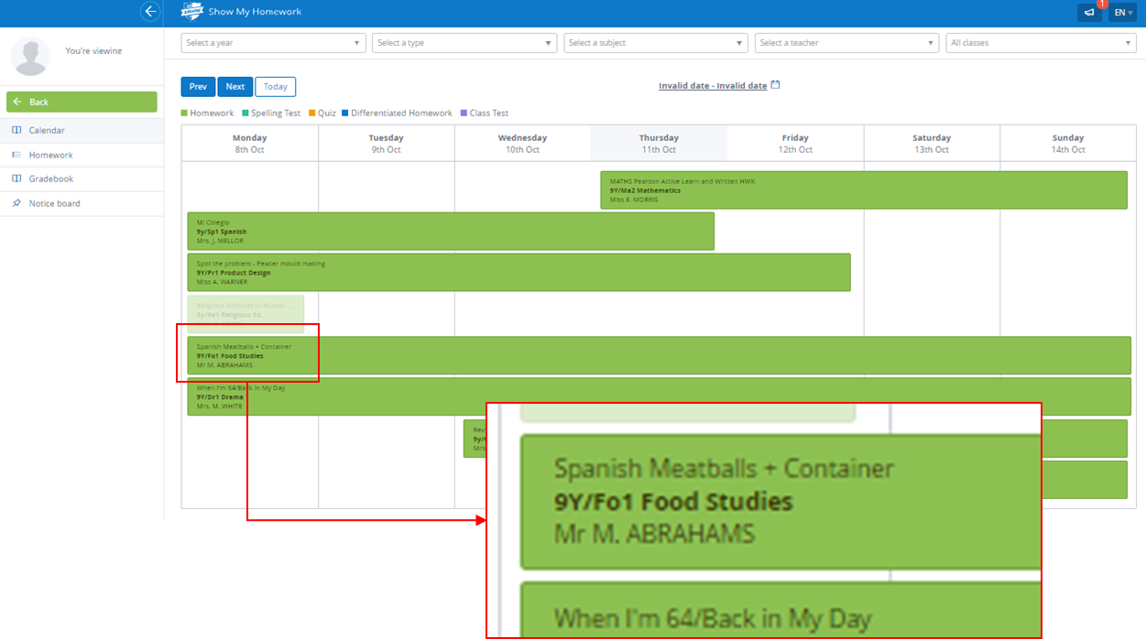

Slide 9
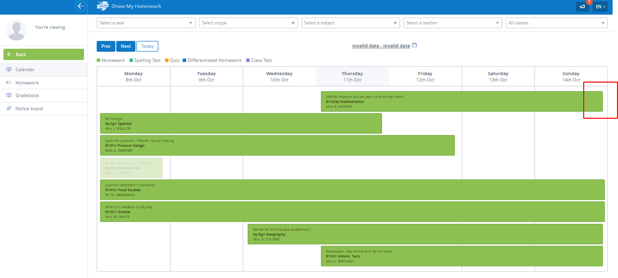

Slide 10
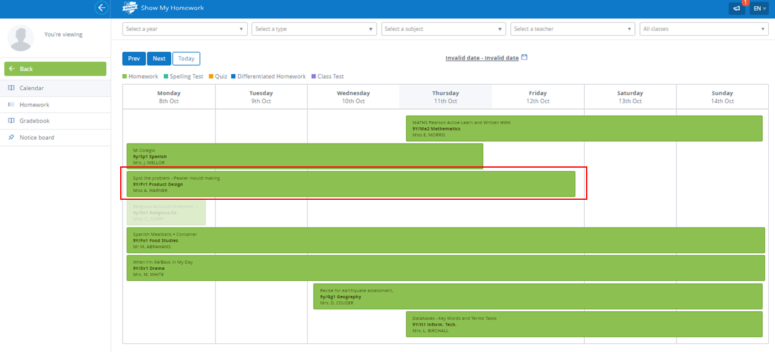

Slide 11
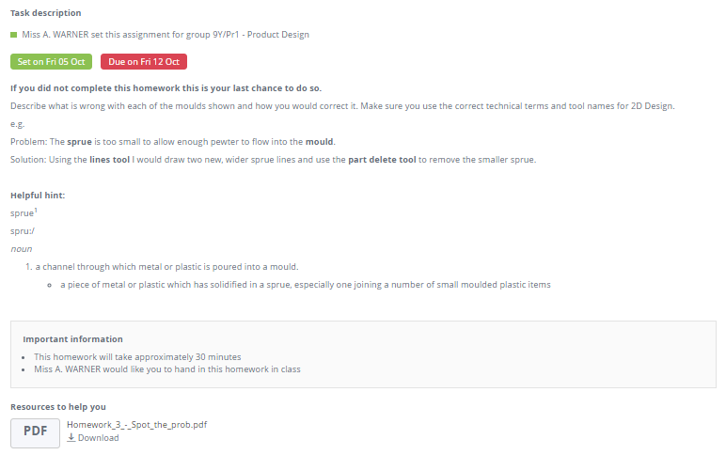

Slide 12
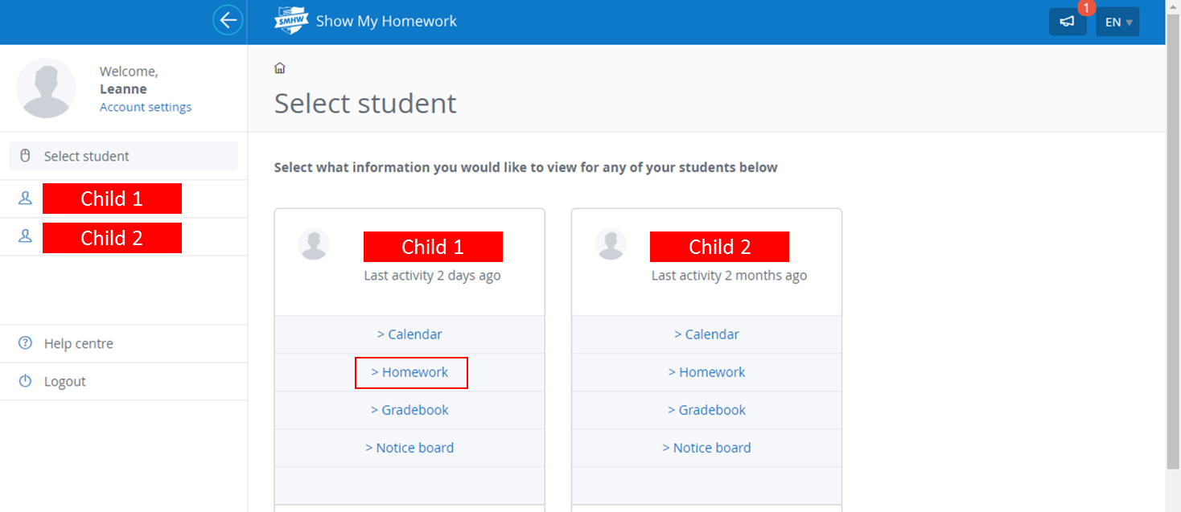

Slide 13
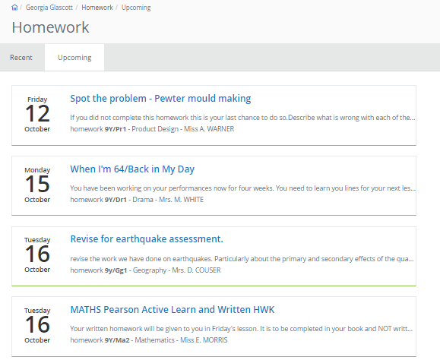

Slide 14
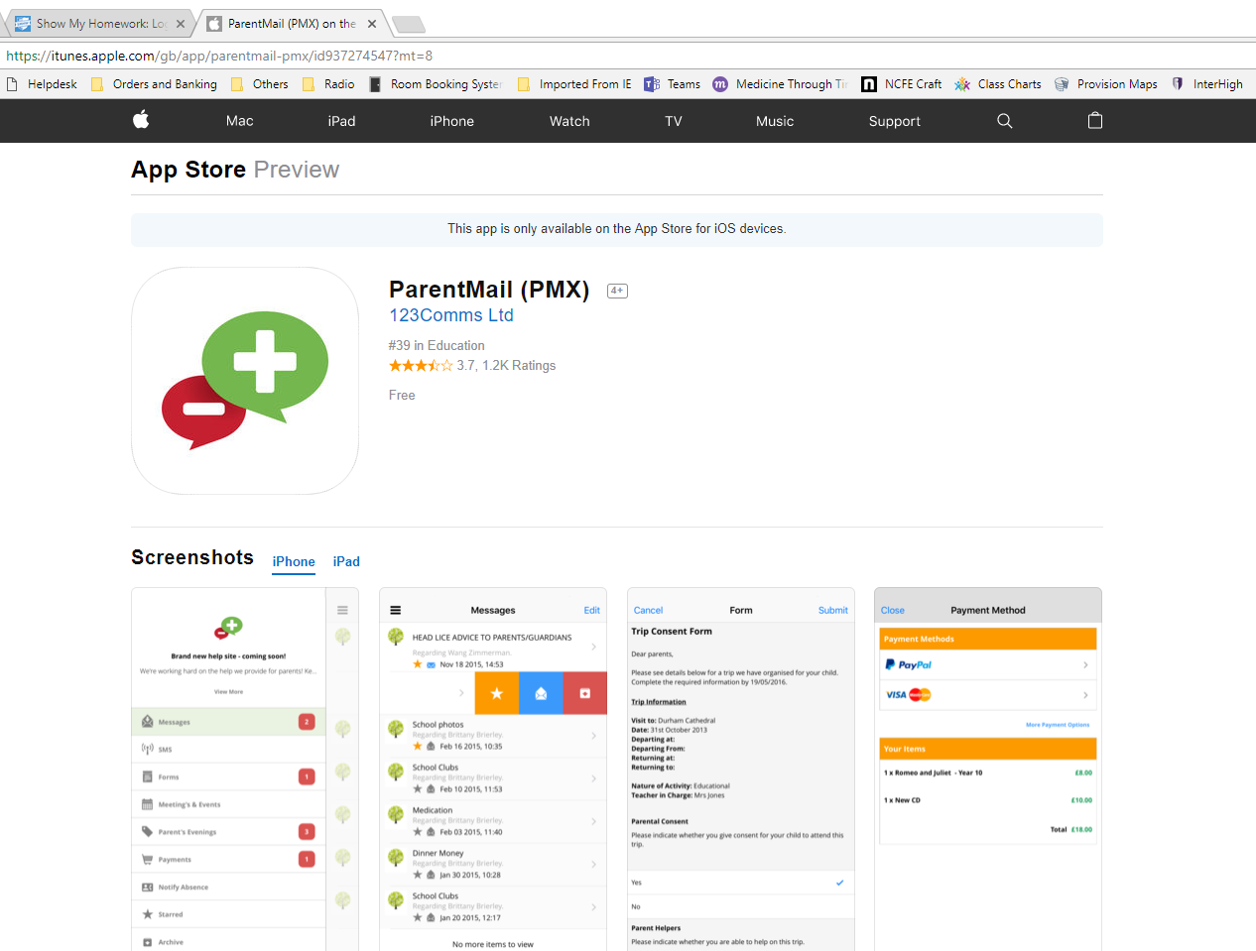
Progress and Communication: ParentMail – www.parentmail.co.uk
This is our primary source of contact with parents.
All school letters will be sent via this platform.
We will use this to inform you of any additional intervention/revision sessions and whether or not your child has attended.
You will receive regular emails and text messages about forthcoming events
Get the app for Android or iOS:

Slide 15
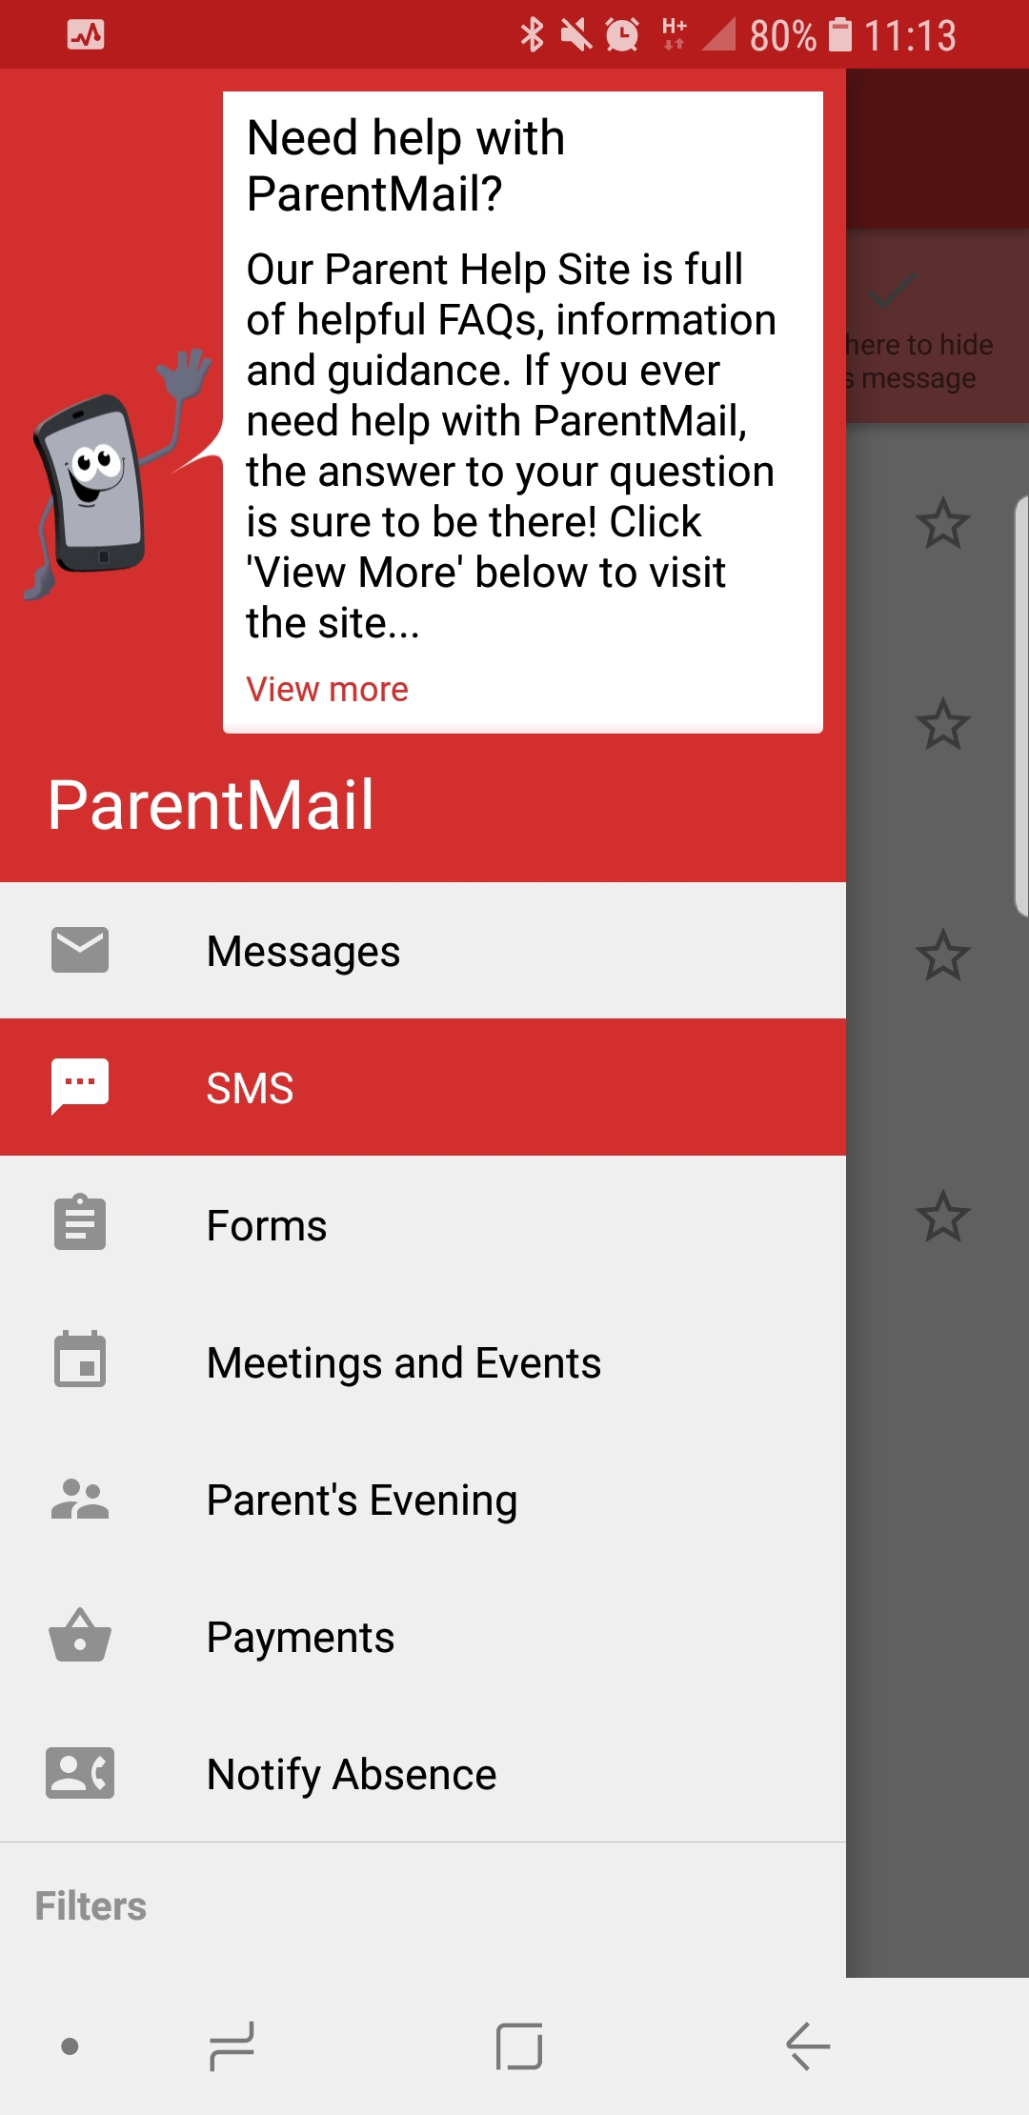
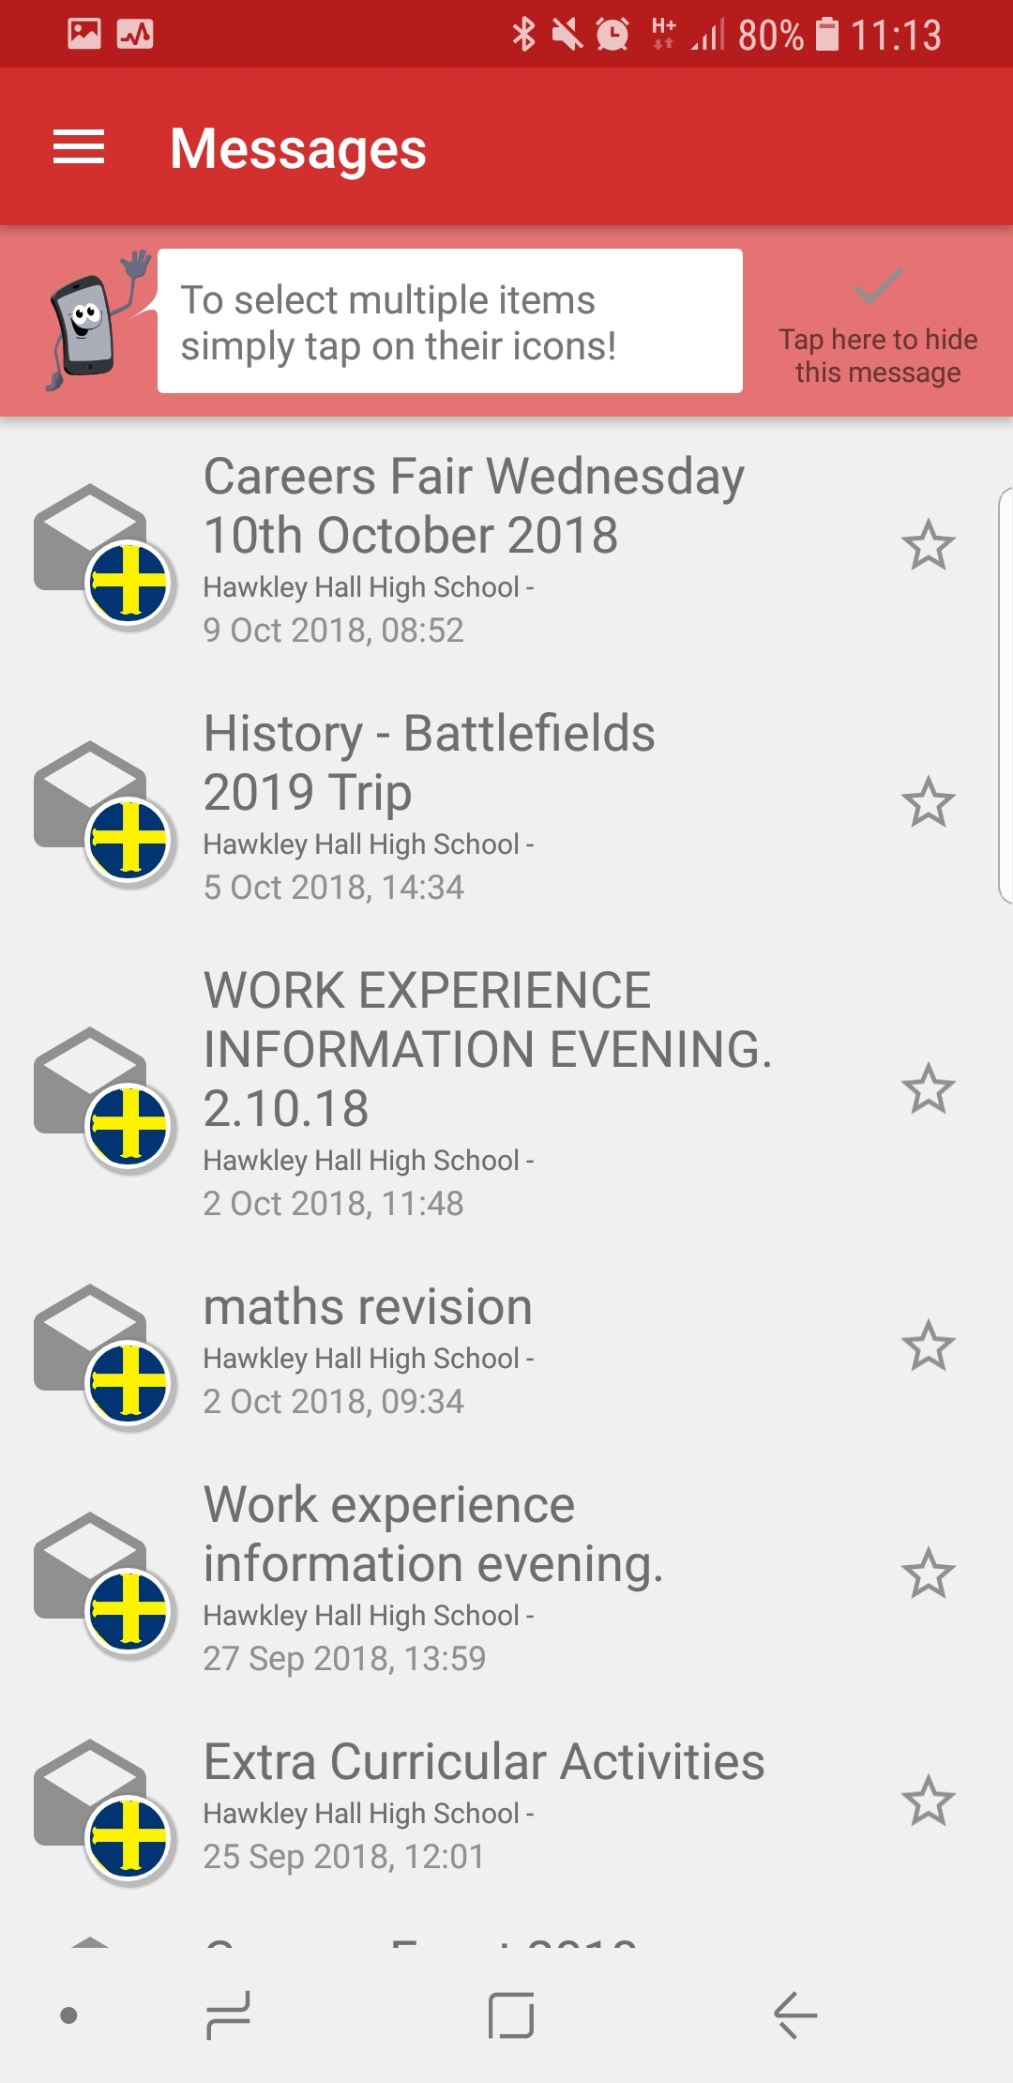
Progress and Communication: ParentMail – www.parentmail.co.uk

Slide 16
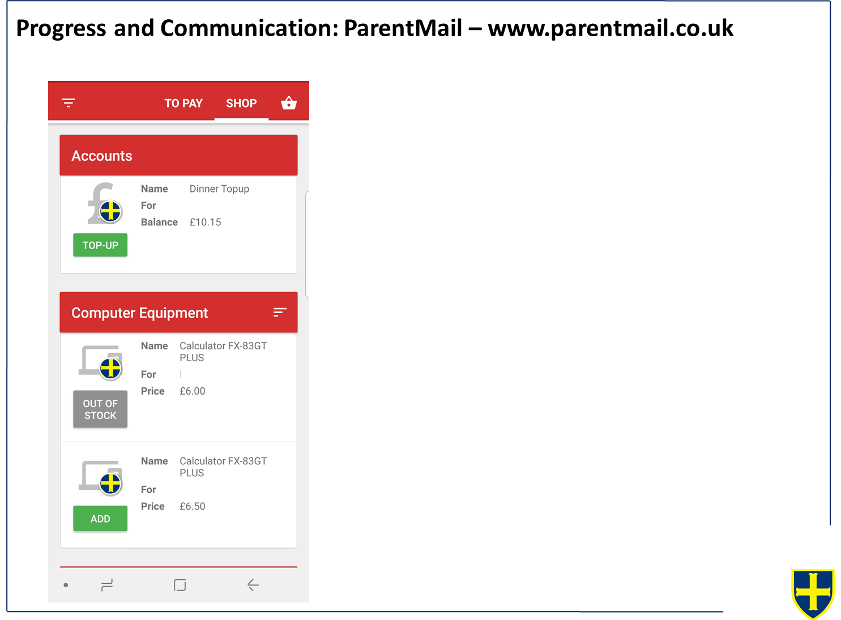

Slide 17
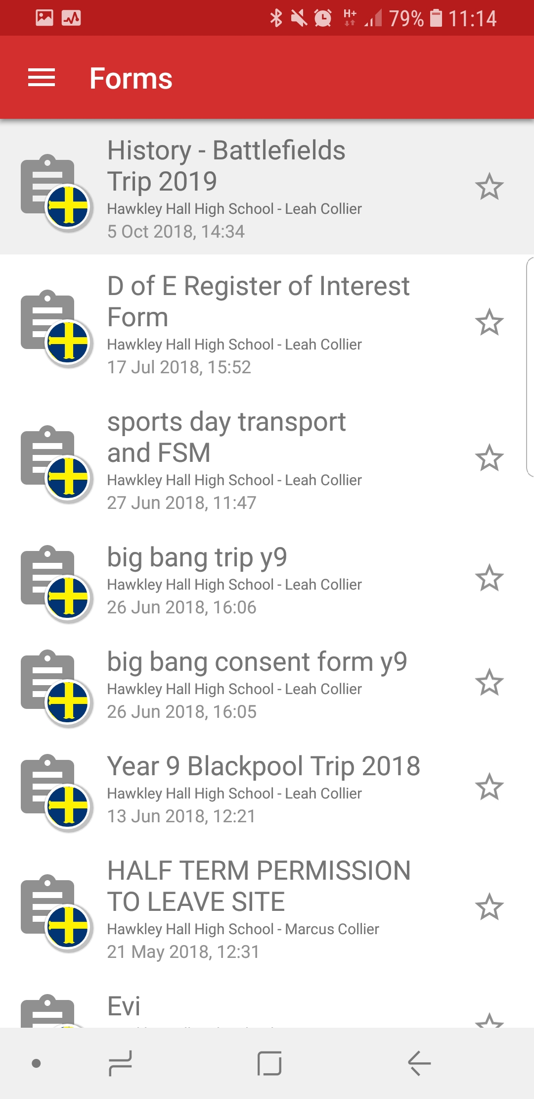
Progress and Communication: ParentMail – www.parentmail.co.uk
Forgotten passwords can be reset on the ParentMail website

Slide 18
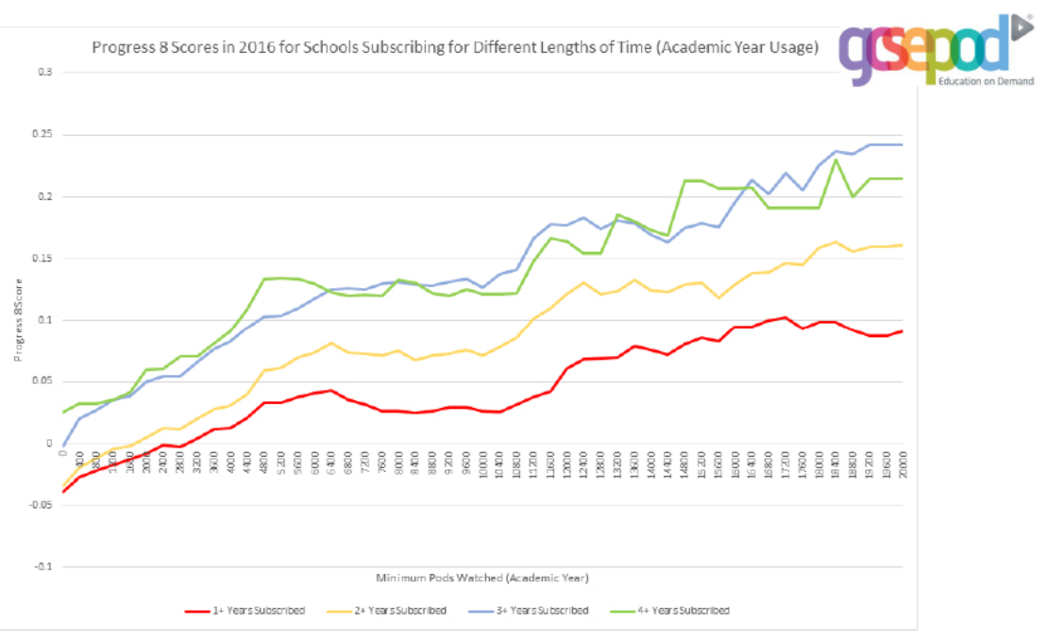
Progress and Revision: GCSE Pod – www.gcsepod.com
This is an excellent revision resource.
Usage data shows that students who regularly access this resource achieve one quarter of a grade better across 8 subjects than student who do not regularly access this.

Slide 19
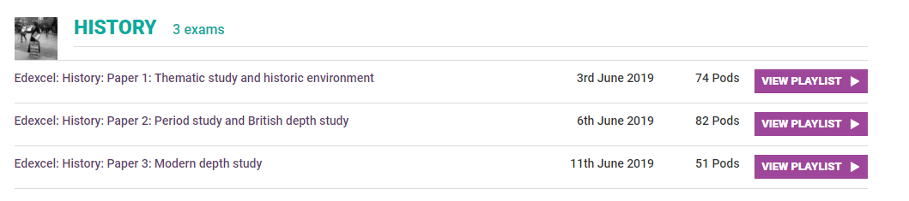
Progress and Revision: GCSE Pod – www.gcsepod.com
GCSE Pod is linked to our exam boards and only shows content relevant to that exam board
It is made up of short video podcasts that cover the content for each of the GCSEs we teach

Slide 20
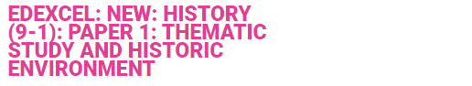
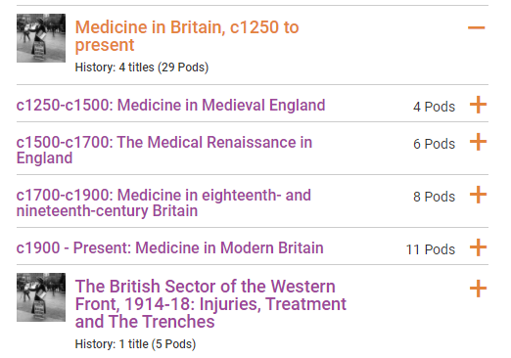
Progress and Revision: GCSE Pod – www.gcsepod.com
Each area is then further broken down into the topics:

Slide 21
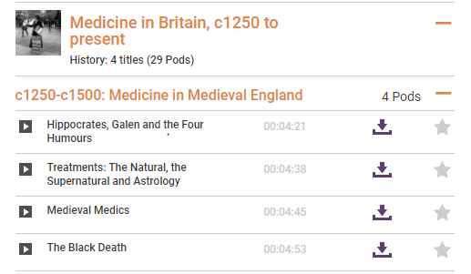
Progress and Revision: GCSE Pod – www.gcsepod.com
Podcasts can then be downloaded over home Wi-Fi to be used when offline or listened to online.

Slide 22
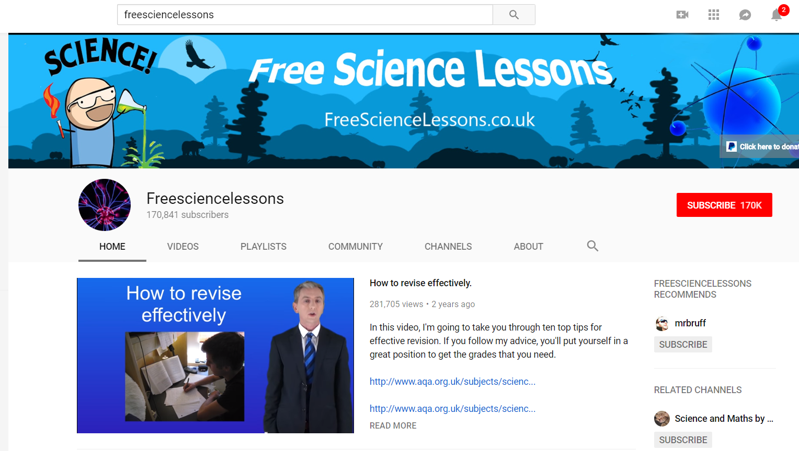
Progress and Revision: Other web-based videos
Key points:
170k subscribers – he must be doing something right!
These videos are written specifically for AQA and there is a video for every single topic.
He gets right to the point – zero waffle!

Slide 23
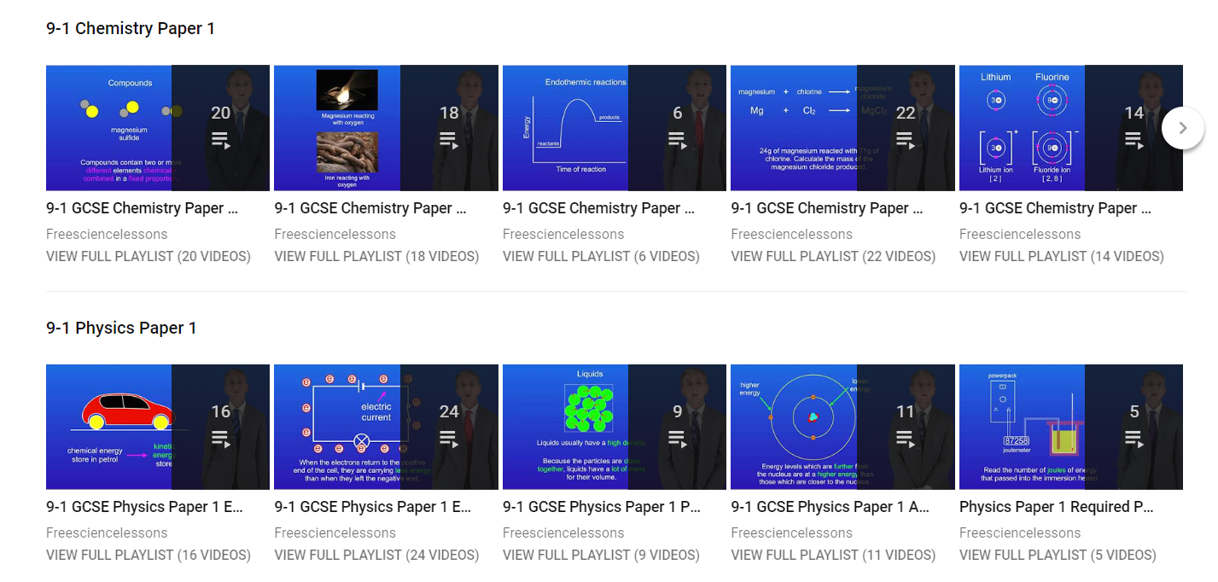
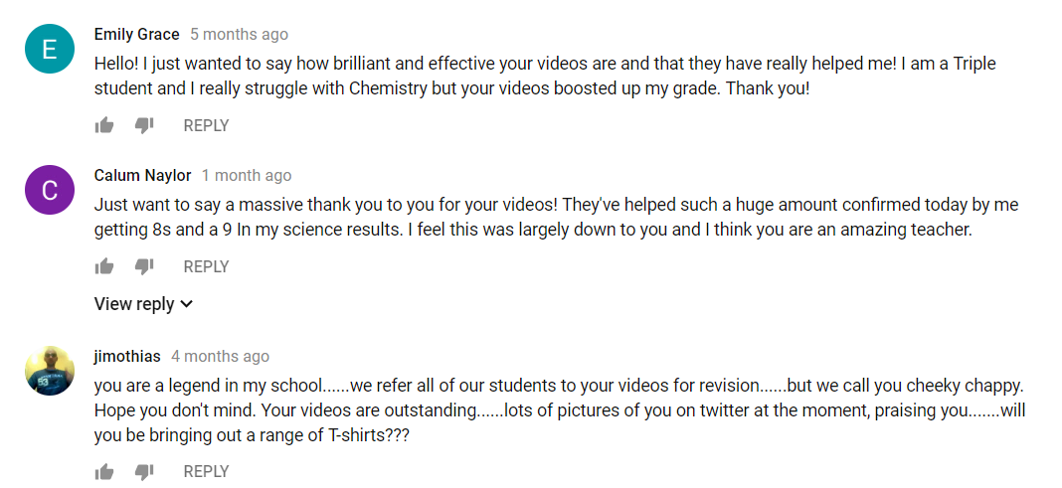
Videos are organised into playlists so they are really easy to find.
The feedback he gets from students is phenomenal

Slide 24
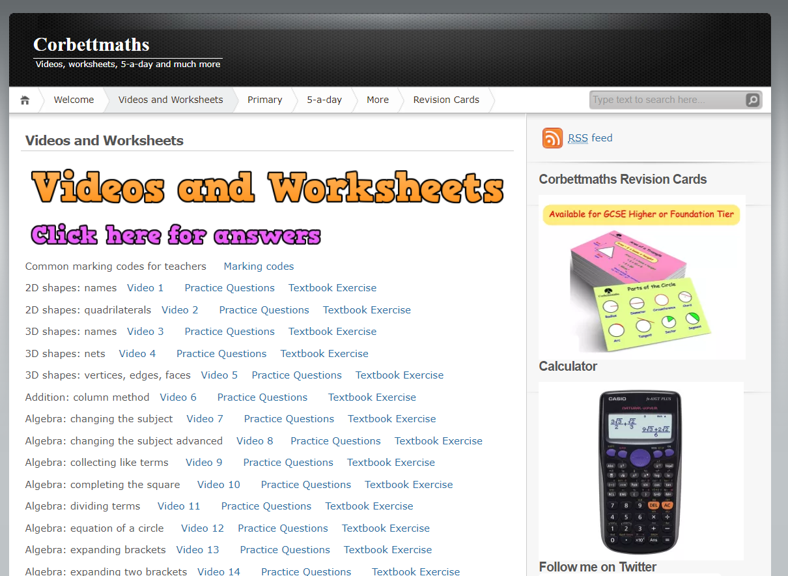
Progress and Revision: Other web-based videos
An unbelievable resource for maths!

Slide 25
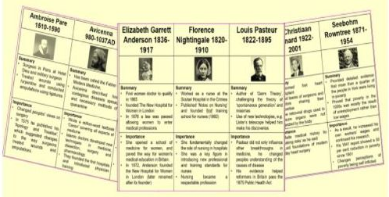
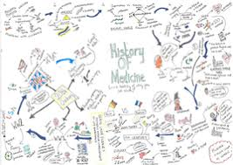
Progress and Revision: GCSE Pod – www.gcsepod.com
A word of warning!
Just listening to the podcasts does not constitute good revision
Revision should always be active, so while listening to a podcast students should be:
  Making a mindmap
  Taking bullet pointed notes
  Creating flash cards
Once they have done this, students should be testing their knowledge by:
Telling you about it!
Asking a friend to test them
Trying to recreate the mindmap/notes/flash card from memory

