Slide 1
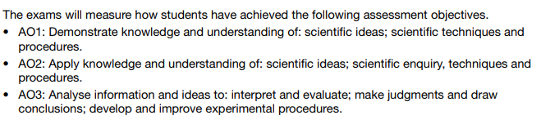
Combined Science
Equivalent of two GCSEs
Grades reported as 9-9, 9-8, 8-8, 8-7, 7-7, 7-6, 6-6, 6-5, 5-5…..
Six exams each worth 70 marks and lasting 1hr15mins
2 papers per science subject

Slide 2
November mocks
Week commencing 19th November 2018
Students will sit 3 mock examinations, one exam per science subject. Each exam will last for 1hr 15minutes and will be paper 1 from each subject.
Biology | Chemistry | Physics
Cell Biology Organisation Infection and Response Bioenergetics | Atomic structure and the periodic table Bonding, structure and properties of matter Quantitative Chemistry Chemical Changes Energy changes | Energy Electricity Particle model of matter Atomic structure

Slide 3
Week beginning | Biology | Chemistry | Physics
15.10.18 | Cell Biology | Atomic Structure and the periodic table | Energy
22.10.18 | Organisation | Bonding structure and properties | Electricity
29.10.18 | Infection and response | Quantitative | Particle model of matter
5.11.18 | Bioenergetics | Chemical and energy changes | Atomic structure
12.11.18 | All topics / weakest areas | All topics / weakest areas | All topics / weakest areas

Slide 4
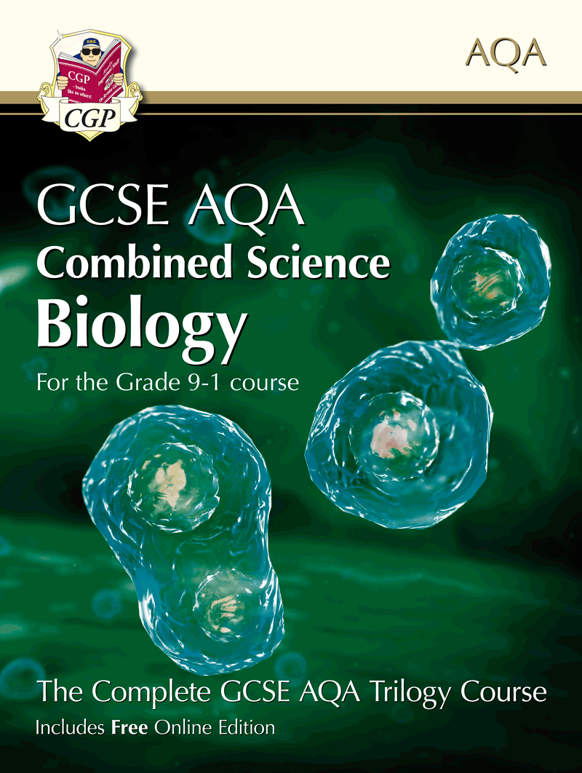
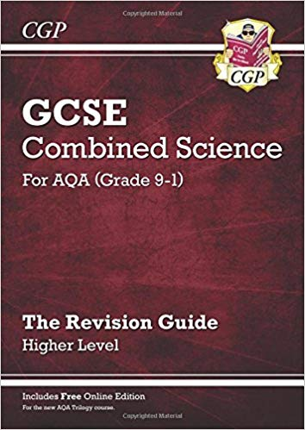
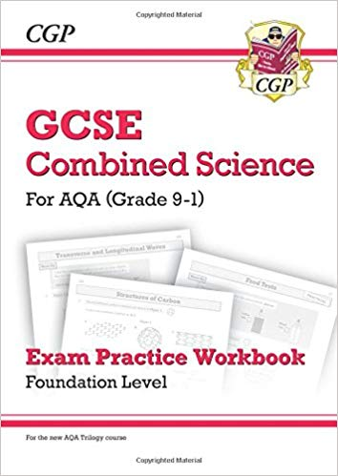
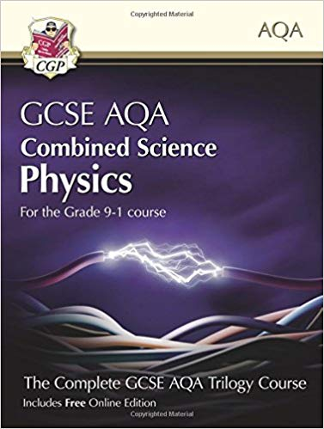
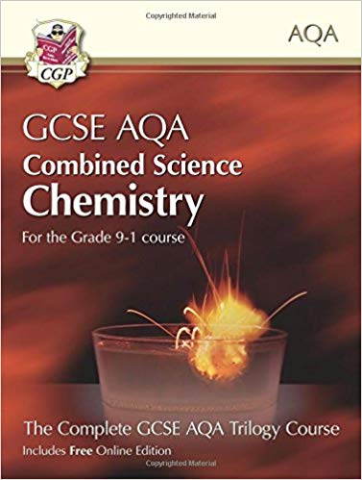
Complete revision guide and practice books £5.50 each
Student textbooks £10 each

Slide 5
Triple science
Chemistry grades carried forwards
Biology and Physics sat at the end of Y11
2 exams per subject, each worth 100 marks and lasting 1hr 45mins

Slide 6
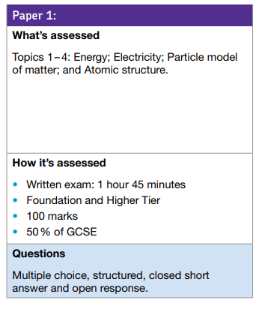
November mocks
Week commencing 19th November
Students will sit paper 1 physics
Paper 1 topics are:
Energy
Electricity
Particle model of matter
Atomic Structure

Slide 7
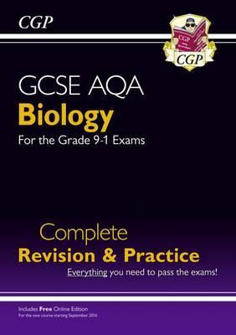
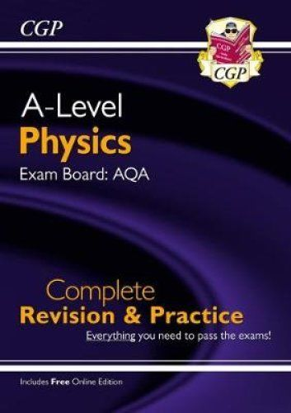
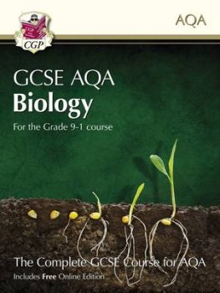
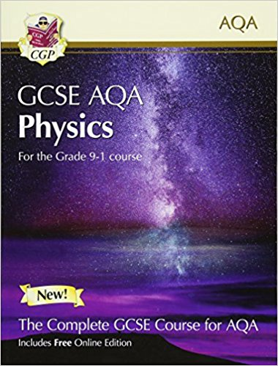
Complete revision guide and practice books £5.50 each
Student textbooks £10 each

Slide 8

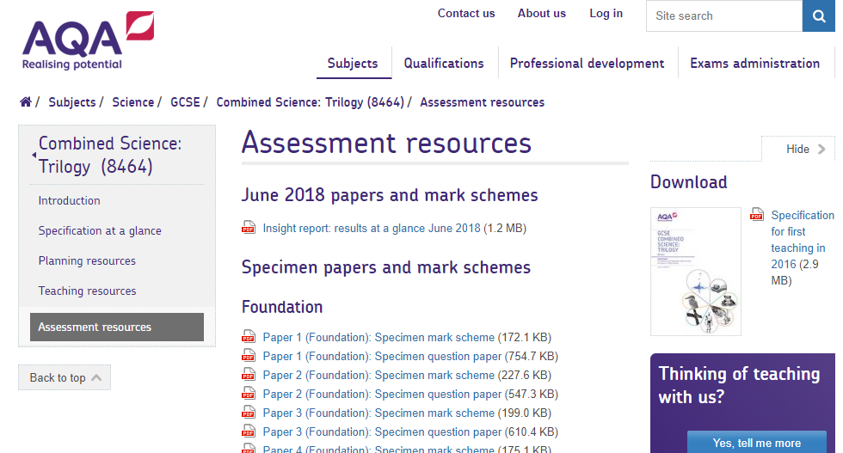

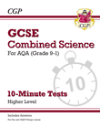
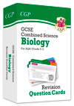
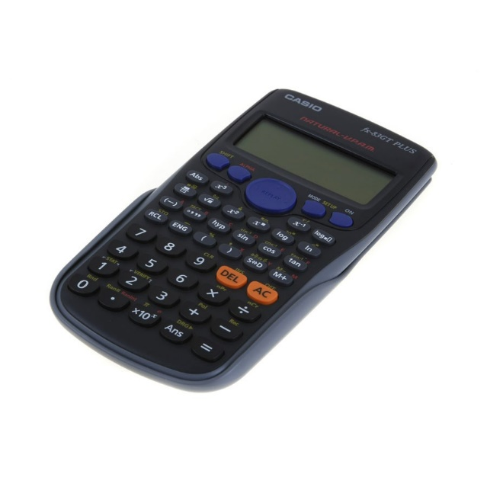
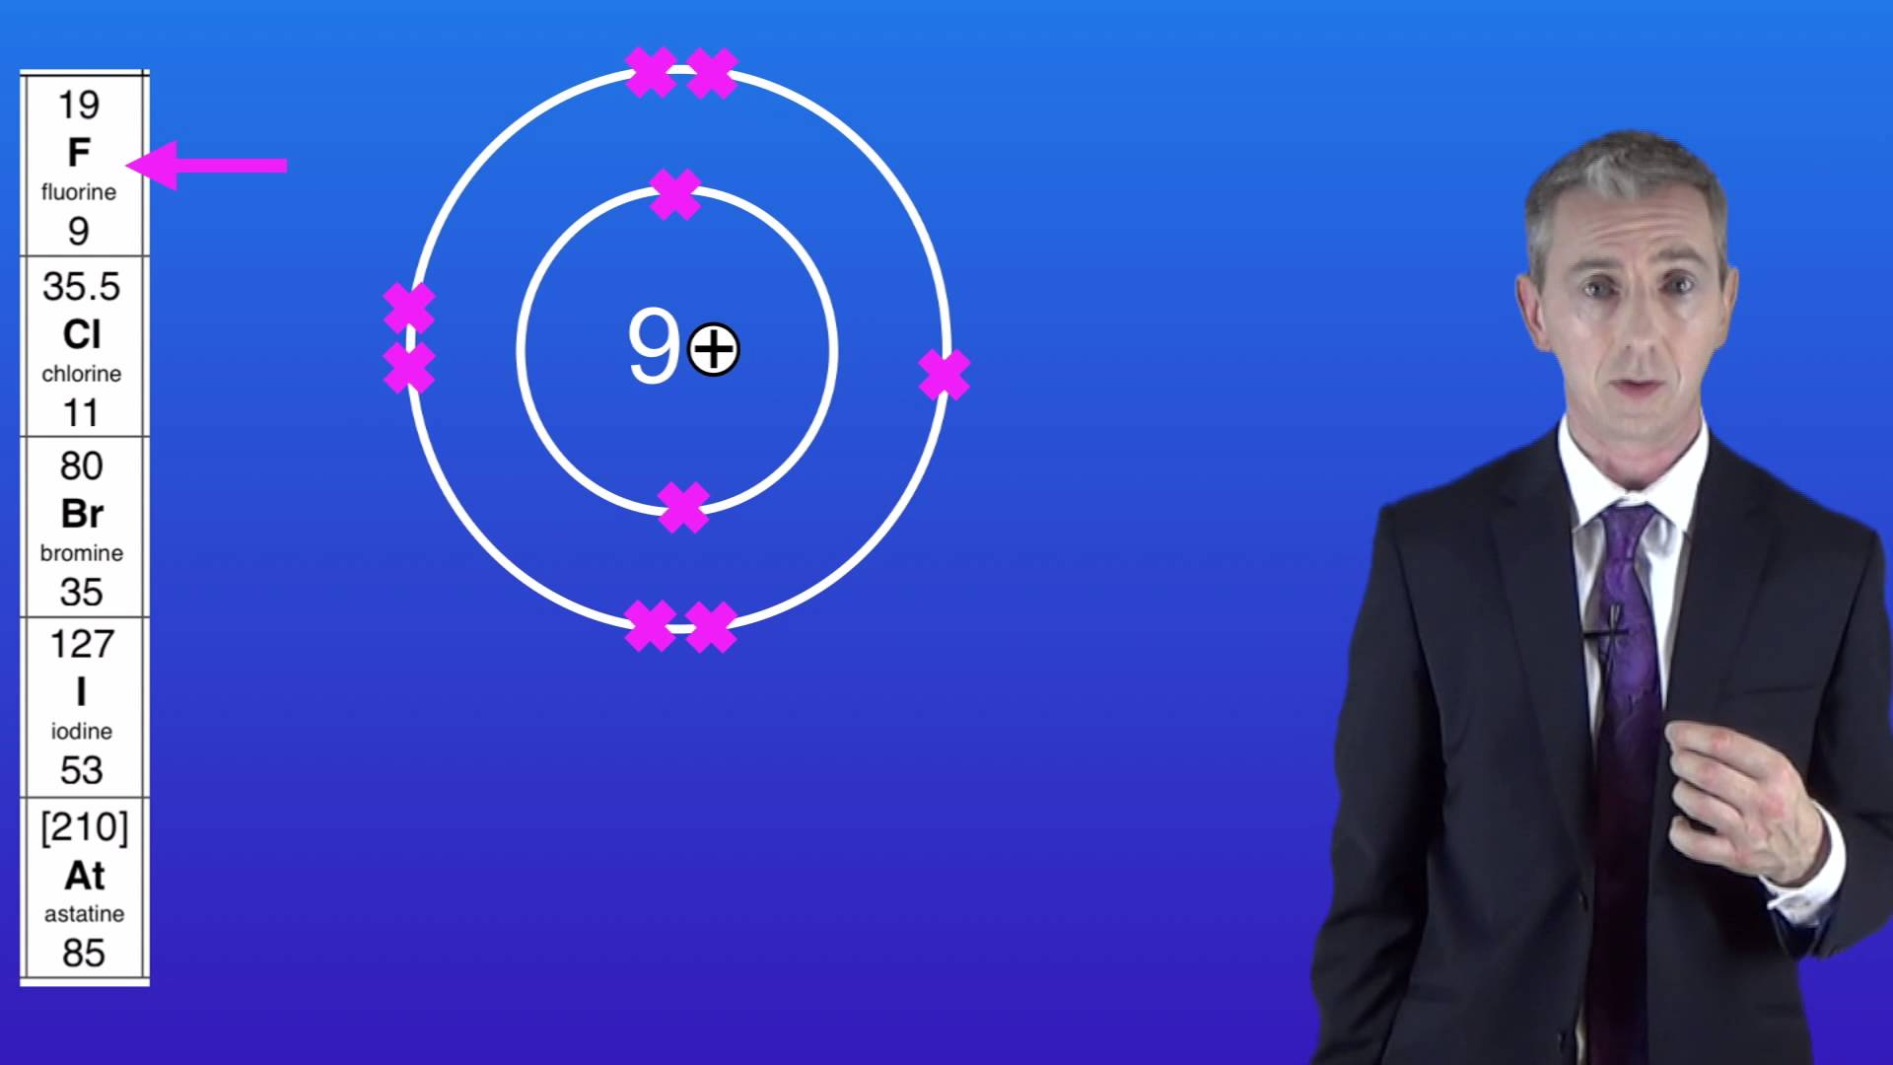
Wednesdays 3-4pm

