Slide 1
STEPS TO REVISION SUCCESS
Class of 2019

Slide 2

First thoughts……
Write down one concern you have about revision.
Don’t write your name on it.
Crunch it up and throw it across the room

Slide 3
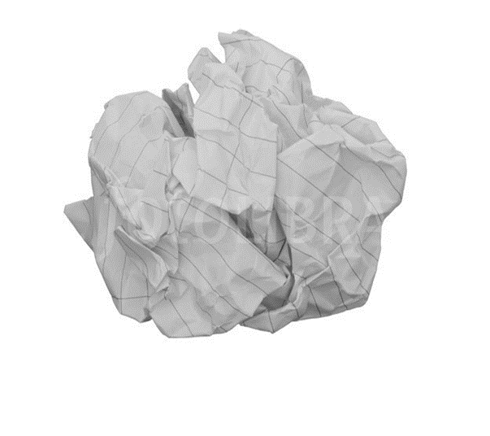
Second thoughts……Positive hat
Pick up a paper ball
Read the words or statement.
Write a positive response or advice to overcome the issue

Slide 4


What revision means to us
Actively looking over work on an on-going basis:
To remind the students of things they may have forgotten;
To reinforce learning to help students access examination;
To identify what students don’t know;
To check understanding and highlight areas for further development.
If progress is ‘KNOWING MORE, REMEMBERING MORE’ then REVISION is key to ‘MAKING IT STICK’

Slide 5
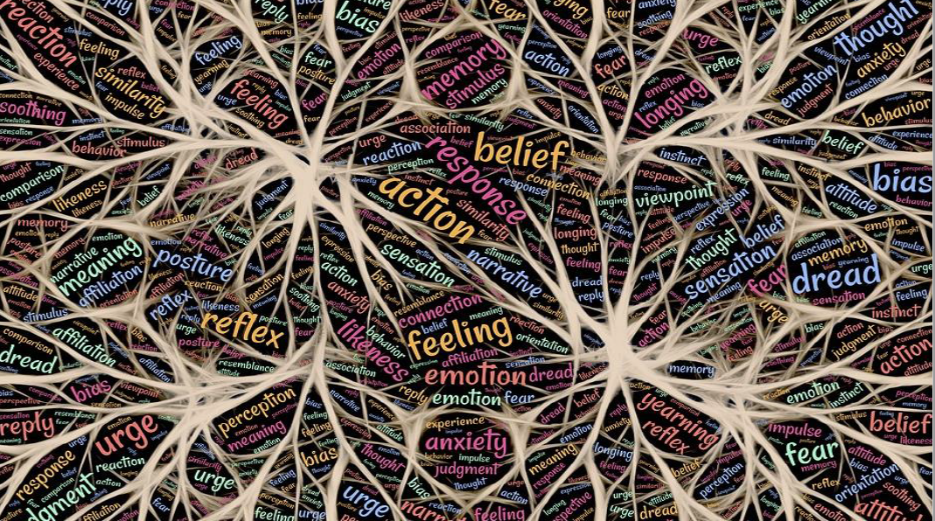
Revision is critical to help the brain create ‘schema’ linking knowledge and committing it to long term memory

Slide 6
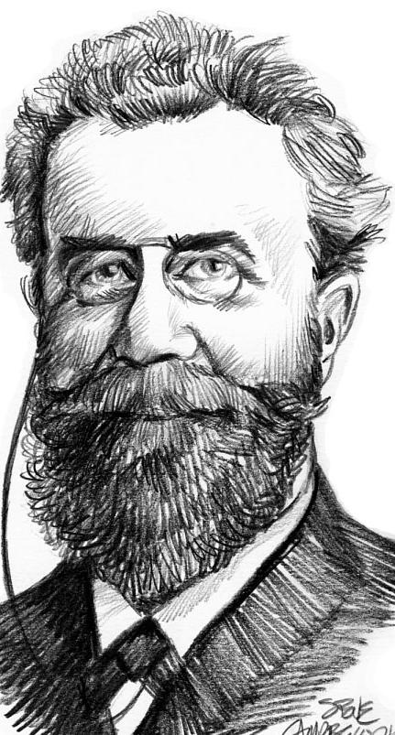
One of the best ways to learn and study effectively is to use spaced repetition.
Review your learning after……
A day
A week
A month
Just before the exam
You will remember more! I promise.
Hermann Ebbinghaus
1850-1909

Slide 7
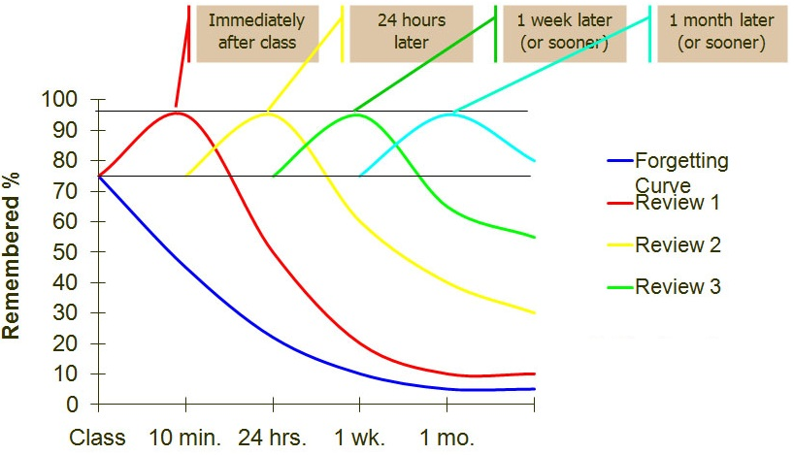
How Does Spaced Repetition Work?
While repetition is essential for remembering what one has learned, the amount of information that the human brain can absorb falls quickly over time. This is known in psychology as the Ebbinghaus Forgetting Curve

Slide 8
SOME TECHNIQUES TO HELP YOUR CHILD

Slide 9


Mind Maps For Memory
The brain likes to work on the basis of association and it will connect every idea, memory or piece of information to tens, hundreds and even thousands of other ideas.
Research by Toi (2009) shows that Mind Mapping can help children recall words more effectively than using lists, with improvements in memory of up to 32%

Slide 10
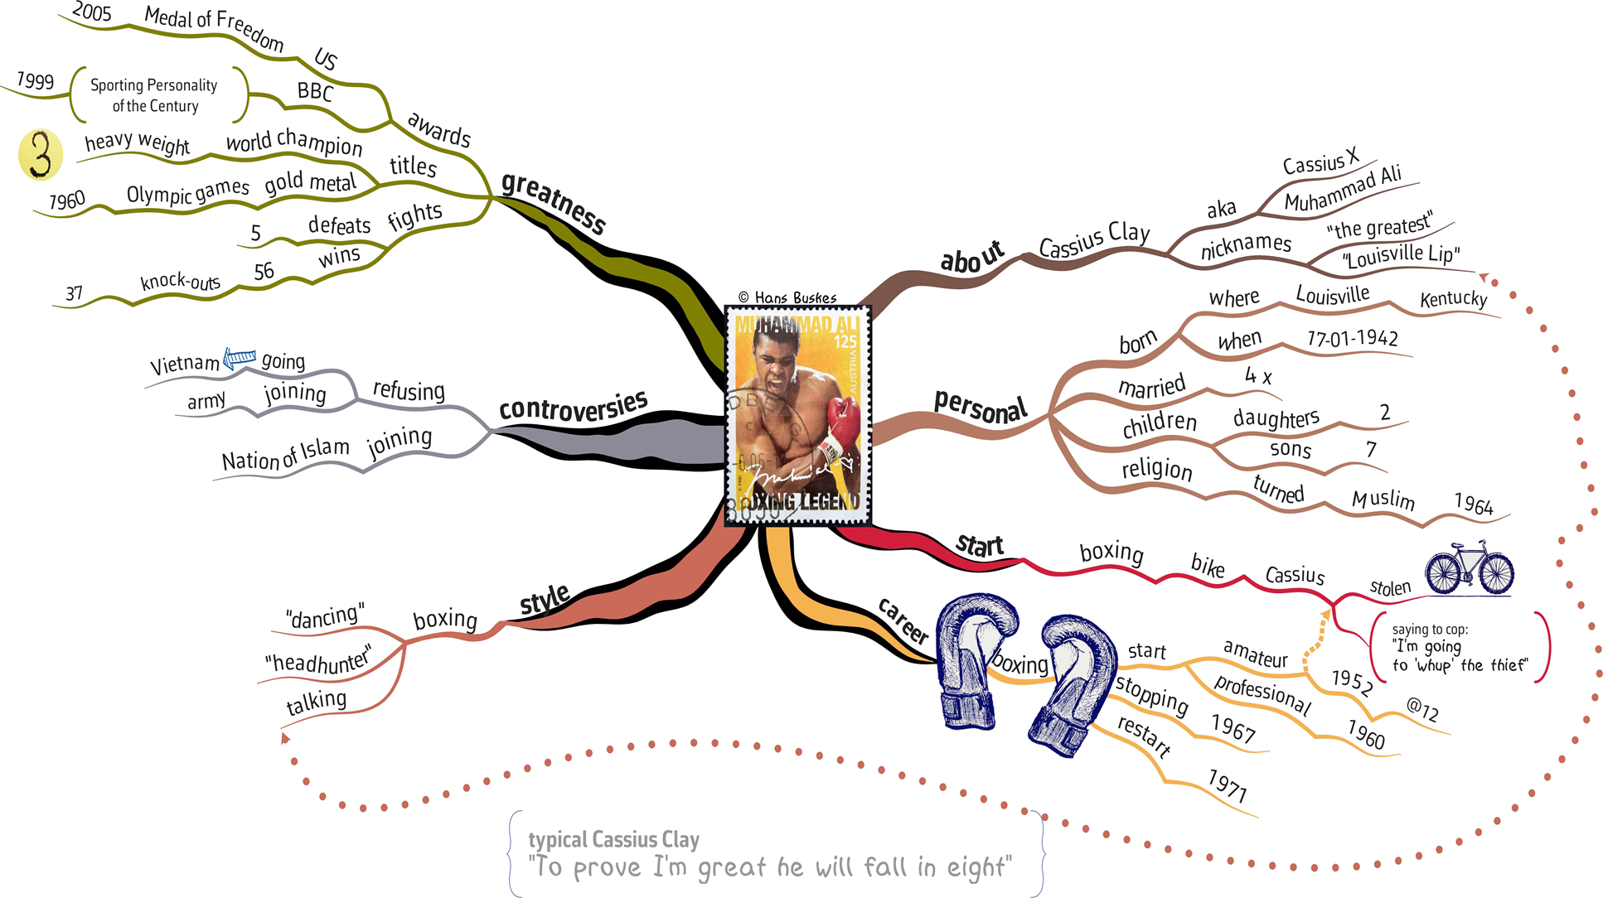











dd
‘Float like a butterfly sting like a bee’

Slide 11

Alternatives….Loci
Memory trick of memory masters:
1. Think about a journey you know well
2. Think about the landmarks along the way.
3. You then add in images to help you remember information.

Slide 12


IT MAKES SENSE TO CATER FOR THE 5 SENSES!
Hearing: Explanations, listening, podcasts, music, making up rhymes, songs or raps to help you remember
Sight: pictures, doodles, video, images, diagrams, lines, colours, drawings
Smell: scented candles, scented pens, coffee brewing in the next room when ready for a break
Touch: Stress balls, moving or sorting Q and A cards, thinking walks
Taste: rewarding yourself with snacks or sweets when you complete work. Eating fruit for brain food

Slide 13
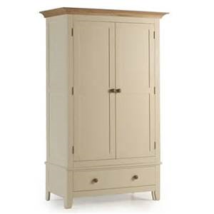
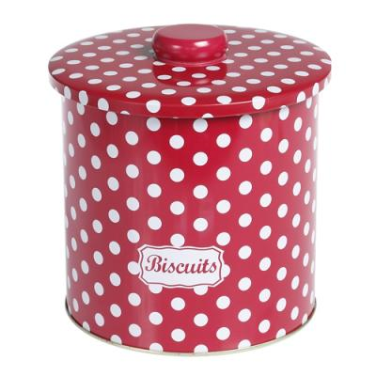
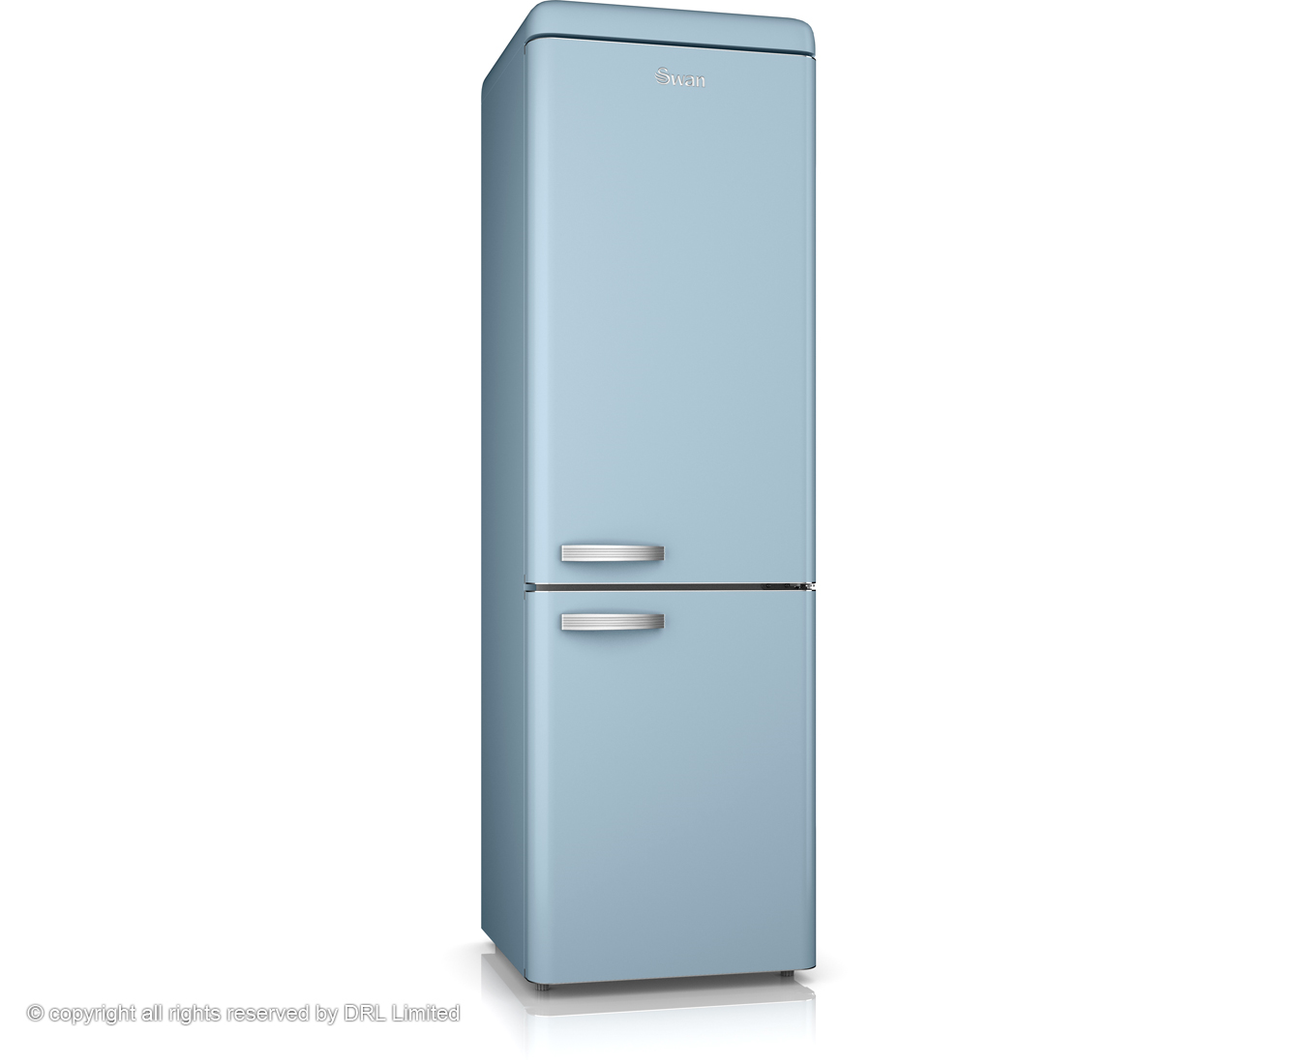

WHAT DO THE FOLLOWING HAVE IN COMMON?

Slide 14

They are all an ideal place to put sticky notes
Write or draw things on sticky notes and then put them where you’ll see them. Seeing them day in day out will help you REMEMBER.

Slide 15
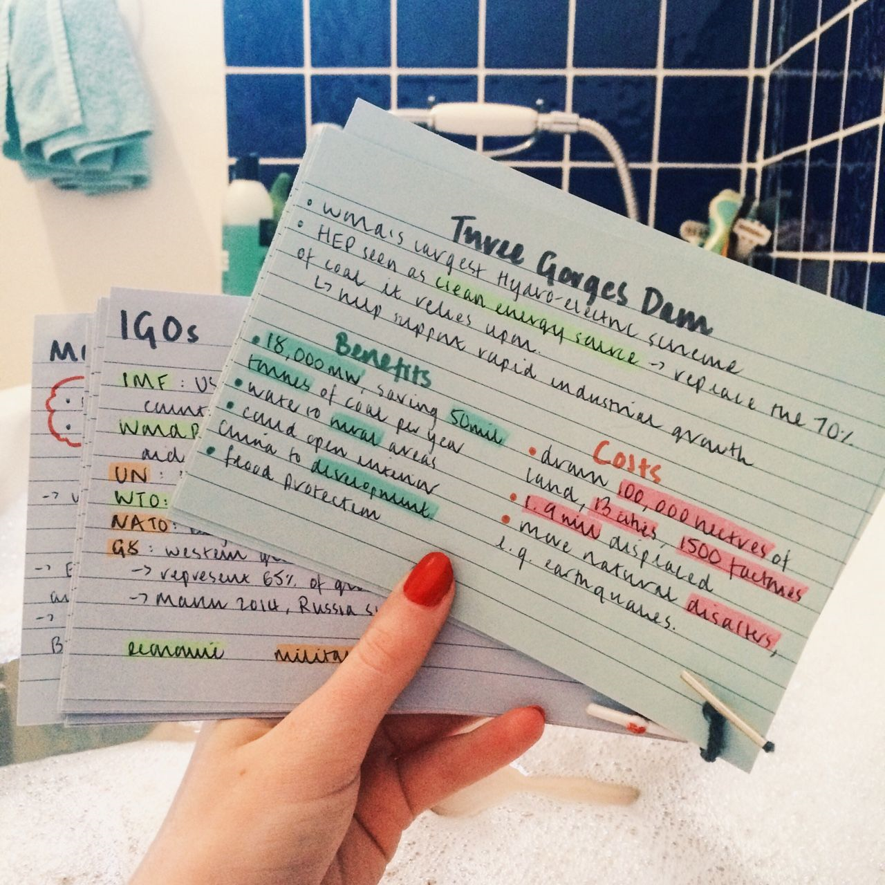
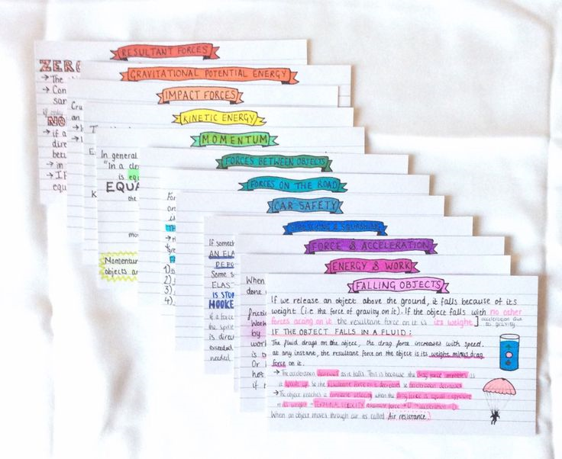
Index Cards
Excellent for working through and then condensing work – Crucial that students colour, highlighters and symbols to help organise their cards. They may put questions on one side and knowledge on the other.

Slide 16
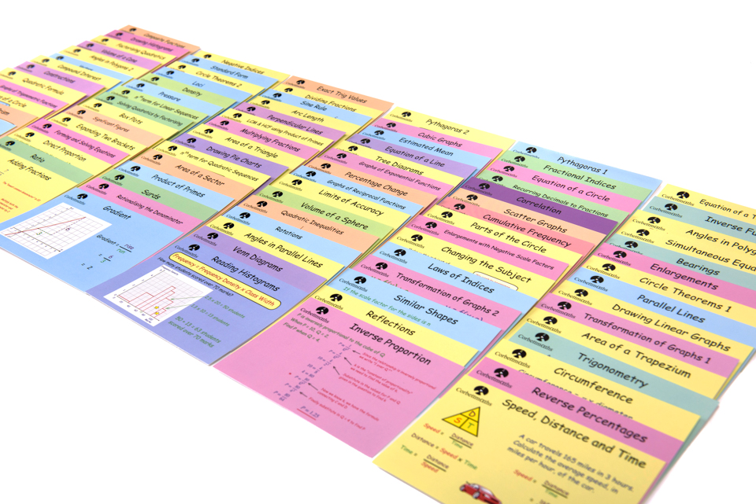
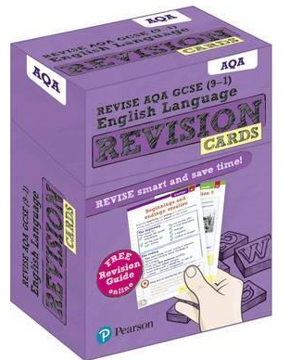
Revision Cards – Available to buy

Slide 17
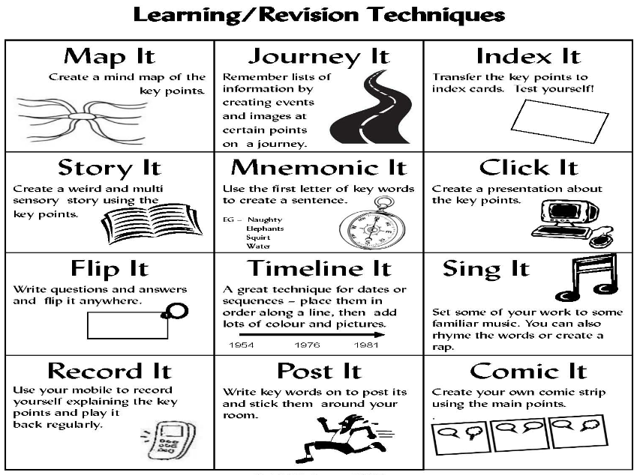
A summary of techniques…..

Slide 18
SOME OTHER THINGS TO CONSIDER

Slide 19
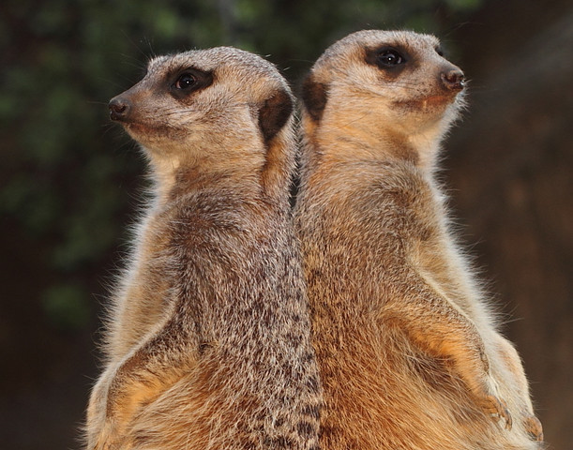
Tear and share – A problem shared is a problem halved
Sometimes it is good to divide up the work and put your heads together.
Take responsibility for learning part of a topic, summarise and then explain it to the other person.
This is the KEY. You learn by TEACHING. Your mind is challenged to process the information.
Only work with people that you KNOW are committed to work

Slide 20

PIZZA SLICE!
Revise in chunks as experts say our attention span is roughly our age plus or minus 1 or 2 minutes.
In one hour revise for three fifteen sections with five minute breaks in between.
Get up and be active in your breaks

Slide 21
Our roles
Provider of a quiet place
Attendance officer – get them up and in
Revision buddy
Encourager
Note taker or the one who listens
Time management adviser
Stress management guru
Subject knowledge support
Check understanding
Help with anything they may need
Open door policy
Offer various revision sessions
Learning environment

Slide 22
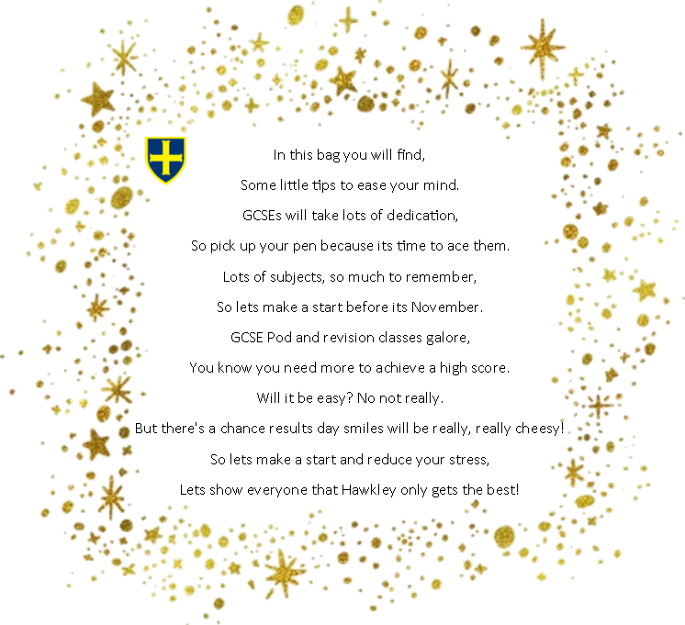
Revision bags
You will find some basic materials to get your child started.
Included also is a parental guide about revision.

Slide 23
‘The best way to finish an unpleasant task is to get started’
Anonymous

