Slide 1


Show My Homework
For Students
HAWKLEY HALL HIGH SCHOOL

Slide 2
Contents
Challenges with homework
Benefits of using Show My Homework
What does the tool look like?
Your school’s plan
Getting started
1
2
3
4
5
Notes:
To change the image behind the Mock up.
Select the layer - > Right Click -> Send to Back -> Delete the image -> Drag & Drop your Own Picture -> Send to Back (again)

Slide 3


Challenges with homework today
Forgetting homework is due
Misunderstanding the assignment
Catching up after absence
Hassle from parents about what is due!
Understanding why it’s useful
Getting feedback on your hard work
Proving that you’ve got too much homework!
Notes:
To change the image behind the Mock up.
Select the layer - > Right Click -> Send to Back -> Delete the image -> Drag & Drop your Own Picture -> Send to Back (again)

Slide 4
These issues are all about how we communicate and manage homework. Not homework itself.
communicate
manage
Notes:
To change the image behind the Mock up.
Select the layer - > Right Click -> Send to Back -> Delete the image -> Drag & Drop your Own Picture -> Send to Back (again)

Slide 5
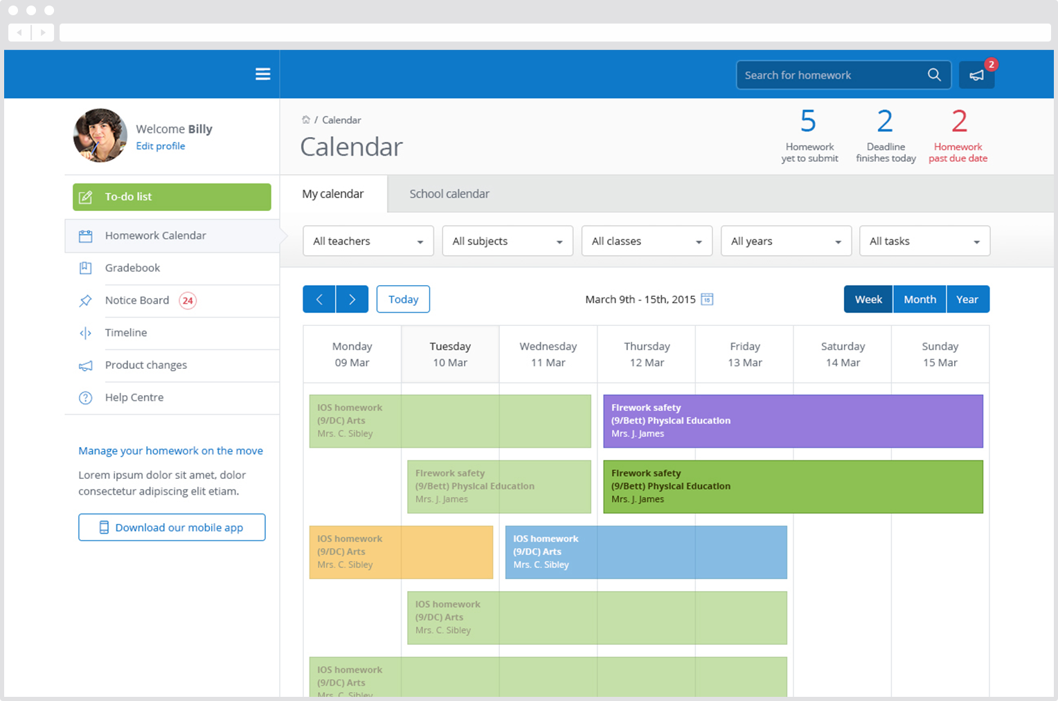
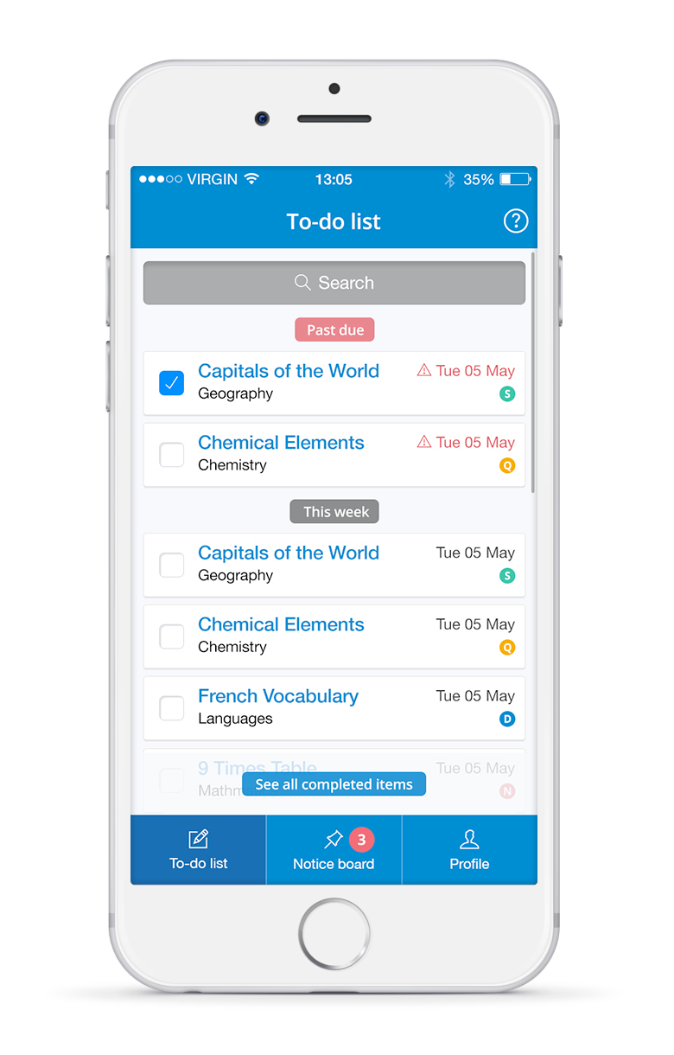
What is Show My Homework?
A simple online homework calendar showing homework information, deadlines and attachments for students.
Notes:
To change the image behind the Mock up.
Select the layer - > Right Click -> Send to Back -> Delete the image -> Drag & Drop your Own Picture -> Send to Back (again)

Slide 6


Benefits for students
See how Show My Homework can benefit you
Automatic notifications to remind you
More time to ask questions in class
Marking and feedback returned faster and in private
See all your homework at the click of a button
Free smartphone app – No more Homework diaries!
Access to description and resources wherever they are
A personalised experience to help stay organised

Slide 7
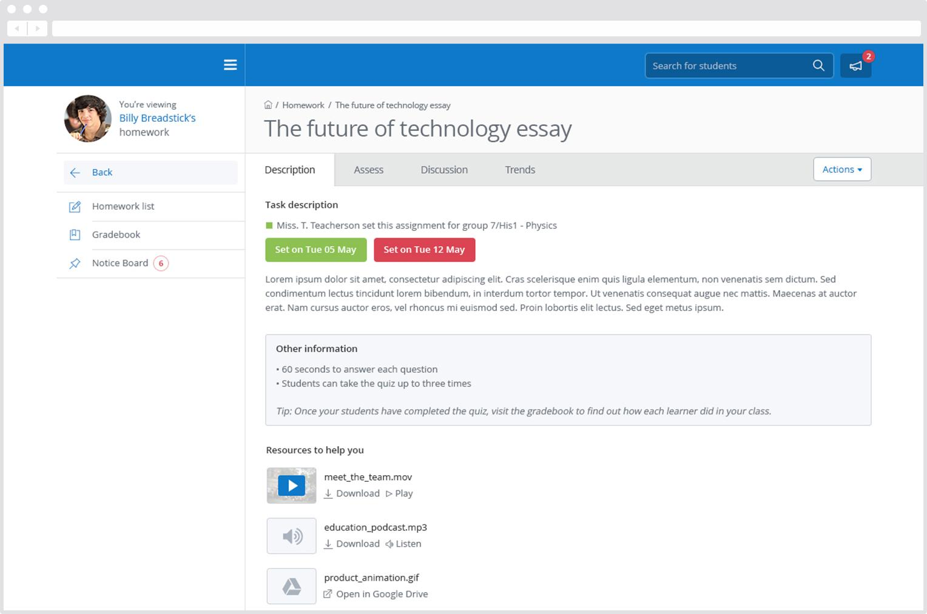
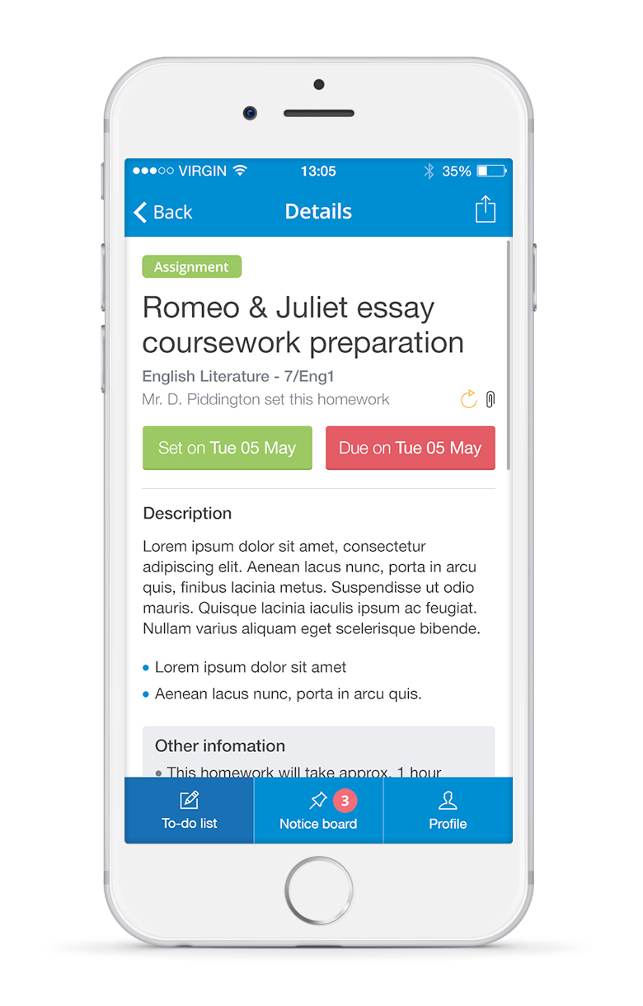

Homework description
In this view we can see a task’s title and description, set and due dates and how it should be submitted.
Helpful resources – files & websites – are displayed below the homework.
Notes:
To change the image behind the Mock up.
Select the layer - > Right Click -> Send to Back -> Delete the image -> Drag & Drop your Own Picture -> Send to Back (again)

Slide 8
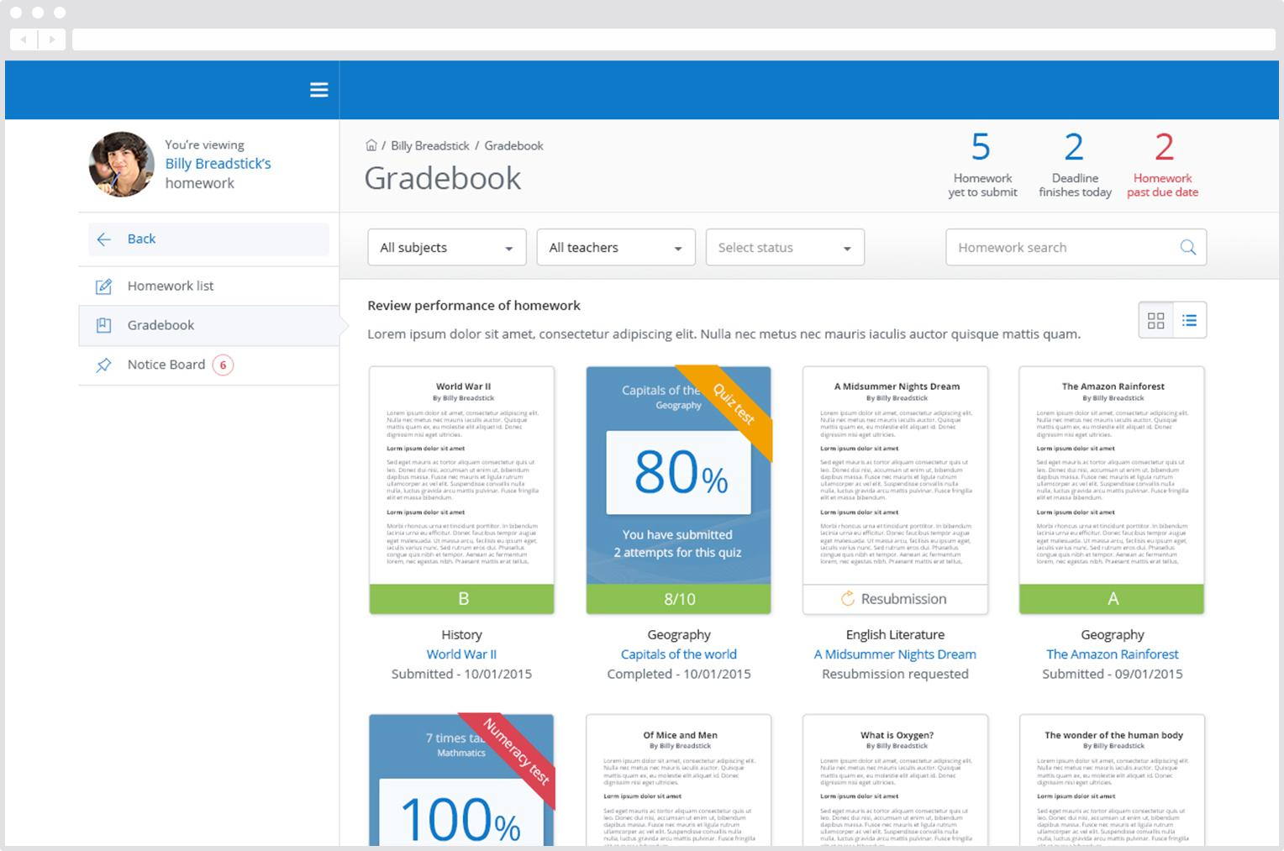
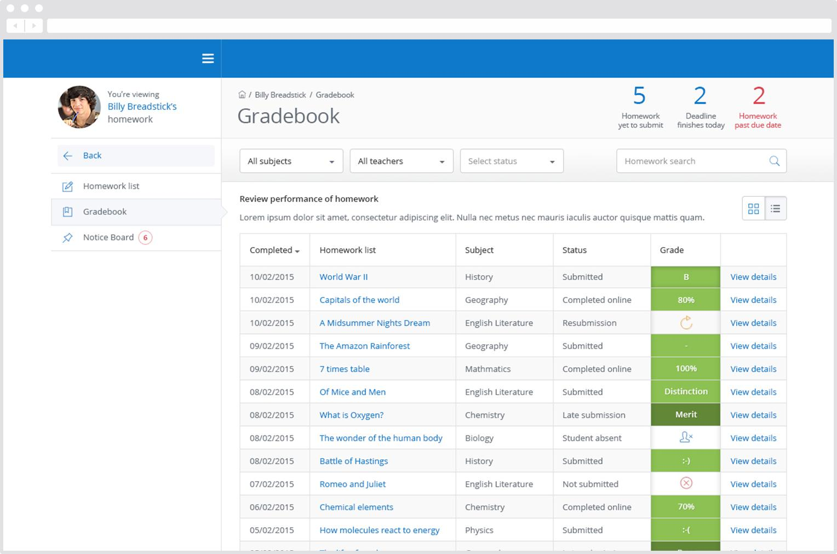
Gradebook
Gradebook helps you keep track of the submission status of homework, and grades, if applicable.
Submission types
Submitted
Submitted late
Absent
Resubmission
Not submitted
Notes:
To change the image behind the Mock up.
Select the layer - > Right Click -> Send to Back -> Delete the image -> Drag & Drop your Own Picture -> Send to Back (again)

Slide 9
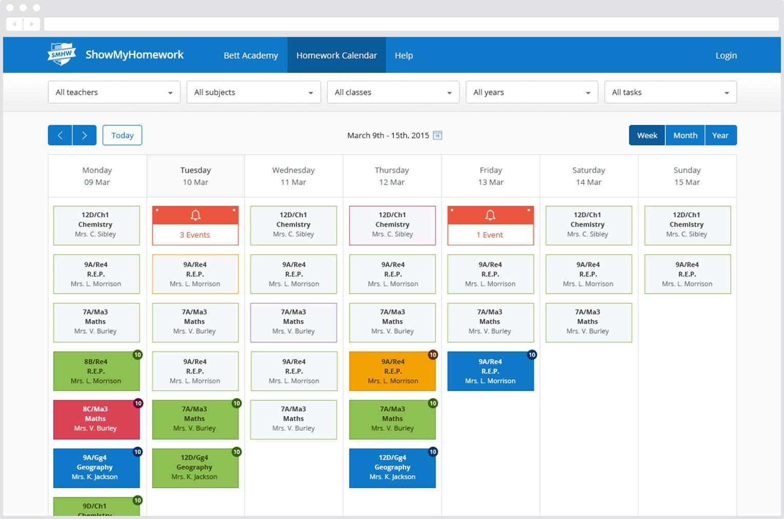
The no-login back up!
You can view the school homework calendar without even logging in
Submission types
Submitted
Submitted late
Absent
Resubmission
Not submitted
Notes:
To change the image behind the Mock up.
Select the layer - > Right Click -> Send to Back -> Delete the image -> Drag & Drop your Own Picture -> Send to Back (again)

Slide 10

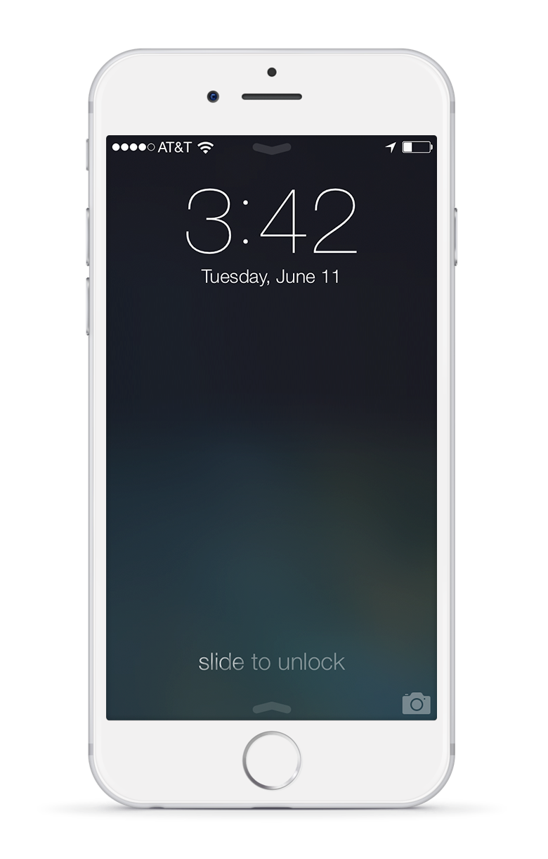
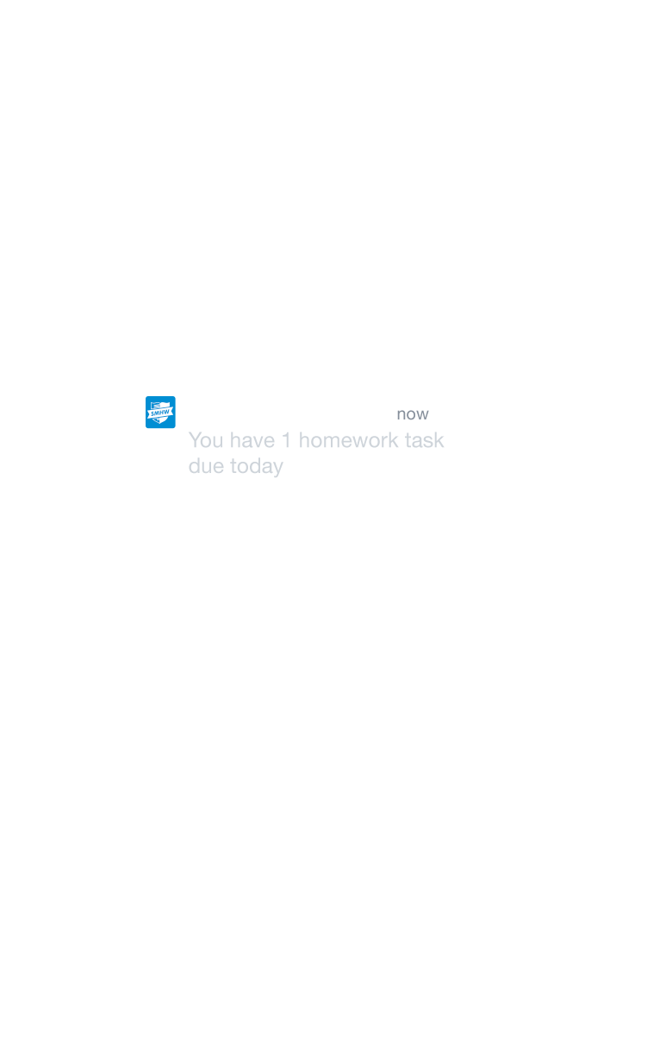
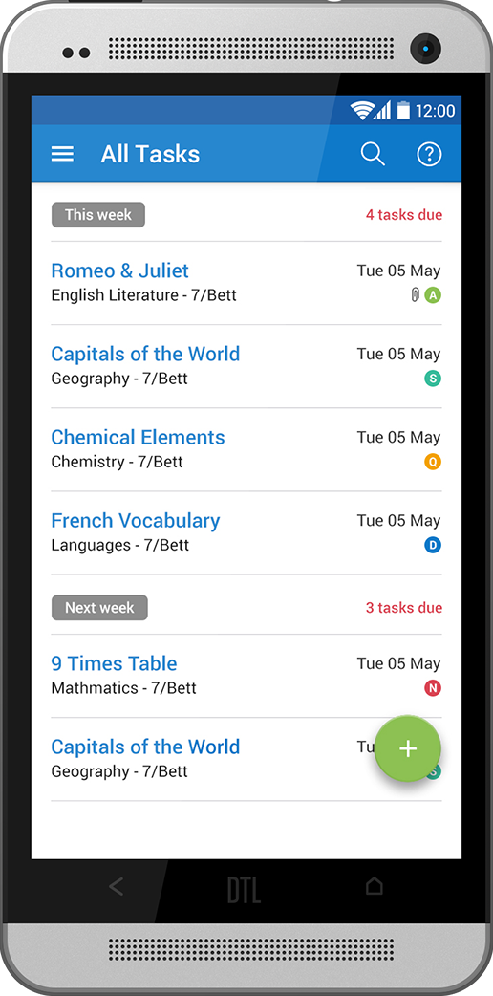
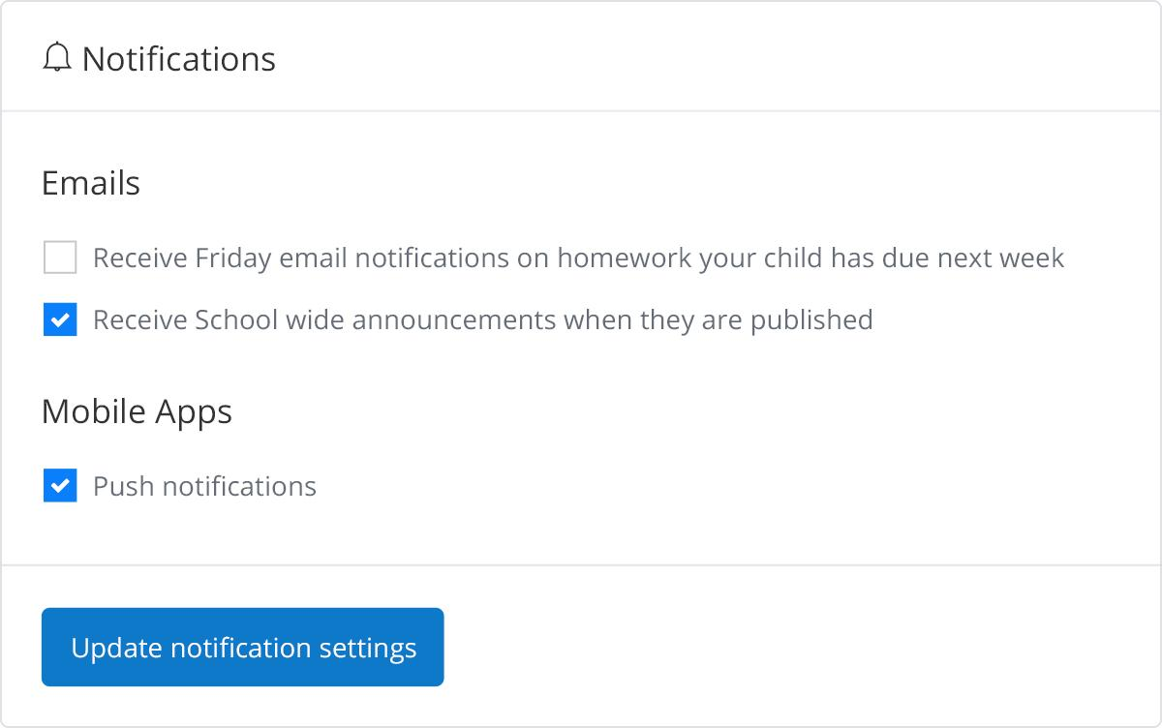


Notifications
In Settings, you can manage Notifications.
Make sure to download the Show My Homework App, for iPhone, iPad, iPod Touch and Android Devices.
Notes:
To change the image behind the Mock up.
Select the layer - > Right Click -> Send to Back -> Delete the image -> Drag & Drop your Own Picture -> Send to Back (again)

Slide 11
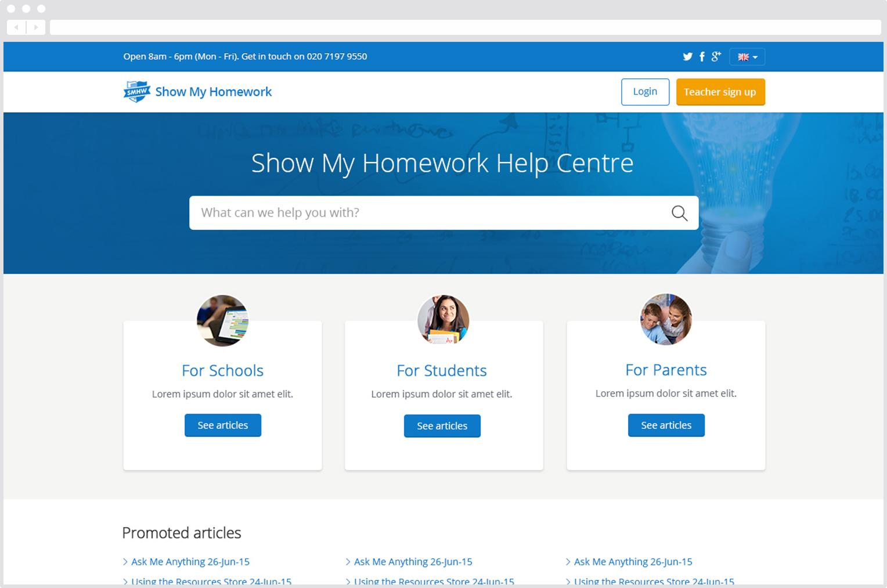
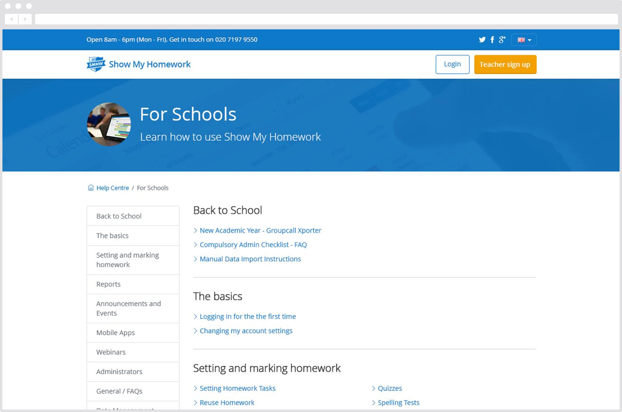
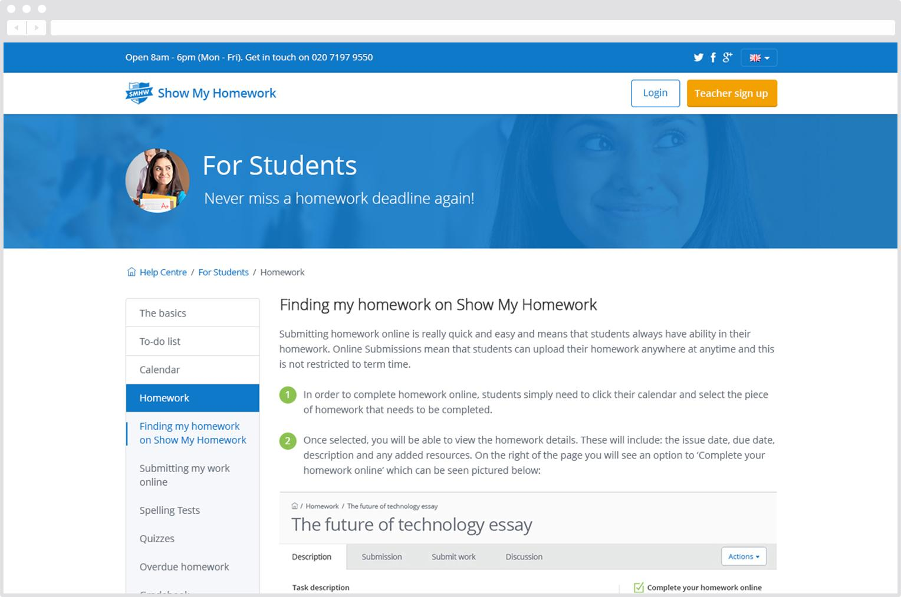
Our Help Centre
You can access our Help Centre at anytime via the left hand menu
Notes:
To change the image behind the Mock up.
Select the layer - > Right Click -> Send to Back -> Delete the image -> Drag & Drop your Own Picture -> Send to Back (again)

Slide 12
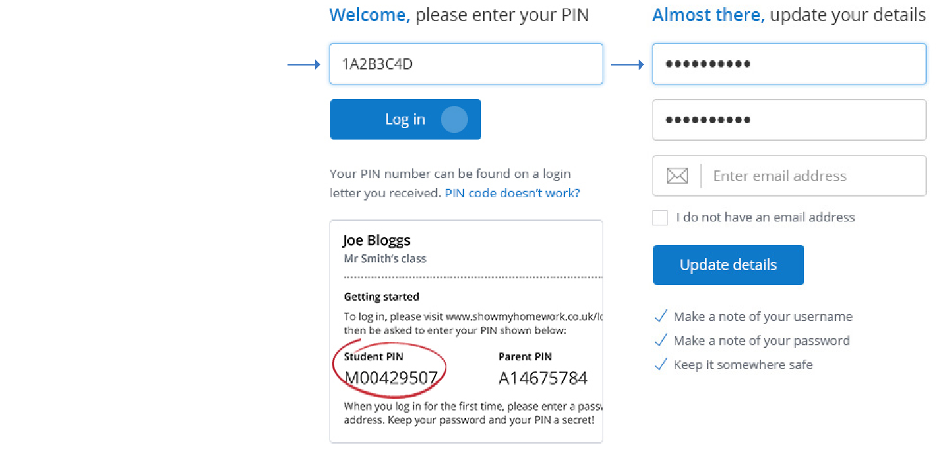
Getting started
Three steps for you to take next to make homework work better for you:
1
Got to http://www. showmyhomework.co.uk/pin
Enter your PIN details found in the letters handed out by the school and click ‘Log in’.
Create a memorable password and enter your email address then click ‘Update you details’.
Download the free App on your smartphone.
2
3
Notes:
To change the image behind the Mock up.
Select the layer - > Right Click -> Send to Back -> Delete the image -> Drag & Drop your Own Picture -> Send to Back (again)

Slide 13
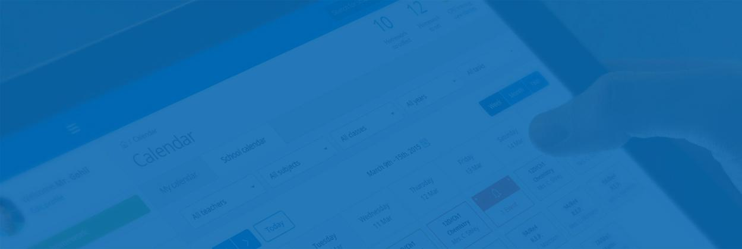

Show My Homework
TeacherCentric Ltd,
4th Floor, 4 Cam Road, Stratford, London, E15 2SN, United Kingdom
Support
Our support team is ready and waiting to help you out.
help@showmyhomework.co.uk
0207 197 9550
@showmyhomework
Notes:
To change the image behind the Mock up.
Select the layer - > Right Click -> Send to Back -> Delete the image -> Drag & Drop your Own Picture -> Send to Back (again)

